Slide 1
CSC 221: Introduction to Programming
Fall 2023
Debugging
  syntax vs. runtime vs. logic errors
  common errors & fixes
  test cases
  diagnostic print statements

Slide 2
Programming is a skill
when you start to develop any skill, mistakes will happen
  e.g., learning to play the piano → you will hit wrong notes
    learning to bake → you will mess up ingredients or overcook
  learning a language → you will mess up words or grammar
because computers are dumb, mistakes often mean total failure
  e.g., a single misspelled word in a statement will keep program from running
you will make mistakes as you learn to program
  even the most experienced programmers make mistakes all the time
  the key is to learn from those mistakes so that you
    make them less frequently
    can identify and fix them more quickly

Slide 3
Categories of programming errors
there are three categories of errors you can make when programming
  syntax error – mistakes in the format of a statement
    print)Hello) print("Hello)
    x = 3 + * 2 3 = num
  runtime error – when the code looks valid, but does something illegal
    primt('Hello') firstName = 'Chris'
    print(firstname)
    print("foo" / 3)
    n = int('def')
    result = 5/0
  logic error – when the program runs but produces the wrong output

Slide 4
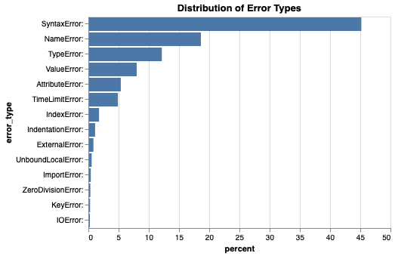
Most common errors
syntax errors are the most common (especially for beginners)
many runtime errors fall under the same patterns

Slide 5
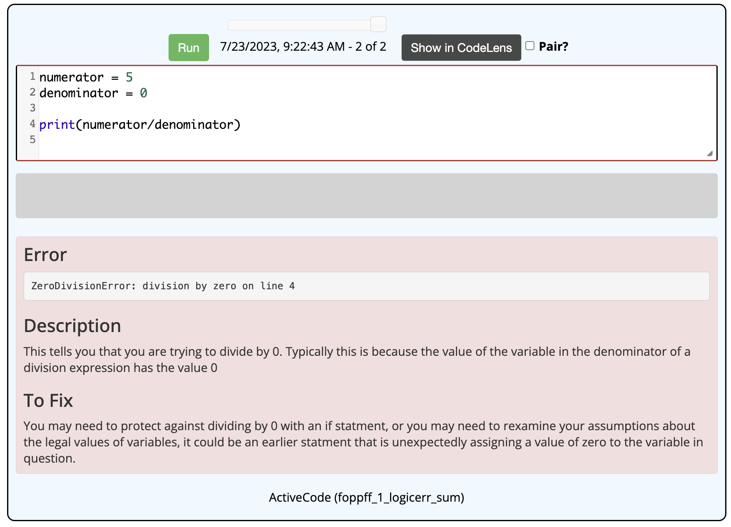
Getting help
fortunately, the interpreter will help with syntax and semantic errors
pay attention to the error message – note the line number and description
  remember the cause and recognize when it occurs again

Slide 6
Logic errors
handling logic errors is much trickier
  because the program is valid (but just does the wrong thing), the interpreter will not be able to identify anything – it is up to you!
  to recognize if the program is wrong, you must first know what is right
test cases
  before executing, create a set of test cases, i.e., inputs with known outputs
  EXAMPLE: Suppose a class has three tests. Overall grade is the average of the two highest test grades (i.e., throw out the lowest).
    80, 90, 100 → 95.0 80, 85, 90 → 87.5 90, 80, 70 → 85.0
    90, 80, 90 → ?? 90, 90, 90 → ??

Slide 7
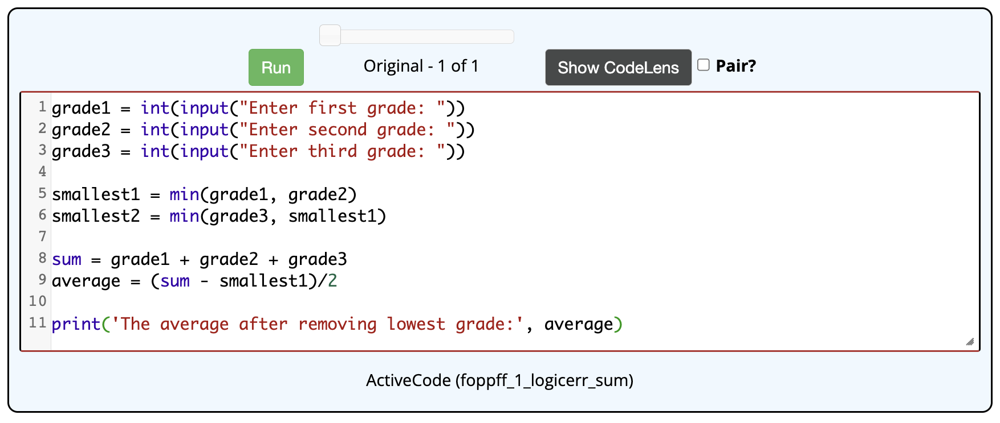
Exercise
does the following program accomplish the task?
maybe you see an issue, maybe you don't
  try out the known test cases
  80, 90, 100 → 95.0 ✓ 80, 85, 90 → 87.5 ✓ 90, 80, 70 → 80.0 ✗

Slide 8
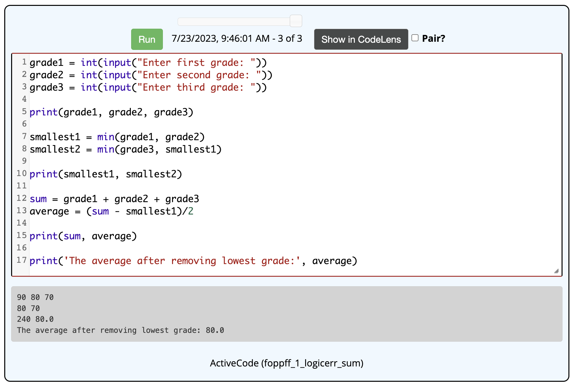
Diagnostic print statements
often, just identifying incorrect test cases will pinpoint the error
  when it is not obvious, add print statements throughout the code to see where things are going wrong

Slide 9
Integrated testing
better yet, test as you go
  write a segment of code, then print the result to make sure it works
  then add next segment and test it
  EXAMPLE:
    read in grades & print to make sure stored correctly
    then add code to calculate smallest & print
    then add code to calculate the sum and average & print
    then add code to display the average nicely
the advantage of integrated testing is that each test is on a small segment
  if a test succeeds, then you know you have accomplished that task and don’t need to worry about that anymore
  when a test does fail, the problem is limited to the last segment added

