Slide 1
CSC 221: Introduction to Programming
Fall 2023
Nested lists & dictionaries
  simple vs. complex data
    records as lists, lists of lists
  state capitals file
    csv files, reading and storing lists of lists
  HDI stats file
    reading in strings with spaces
    lookup, interactive quiz
  dictionaries
    manyDecisions: counters vs. list vs. dictionary
    wordCounts, mostAnagrams revisited

Slide 2
Complex data
the dictionary file was large but simple
  one word per line, could be stored in a single (flat) list
complex applications generally involve grouping related data into records
  e.g., personal record: first name, MI, lastname, birthdate, address, …
  e.g., college course: title, number, CRN, instructor, times, classroom, …
  e.g., movie: title, release date, director, distributor, actors, …
in Python, a list can be used to store the data from a record
  ["Chris", "M", "Wilson", "02-12-2004", "1024 Binary Drive", …]
  ["Intro to Programming", "CSC221", 70628, "Reed", "MW 9:00-10:45", "Eppley 110", …]
  ["The Marvels", "11-10-2023", "Nia DaCosta", "Walt Disney", "Brie Larson", …]

Slide 3
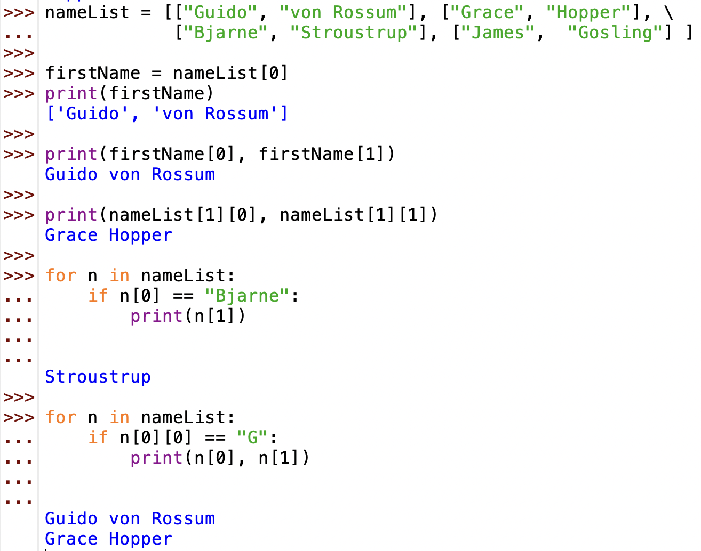
Lists of lists
if we want to store a list of records, then need a list of lists
  recall: lists can store any type of values, including other lists
line continuation character

Slide 4
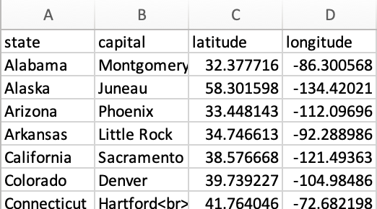
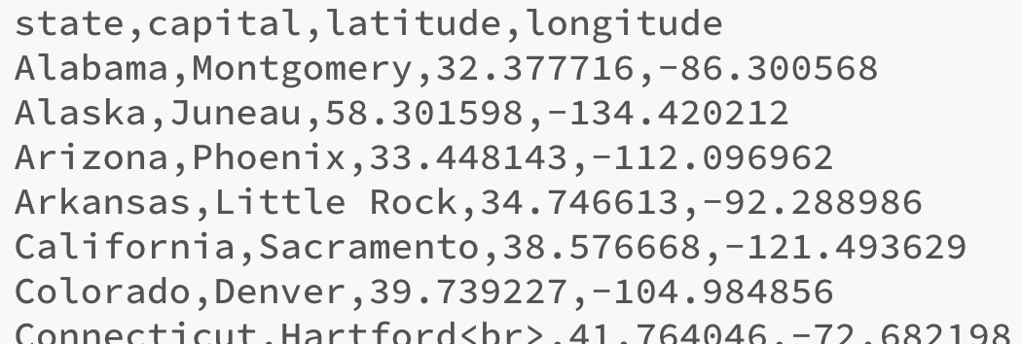
Example: state capitals
capitals.csv contains a list of state capitals and their GPS coordinates
  potential tasks
  look up the capital of a state
  look up the GPS of a capital
  make a quiz of random states/capitals
  calculate distance between capitals
csv stands for Comma Separated Values
  each row in the table is a line in the file; each column value separated by comma

Slide 5
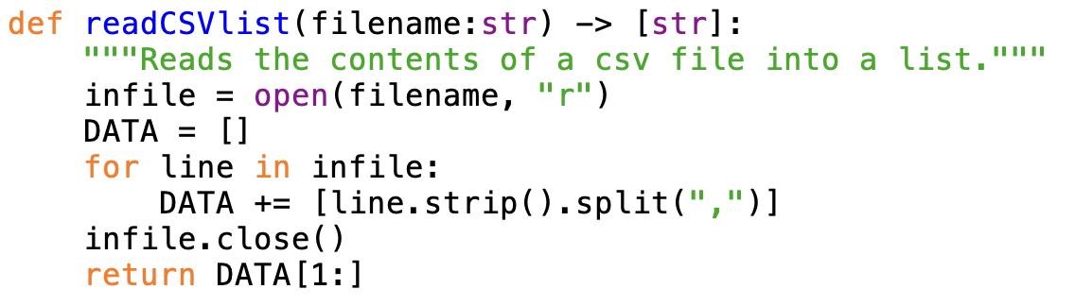
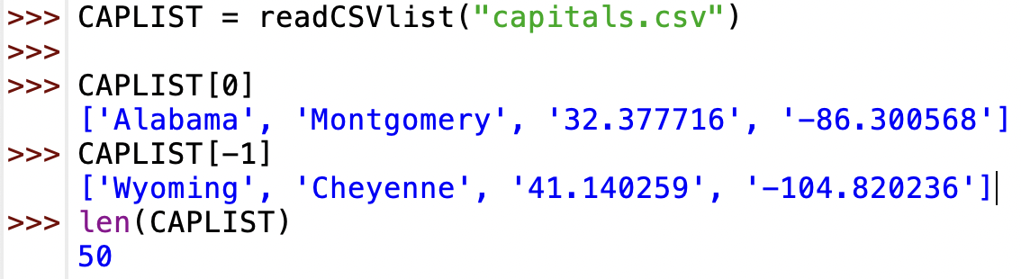
Storing records
how do we read in and store records?
  each record is on a separate line, so read the file one line at a time using for loop
    use strip to remove the line break, split to convert to a list
    then append onto the end of a list of lists (accumulator pattern)
  finally, remove the headers from the list of lists

Slide 6
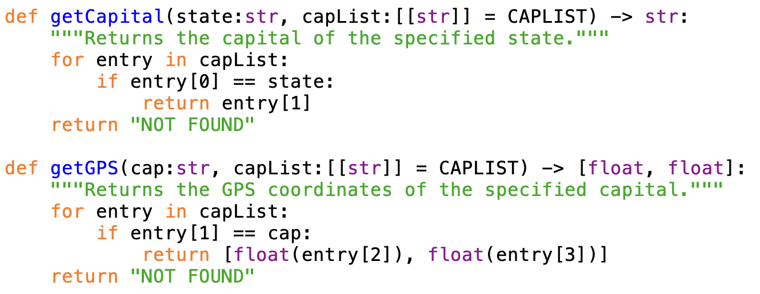
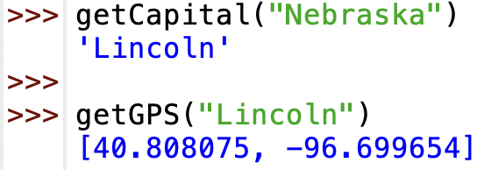
Lookup functions
to lookup a capital given the state name
  find the record for that state, then access the capital
similarly, to find the GPS coordinates of a city
  find the record for that city, then access the coordinates
for a given entry:
entry[0] is state
entry[1] is capital
entry[2] is latitude
entry[3] is longitude

Slide 7
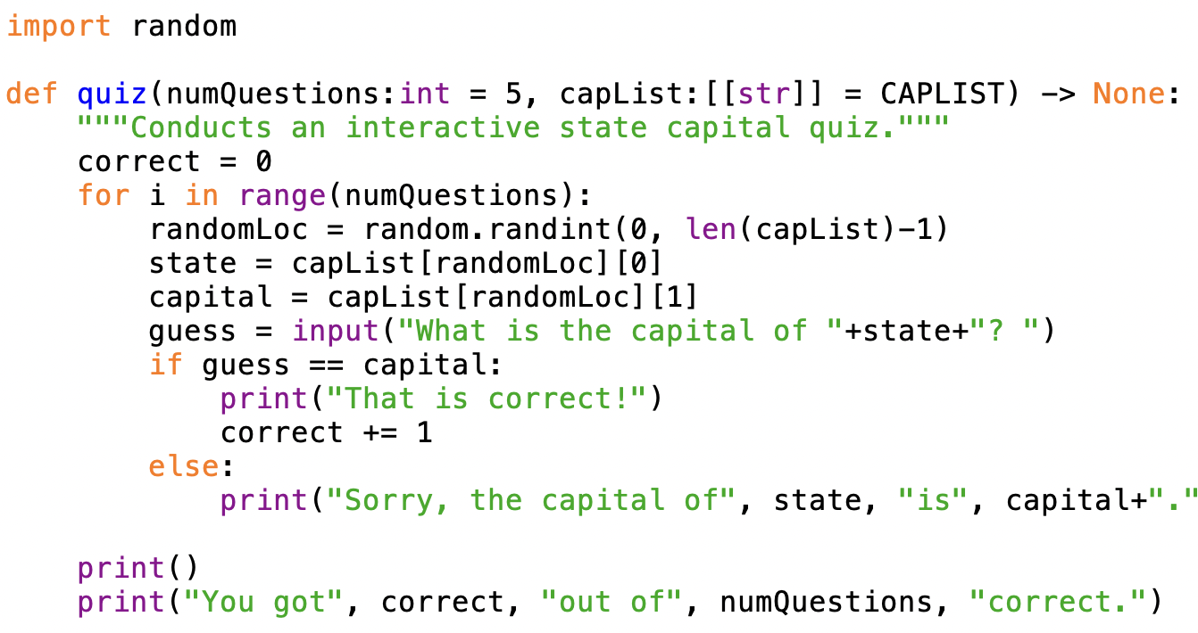
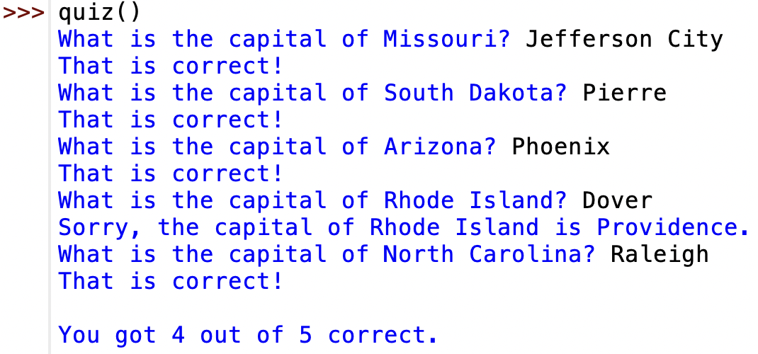
Interactive quiz

Slide 8
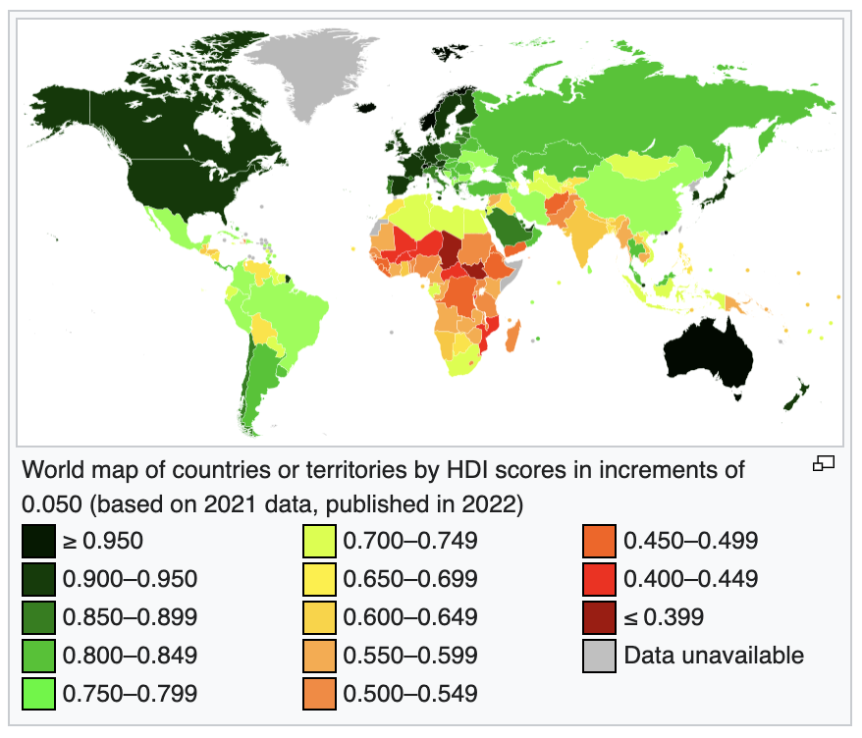
example: Human Development Index
Human Development Index (HDI) is a statistical index combining life expectancy, education and per capita income

Slide 9
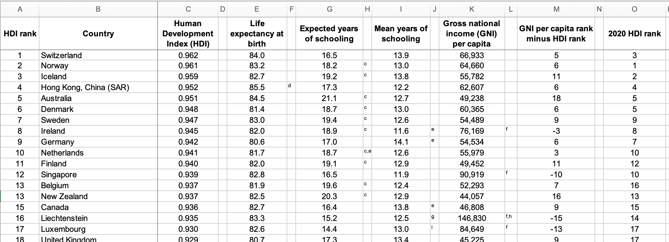
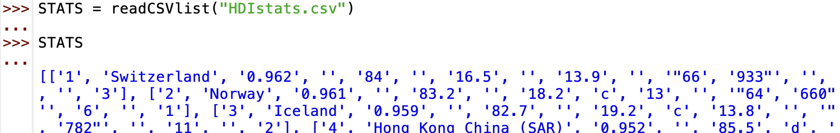
HDI data
HDIstats.csv contains a list of countries with their 2021 HDI stats

Slide 10
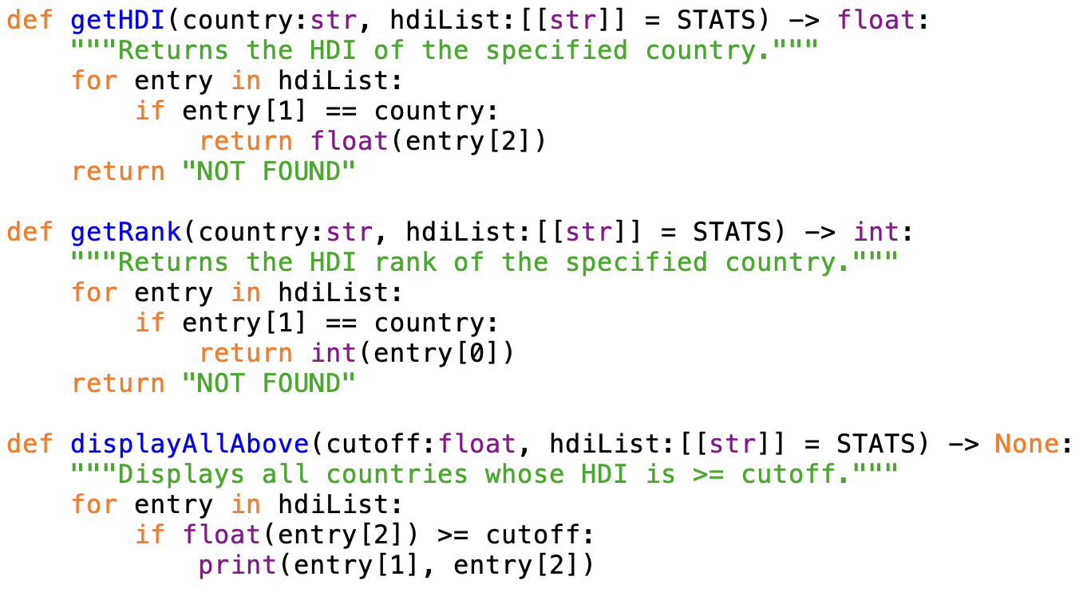
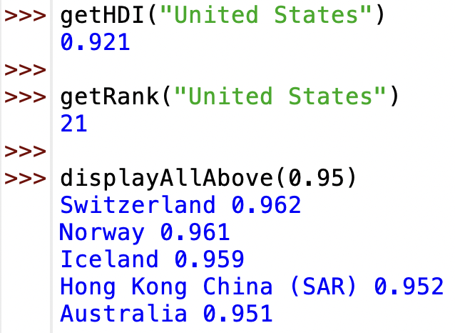
HDI functions

Slide 11
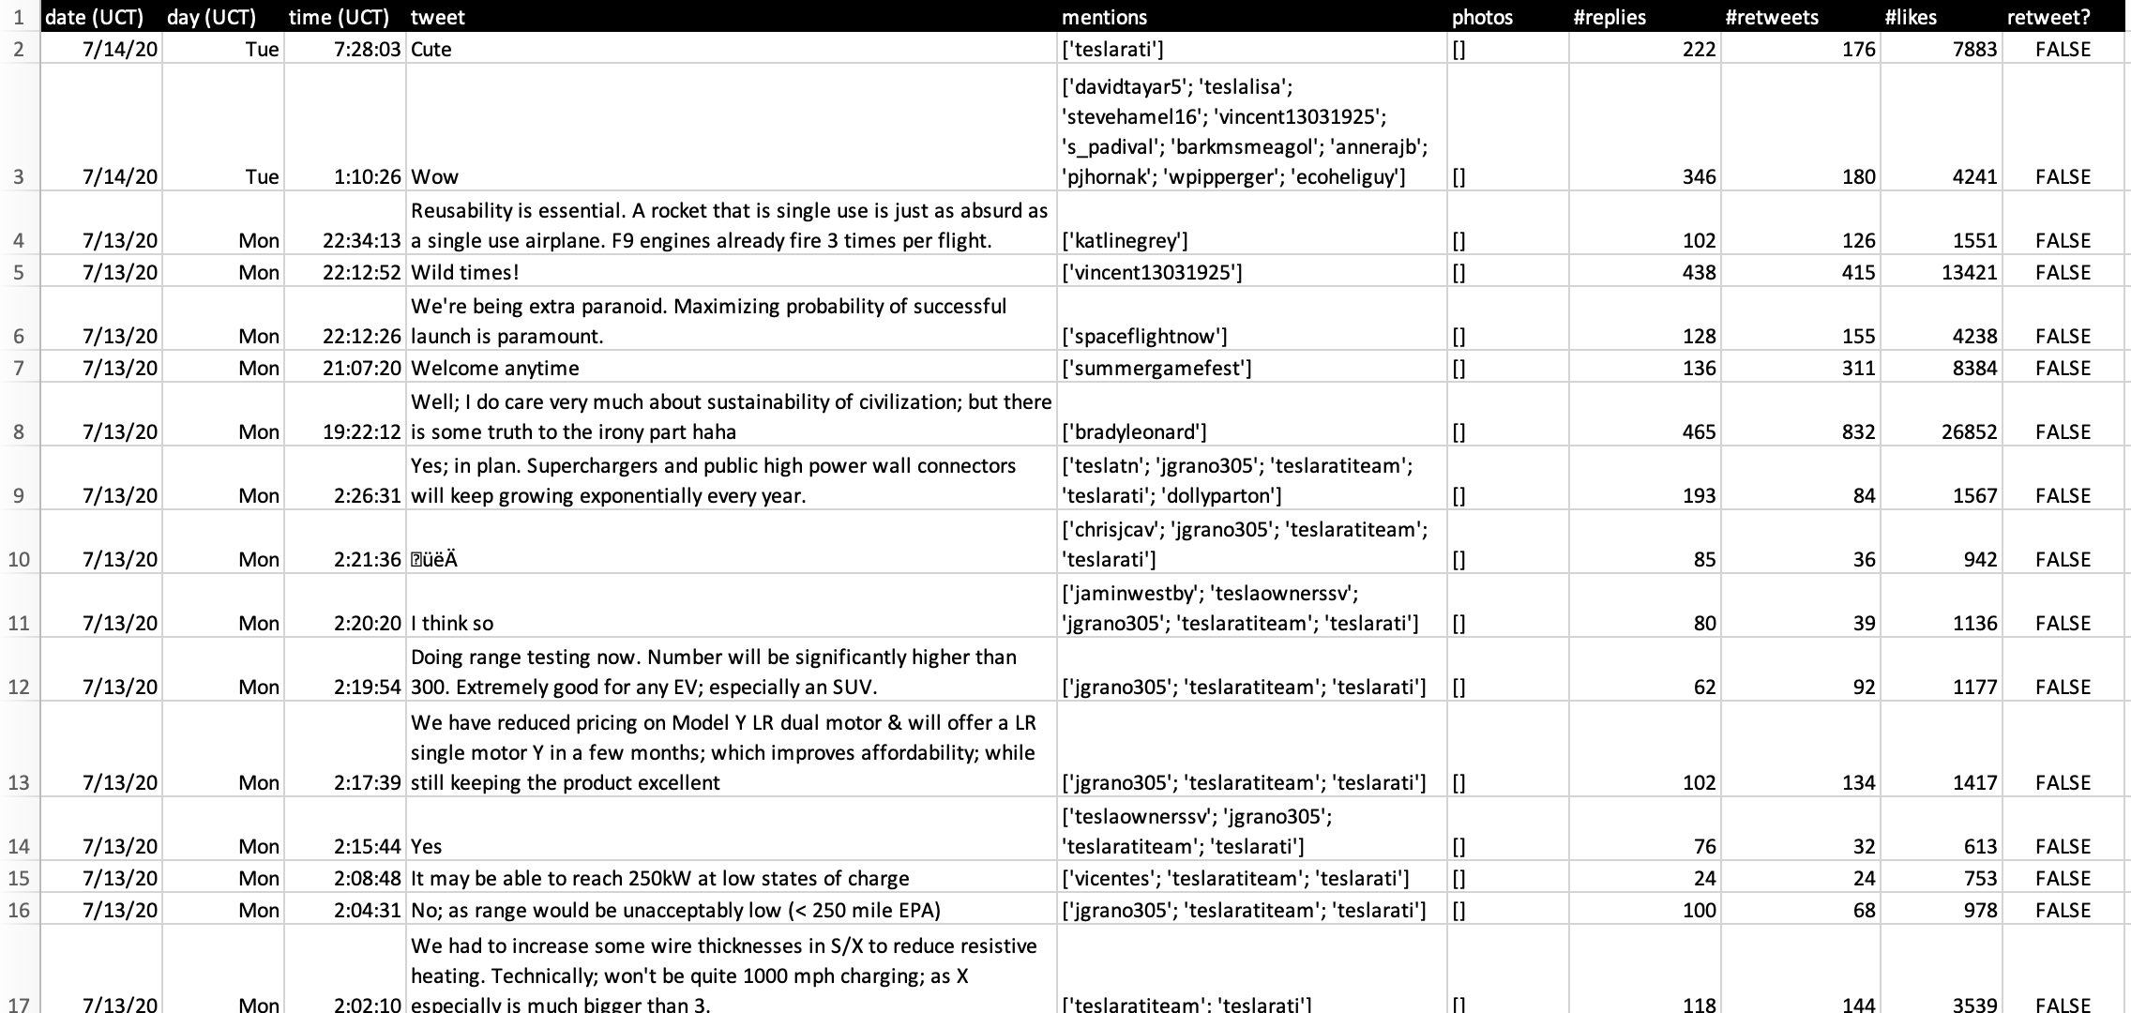
Tweets with metadata
elonmusk.csv contains tweets by Elon Musk from 2017-2020
  column 0: date in MM-DD-YY format (UCT) column 5: list of embedded photos
  column 1: day (UCT) column 6: # of replies
  column 2: time HH:MM:SS format (UCT) column 7: # of retweets
  column 3: the tweet column 8: # likes
  column 4: list of people mentioned column 9: is it a retweet?

Slide 12
New questions
with the addition of metadata, we can ask more interesting questions
  how often did he refer to Tesla in his tweets?
  how often did he mention Mark Zuckerberg?
  what tweet was liked the most?
  on what day of the week did he tweet the most?
  did he tweet more in the a.m. or p.m.?
  other questions?

Slide 13
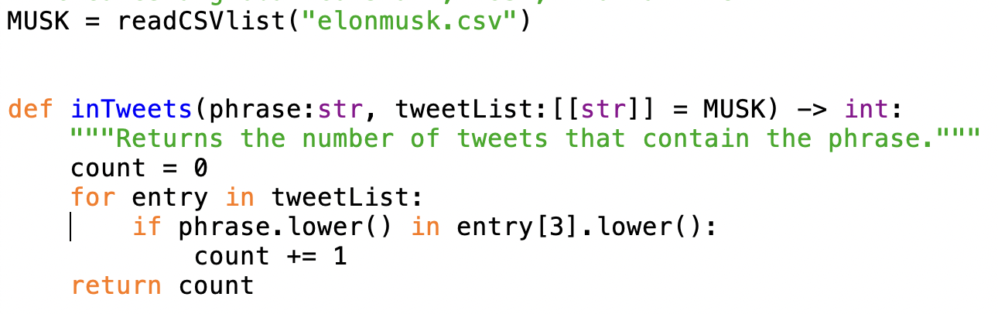
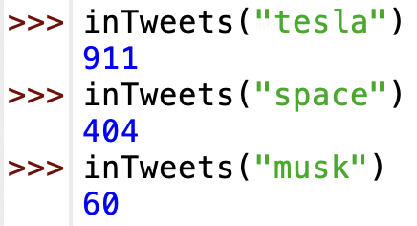
Counting phrases
to count how often a phrase appears in a tweet
  traverse the list of tweets
    for each tweet (a list), access column 3 to see if it contains the phrase
    if so, add to a count

Slide 14
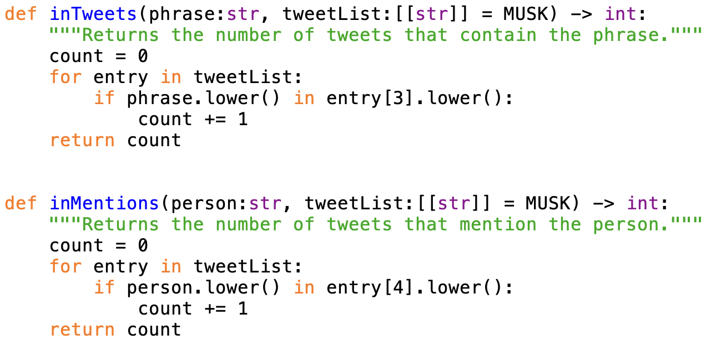
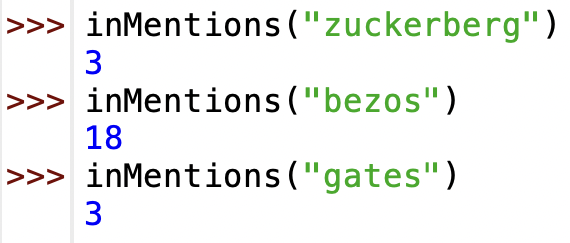
Counting mentions
to count how often a person is mentioned:
  pretty much the same, but looking at column 4

Slide 15
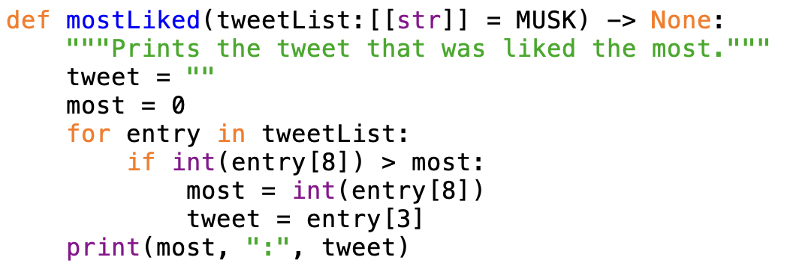
Most liked
to determine the tweet that was liked the most:
  traverse the list of tweets
    for each tweet (a list), access column 8
    if larger than most liked so far, then update to be new most liked
  print the most liked tweet, along with its count

Slide 16
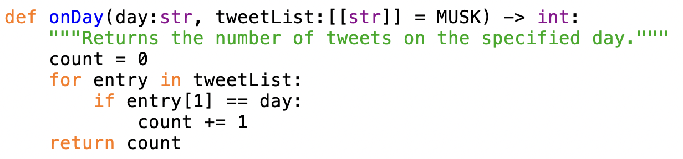
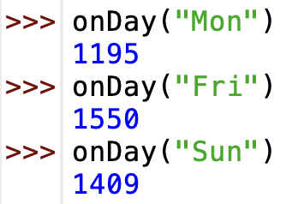
Day of the week
to determine the number of tweets on a given weekday
  traverse the list of tweets
    for each tweet (a list), access column 3
    if it is the desired day, add to a counter
  return the counter

Slide 17
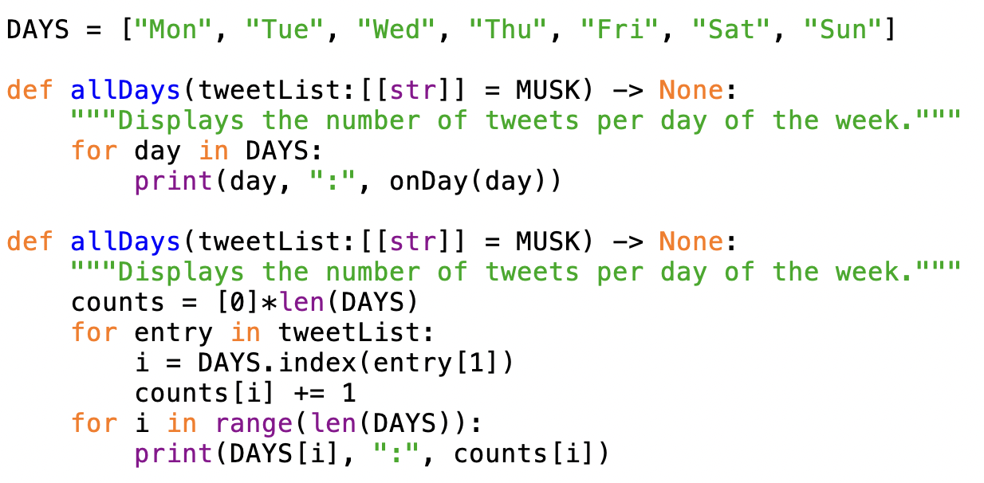
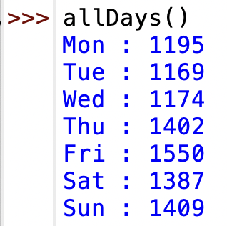
All days
to compare the counts from all the weekdays,
  could just call onDay seven times, once for each day
    (requires traversing the list seven times, but it is fast)
  could traverse once and keep seven counters, one or each day
    (similar to dice stats & word lengths examples, more work to code but faster)

Slide 18
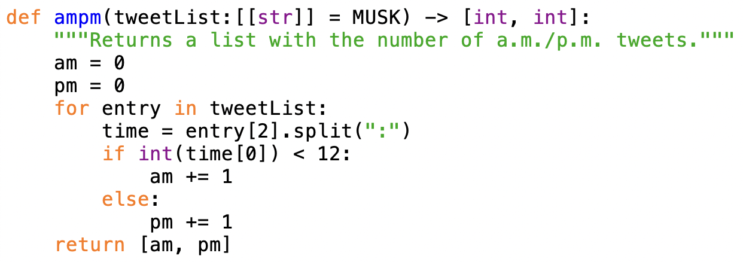

a.m. vs. p.m.
to determine which is more frequent, a.m. or p.m.:
  traverse the list of tweets
    for each tweet (a list), access column 2 (e.g., 8:40:00)
    split using ":" and access the first component (e.g., 8)
    if the hour is < 12, add to an a.m. counter, else add to a p.m. counter
BUT WAIT - times are in UCT (8 hours later than PST)

Slide 19
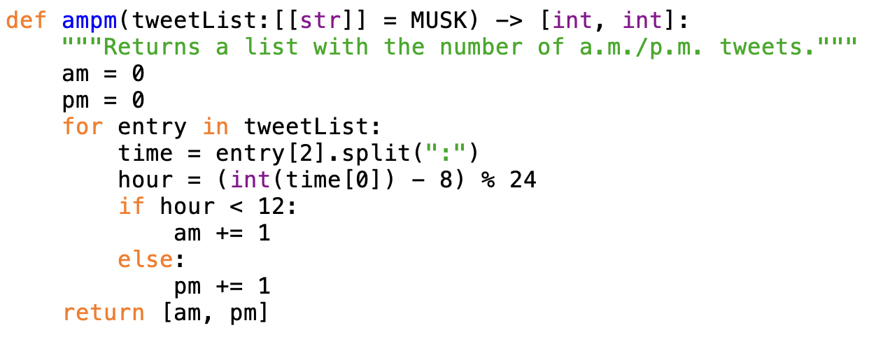

a.m. vs. p.m. (adjusted)
to count a.m./p.m. assuming Pacific time zone:
  traverse the list of tweets
    for each tweet (a list), access column 2 (e.g., 8:40:00)
    split using ":" and access the first component (e.g., 8)
    convert to Pacific time (e.g., 8 → 0, 6 → 22)
    if the Pacific hour is < 12, add to an a.m. counter, else add to a p.m. counter

Slide 20
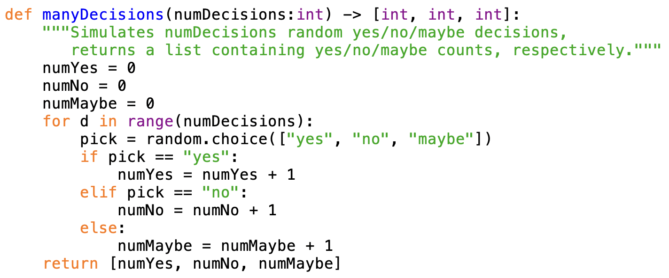
manyDecisions revisited
earlier, we considered a function for making random decisions
  this is somewhat tedious code (3 counters, three if-else cases)
  would be even worse if there were more options to choose from
  COULD WE USE A LIST OF RECORDS INSTEAD?

Slide 21
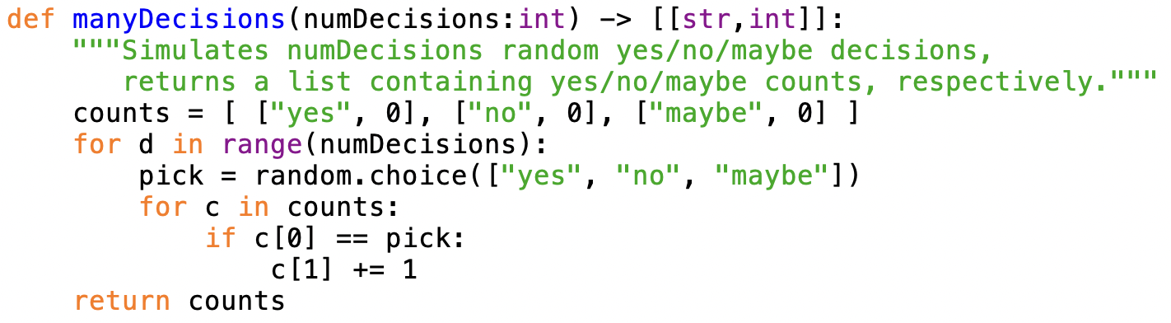
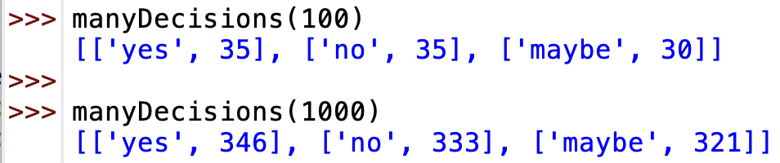
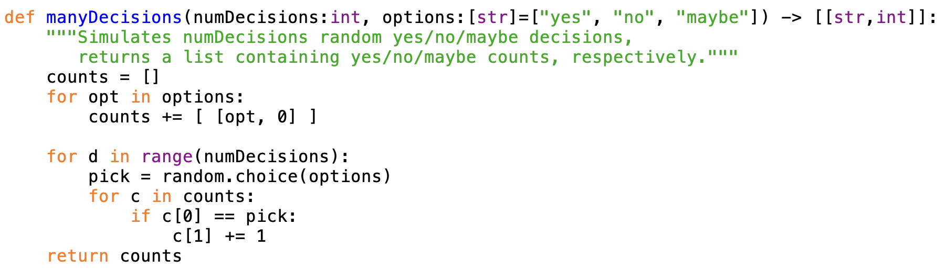
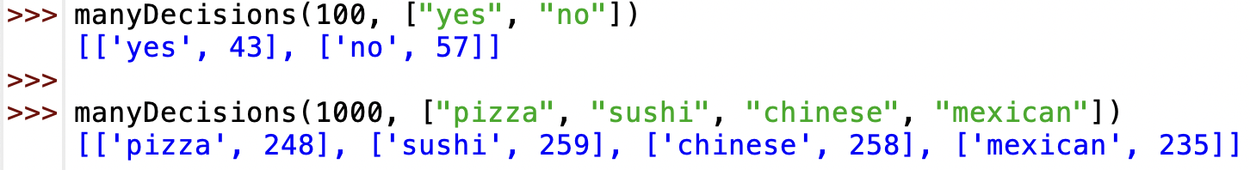
manyDecisions w/ lists
we could even generalize – pass in a list of options

Slide 22
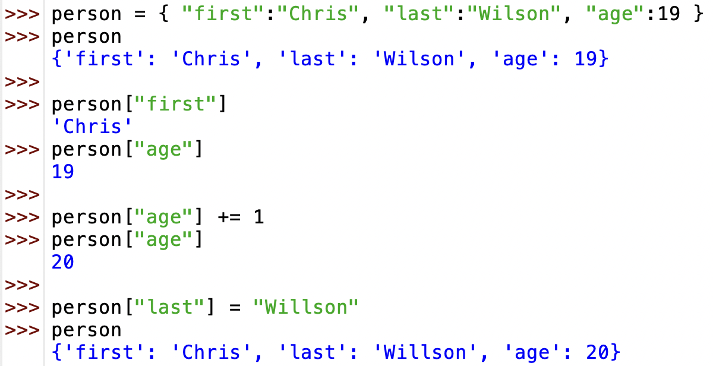
Dictionary
in Python, a dictionary is a data structure, similar to a list, that stores a sequence of key:value pairs
  you can easily access and change a value using the associated key
  initialize using { }, but then access or change entries using [] (as with lists/strings)
a dictionary is like a list, but you can index via a string

Slide 23
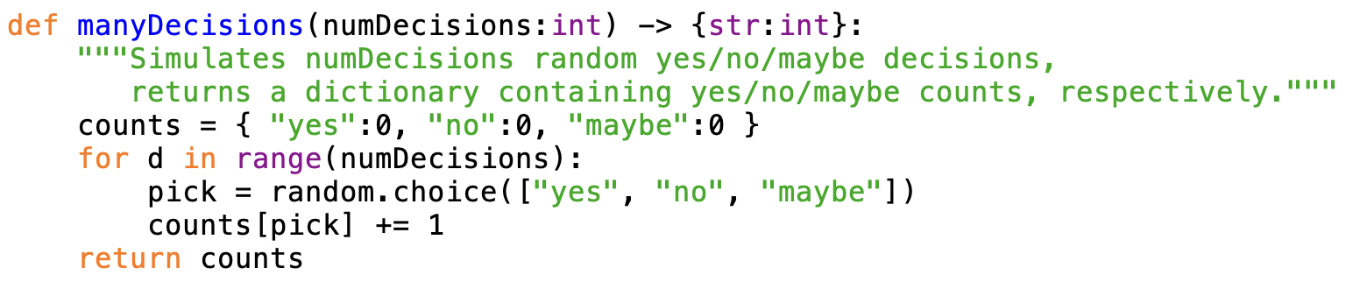
manyDecisions w/ dictionary
equivalent code using a dictionary

Slide 24
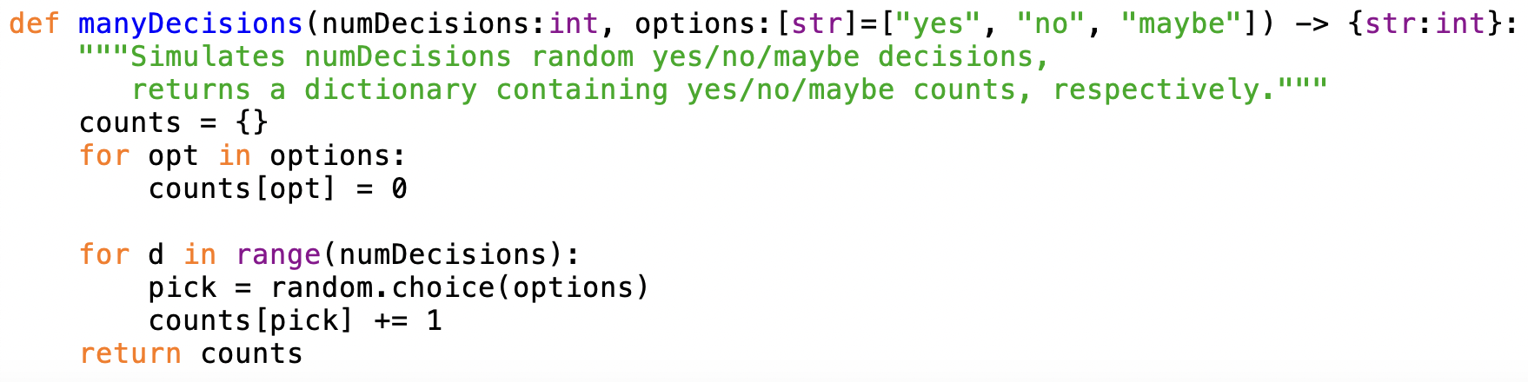
Options version w/ dictionary
equivalent code using a dictionary

Slide 25
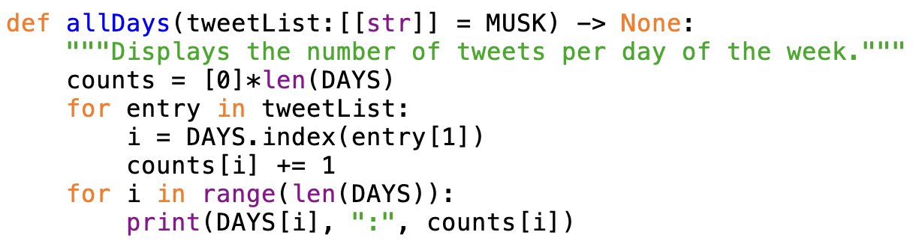
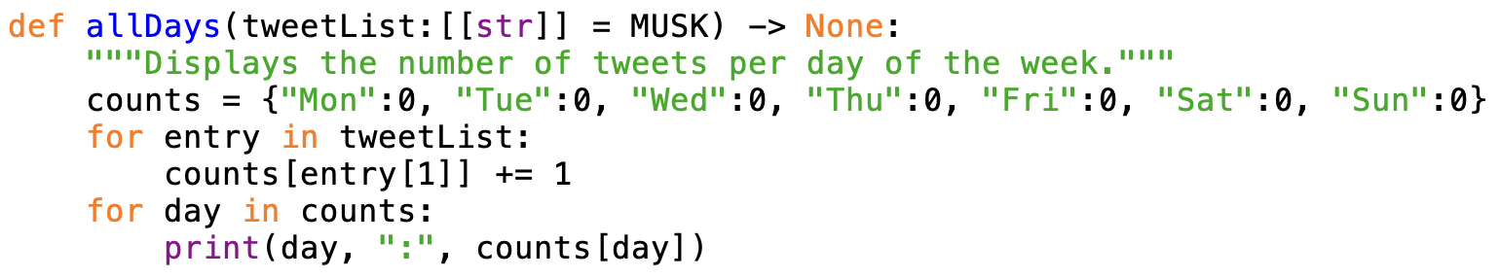
allDays w/ dictionary
equivalent code using a dictionary

Slide 26
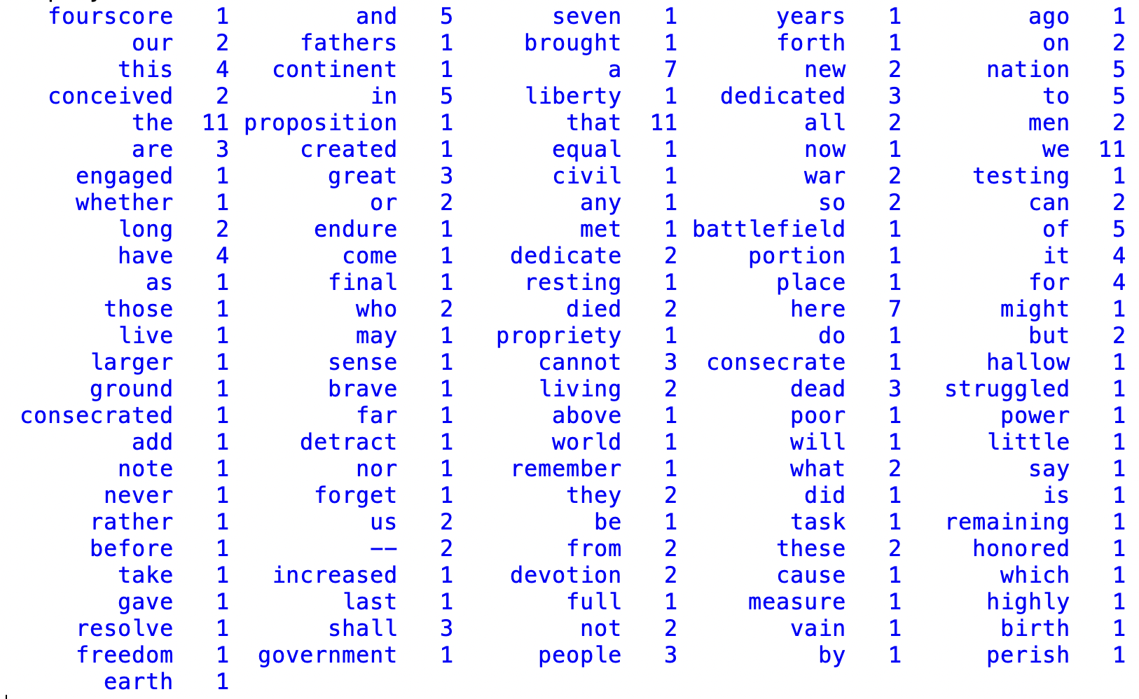
Word counts
in HW5, you had to count the occurrences of letters in a file
  utilized a list of 26 counters, initialized to 0
  there is a natural mapping: #a's in count[0], #b's in count[1], ...,
what if we wanted to count how many times words appeared in a file
  e.g., Gettysburg Address

Slide 27
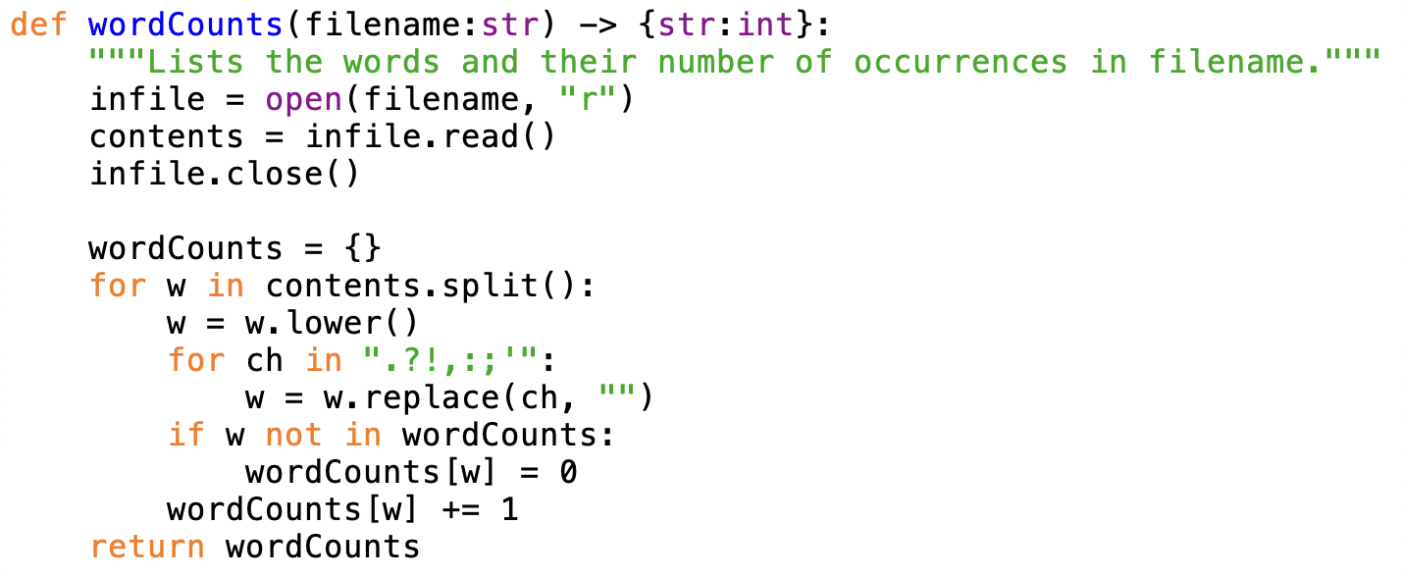
Word counts w/ dictionary
there is no natural mapping from words to indices
  can't predict what words will be in the file, or place specific ordering
perfect use of a dictionary
start with empty dictionary
for each word
  make it lower case
  and strip punctuation
  if not already seen, add an entry to
  the dictionary (with 0 count)
  add one to the count for that word

Slide 28
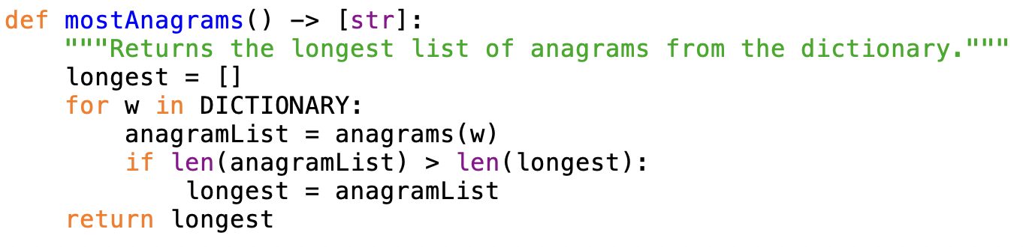
Anagrams revisited
recall the anagrams code from earlier
  way too inefficient, requiring more than 13 billion word comparisons
alternative approach
  create a dictionary where the keys are alphagrams and the corresponding value is a list of words with that alphagram
  ANAGROUPS = { "aelp" : ["leap", "pale", "peal", "plea"], "ape" : ["ape", "pea"], … }
  to find all the anagrams of a word, just generate the alphagram and look it up
  to find the largest list of anagrams, traverse the dictionary and compare lengths

Slide 29
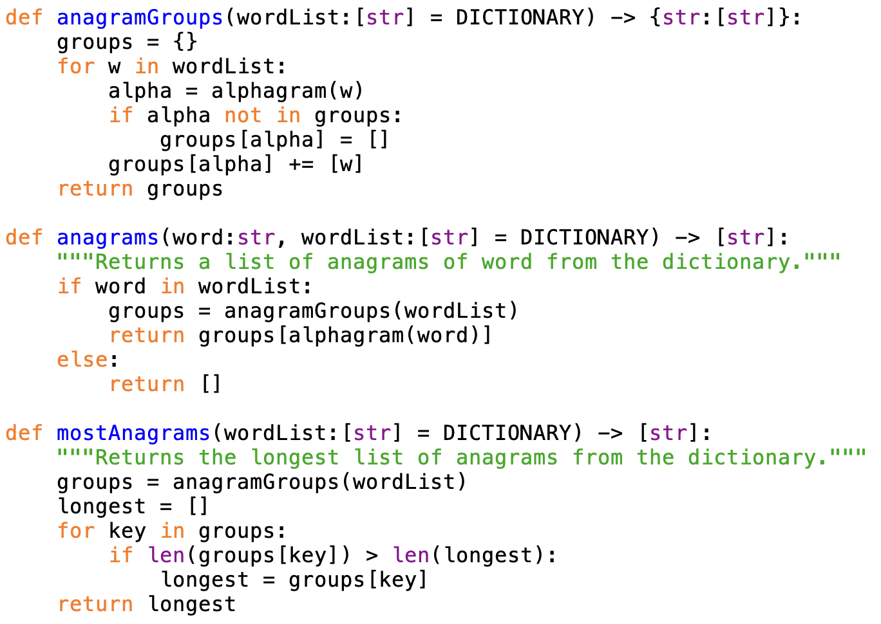
Efficient mostAnagrams
builds a dictionary with 103,020 entries (one for each unique alphagram)

Slide 30
List/dictionary summary
a list can store a sequence of values of any type (including lists)
  created and indexed/sliced using [ ]
  useful when the order doesn't matter (e.g., list of arbitrary words)
  or when the order naturally corresponds to indices (e.g., a..z → 0..25)
complex applications generally involved grouping related data into records
  a record can be implemented as a list of data items
  when storing/processing a list of records, need a list of lists
  csv file can easily be read in and stored as a list of lists
  simple, but require searching through the list to find a specific record
a dictionary is similar to a list, but the index can be any value (not just int)
  created using { }, indexed/sliced using [ ]
  useful when want to access values via a non-integer key (e.g., a string)
  provide fast and easy access to the value via the key

