Slide 1
CSC 221: Introduction to Programming
Fall 2023
Lists & files
  codingbat practice
  dictionary file
  searching a list
    try-except, efficiency (sequential vs. binary search)
  word stats
    shortest/longest, many vs. one pass
  anagrams
    alphagrams, anagram lists

Slide 2
Codingbat
before we look at a large list, a little more practice
go to codingbat.com → Python → List-2
  complete count_evens
  complete big_diff
  complete centered_average
  complete has22

Slide 3
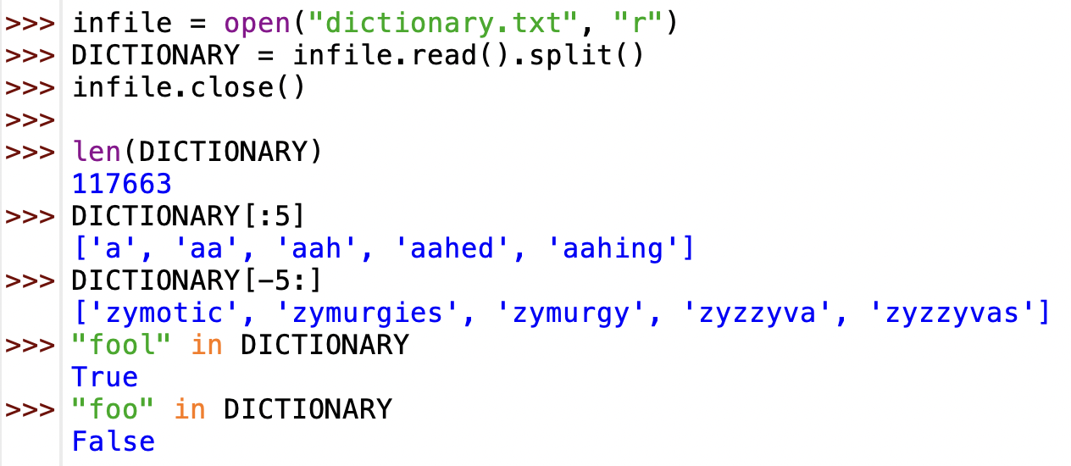
Dictionary file
suppose we want to be able to process a large dictionary of words
  dictionary.txt contains 117,663 words
  can use read to read the contents, then split to build the list of words

Slide 4
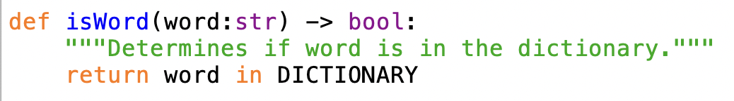
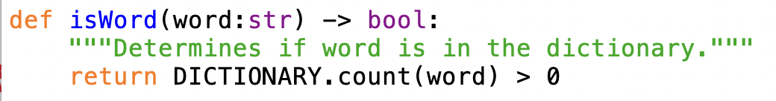
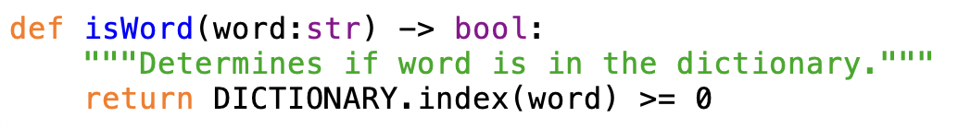
List membership
there are many ways to determine if an item is in a list
actually, this won't work - what would happen if the word is not in wordList?

Slide 5
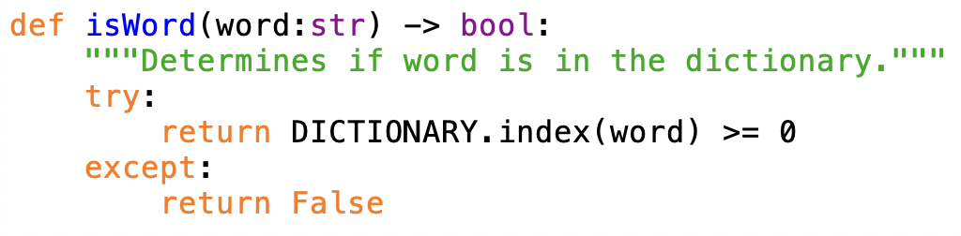
try-except
recall that index crashes if the item is not found
  will return True if the word is in the dictionary; otherwise, crashes
a try-except statement can be used to get around this
  looks somewhat similar to an if-else
  will try to execute the code in the try section
  if an error occurs while doing so, will execute the code in the except section

Slide 6
Efficiency
how efficient are these functions?
utilizes sequential search – starts at the beginning of the list, keeps comparing until the item is found or reaches the end
has to traverse the entire list, keeping count – then compares the count with zero when done
utilizes sequential search as in the first function

Slide 7
Does it matter?
since all three functions may need to traverse the entire list (worst case), we say the amount of work is proportional to the list length
  in other words, double the length of the list → double the amount of work
  i.e., if it took X seconds to search a list of size Y,
      then it would take 2X seconds to search a list of size 2Y
modern computers are extremely fast
  the time it takes for IDLE to compare 117,633 strings is negligible
  any three of these functions is fine for a file of this size
  the 1st and 3rd are marginally better, since the search stops when the word is found

Slide 8
Binary search
if the dictionary was considerably larger, or if we really wanted to optimize efficiency, we could do better
  binary search is a more efficient algorithm that can be used when the data is sorted
  in this case, the words in the dictionary file are alphabetized
binary search for finding aword in an alphabetized list
  initially, the potential range in which the item could occur is the entire list
  as long as the potential range is nonempty and the word is not found, repeatedly:
    examine the word at the middle of the potential range
    if desired word == middle word, then you are done
    if desired word < middle word, then potential range = entries left of the middle
    if desired word > middle word, then potential range = entries right of the middle

Slide 9
Binary search example
by repeatedly cutting the potential range in half, binary search can home in on the value very quickly
suppose we are looking for "cat" in a list of animals
"ant" | "bat" | "cat" | "dog" | "emu" | "fox" | "gnu"
left |  |  | middle |  |  | right
"ant" | "bat" | "cat" | "dog" | "emu" | "fox" | "gnu"
left | middle | right
"ant" | "bat" | "cat" | "dog" | "emu" | "fox" | "gnu"
 |  | left middle right
worst case: requires 3 comparisons to find an item in a list of length 7

Slide 10
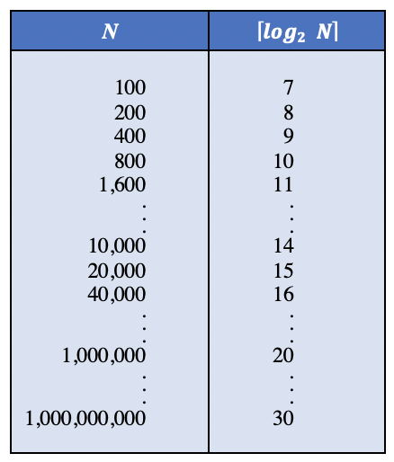
Binary search
in the worst case, binary search must do work proportional to log₂(list length)
  informally, log₂(N) = how many times must N be divided in half before it is 1
  in other words, double the size of the list → one additional comparison
  i.e., if it took X seconds to search a list of size Y,
      → then it would take X+c to search a list of size 2Y (where c is the time it takes for one comparison)
log2(N) grows MUCH more slowly than N
so, if lists are extremely large or the work done for each item is significant, binary search can be worth the extra complexity

Slide 11
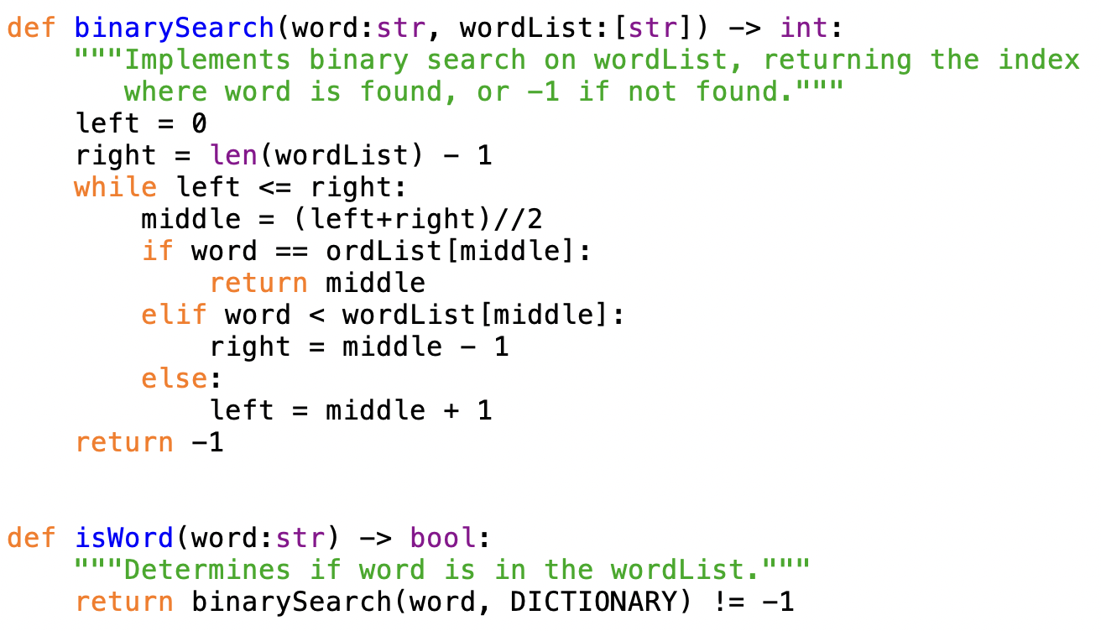
Binary search implementation

Slide 12
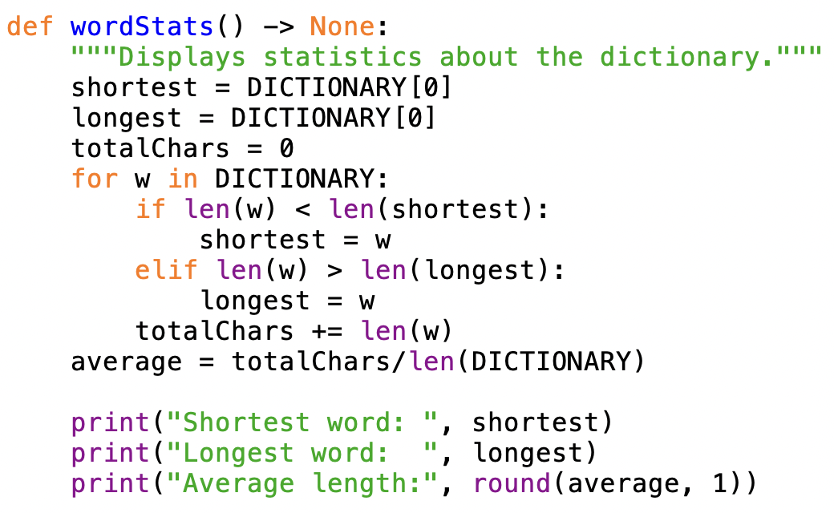
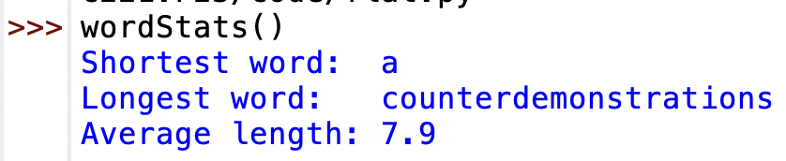
Word stats
similar to previous examples that generated stats on text files, we can analyze a word list and display stats
is this crashable?

Slide 13
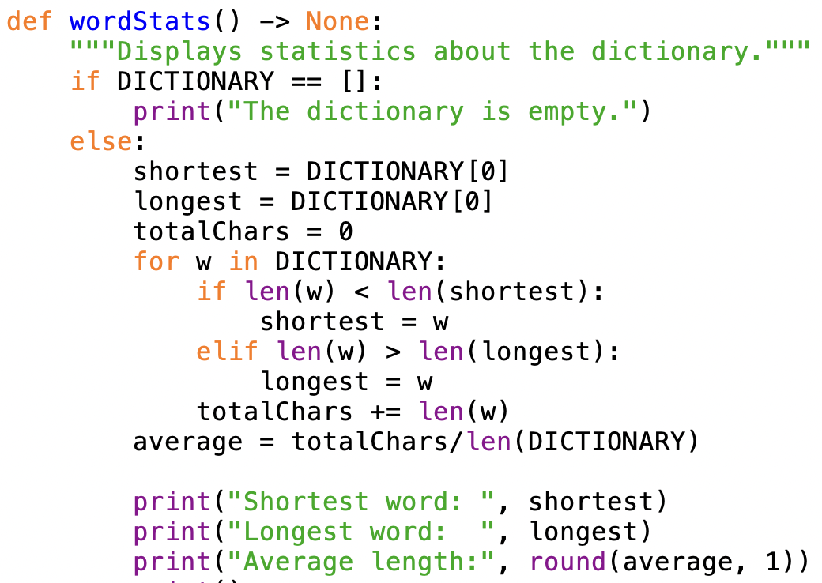
Word stats (safer)
when processing lists/files, always need to worry about the empty list/file

Slide 14
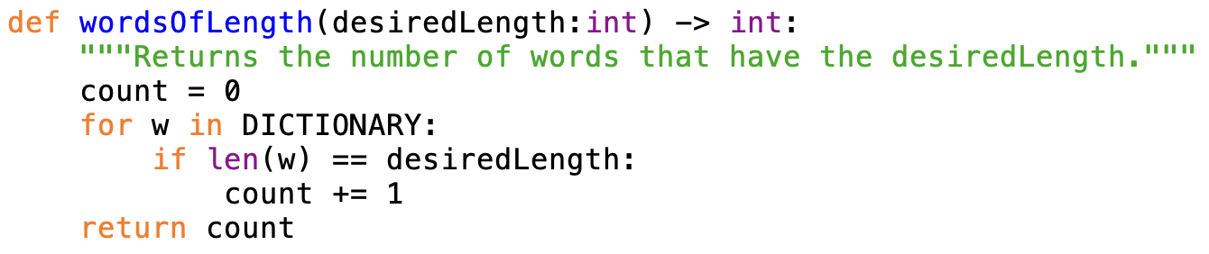
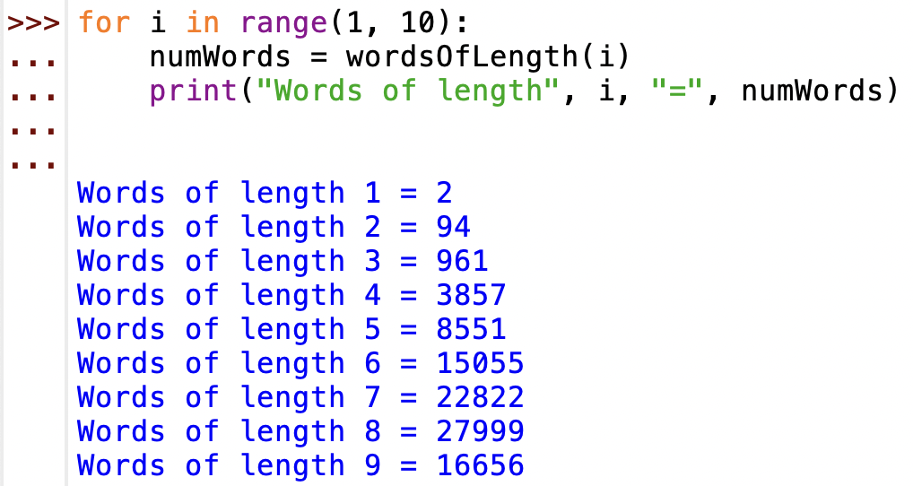
Counting word lengths
if we wanted to know how many words had a given length
  use the accumulator pattern we have seen over and over
  initialize a counter to 0
  traverse the words, adding to the counter if a word has the desired length

Slide 15
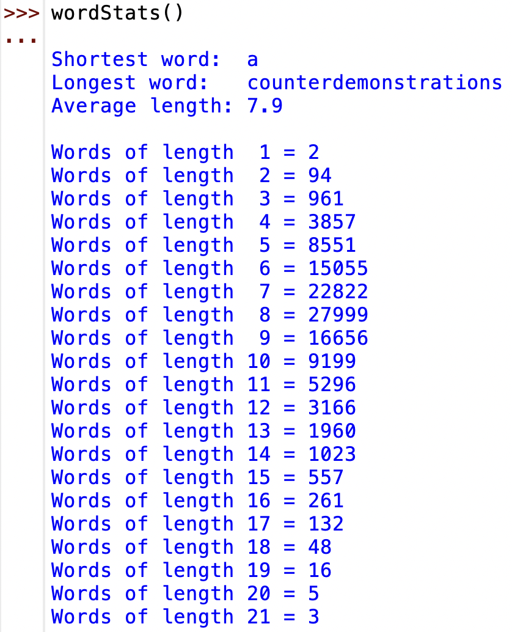
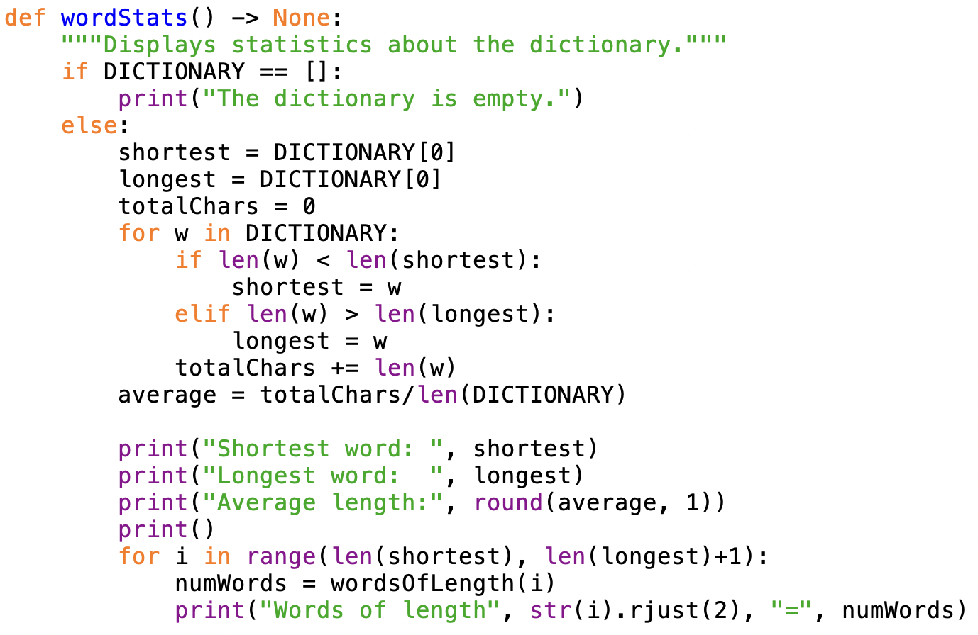
Adding to wordStats

Slide 16
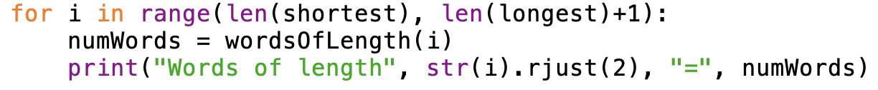
Many passes vs. one pass
note that wordStats calls the wordsOfLength function over and over
  simple, since each call counts a different word length
  wasteful, since each call traverses the entire list of words
since shortest = 1 and longest = 21,
  the for loop traverses the list 21 times
  so, must access/get length of 21 x 117,633 = 2,470,293 words!
that seems like a lot, but computers are very fast!
  if we wanted to speed it up, could count the words in a single pass
  would need 21 counters (or, a list of 21 counters) to keep track of all totals

Slide 17
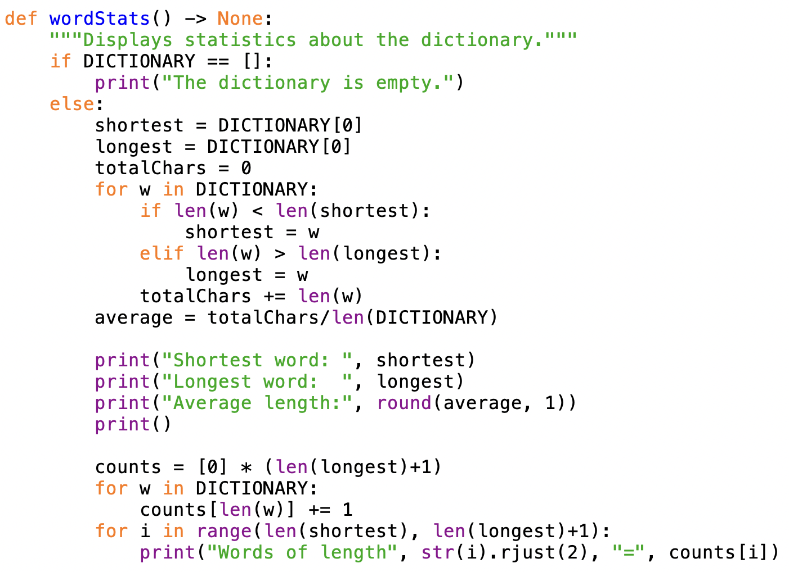
One-pass version

Slide 18
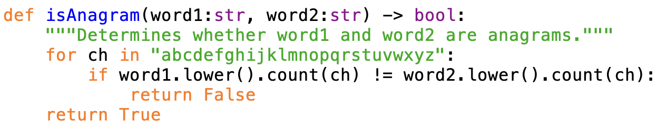
Example: finding anagrams
suppose we want to be able to find all anagrams of a word
  recall: anagrams are words made up of exactly the same letters
  cool loco
  race care acre
    pale peal leap plea
    banana
how can we determine if two words are anagrams?
  could count the number of a's, b's, … in each word
    if all counts are the same, then the words are anagrams

Slide 19
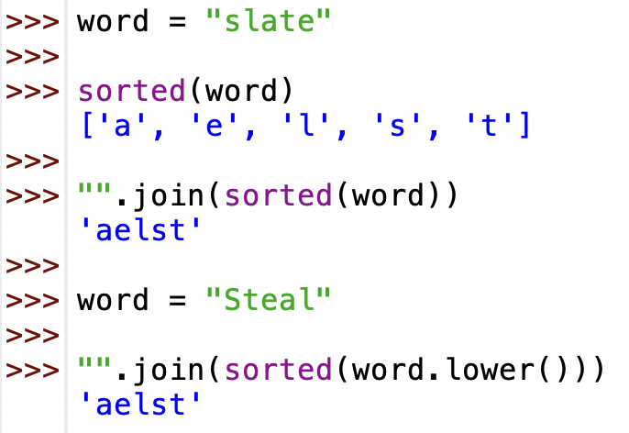
Alphagrams
that works, but must loop 26 times
  each time, must traverse the two strings and count characters
  again, computers are very fast, so this will take negligible time
a more clever (and efficient) approach utilizes alphagrams
  an alphagram is a copy of a word, but with the letters in alphabetical order
      "spear" → "aeprs" "pares" → "aeprs
  if two words have identical alphagrams, then they are anagrams
we can generate alphagrams using sorted, join and lower

Slide 20
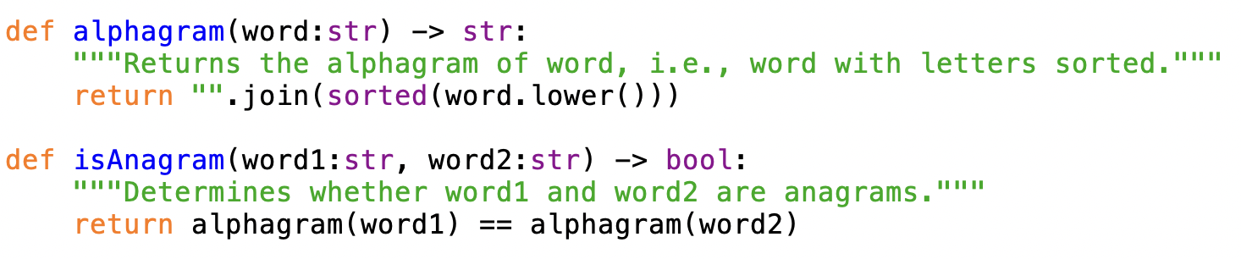
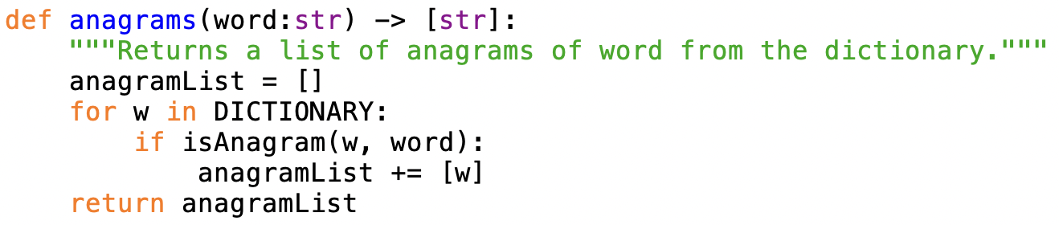
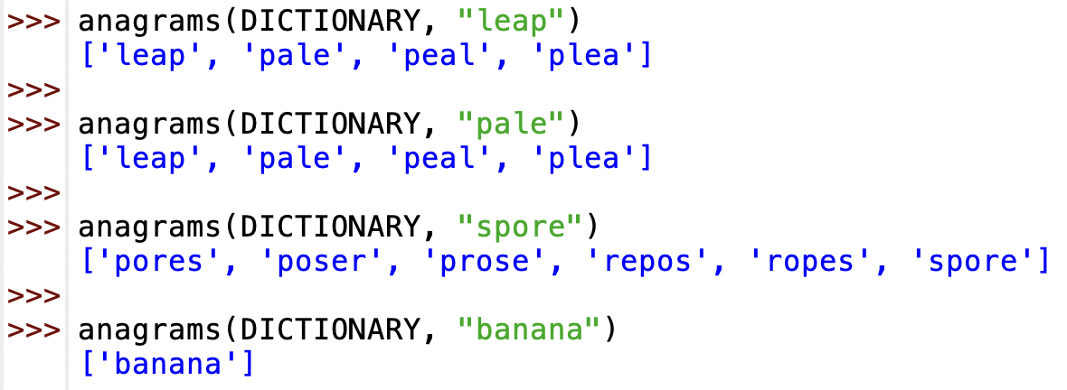
Alphagram lists
can rewrite isAnagram using alphagrams
can then write a function to generate anagram lists

Slide 21
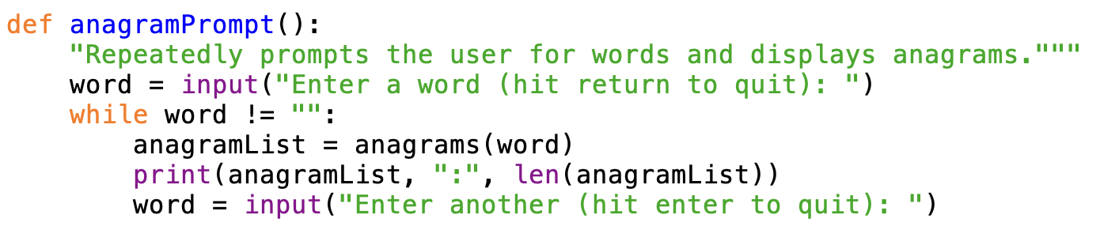
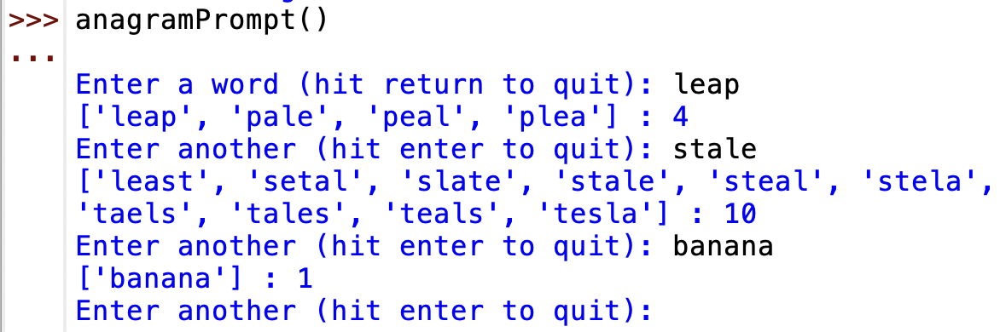
Interactive anagram finder
what word has the most anagrams?

Slide 22
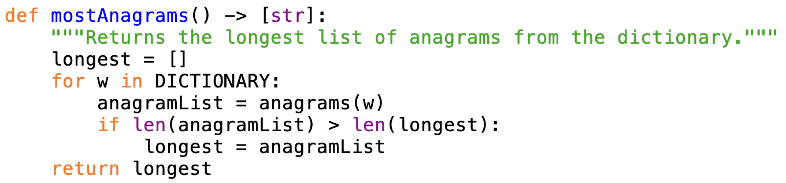
Finding the largest
we can write a function to find the largest anagram set
  ANY POTENTIAL PROBLEMS?
in theory this will work; in practice, it takes WAY too long!
  the for loop traverses the entire dictionary → 117,663 times
    each time, the call to anagrams also traverses the dictionary (117,663 words)
  so, must access/sort/compare 117,663 x 117,663 = 13,844,581,569 words!
solution requires a new data structure: dictionary (LATER)

