Slide 1
CSC 221: Introduction to Programming
Fall 2023
Object-oriented programming
  object-oriented approach
    classes & objects
  user-defined classes
    examples: Die, Coin, Card, DeckOfCards
    useful methods: __str__, __eq__, __lt__, __le__
  Card examples:
    flush statistics, game of war
  variables & scope
  parameter passing

Slide 2
Object-oriented programming
the dominant approach to (large-scale) software development today is object-oriented programming (OOP)
  in order to solve a problem, you identify the objects involved in the real-world solution and model them in software
    e.g., if designing a banking system, model clients, accounts, deposits, …
  a program is a collection of interacting objects
  in software, objects are created from classes
    the class describes the kind of object (its properties and behaviors)
    the objects represent individual instantiations of the class
e.g., Python classes: str list
objects: "" [ ]
"foo" [1, 2, 3]
"howdy do" ["a", [10, 20], "b"]

Slide 3
Class & object examples
REAL WORLD CLASS: automobiles
REAL WORLD OBJECTS: my 2022 Subaru Outback, the batmobile, …
  the class encompasses all automobiles
    they all have common properties: wheels, engine, brakes, …
    they all have common behaviors: can sit in them, start them, accelerate, steer, …
  each car object has its own specific characteristics and ways of producing behaviors
    my car is green & seats 5; the batmobile is black & seats 2
    accelerating with V-4 is different than accelerating with jet engine
class or object?
  student
  Creighton University
  Morrison Stadium
  shoe

Slide 4
OO in Python
Python supports the object-oriented approach
  useful classes are built-in (e.g., string, list); new classes can be defined
str class:
  properties/fields: the sequence of characters
  behaviors/methods: upper, lower, toupper, tolower, capitalize, strip, split, …
    >>> str1 = "foo" ➔ shorthand for str1 = str("foo")
    >>> str1.upper()
    'FOO'
list class:
  properties/fields: the sequence of items
  behaviors/methods: sort, reverse, index, count,…
    >>> list1 = [2, 6, 4] ➔ shorthand for list1 = list([2, 6, 4])
    >>> list1.sort()
    >>> list1
    [2, 4, 6]
Turtle class

Slide 5
Python class definition
    each method has an implicit parameter self, which refers to the object that the method is being applied to
    __init__ is a special method for initializing an object; it is automatically called when an object is created:
      obj = CLASSNAME()
    the fields (i.e., properties) of the object are variables with the prefix self., which implies that they belong to this object
    fields can be accessed by all the methods; they exist as long as the object does
general form:
  class CLASSNAME:
  def __init__(self):
  self.FIELD1 = INITIAL_VALUE
  …
  self.FIELDn = INITIAL_VALUE
  def METHOD1(self):
  STATEMENTS
  …
  def METHODn(self):
  STATEMENTS

Slide 6
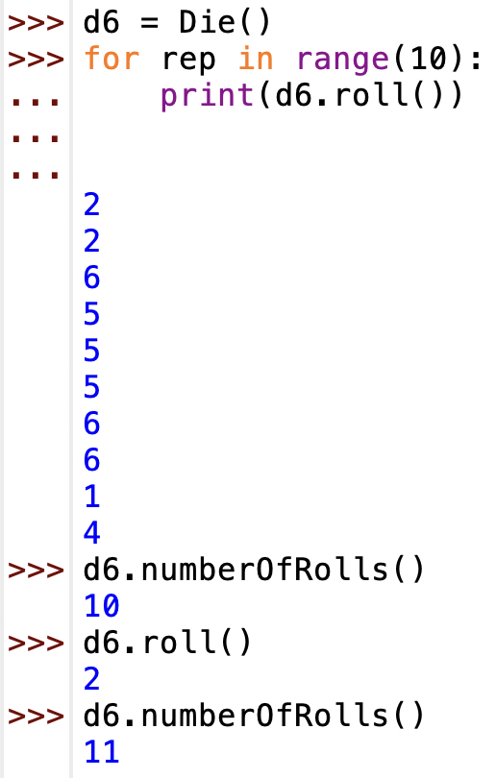
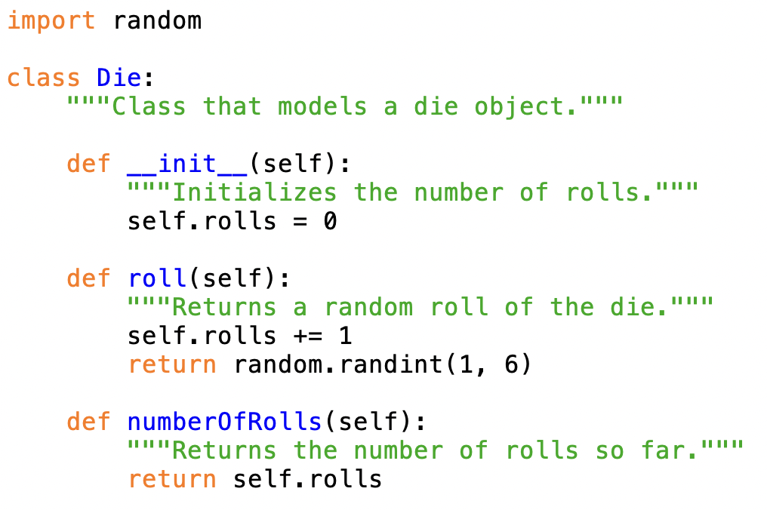
Example: modeling a 6-sided die
properties/fields: rolls
behaviors/methods: roll, numberOfRolls
by convention: class names are capitalized; field & method names are lowercase

Slide 7
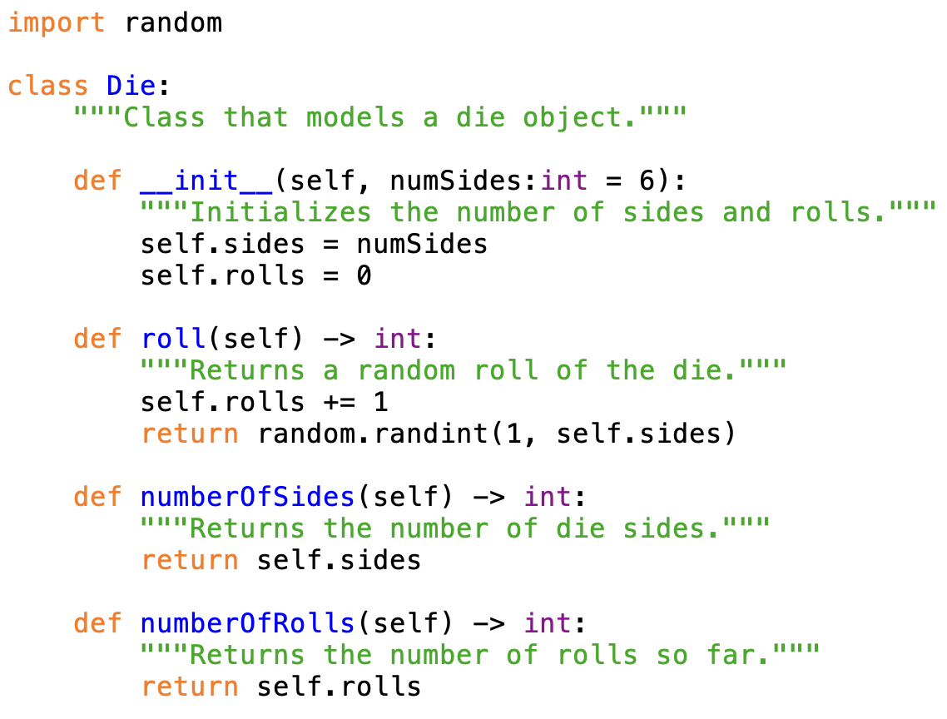
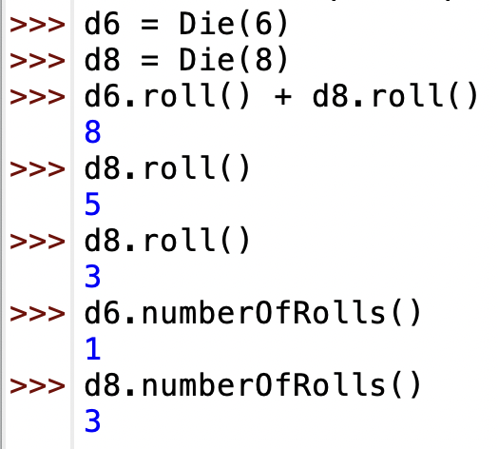
Example: N-sided die
can easily generalize the class to allow for different sided dice
  properties/fields: number of sides, number of rolls
  behaviors/methods: rolls, numberOfSides, numberOfRolls
if a method has explicit parameters, place after self
note: each Die object has its own copy of the fields

Slide 8
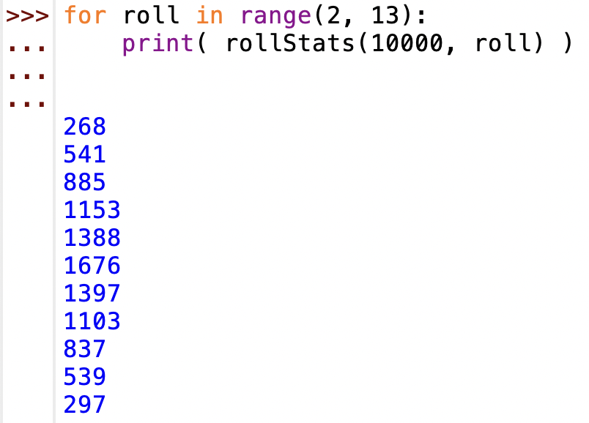
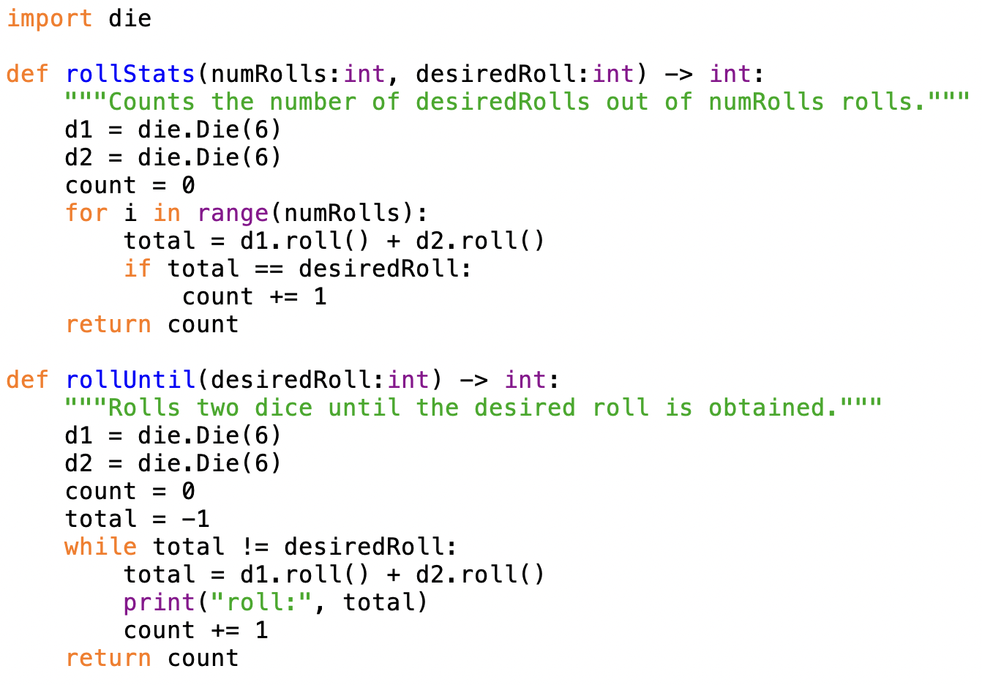
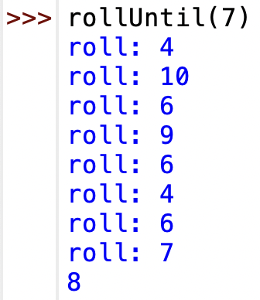
Dice simulations

Slide 9
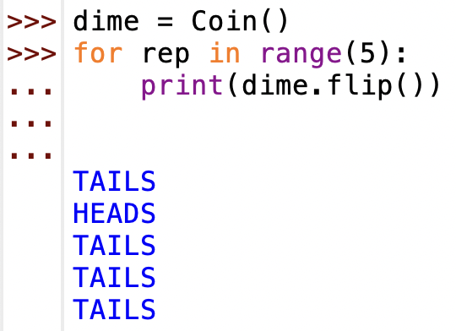
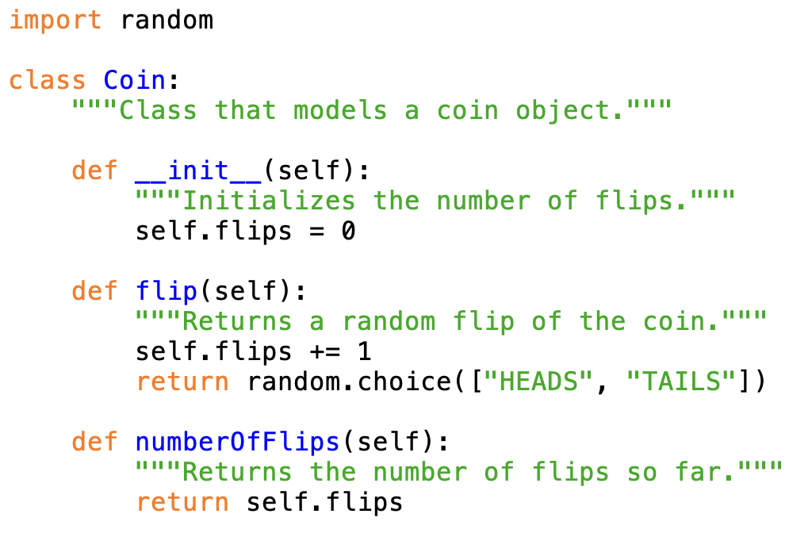
Exercise: Coin class
define a module with a Coin class (should be similar to Die)
  field: flips
  methods: flip (returns "HEADS" or "TAILS"), numberOfFlips

Slide 10
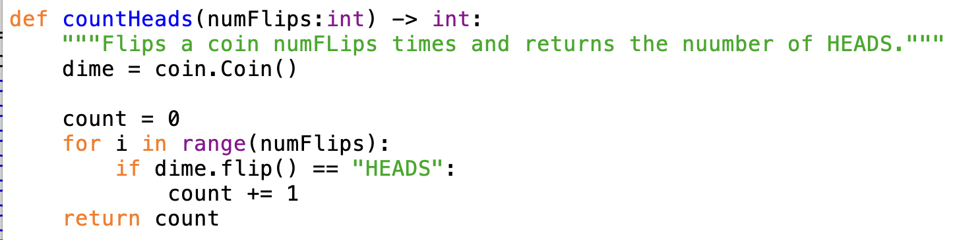
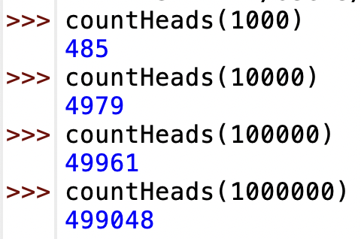
Exercise: Coin simulations
write a function that simulates a specific number of coin flips
  should return the number of HEADS obtained

Slide 11
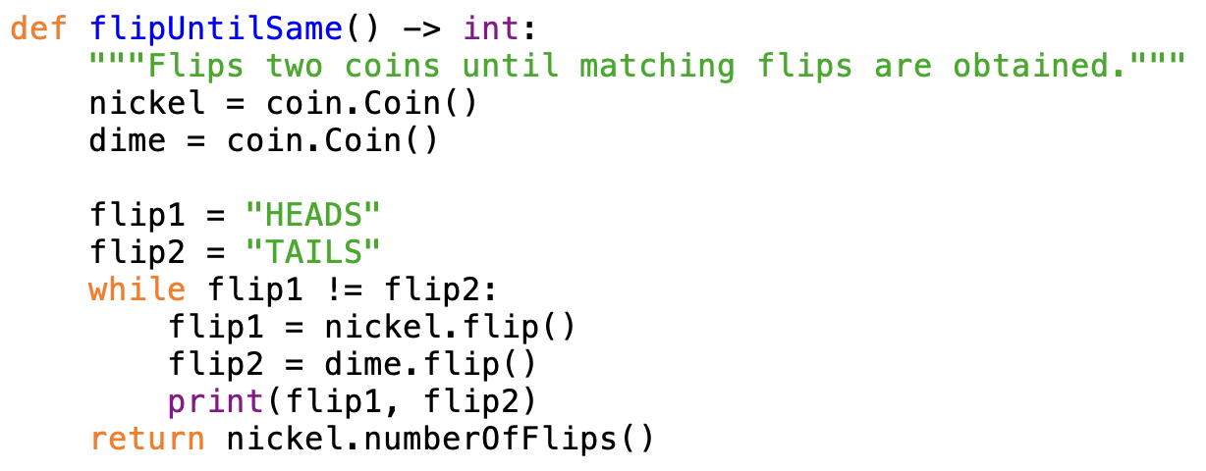
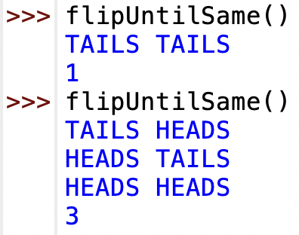
Exercise: Coin simulations
write a function that repeatedly flips two coins until identical flips are made
  should print the flips, and return the number of flips

Slide 12
Card game simulations
suppose we wanted to simulate card games
  e.g., Game of War, solitaire, poker, …
we need to model individual cards, decks of cards, …
  we could do so with built-in structures
    e.g., could represent a card as a string: "2C" "9H" "QS" "AD"
    e.g., could represent a deck as a list of such strings: ["AS", "KS", "QS", …, "2C"]
  would need to remember the details (rank before suit, top of deck is end, …)
  common tasks would result in duplicated code (e.g., dealing from the deck)
better solution: define classes that capture their data + behaviors
  Card class
    fields: rank, suit
    methods: getRank, getSuit, …
  DeckOfCards class
    fields: list of cards
    methods: shuffle, dealCard, addCard, numCards, …

Slide 13
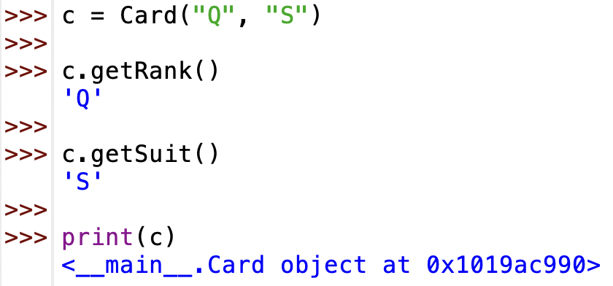
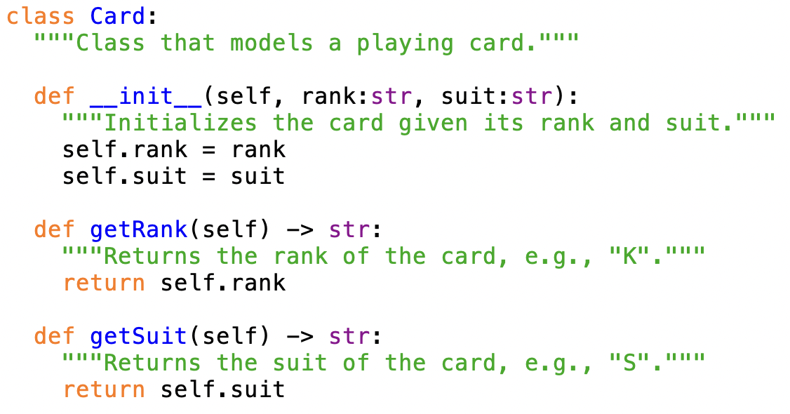
Card class
a Card object will have two fields: rank and suit
  __init__ has two inputs (in addition to self)
  when you create a Card object, must specify the rank and suit
note: by default, printing an object just prints the address of that object
-- not very useful!

Slide 14
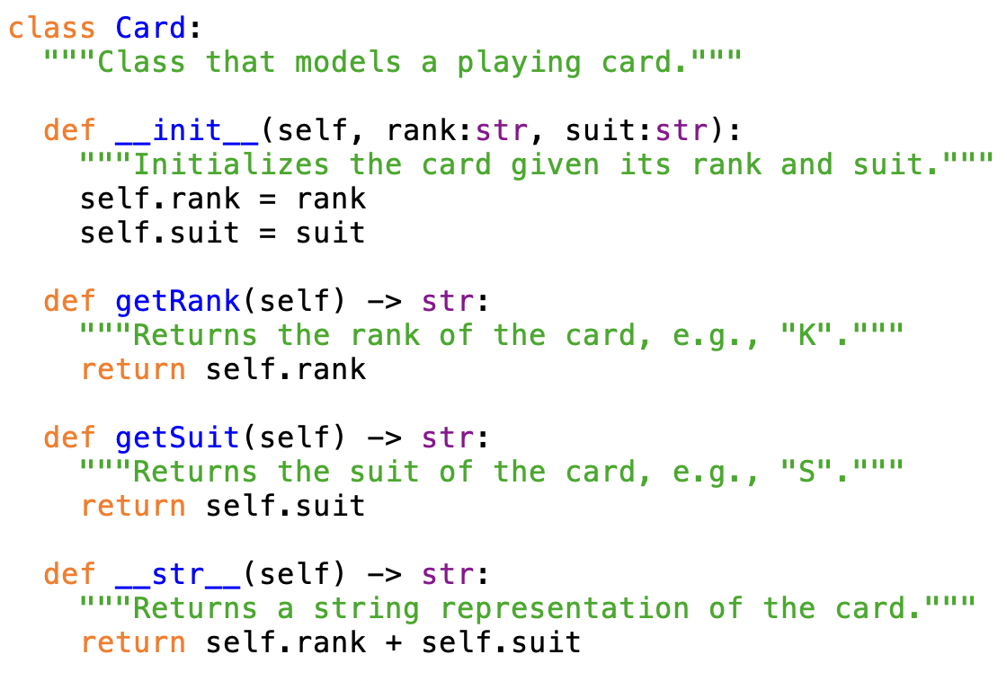
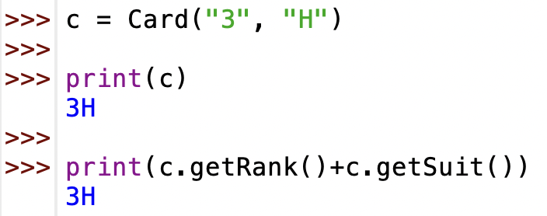
__str__ method
if you want to naturally print an object of a class,
  define a __str__ method that returns the string representation of that object
  this method is automatically called when printing an object

Slide 15
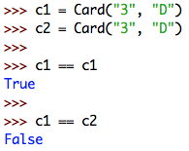
Object comparisons
by default, == and != are defined for objects
  X == Y if and only if X and Y are the same object
  not incredibly useful – we would like to define when two objects are equal
    e.g., we will say 2 cards are "equal" if they have the same rank & suit

Slide 16
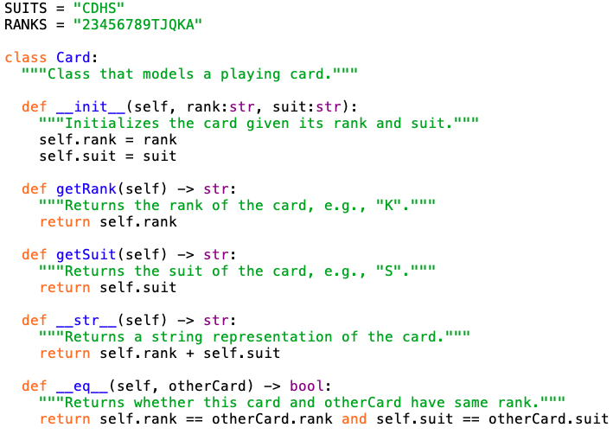
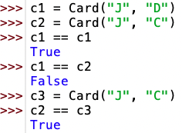
__eq__ method
can define the __eq__ method that has another object as input
  returns True if this object and the other are "equal", else False
  this method is used when you use == to compare objects
  note: X != Y is automatically inferred as not (X == Y)

Slide 17
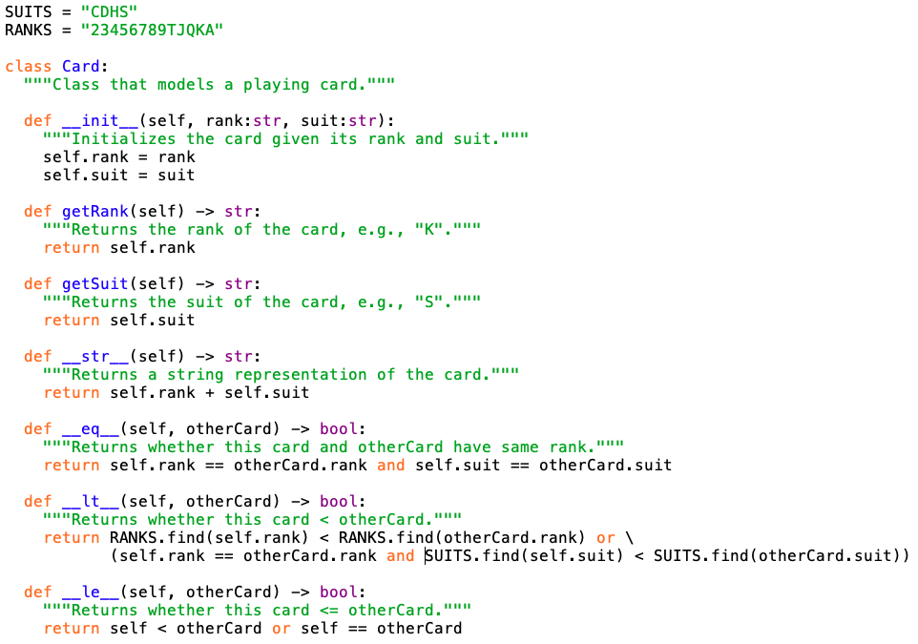
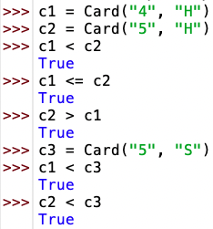
Other comparisons
can similarly define__lt__ and __le__ methods
  used for < and <=
  all other comparisons are inferred from these

Slide 18
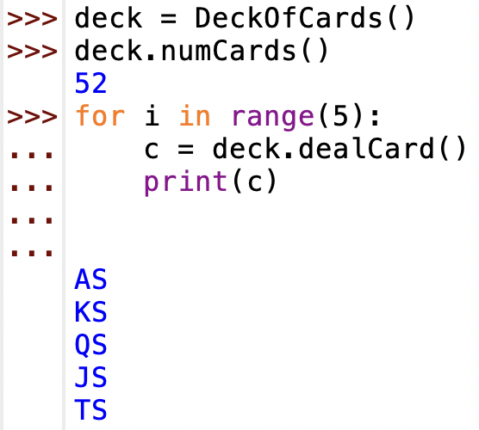
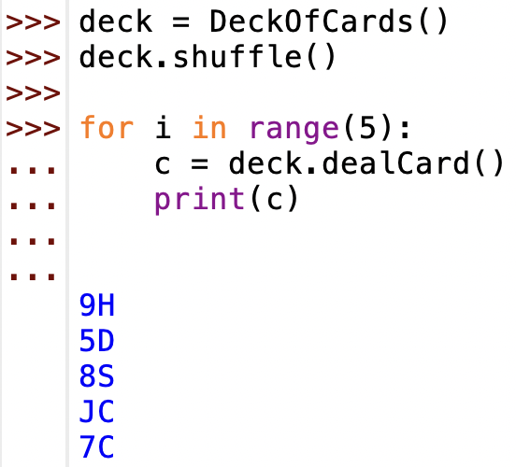
Deck of cards
for most games, we really want to model a deck of cards
  by default, a deck of cards is initialized to represent a list of 52 cards (in order)
    [2C, 3C, 4C, 5C, …, KS, AS]
  want to be able to:
    shuffle the deck (randomly rearrange the cards)
    deal a card (remove it from the "top")
    add a card (insert it on the "bottom")
    determine the number of cards remaining in the deck

Slide 19
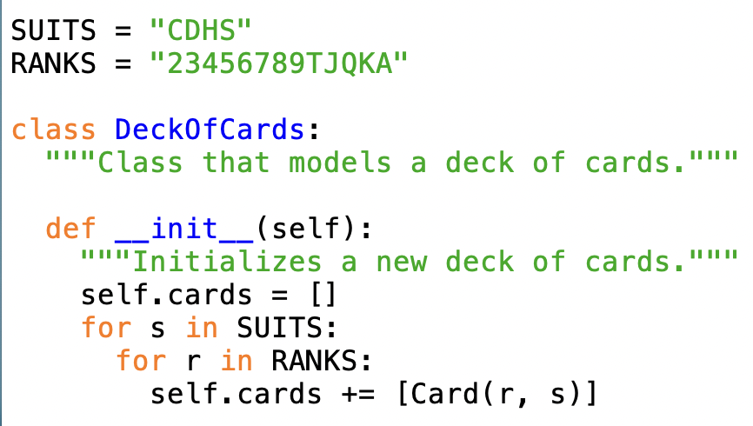
DeckOfCards class
  initializing the 52 card deck seems like a complex task
    but can be done easily with a nested loop
    for every suit in "CDHS"
    for every rank in "23456789TJQKA"
    add Card(rank, suit) to the list
  QUESTION: why is suit in the outer loop, rank in the inner?

Slide 20
Ordering the cards
SUITS = "CDHS"
RANKS = "23456789TJQKA"
self.cards = []
for s in SUITS:
for r in RANKS:
cards += [Card(r, s)]
builds [2C, 3C, 4C, 5C, 6C, 7C, 8C, …, TS, JS, QS, KS, AS]
self.cards = []
for r in RANKS:
for s in SUITS:
cards += [Card(r, s)]
builds [2C, 2D, 2H, 2S, 3C, 3D, 3H, 3S, …, AC, AD, AH, AS]

Slide 21
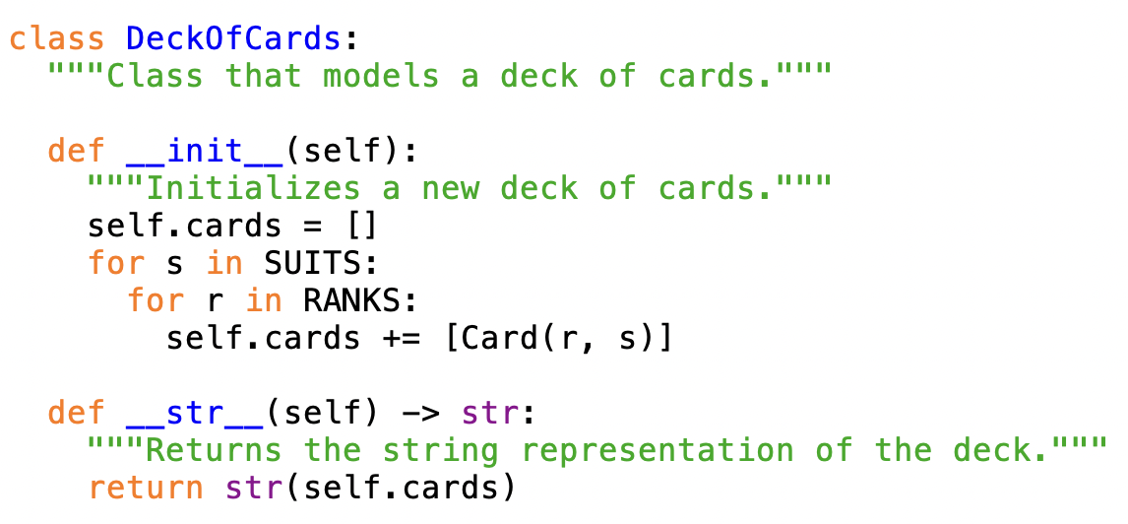
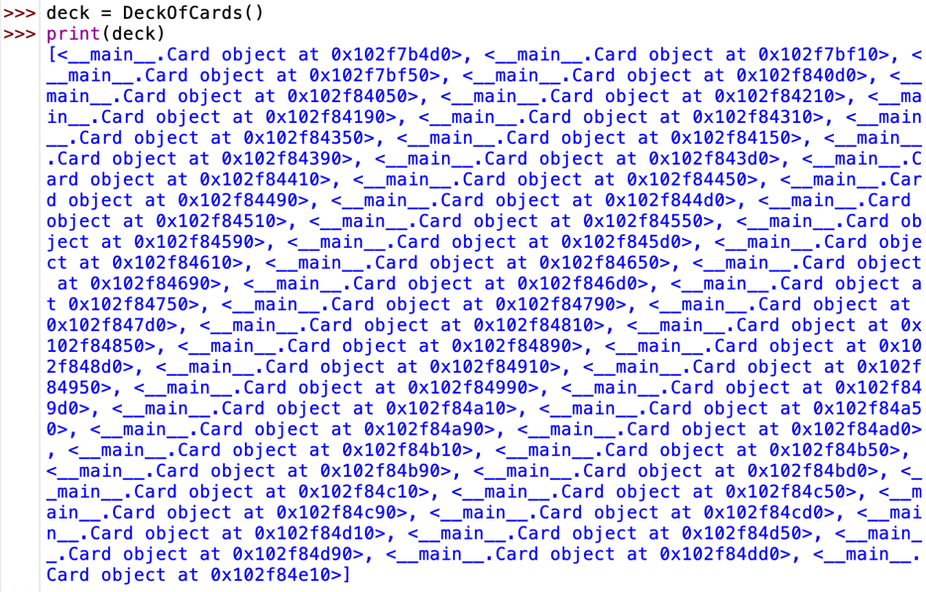
Printing a deck
to convert to a string (e.g., for printing), it is tempting to just convert the list of cards field to a string and return that
problem: when converting the list to a string, Python does not automatically convert the individual cards into strings
how can we fix this?

Slide 22
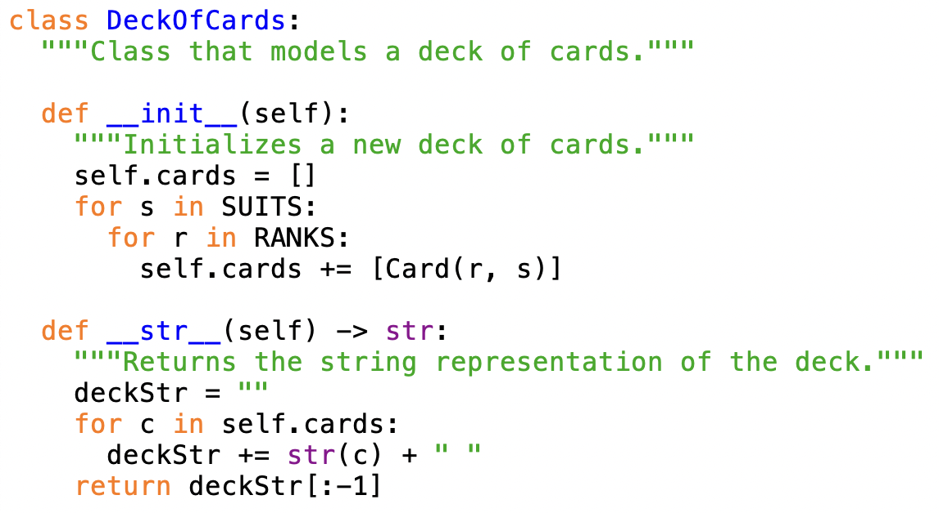
Printing a deck (cont.)
  can traverse the deck, accumulating the card strings into a single string
    why the slice in the return statement?

Slide 23
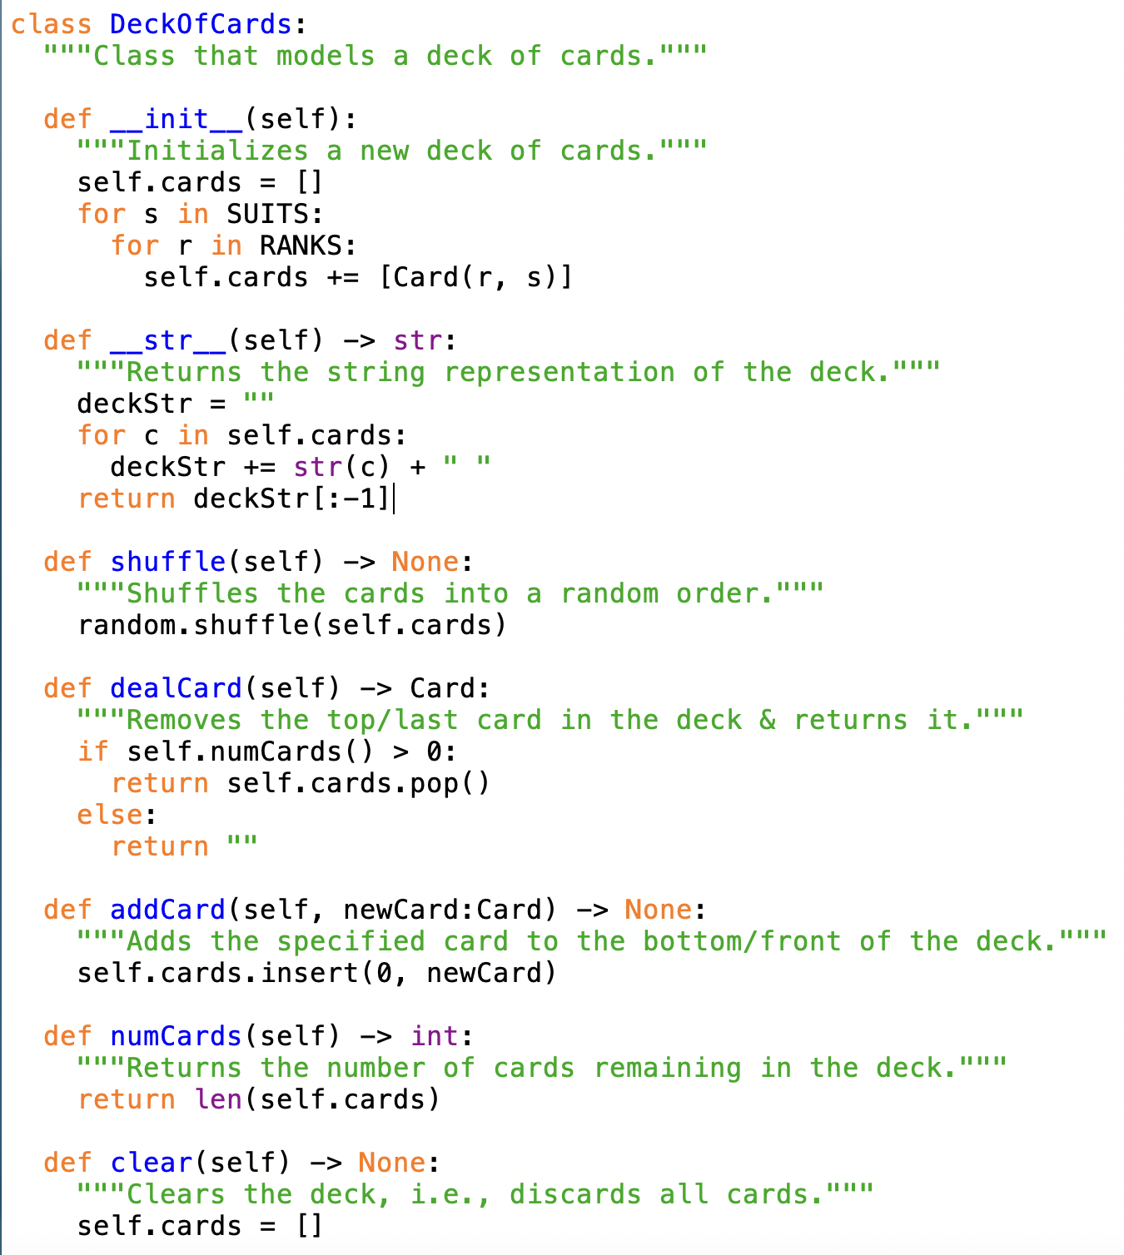
DeckOfCards class
shuffle
  the shuffle method from random does this
dealCard
  assuming there are cards in the deck, want to remove from the "top" (end of the list)
  the list pop method removes and returns the last item
addCard
  want to add at the "bottom" (front of the list)
  call insert with index 0
numCards
  simply returns the length of the card list
clear
  discards all cards

Slide 24
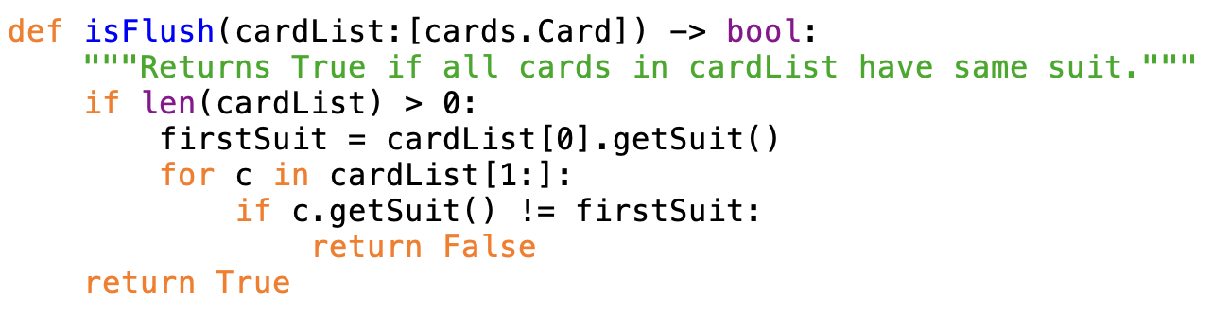
Example: isFlush
determine if a hand (list) of cards are all of the same suit
  there are a number of way to approach this
QUESTION: will this function work if the card list doesn't contain 5 cards?
  odds of being dealt a 5-card flush:
    1 * (12/51) * (11/50) * (10/49) * (9/48) = 0.00198 = .198%
  odds of being dealt a 3-card flush:
    1 * (12/51) * (11/50) = 0.05176 = 5.176%

Slide 25
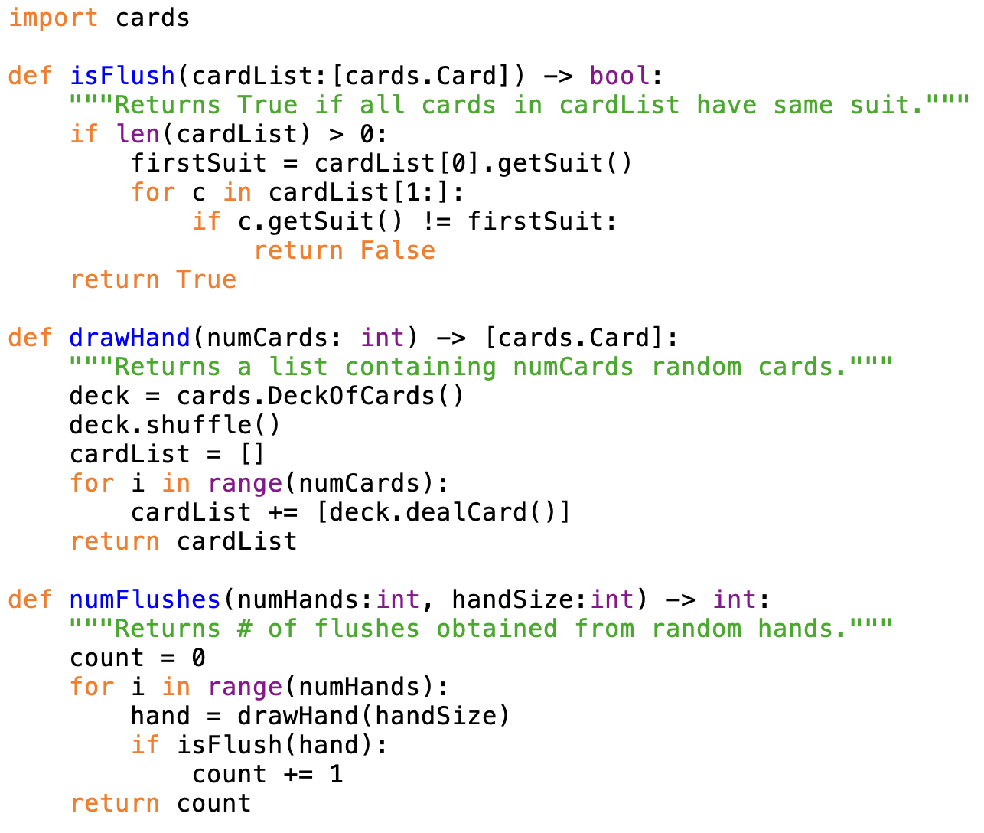
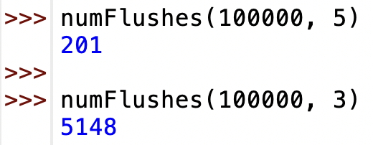
Experimental verification

Slide 26
Game of War
suppose we wanted to model the "game of war" card game
  shuffle and split a deck of cards among two players
  repeatedly, each player deals a card
    higher card (by rank only) wins, that player adds both cards to his/her deck
    if there is a tie, a war ensues
      each player deals three cards and the last cards are compared
      winner adds all cards to his/her deck (repeat if another tie)
  game ends when a player runs out of cards
how do we design, code & debug a solution?
  first step: object-oriented design
    identify the physical objects involved and build software models
    we have already done this with Card and DeckOfCards classes
  next step: divide-and-conquer?
    identify the smaller tasks, implement & test code for each task
    this has worked fine so far (when problems are modestly sized)

Slide 27
Agile development
going straight to coding subtasks does not work as well with large, real-world problems
  can be too much complexity
  waiting until you have a complete design before coding is not practical
  in the real world, customers want to see working code, provide feedback
the predominant development process in commercial software engineering is agile development
agile development takes a high-level (usually OO) design and builds a series of incremental prototypes
  simplify the problem, get a working prototype done quickly
  then, can repeatedly augment/revise the prototypes to build toward the complete version

Slide 28
Agile approach to the game of war
high-level design
  start with a shuffled deck of cards
  deal an equal number to each player
  while both players have cards
    each deals a card
    if different ranks, player with higher rank adds both cards (in random order) to the bottom of his/her deck
    if same rank, a war ensues
      repeatedly deal three cards and compare, until ranks are different (or a player runs out of cards)
      player with higher ranked card wins all and adds (in random order) to the bottom of his/her deck
  winner is declared when opponent runs out of cards
what are the most complicated parts of this solution?
what can be simplified, then incrementally added back in?

Slide 29
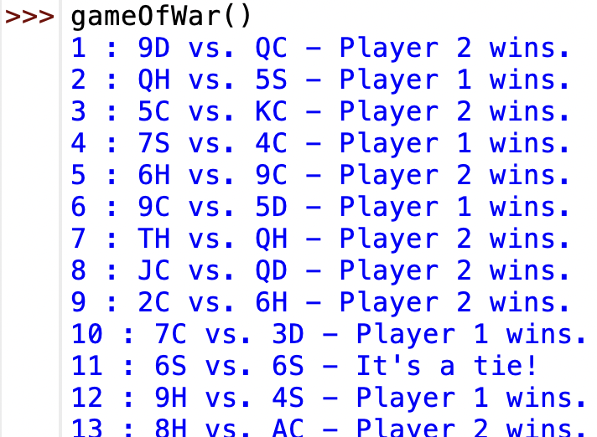
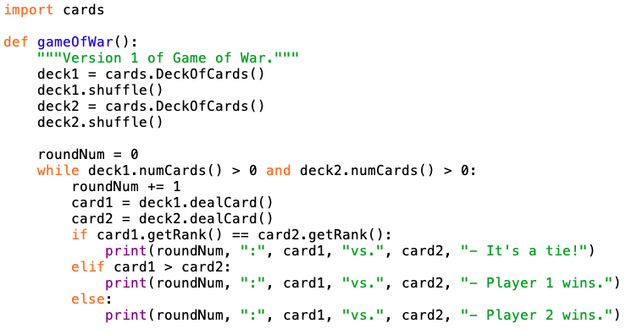
Game of war (prototype 1)
  assume each player starts with a complete deck of cards
  use card comparison (which uses rank & suit)
  throw away cards after each comparison

Slide 30
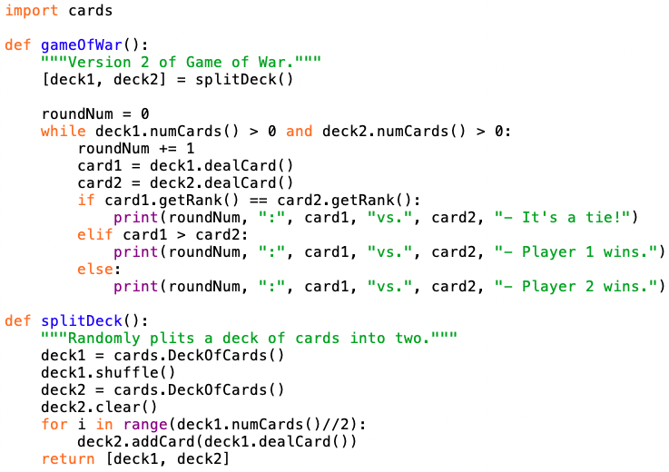
Game of war (prototype 2)
next, modify so that a single deck is split between the players
  to keep the main loop simple, can define a separate function for splitting the decks
  here, the function returns the half decks

Slide 31
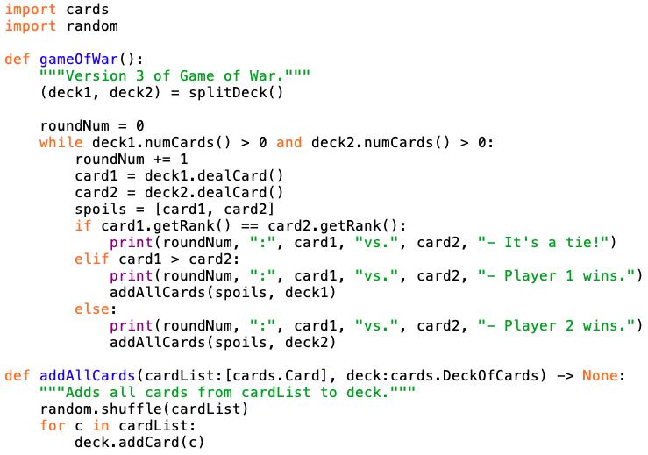
Game of war (prototype 3)
next, modify so that cards are awarded to the winner (still ignoring ties)
  note: the card order should be random
  again, can define a separate functions to keep the main loop simple (splitDeck not shown for brevity)

Slide 32
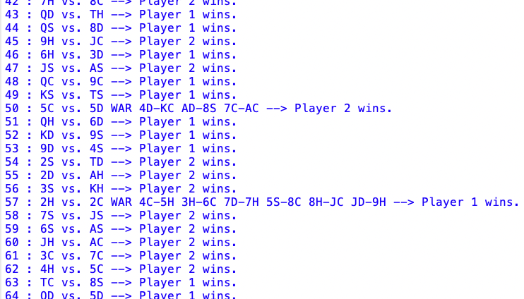
Implementing wars
the last step, handling ties, is by far the most complex
  how do you display the war?
  what if the war ends in a tie?
  what if a player runs out of cards in a war?

Slide 33
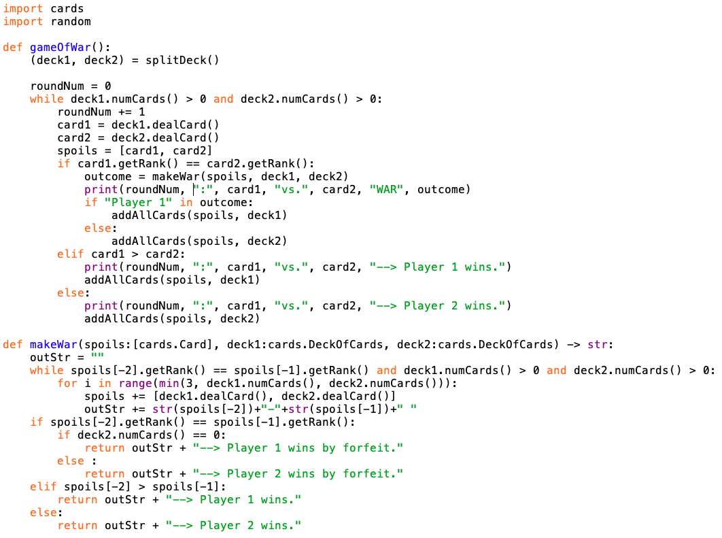
Game of war (final version)

Slide 34
Variables & scope
throughout this course, we have used variables to
  store the results of calculations
  keep running counts or sums
  store values read in from the user or from a file
  store inputs to functions (known as parameters)
  maintain the internal values of objects (known as fields)
in addition to its value and type, each variable has another attribute associated with it, known as its scope
  the scope of a variable is that portion of the code in which that variable exists and can be accessed

Slide 35
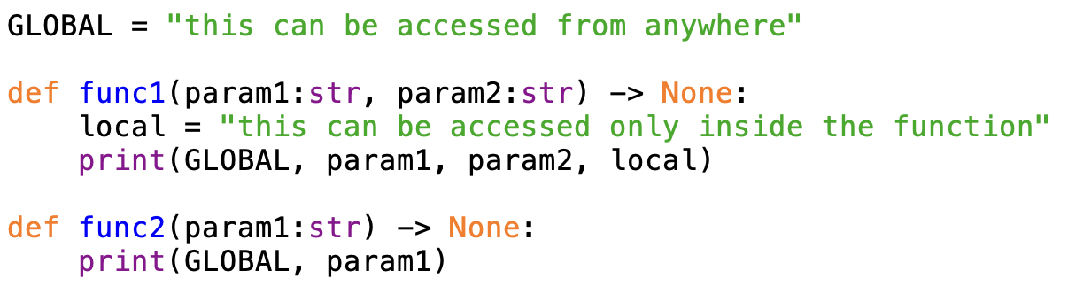
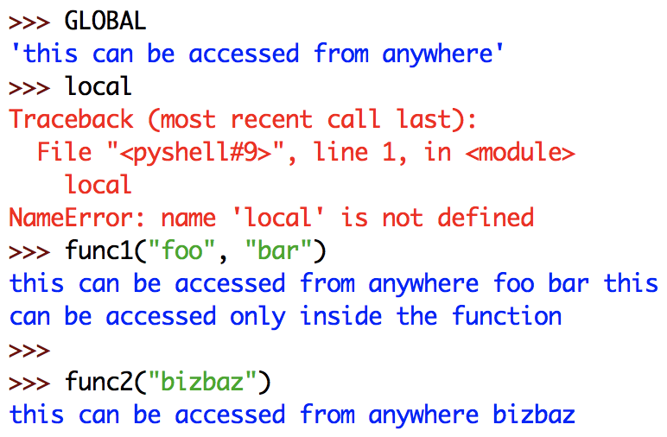
Global vs. local scope
variables that appear outside of any function are global
  their scope is unlimited
variables that appear only in a function (which includes parameters) are local to that function
  their scope is limited to the function
  attempting to access them outside of their function produces an error

Slide 36
Locality
locality simplifies the development of functions
  can have local variables with the same name in different functions
  each function has its own, distinct variable

Slide 37
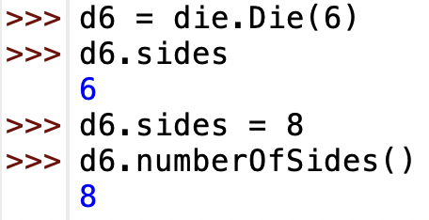
Fields & scope
in most languages, the scope of a field is limited to within the object
  this protects the integrity of fields - can only access and change them through methods
Python is flawed in this respect
  fields are global – can be accessed and even changed outside of the methods
  DO NOT EXPLOIT THIS FLAW
don't' ever do this!
only access/change fields through methods

Slide 38
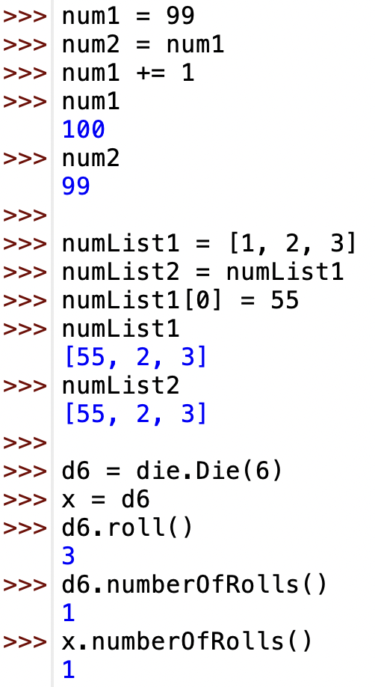
Immutable vs. mutable values
recall that some types in Python are immutable (int, float, bool, str), while others are mutable (list, objects)
  you cannot change an immutable value, you can only reassign a variable to a different value
  so, if more than one variable refers to the same immutable value, changing one does not affect the others
  you can change a mutable value
  so, if more than one variable refers to the same mutable value, changing one changes them all

Slide 39
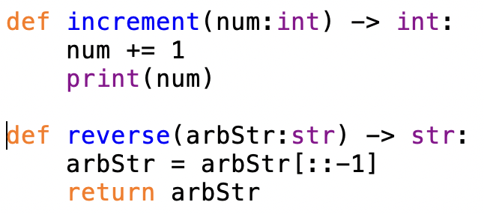
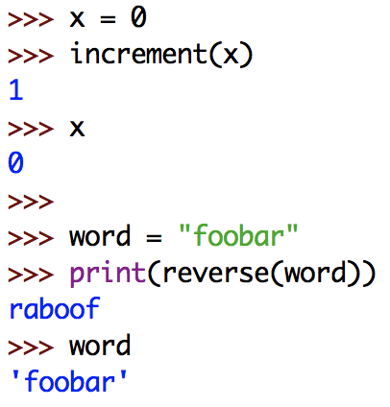
Passing immutable values
parameters are local variables
  meaning their names exist and can only be accessed within the function
  when you pass a value to a function, that value is automatically assigned to the parameter variable
for immutable types (int, float, bool, str)
  any changes you make in the function will not affect the outside
    e.g., for the call increment(x), x and num both refer to 0. Incrementing num does not change the value of 0, it reassigns num (and only num) to be 1

Slide 40
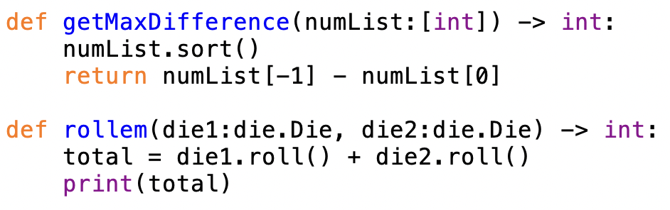
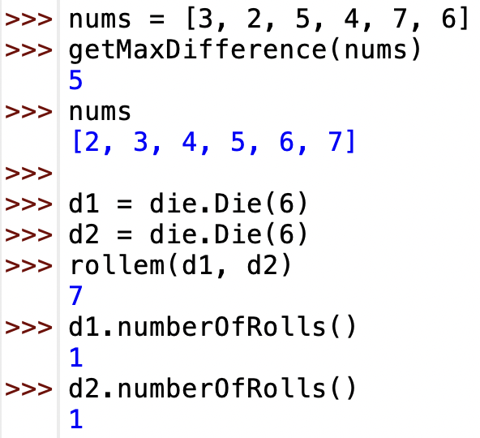
Passing mutable values
however, for mutable types (lists, objects), the behavior is quite different
  as before, the parameter variable is assigned the passed value
  any change you make to a mutable value affects all variables that refer to it
  so, if you pass a list to a function and add to or rearrange its contents, those changes will persist
  likewise, if you pass an object to a function and call methods that change its fields, those changes will persist

