Slide 1
CSC 221: Introduction to Programming Fall 2018
Introduction to programming in Scratch
animation sprites
motion, control & sensing
costume changes
variables & state
interacting sprites & broadcasts
animation & game programming

Slide 2
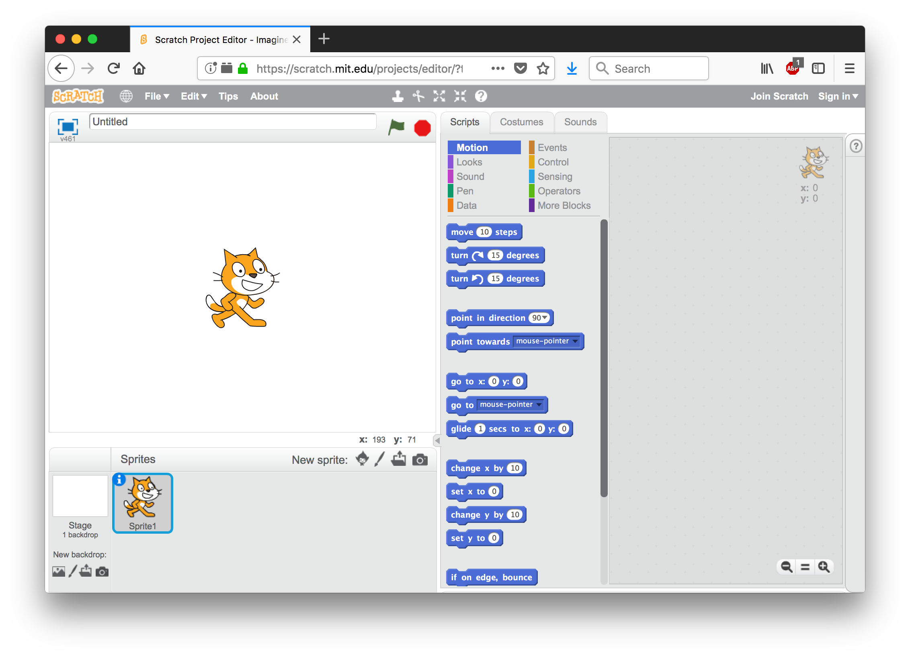
Scratch
Scratch is a simple environment for creating animations & games
developed at MIT to introduce programming & creative design
great for making programming and object-oriented concepts concrete
sprite: an animation object with properties and behaviors
by default, the Scratch cat sprite loads
can add properties and behaviors by dragging blocks from the middle pane to the right pane
Scratch is free & online at scratch.mit.edu
Web site contains numerous guides & tutorials
more than 38 million projects online
you can download to/upload from your computer, or create a free account and store projects online

Slide 3
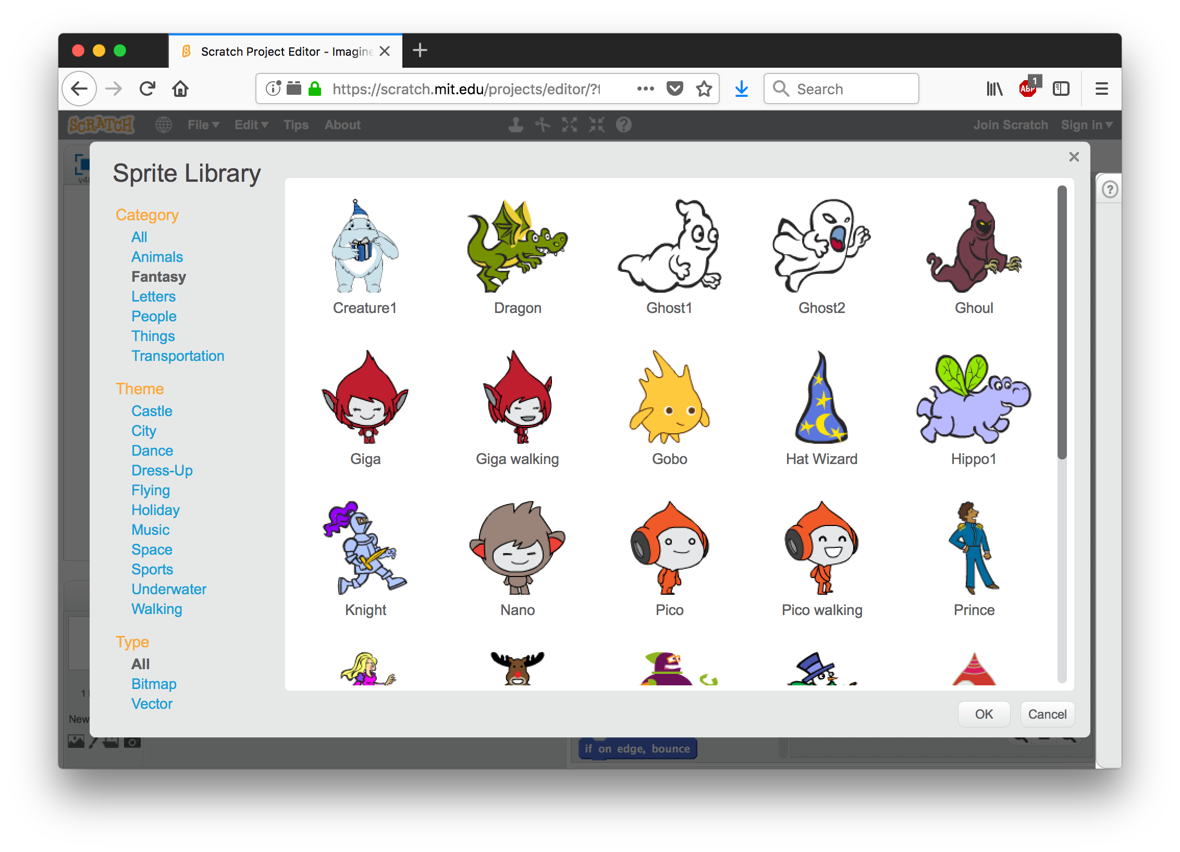
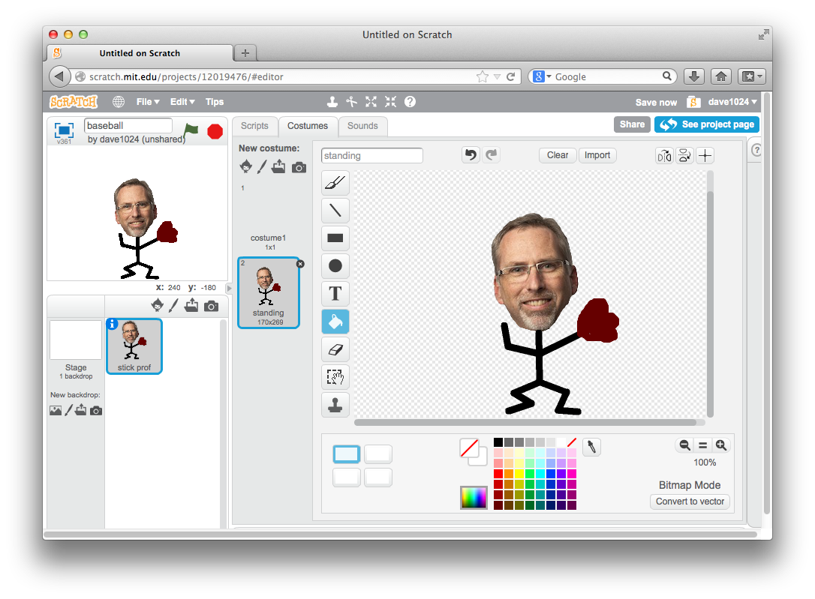
Adding sprites
can select from a provided collection of sprites
click on the cartoon character next to New Sprite:
collections include animals, fantasy characters, people, things, …
can create a new sprite using the Paint Editor
click on the paint brush
can draw, add shapes, fill, erase, rotate, resize, add text, …
can even import an image, then edit as desired (e.g., erase unwanted parts)
can move sprites around the stage using the mouse, shrink or grow by right-clicking

Slide 4
Sprite motion
each sprite can move around the stage
select the desired (blue) Motion block
drag that block to the Script panel for the sprite
click on that block to execute it
note:
coordinates: center = (0,0)
bottom-left = (-240, -180)
top-right = (240, 180)
directions: 0 = up
90 = right
180 = down
270 = left
can control whether the sprite turns using the "set rotation style" block

Slide 5
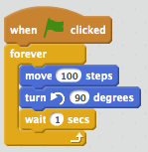
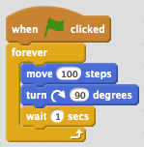
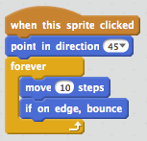
Sprite control
the (yellow) Control blocks allow for repeated or conditional behavior
when blocks allow for behaviors to be triggered by events (click on green flag, press a key, click on sprite)
wait block causes execution to delay a set amount of time
forever block encloses other block(s) that are to be executed over and over, indefinitely
repeat block encloses other block(s) that are to be executed a set number of times

Slide 6
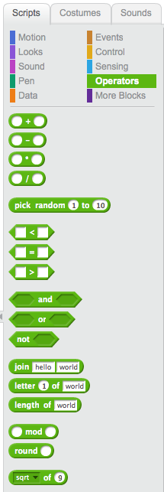
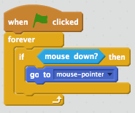
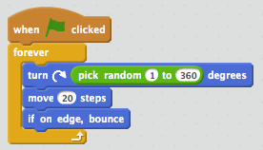
Sprite sensing
other blocks allow the sprite to sense the environment and make comparisons

Slide 7
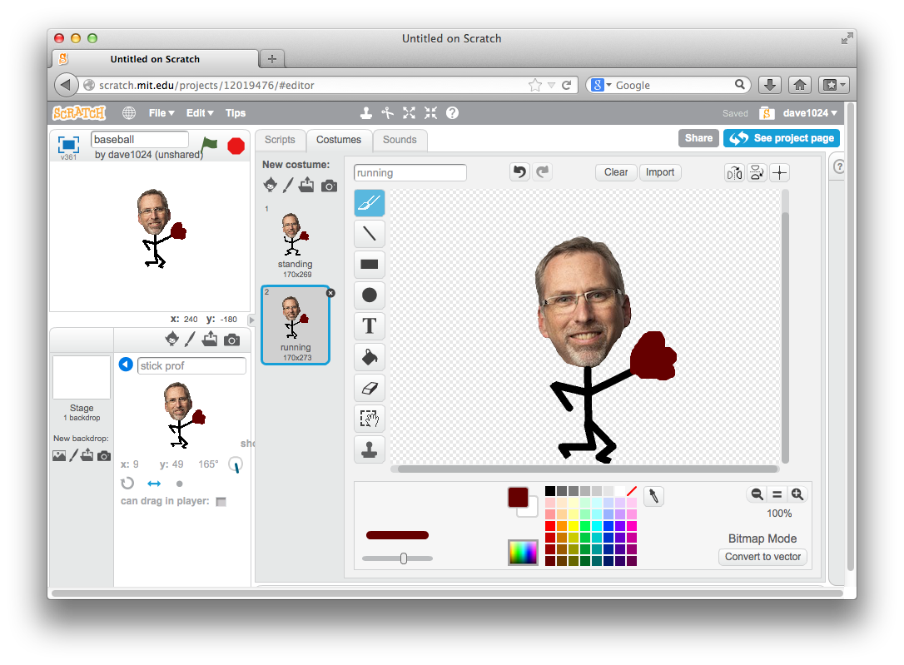
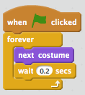
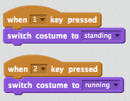
Changing costumes
can create multiple costumes for a sprite
click on the Costumes tab
either:
click on brush to draw a new costume
click on file to load an image
right click on an existing costume to make a duplicate, then edit
switch to costume and next costume from the (purple) Looks blocks change the sprite’s costume

Slide 8
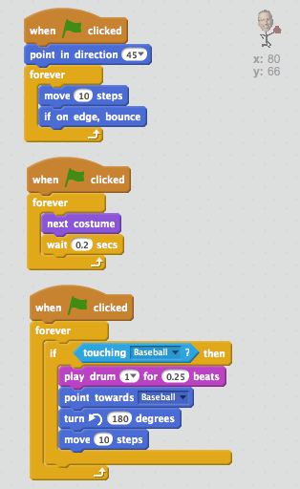
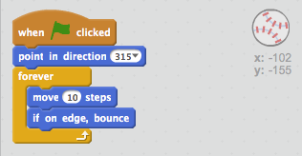
Interacting sprites
can have multiple sprites active at once
can sense and react to each other
note use of sound when sprites collide -- can also record sounds (or even play music), but much slower!

Slide 9
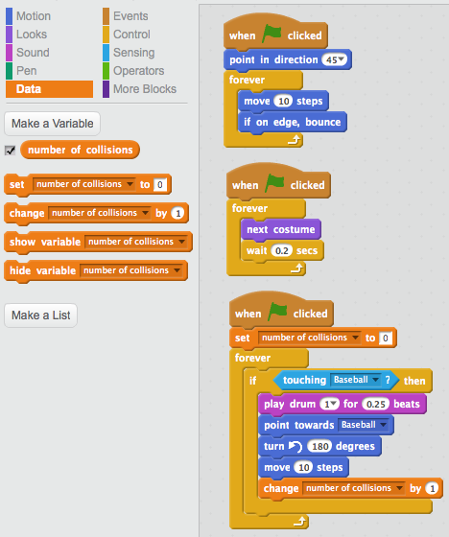
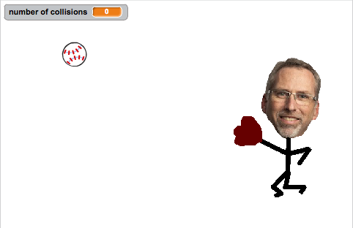
Variables & state
the state of a sprite is its current set of properties (e.g., location, color, heading)
can add new properties to a sprite’s state with variables
a variable is a name that refers to some value/property
create a variable by clicking on Make a Variable
by default, the variable is displayed on the stage
a sprite can access and update a variable using the set and change (orange) blocks

Slide 10
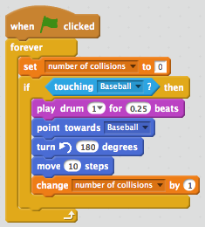
Counters
in general, a counter is a variable that keeps track of some event
initially, the counter value is 0 (nothing has happened yet)
each time the event occurs, the variable value goes up by one
it is VERY important that the initialization happens OUTSIDE the loop -- WHY?

Slide 11
New game
we want to repurpose the stick prof and baseball into a game
the stick prof is controlled by the mouse
by moving the mouse, the user can move the stick prof left and right
the baseball drops out of the sky from a random location
the user must move the stick prof so that the ball lands in the glove
if caught, the player's score goes up and a new ball drops
if missed, then the game ends
would like to make it easy to start and restart the game
when the green flag is clicked, the stick prof is positioned & instructions displayed
when the user hits space bar, then balls start dropping
when the game ends, a message is displayed and the space bar restarts

Slide 12
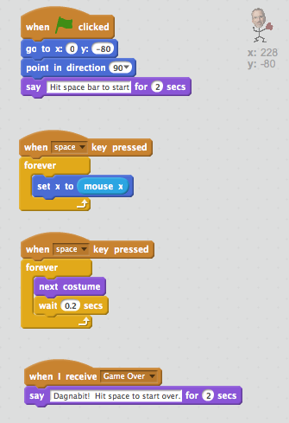
Ball drop game
it makes sense for the stick prof to handle the start and end of the game
but the baseball knows when it hits the ground
how do they communicate and coordinate?
one sprite can broadcast a message when an event occurs (e.g., ball hits the ground)
another sprite can receive the broadcast and react

Slide 13
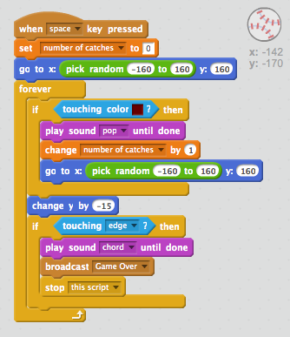
Ball drop game
note: there is only one ball
when it is caught, it reappears at the top at a new position
when it hits the ground, it broadcasts the "Game Over" message and stops the script
what if we changed the number?

Slide 14
Animations & games
numerous projects are included with the Scratch download
more than 38 million projects uploaded to the scratch.mit.edu site
lots of animations
stories with characters interacting (especially cats & anime)
tutorials, dance & music, drawing, …
lots of games
interactive video games (e.g., tetris, pacman, breakout)
casino games, word games, stick figure movement, …
recall: programming is the process of designing, writing, testing and debugging algorithms that can be carried out by a computer
➔ Scratch is programming!
you design the sprites (objects), their properties & behaviors, their interactions
you create the scripts (algorithms) that implements those behaviors
you test and debug the projects to make them work as desired

