Slide 1
CSC 221: Introduction to Programming Fall 2018
See online syllabus (also accessible via BlueLine):
http://dave-reed.com/csc221
Course goals:
To develop problem solving and programming skills to enable the student to design solutions to non-trivial problems and implement those solutions in Python.
To master the fundamental programming constructs of Python, including variables, expressions, functions, control structures, and arrays.
To build a foundation for more advanced programming techniques, including object-oriented design and the use of standard data structures (as taught in CSC 222).

Slide 2
What is programming?
programming is applied problem-solving
understand a problem
identify relevant characteristics
design an algorithm (step-by-step sequence of instructions to carry out a task)
implement the algorithm as a computer program
test the program by repeated (and carefully planned) executions
GO BACK AND REPEAT/REVISE AS NECESSARY
in short: programming is the process of designing, writing, testing and debugging algorithms that can be carried out by a computer
we encounter algorithms everyday: directions to dorm, instruction manual, recipe
people are smart, so spoken languages can be vague
computers are not smart, so programming languages are extremely picky

Slide 3
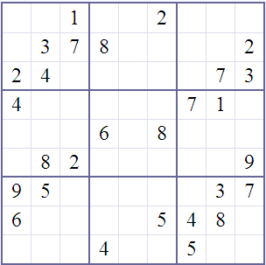
Problem-solving example
Sudoku is a popular puzzle
given a partially-filled 9x9 grid, place numbers in the grid so that
each row contains 1..9
each column contains 1..9
each 3x3 sub-square contains 1..9
how do people solve Sudoku puzzles?
if we wanted to write a program to solve Sudoku puzzles, must/should it use the same strategies?

Slide 4
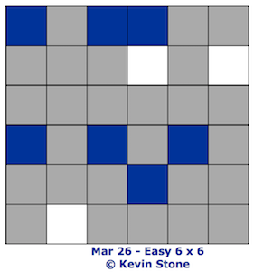
Related example
3-in-a-row is another puzzle
given a partially-filled NxN grid, color the squares blue or white so that
each row/column has the same number of each color
never 3-in-a-row of same color
how similar/different is the human strategy compared to Sudoku?
how similar/different would a computer strategy need to be?

Slide 5
Programming is a means to an end
important point: programming is a tool for solving problems
computers allow people in many disciplines to solve problems they couldn’t solve without them
— natural sciences, mathematics, medicine, business, …
to model this, many exercises will involve writing a program, then using it to collect data & analyze results
DISEASE VECTOR MODELING: suppose you started with a single infected individual in a population – given a constant infection rate, how long until half the population is infected?
what information do you need (e.g., population, infection rate)?
what data values do you need to store and update?
what is the basic algorithm?
what real-life factors are we ignoring?

Slide 6
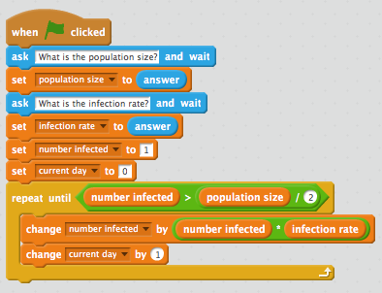
Disease vector model in Scratch

Slide 7
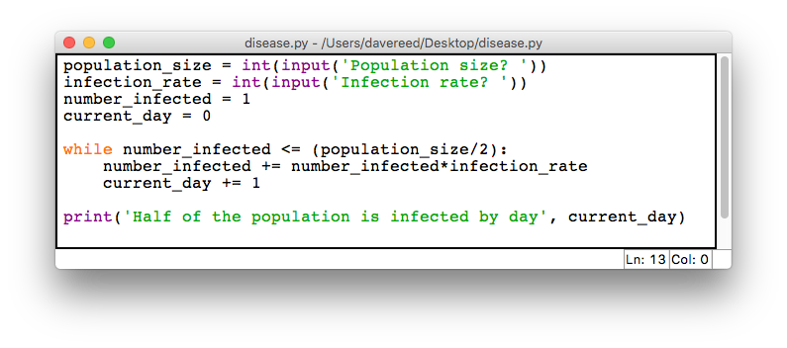
Disease vector model in Python

Slide 8
Another interesting problem
PAPER FOLDING: if you started with a regular sheet of paper and repeatedly fold it in half, how many folds would it take for the thickness of the paper to reach the sun*?
*assuming you had a big enough sheet of paper, a space ship with a forklift, other physically improbable/impossible things…
what information do you need (e.g., distance of sun)?
what data values do you need to store and update?
what is the basic algorithm?

Slide 9
Where do we start?
explore programming concepts using Scratch
a fun, interactive, online environment for creating animations & games
we will explore your creative side, while building the foundation for programming
learn-by-doing, so be prepared to design & experiment & create
no previous programming experience is assumed
freely accessible at scratch.mit.edu
will then segue into Python (v. 3) programming
transfer Scratch programming concepts into a powerful & flexible scripting language
classes will mix lecture and hands-on experimentation, so be prepared to do things!
freely downloadable from python.org

