Slide 1
CSC 221: Introduction to Programming Fall 2018
Lists
lists as sequences
list operations
+, *, len, indexing, slicing, for-in, in
from strings to lists
literary fingerprints (HW5)
lists of counters
dice stats, letter frequencies
list methods
index, count, append, insert, remove, sort, reverse

Slide 2
String review
recall that a Python string is a sequence of characters
basic operations on strings:
+ concatenates strings
* concatenates multiple copies
len function
indexing via [i]
slicing via [s:e], [s:e:n], [:e], [s:], …
sorted returns a sorted list of letters, e.g., sorted("bad"]) → ['a','b','d']
string methods:
isupper, islower, isalpha, isdigit, isspace
capitalize, upper, lower
find, rfind, count, replace
strip, lstrip, rstrip
center, ljust, rjust

Slide 3
Lists
closely related: a list is a sequence of arbitrary items
can specify the contents of a list in brackets, separated by commas
the same sequence operations apply to lists:
+ concatenates lists
* concatenates multiple copies
len function
indexing via [i]
slicing via [s:e], [s:e:n], [:e], [s:], …
sorted returns a sorted copy of the list, e.g., sorted([3,7,1]) → [1,3,7]

Slide 4
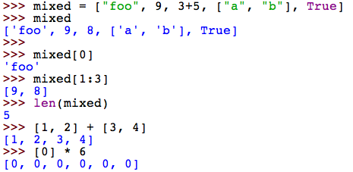
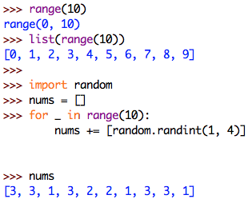
List operation examples
note: a range is sequence similar to a list
can be converted into a list using list

Slide 5
Exercises
grab a partner and go to codingbat.com
solve problems (in order) from the List-1 category
all of these problems can be solved using list indexing, slicing, +, and *

Slide 6
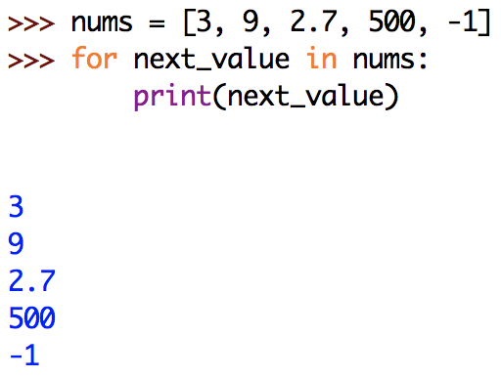
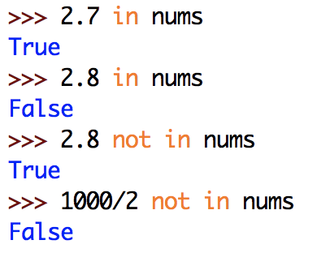
Traversing a list sequence
as with strings (character sequences), can traverse a list using for-in
likewise, can test for list membership using in and not-in

Slide 7
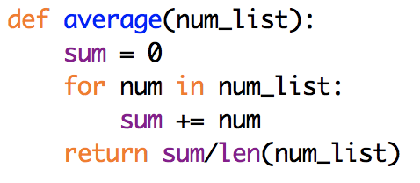
Example: averaging numbers
suppose you have a list of numbers (e.g., grades)
want to calculate the average of those numbers
any potential problems?
i.e., will this function work correctly on all possible lists of numbers?
modify this function so that it returns 0.0 on an empty list

Slide 8
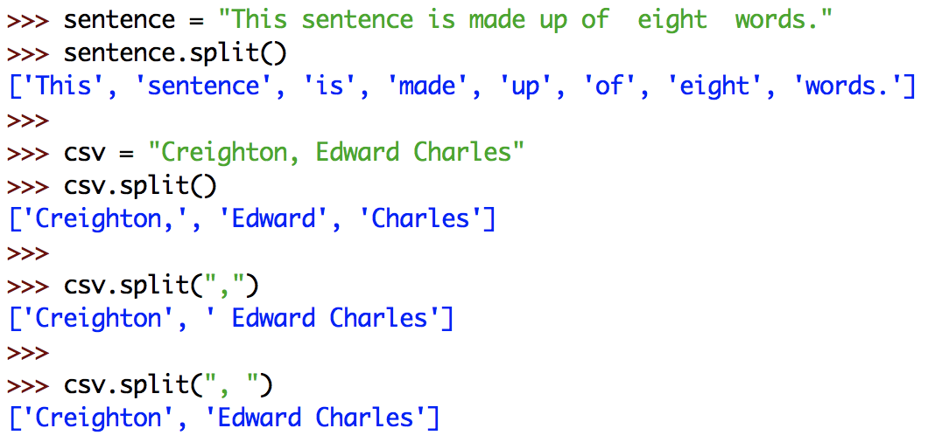
Strings & lists
there is a useful string method that converts a string into a list
str.split() returns a list of the separate words in str
by default, it uses whitespace to separate the words, but can provide an optional argument to specify different separators

Slide 9
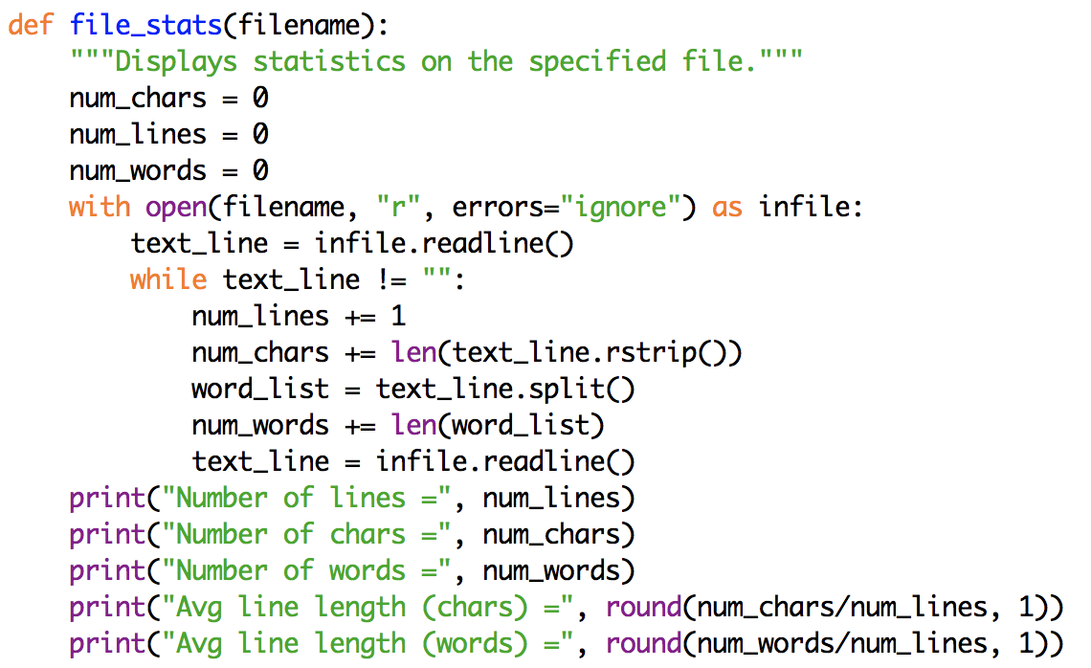
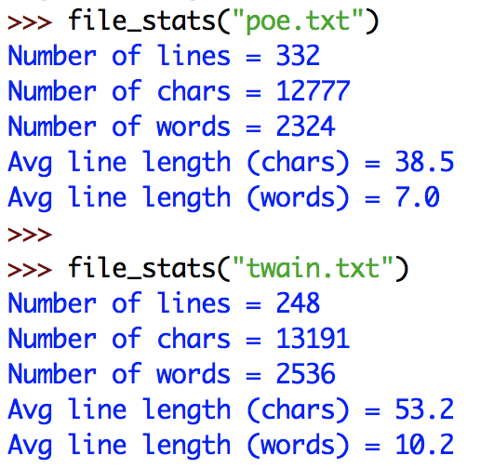
Adding word stats
we can update file_stats so that it also counts the number of words
use split to split each line into a list of words, then total the number of words

Slide 10
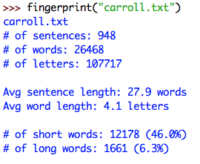
HW5 (part 1)
you are two write a function (or functions) that process a file and produce statistics on the patterns of word and letter usage
could be used to produce literary fingerprints for authors
e.g., for Alice's Adventures in Wonderland (by Lewis Carroll)
we are making several simplifying assumptions:
any sequence of characters surrounded by whitespace is a word
any word that ends in '.', '!', or '?' marks the end of a sentence
we only count letters (uppercase and lowercase)
short words are $≤$ 3 letters
long words are $≥$ 8 letters
This is a sentence. This 1 is 'not.'
1 sentence, 8 words, 24 letters
5 short words, 1 long word

Slide 11
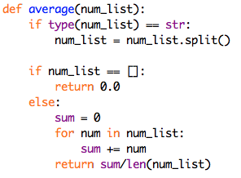
Strings → lists
since it is easier for the user to enter multiple items in a string, taking a string and splitting it into a list of values is a common approach
will the following work for averaging grades?

Slide 12
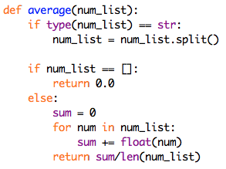
Strings → lists (cont.)
not quite – split produces an array of strings
but, average is expecting a list of numbers
could go through the list and convert each string with the corresponding number
simpler: convert each element to a number before adding to the sum
(if the list contents are already numbers, the call to float does no harm)

Slide 13
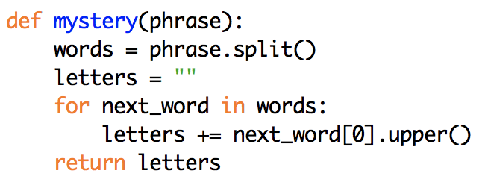
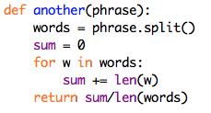
Mystery functions

Slide 14
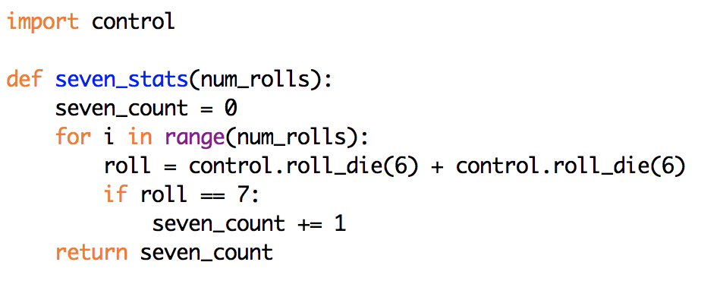
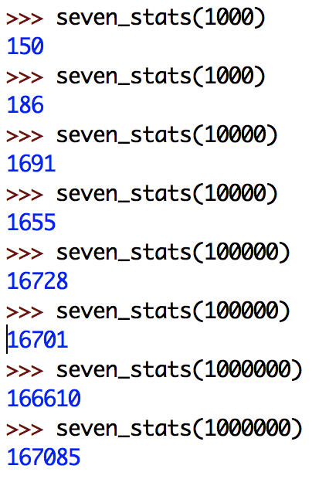
Dice stats
recall earlier examples involving simulated dice rolls
suppose we wanted to perform repeated rolls, keep track of the number of 7's

Slide 15
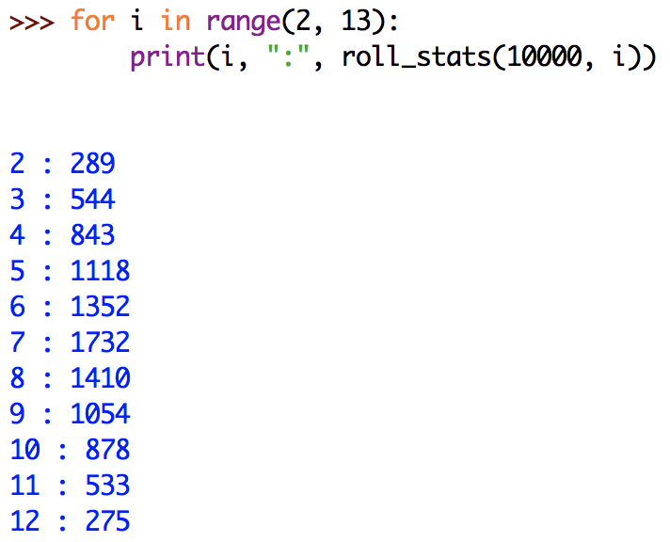
Dice stats (cont.)
we could similarly define functions for the other dice totals
or, could generalize by adding a parameter for the desired total
do these totals add up to 10,000?
should they?

Slide 16
Dice stats (cont.)
the problem with separate calls for each dice total is that each call is independent of the others
actually simulating 10,000 x 11 different rolls
WASTEFUL, and leads to inconsistent results
what we need is to be able to count all the totals at the same time
could do it by having 11 variables, each keeping count for a dice total
would need an 11-case if-elif-else to check for each dice total
would then need to return or print each count

Slide 17
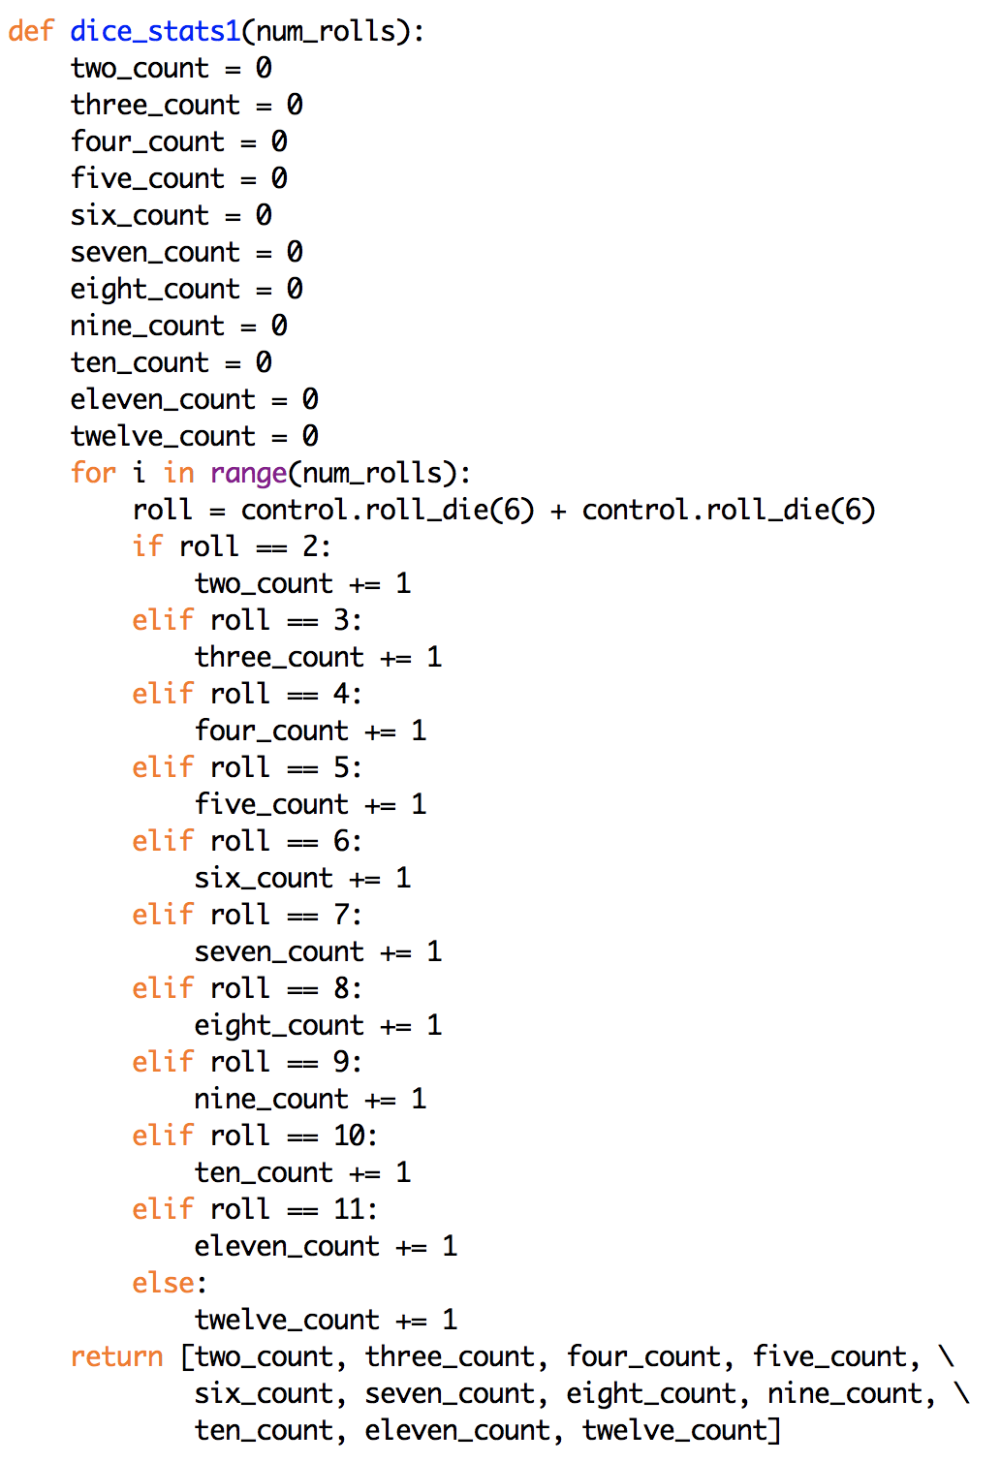
UGLY!
extremely tedious
what if we wanted to extend this example to 8-sided dice?
what would have to change?

Slide 18
Better solution
11 separate variables are unwieldy – no way to test/update uniformly
alternatively, could place all 11 counters in a single list
actually, to simplify things will create a list with 13 numbers
twoCount will be stored in rollCount[2]
threeCount will be stored in rollCount[3]
…
twelveCount will be stored in rollCount[12]

Slide 19
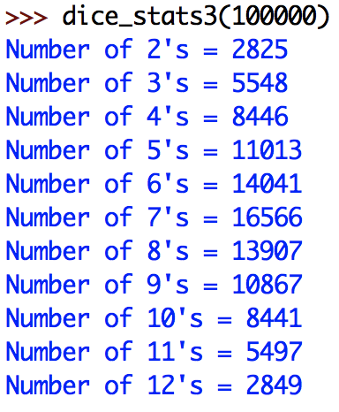
Nicer output
simply returning the list of counts is not ideal
difficult to see which number goes with which dice total

Slide 20
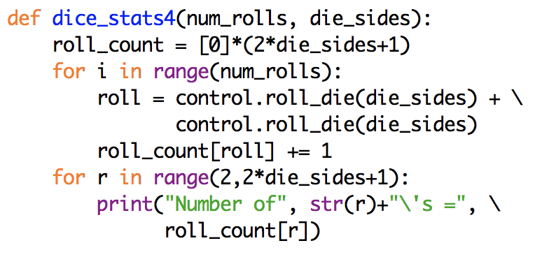
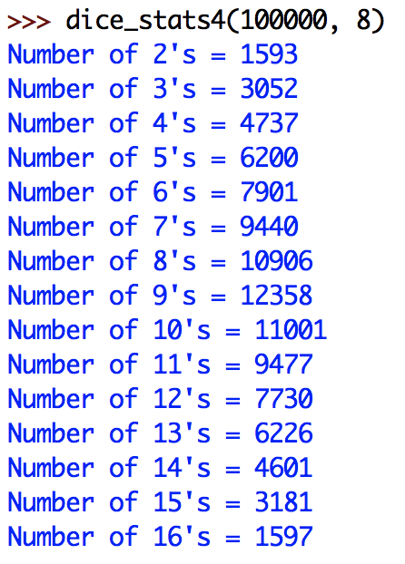
Generalized version
could generalize to work for different dice
specify number of die sides as an additional parameter
need a list with 2*die_sides+1 counters (but ignore first two entries)

Slide 21
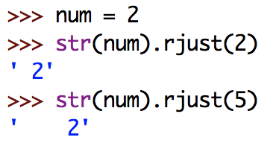
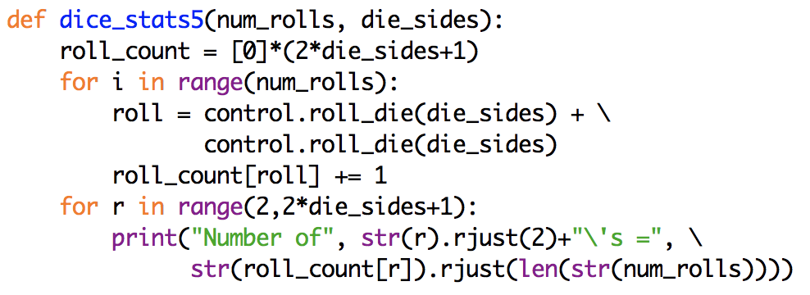
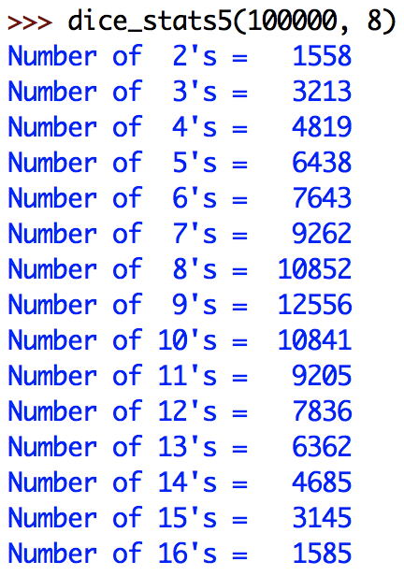
Aligned output
could even use rjust to align the output
recall: rjust pads with spaces on the left

Slide 22
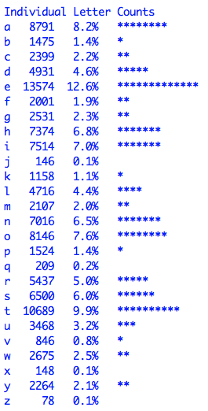
HW5 (part 2)
in addition, you need to generate letter frequency statistics for the file
number of occurrences of each letter (case-insensitive)
percentage for each letter (with respect to total number of letters)
a histogram, with a * for each (rounded) percentage point
you will need to:
maintain a list of 26 counters, one for each letter (similar to dice stats)
align the data into columns (also similar to dice stats)

Slide 23
List methods
similar to string, the list type has useful methods defined for it
index(x) return the index of the first occurrence of x (error if not in the list)
count(x) return the number of times x appears in the list
the following methods actually modify the contents of the list
unlike strings, lists are mutable (changeable) objects
append(x) add x to the end of the list
note: nums.append(3) is the same as nums += [3]
insert(i, x) insert x at a given position i
remove(x) remove the first occurrence of x (error if not in the list)
sort() sort the items of the list, in place
reverse() reverse the elements of the list, in place

