Slide 1
CSC 221: Introduction to Programming Fall 2018
Python data, assignments & functions
data types
numbers, strings, booleans
functions & type conversions
variables & assignments
input & output
modules
turtle graphics, math, random
Python documentation, help

Slide 2
Python number types
Python distinguishes between different types of numbers
int integer values, e.g., 2, -10, 1024, 99999999999999
can be specified in binary, octal or hexidecimal using '0b', '0o', and '0x' prefixes
0b1011 → 1011₂ → 11₁₀ 0o23 → 23₈ → 19₁₀ 0x1A → 1A₁₆ → 26₁₀
float floating point (real) values, e.g., 3.14, -2.0, 1.9999999
scientific notation can be used to make very small/large values clearer
1.234e5 → 1.234 x 10⁵ → 123400 9e-5 → 9 x 10⁻⁵ → 0.00009
complex complex numbers (WE WILL IGNORE)

Slide 3
Numbers & expressions
recall in Scratch:
standard numeric operators are provided
+ addition 2+3 → 5 2+3.5 → 5.5
– subtraction 10–2 → 8 99–99.5 → -0.5
* multiplication 2*10 → 20 2*0.5 → 1.0
/ division 10/2.5 → 4.0 10/3 → 3.333…
** exponent 2**10 → 1024 9**0.5 → 3.0
less common but sometimes useful
% remainder 10%3 → 1 10.5%2 → 0.5
// integer division 10//4 → 2 10//4.0 → 2.0
note: spacing around an operator is optional: 2/3 = 2 / 3

Slide 4
Exercise: calculations
use IDLE to determine
the number of seconds in a day
the number of seconds in a year (assume 365 days in a year)
your age in seconds
the number of inches in a mile
the distance to the sun in inches
the solution to the Wheat & Chessboard problem

Slide 5
Python strings
in addition to numbers, Python provides a type for representing text
a string is a sequence of characters enclosed in quotes
Python strings can be written using either single- or double-quote symbols
(but they must match)
OK:
"Creighton" 'Billy Bluejay' "Bob's your uncle"
not OK:
"Creighton' 'Bob's your uncle'
can nest different quote symbols or use the escape '\' character
"Bob's your uncle" 'Bob\'s your uncle'

Slide 6
Python strings (cont.)
on rare occasions when you want a string to span multiple lines, use three quotes
"""This is
a single string"""
'''So is
this'''
the + operator, when applied to strings, yields concatenation
"Billy " + "Bluejay" → "Billy Bluejay"

Slide 7
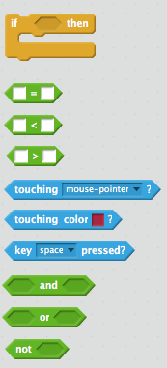
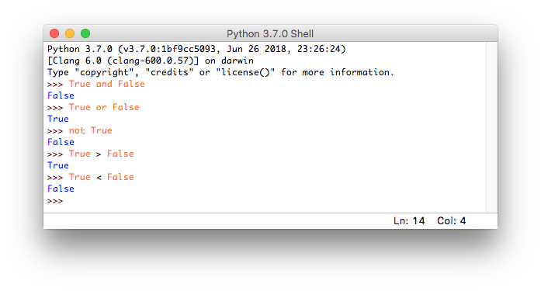
Boolean type
Scratch had implicit true/false values
recall that control blocks such as if, if-else, repeat-until had true/false tests that determined the action
Python has explicit True and False values
these values can be used in expressions, assigned to variables, used to control other statements, …
True and False are Boolean values (named after mathematician George Boole)

Slide 8
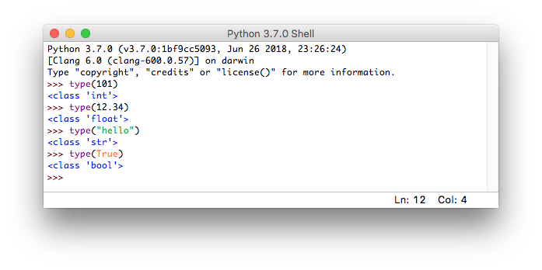
type function
in mathematics, a function is a mapping from some number of inputs to a single output
e.g., square root function $\sqrt{9}$ → 3
e.g., maximum function max(3.8, 4.2) → 4.2
Python provides numerous built-in functions for performing useful tasks
the type function takes one input, a value, and returns its type as output

Slide 9
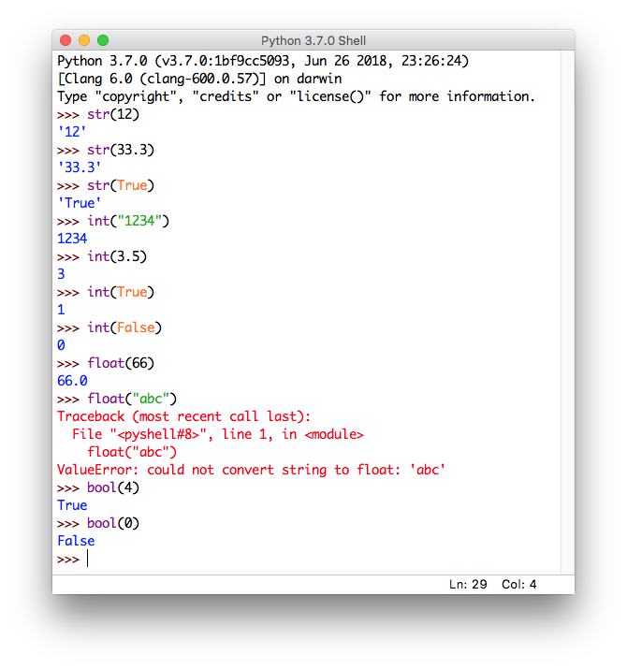
type conversions
there are functions associated with each type for converting values
str(X) → converts X into a string (with quotes around it)
int(X) → converts X into an integer, if possible
float(X)→ converts X into a real number, if possible
bool(X) → converts X into a Boolean value (false if 0 or empty string, else true)

Slide 10
Variables & assignments
recall from Scratch, variables were used to store values that could be accessed & updated
e.g., the lines spoken by the sprites in conversation
e.g., the number of times an event occurred
similarly, in Python can create a variable and assign it a value
the variable name must start with a letter, consist of letters, digits & underscores (note: no spaces allowed)
an assignment statement uses '=' to assign a value to a variable
general form: VARIABLE = VALUE_OR_EXPRESSION
age = 20
seconds_in_day = 24 * 60 * 60
seconds_in_year = 365 * seconds_in_day
name = "Prudence"
greeting = "Dear " + name

Slide 11
Variable names
some reserved words cannot be used for variable names
Python libraries tend to use underscores for multi-word variable names
first_name number_of_sides feet_to_meters
note: capitalization matters, so first_name ≠ first_Name

Slide 12
Exercise: population growth
visit http://www.census.gov/popclock for a current U.S. population estimate
e.g., 328,553,944 at 3:15 pm (CDT) on 9/10/18
according to U.S. Census Bureau:
one birth every 8 seconds
one death every 12 seconds
one naturalized citizen (net) every 28 seconds
we want to predict the population some number of years in the future
e.g., what would be the population 10 years from now? (assume 365 day years)
\ is the line continuation character – can break a statement across lines

Slide 13
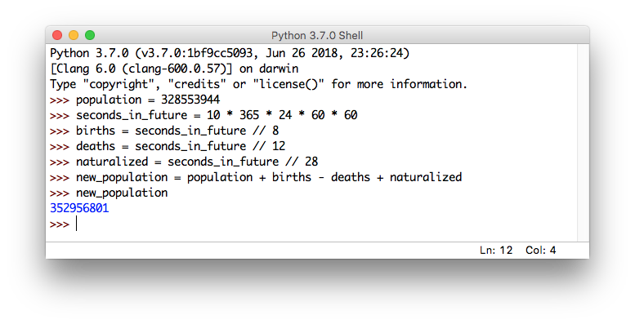
Issues (pt. 1)
not readable
significant duplication
difficult to edit/fix/change
we can address readability & duplication by introducing variables

Slide 14
Issues (pt. 2)
variables make the code more readable and reduce duplication, but entering statements directly into the interpreter has limitations
no way to go back and fix errors
no way to save the code for later use
better to enter the statements in a separate, editable, re-executable file
the IDLE environment has a built-in file editor
under the File menu, select New Window
this will open a simple file editor
enter the statements
save the file (using File→Save) then load the function (using Run→Run Module)
the statements are loaded and run just as if you typed them in directly

Slide 15
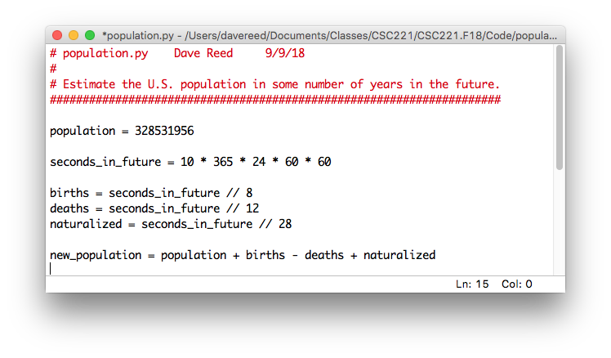
Modules
a module is a file of code that can be repeatedly edited and loaded/run
lines starting with # are comments, ignored by the Python interpreter
should start each file with a comment block documenting the file
note: after running this module, you still need to query the interpreter for the value of new_population

Slide 16
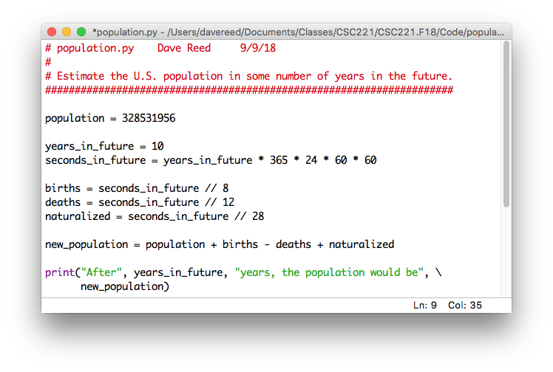
Built-in print function
the print function can automatically display a value or sequence of values (separated by commas)
print(VALUE_1, VALUE_2, …, VALUE_n)
now, a complete message containing the answer is displayed when the module is run

Slide 17
User input
as is, changing the years_in_future assignment and performing a different calculation is easy
but it would be even better to just ask for the number
the built-in input function displays a prompt and reads in the user's input
response = input("PROMPT MESSAGE")
the input function always returns what the user typed as a string
if you want to treat the input as a number, you must explicitly convert them
int_response = int(input("PROMPT MESSAGE"))
float_response = float(input("PROMPT MESSAGE"))

Slide 18
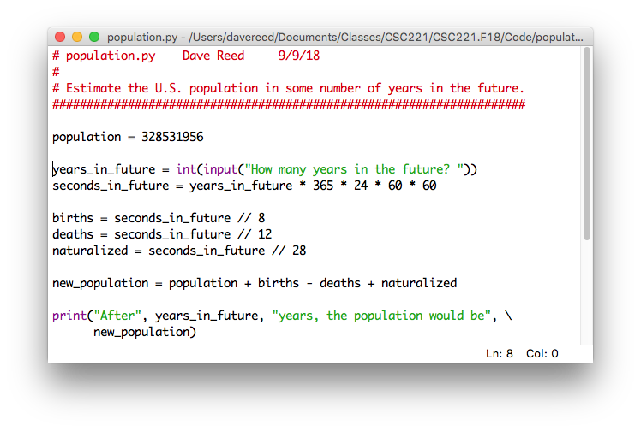
Final version
now, can enter a different number of years each time the module is run

Slide 19
Exercise: reading level
in the 1970's, the U.S. military developed a formula for measuring the readability of text (*for young adults)
the FORCAST formula assigns a reading age to text based on the following:
$$\text{reading} \text{age}\text{ = 20 }–\text{ 15 }× \frac{\text{\# }\text{single} \text{syllable} \text{words}}{\text{total}\text{ \# }\text{of} \text{words}}$$
create a Python module that
prompts the user for the # of single syllable words and total # of words in a text
calculates the reading age for that text
prints that reading age (in a readable format)

Slide 20
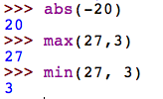
Built-in functions
Python provides many built-in functions
mathematically, a function is a mapping from some number of inputs to an output
e.g., the abs function maps a single number to its absolute value
e.g., the max/min functions map two or more numbers to the maximum/minimum number
note that these functions do not just print the output, they return it
that is, a function call can appear in an expression, its value is the output value

Slide 21
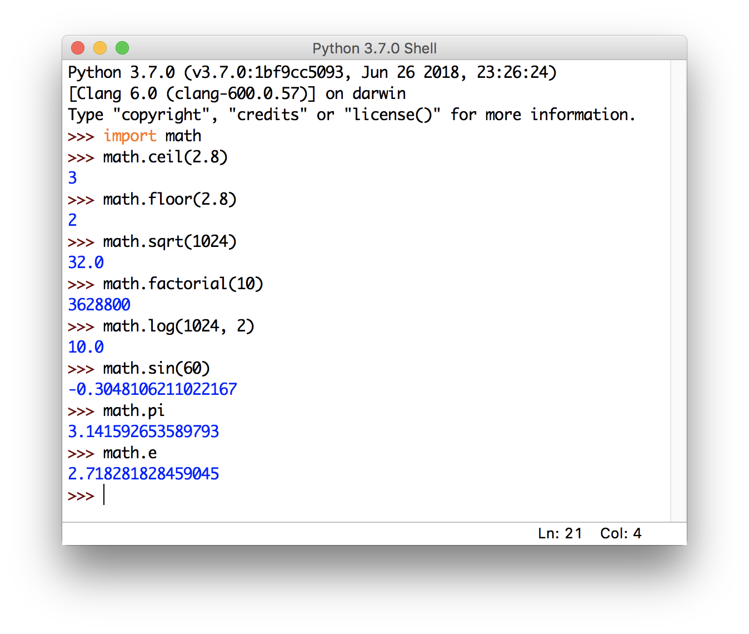
Modules & functions
in addition to these basic, built-in functions, the math module contains other useful functions
you load a module using import
can then call functions from the math module as math.FUNC(…)
also have constants for π and e

Slide 22
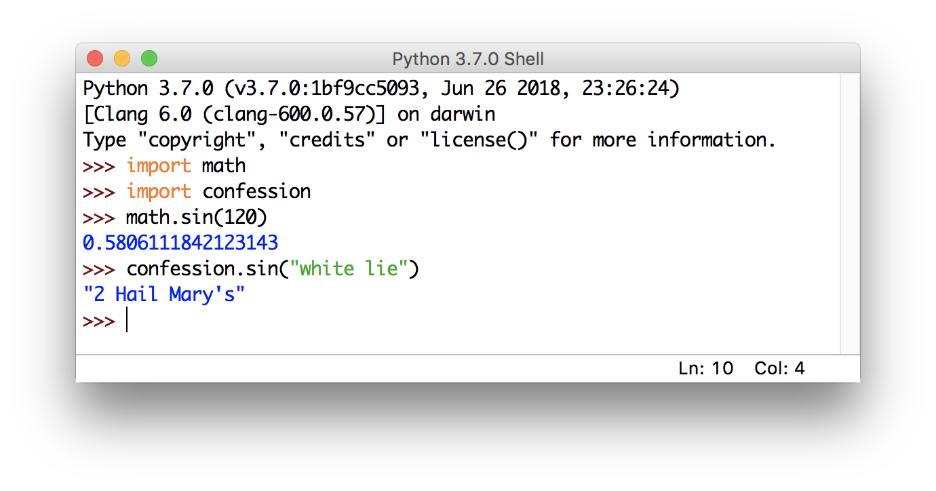
Why the prefix?
the round function does not have a prefix: round(3.2)
but the ceiling function does: math.ceil(3.2)
when a module is loaded using import, the module prefix must be used to clearly identify functions (since different modules might have functions with the same name)
no ambiguity for built-in functions or modules run directly in IDLE, so no prefix required

Slide 23
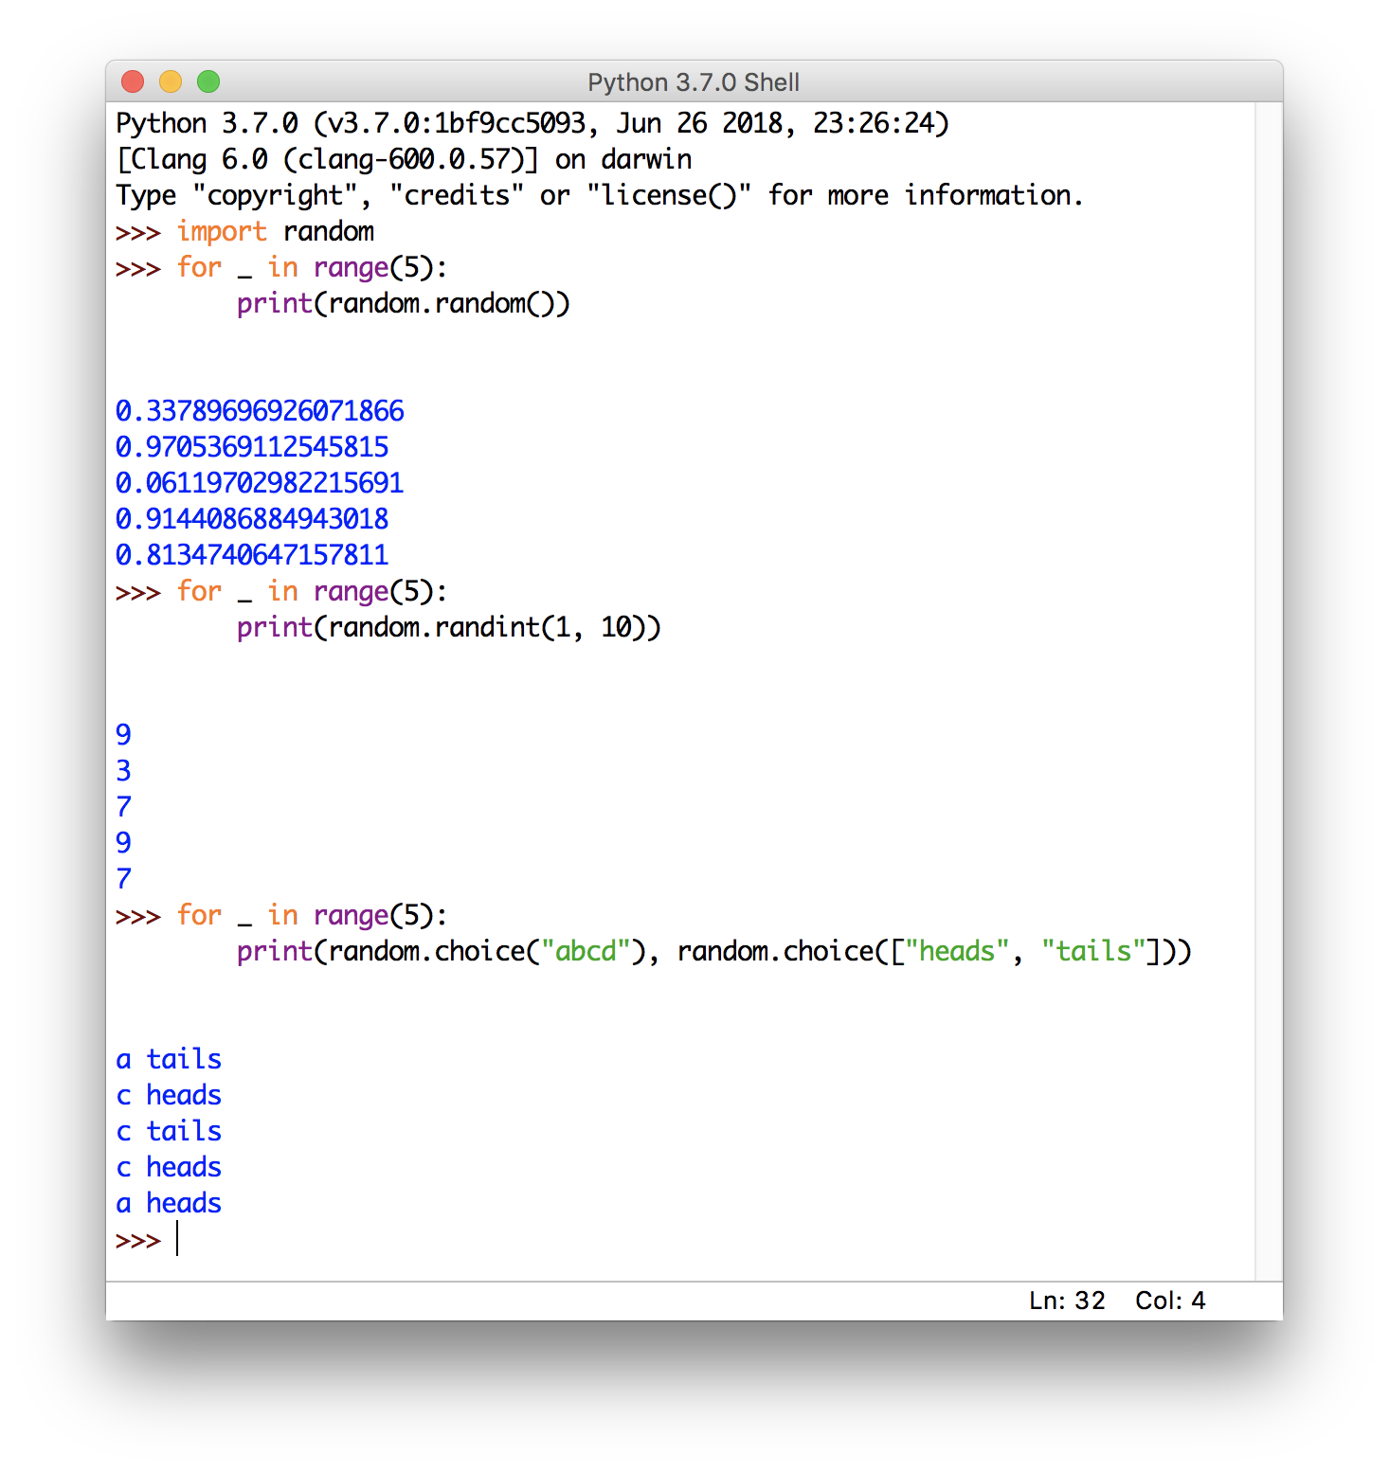
random module
the random module contains functions for generating random values
random() returns a float from range [0, 1)
randint(X, Y) returns an int from range [X, Y]
choice() returns a random character/item from a string/list

Slide 24
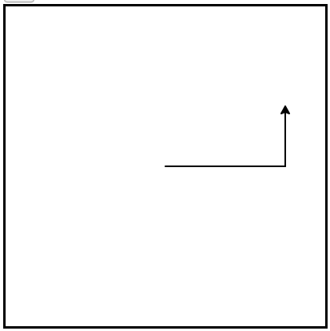
Turtle graphics module
IDLE comes with a built-in module for turtle graphics
must import the turtle module to make the code accessible
can then call functions from the module via the notation turtle.FUNCTION()
play with the executable code in the interactive book

Slide 25
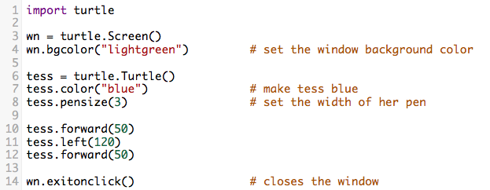
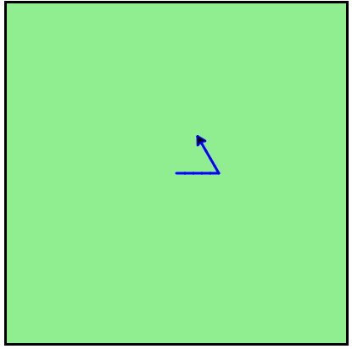
Turtle commands
in addition to movement commands (left, right, forward, backward), there are commands for setting color and pen width
complete the exercise (ch3_2) – prompt the user for colors, pen size

Slide 26
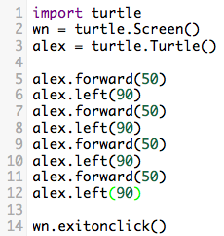
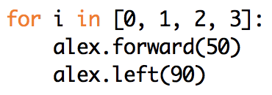
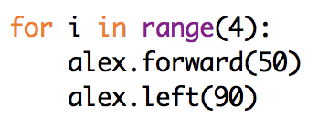
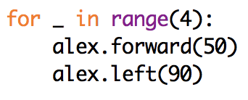
For loops
suppose we want to draw a square – need to draw a side & turn (4 times)
a for loop specifies a repetitive task
for VARIABLE in LIST:
STATEMENTS
the range function makes this even cleaner
for VARIABLE in range(SIZE):
STATEMENTS
try the Turtle race lab
(bottom of 4.8)
if you don't ever need the loop variable, use _

Slide 27
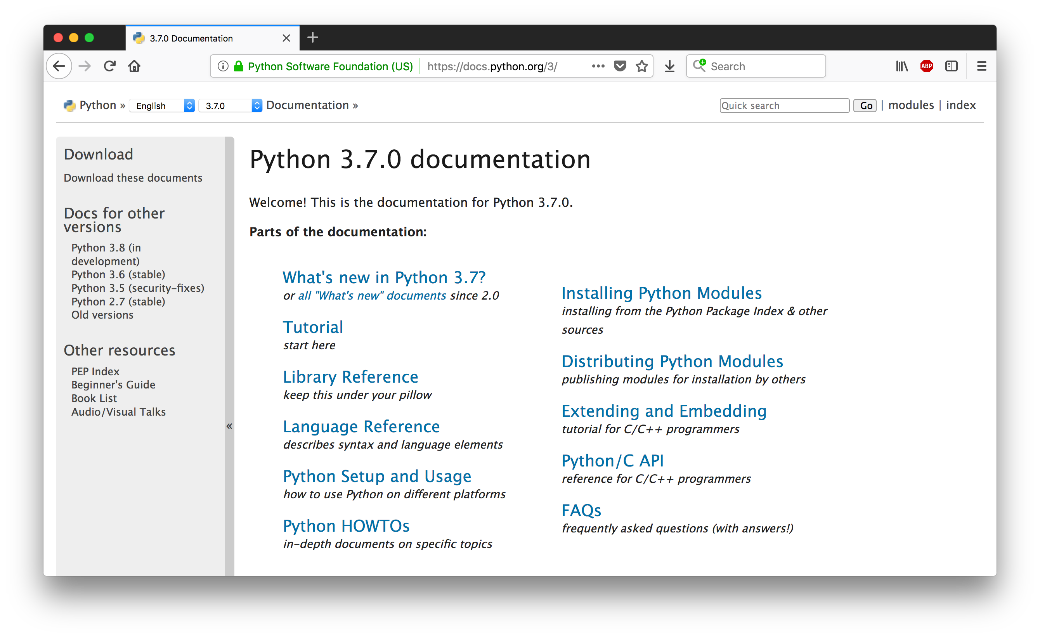
Python documentation
you can get the latest Python details in IDLE by selecting Help>Python Docs
Language Reference gives an overview of the language
Library Reference documents the common library modules (e.g., math, random, turtle)
Global Module Index allows you to search for modules by name

Slide 28
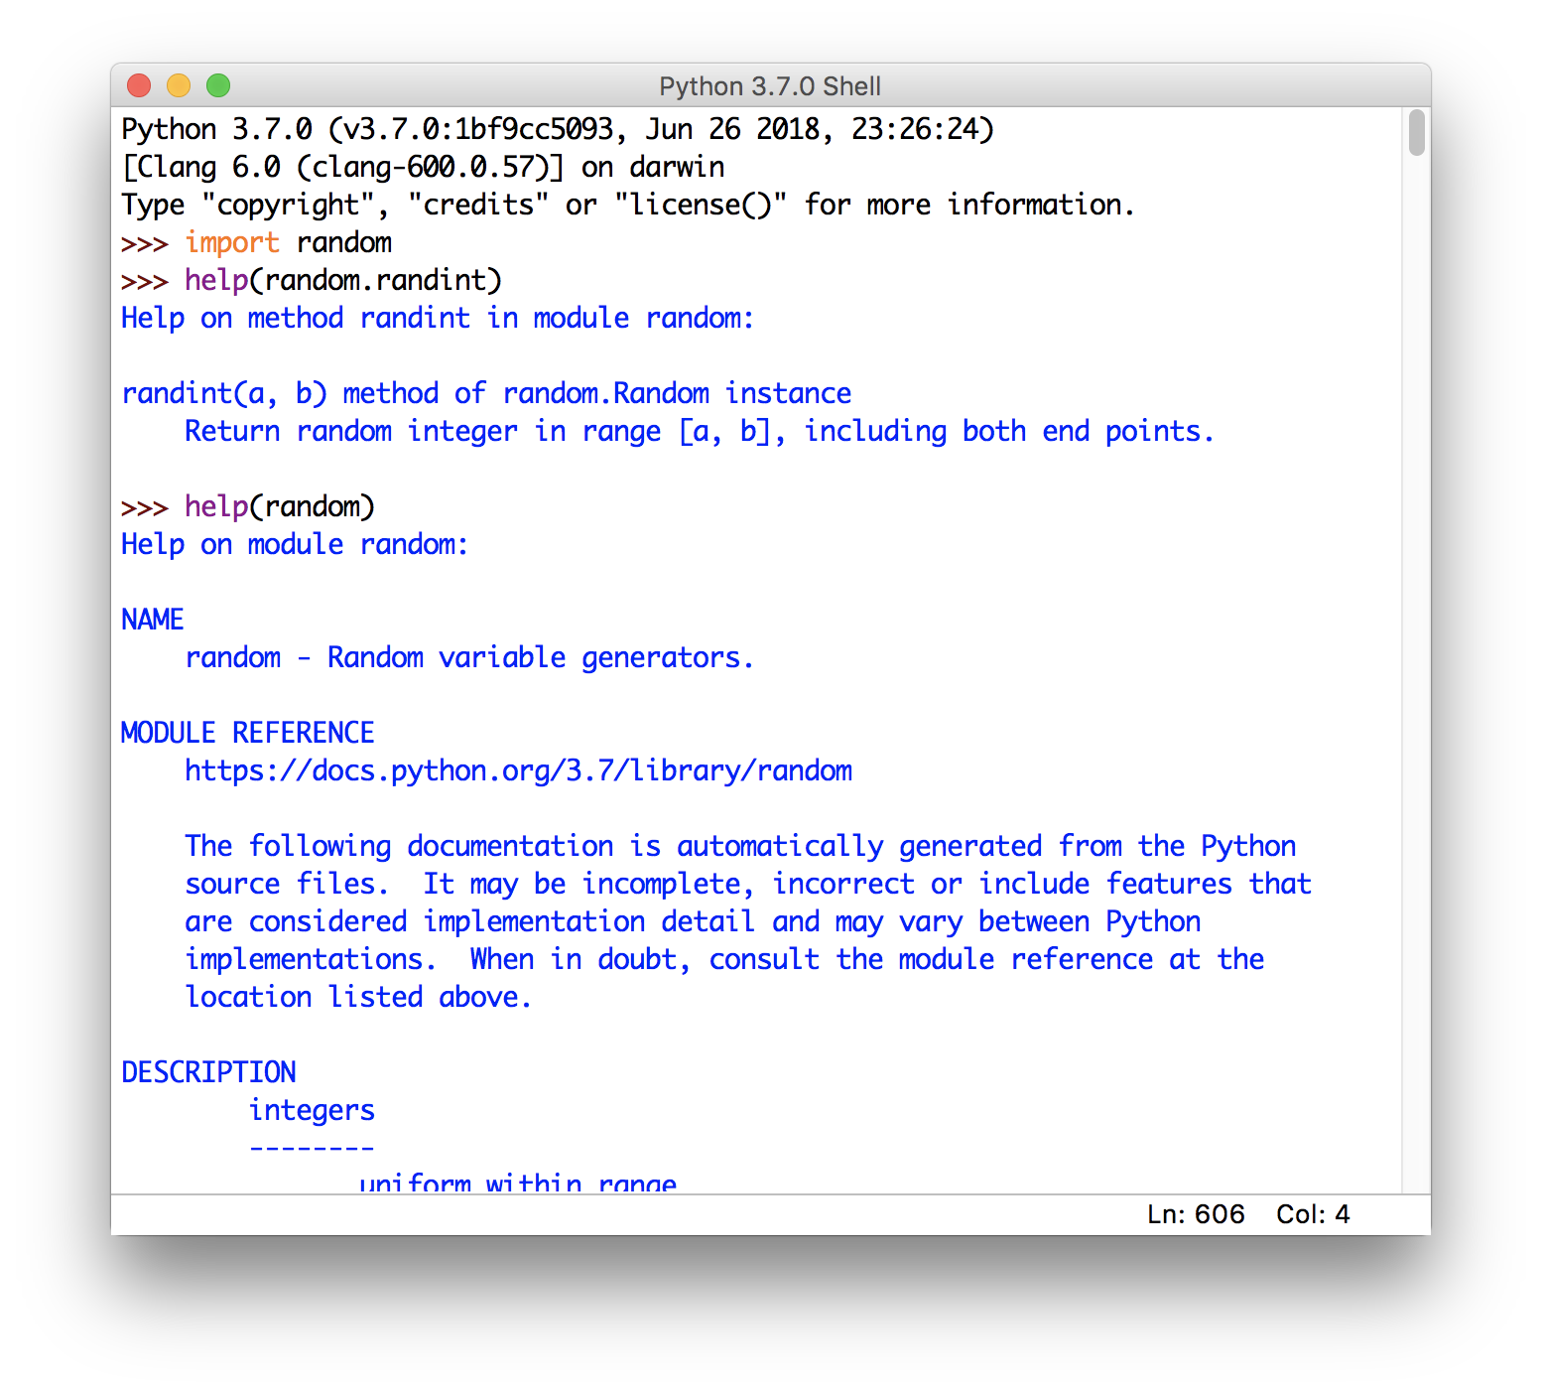
Python help
modules are also self-documenting
call the help function to see info on a function
can also call help on the entire module

