Slide 1
CSC 221: Introduction to Programming Fall 2018
Big data
storing large data sets
reading a list of lines
example: Trump tweets, word frequencies
reading a list of words
example: dictionary, anagram finder
structured data
reading and organizing a list of lists
example: Trump tweets with metadata
list comprehensions

Slide 2
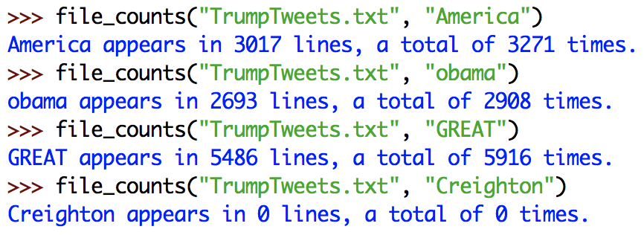
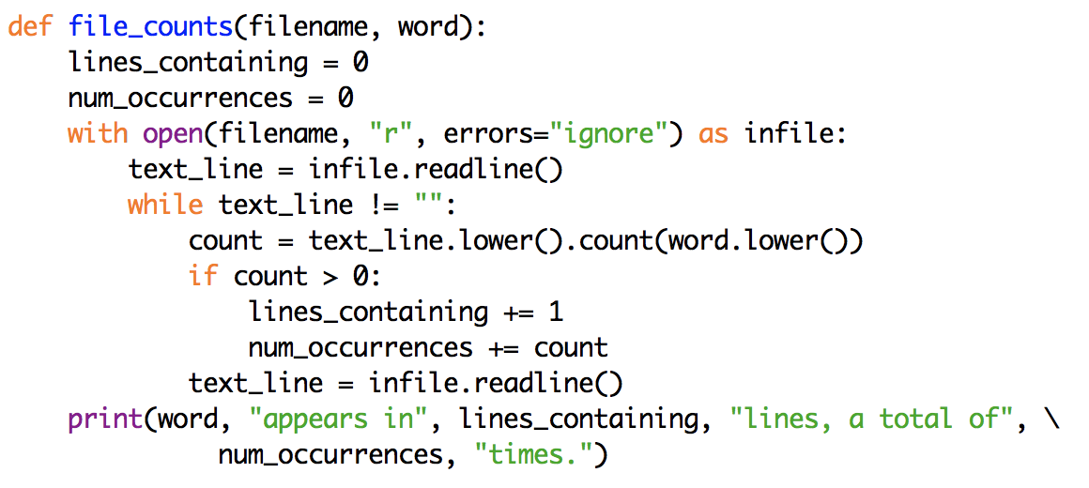
Last week…
recall the task we completed as a class
create a list of common Trump tweet words and find the most common
we started with file_stats and modified it to our needs
more directly:

Slide 3
Handling repetition
it becomes tedious to have to make a separate call for each possible word
we could have a 2nd function with a list of words as parameter, and which calls file_counts on each of those words

Slide 4
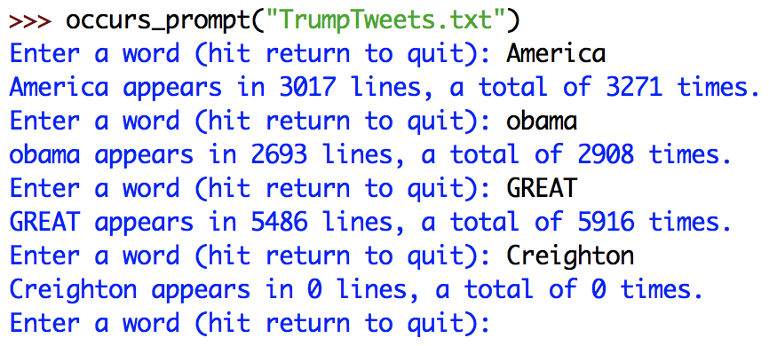
Handling repetition (alt.)
another approach to repetition is to have the user specify values directly
prompt the user for each word, quitting when an empty string is entered

Slide 5
Efficiency alert
note that each call to file_counts rereads the file
e.g., reads the file and counts "America", then rereads the file and counts "obama", then rereads the file and counts "GREAT", …
opening and reading from a file is a relatively slow operation
when possible, it is preferable to
read in the data from the file
store it in an easily searchable format
perform repeated searches on that stored data
e.g., for file counts, we would need to store a list of lines (one tweet per line)
recall: TrumpTweets.txt had 35,553 lines with a total of 4,120,538 characters
CAN WE STORE THAT MUCH DATA IN A PYTHON LIST?

Slide 6
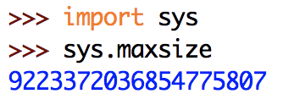
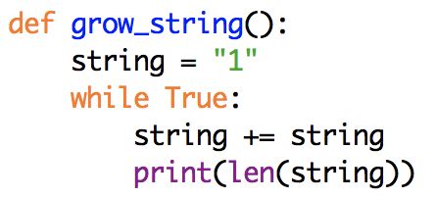
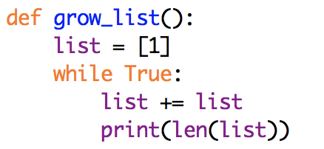
Side questions
is there a limit to how long a Python string can be?
is there a limit to how long a Python list can be?
BORING ANSWER: Google it!
MORE PRACTICAL ANSWER: see what sizes produce reasonable performance in Python

Slide 7
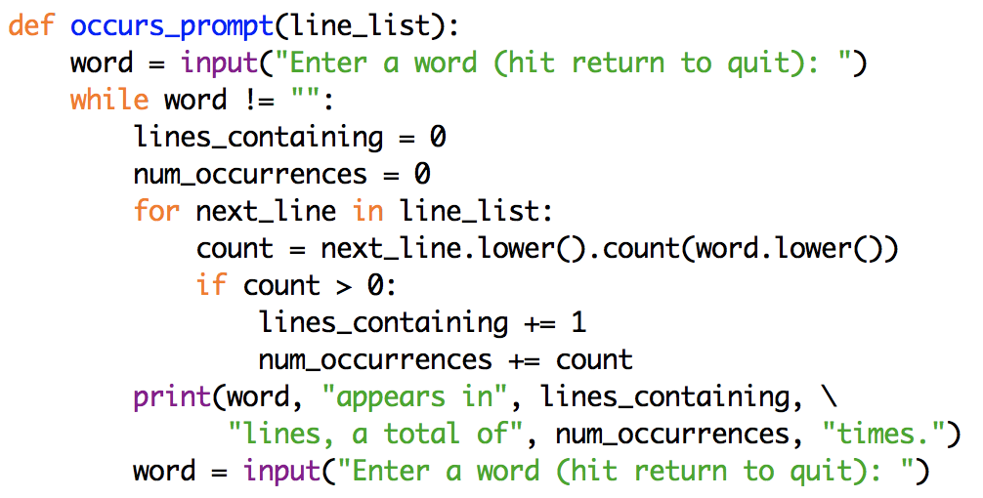
Sky's the limit
so, Python can easily handle storing the entire file of Trump tweets
we can write a function to read in the file and store it as a list of lines
can then revise occurs_prompt to use it (similarly with occurs_list)

Slide 8
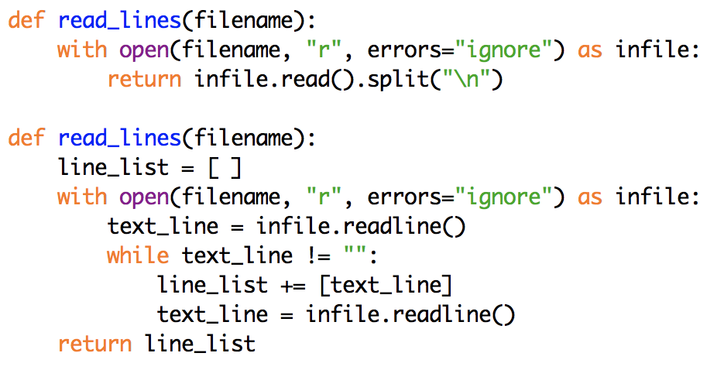
read() vs. readline()
note that this version of read_lines first reads in the entire file contents as a string, then splits that string into a list
it stores the file contents twice! WASTEFUL!
we could avoid this by reading each line separately and building up a list of lines
in reality, memory is cheap so either version is fine

Slide 9
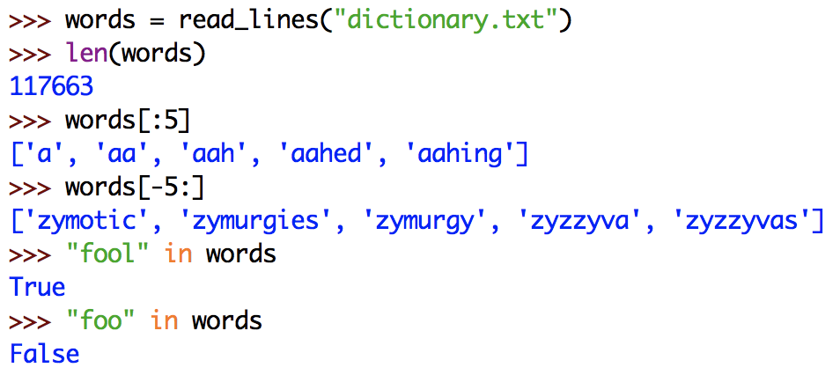
Another example
suppose we want to be able to process a large dictionary of words
dictionary.txt contains 117,663 words
the files has one word per line, so read_lines would work to read in and store the words

Slide 10
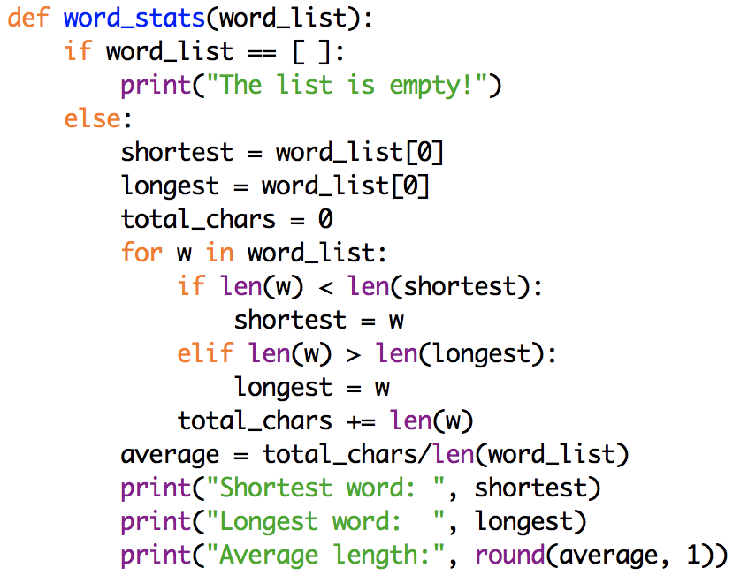
Reading words
in general, if we want to read the contents of a file and obtain a list of the words (regardless of lines), just need to change the split delimiter

Slide 11
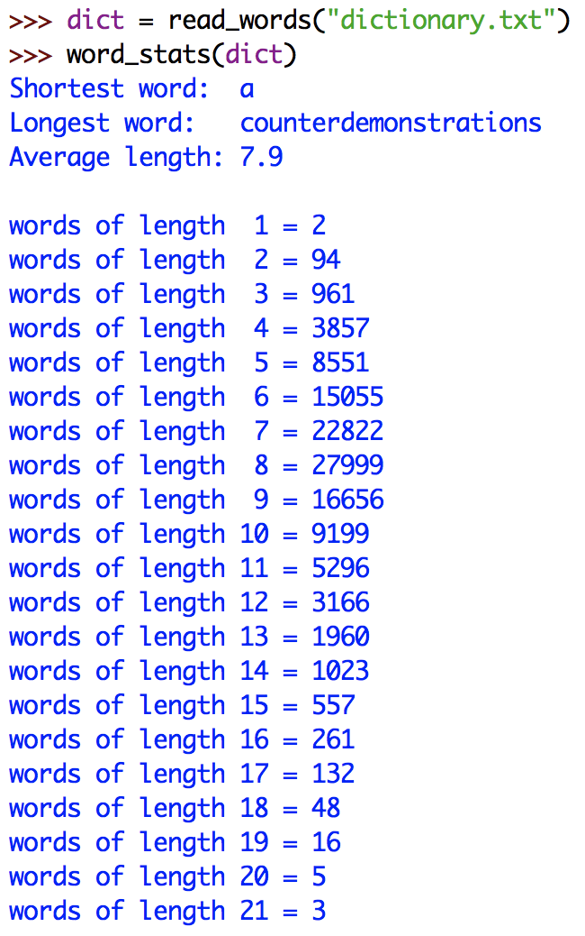
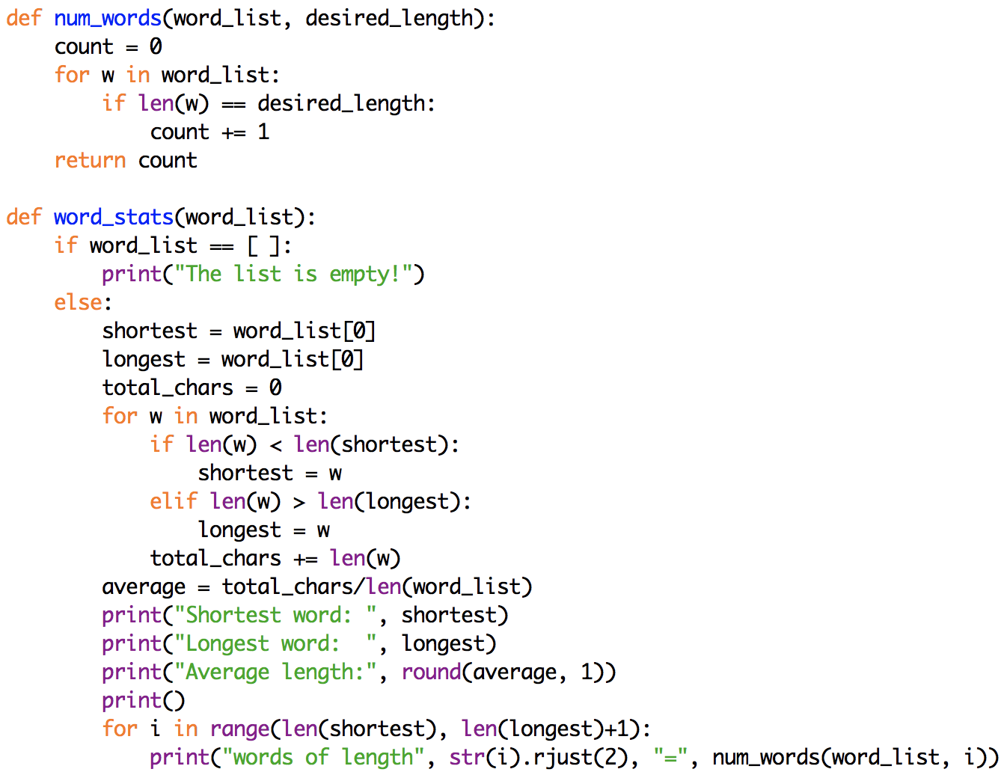
Adding word length counts

Slide 12
Many passes vs. one pass
note that word_stats calls the num words function over and over
simple, since each call counts a different word length
wasteful, since each call traverses the entire list of words
if we really cared about efficiency, we could define a single function that counted all the word lengths in a single traversal of the list
both are fast, so either version is fine

Slide 13
Example: finding anagrams
suppose we want to be able to find all anagrams of a word
recall: anagrams are words made up of exactly the same letters
cool loco
race care acre
pale peal leap plea
banana
how can we determine if two words are anagrams?
could count the number of a's, b's, … in each word
if all counts are the same, then the words are anagrams
better yet, generate the alphagram (sorted letters) of each word:
"spear" → "aeprs" "pares" → "aeprs
if the alphagrams are identical, the words are anagrams

Slide 14
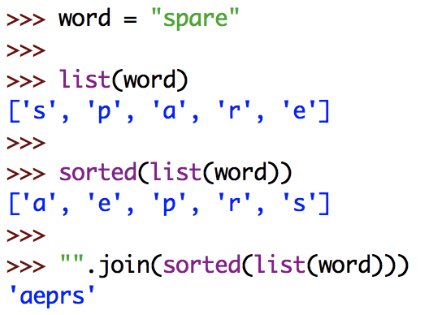
Alphagrams
can use string & list functions to produce an alphagram

Slide 15
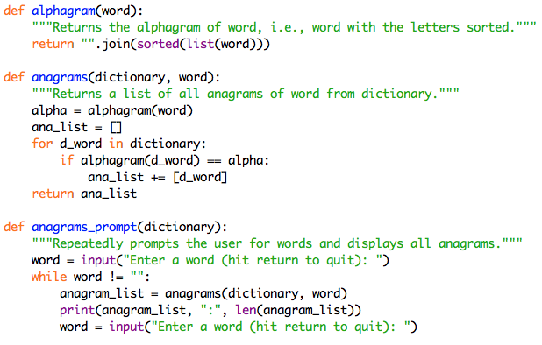
Anagram finder

Slide 16
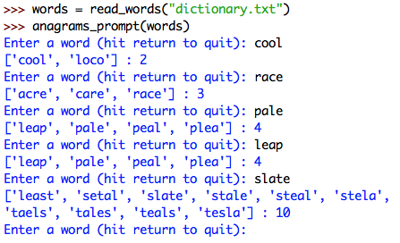
Anagrams
download and experiment with anagrams_prompt
what is the largest set of anagrams you can find?

Slide 17
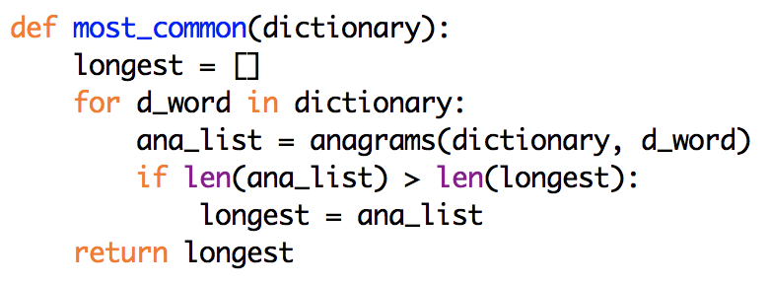
Finding the largest
we can write a function to find the largest anagram set
ANY POTENTIAL PROBLEMS?
in theory this will work; in practice, it takes WAY too long!
the for loop traverses the entire dictionary → 117,663 times
each time, the call to anagrams also traverses the dictionary (117,663 words)
so, must access/sort/compare 117,663 x 117,663 = 13,844,581,569 words!
solution requires a new data structure that we are not covering (a dictionary)
['apers', 'apres', 'asper', 'pares', 'parse', 'pears', 'prase', 'presa', 'rapes', 'reaps', 'spare', 'spear']

Slide 18
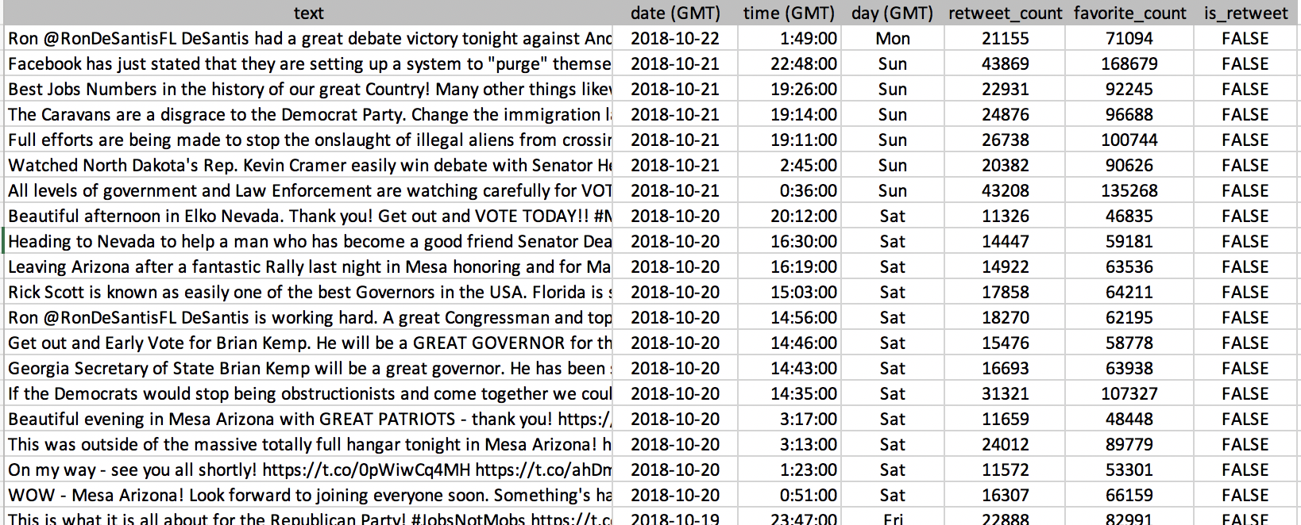
Tweets with metadata
consider the file TrumpTweetsMeta.csv
column 0: text of the tweet (as in TrumpTweets.txt)
column 1: date of the tweet in YYYY-MM-DD format
column 2: time of the tweet in HH:MM:SS format
column 3: day of the tweet
column 4: # of times it was retweeted
column 5: # of times it was favorited
column 6: whether this tweet is a retweet

Slide 19
New questions
with the addition of metadata, we can ask more interesting questions
what percentage of his tweets were retweets (vs. original content)?
what tweet was favorited the most?
does Trump tweet more in the a.m. or p.m.?
on what day does he tweet the most?
other questions?

Slide 20
Structured data
we could just store the tweet data as before, as a list of strings
1 string per tweet, consisting of comma-separated values
simple, but accessing any piece of data requires splitting the string
["Ron @RonsDeS…,2018-10-22,1:49:00,Mon,21155,71094,FALSE",
"Facebook has…,2018-10-21,22:48:00,Sun,43869,168679,FALSE",
"Best Jobs Nu…,2018-10-21,19:26:00,Sun,22931,92245,FALSE",
…]
better to store as structured data
a list where each entry is itself a list, containing each of the column data values
[["Ron @RonsDeS…","2018-10-22","1:49:00","Mon",21155,71094,"FALSE"],
["Facebook has…","2018-10-21","22:48:00","Sun",43869,168679,"FALSE"],
["Best Jobs Nu…","2018-10-21","19:26:00","Sun",22931,92245,"FALSE"],
…]

Slide 21
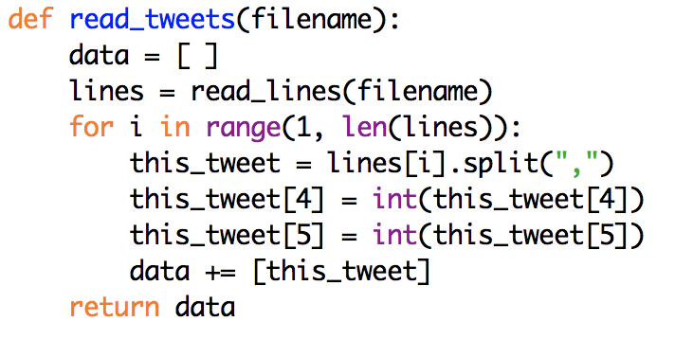
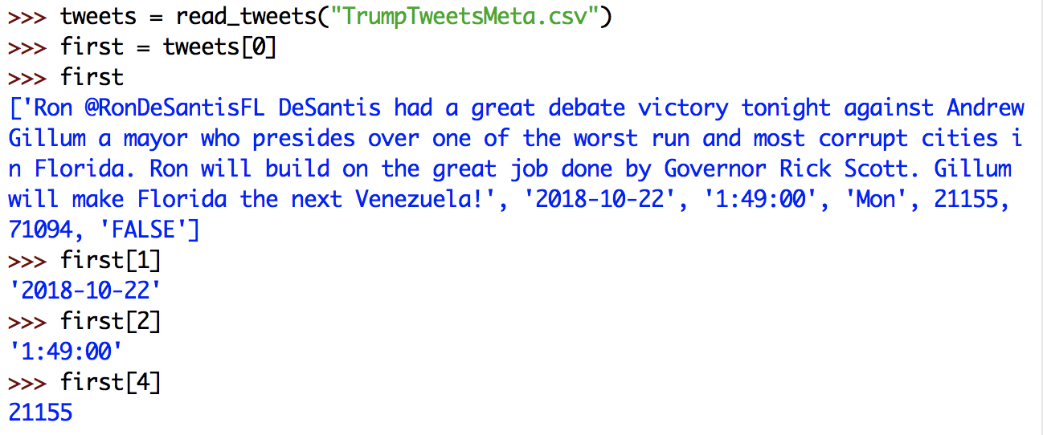
Reading structured data
in order to create structured data, must split and convert when reading
requires up-front work, but then the data is in an accessible format

Slide 22
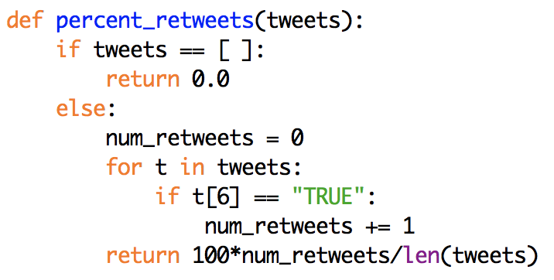
Percent of retweets
to determine the percentage of retweets
traverse the list of tweets
for each tweet (a list), access column 6 to see if it is "TRUE"
if so, add to a count
calculate the percentage using the count and total number of tweets

Slide 23
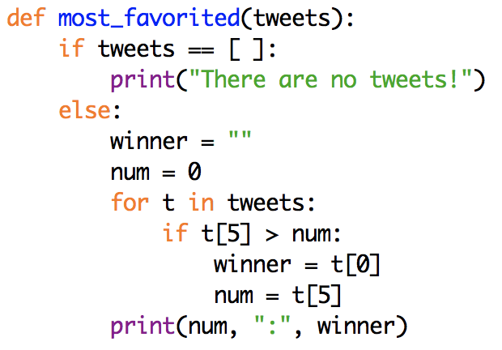
Most favorited
to determine the tweet that was favorited the most:
traverse the list of tweets
for each tweet (a list), access column 5
if larger than most favorited so far, then update to be new most favorited
print the most favorited tweet, along with its number

Slide 24
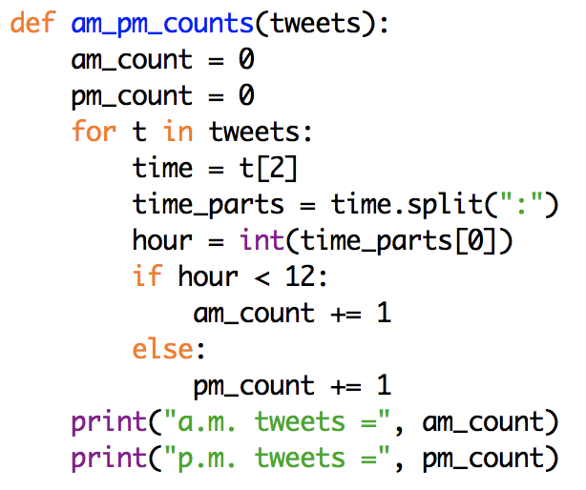
a.m. vs. p.m.
to determine which is more frequent, a.m. or p.m.:
traverse the list of tweets
for each tweet (a list), access column 2 (e.g., 8:40:00)
split using ":" and access the first component (e.g., 8)
if the hour is < 12, add to an a.m. counter, else add to a p.m. counter
print the a.m. and p.m. counts
BUT WAIT - times are in GMT
GMT is 5 hours later than Eastern, so results are off

Slide 25
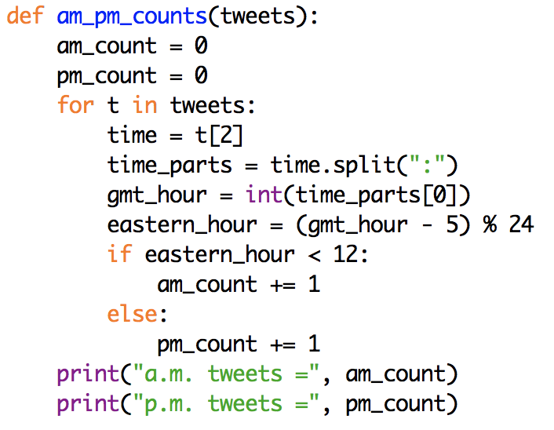
a.m. vs. p.m. (revised)
to determine which is more frequent in the Eastern time zone,
traverse the list of tweets
for each tweet (a list), access column 2 (e.g., 8:40:00)
split using ":" and access the first component (e.g., 8)
convert to Eastern time (e.g., 8 → 3)
if the Eastern hour is < 12, add to an a.m. counter, else add to a p.m. counter
print the a.m. and p.m. counts

Slide 26
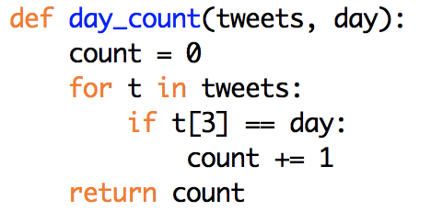
Day of the week
to determine the number of tweets on a given weekday
traverse the list of tweets
for each tweet (a list), access column 3
if it is the desired day, add to a counter
return the counter

Slide 27
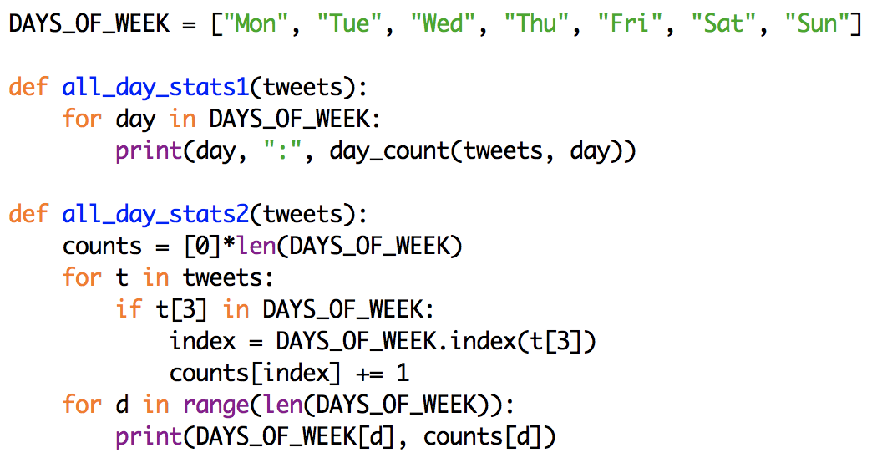
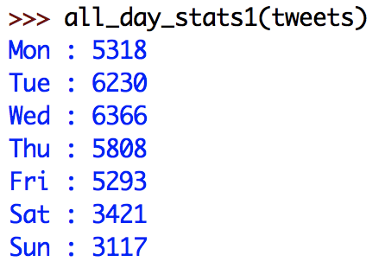
All days
to compare the counts from all the weekdays,
could just call day_count seven times, once for each day
(requires traversing the list seven times, but it is fast)
could traverse once and keep seven counters, one or each day
(similar to dice stats & word lengths examples, more work to code but faster)

Slide 28
HW6
for HW6, you will answer two other questions
In what hour of the day has Trump tweeted the most?
In 2016, did he tweet more before or after election day?
for the first question, you will write a function named all_hour_stats that displays the tweet counts for each hour of the day (0-23)
note: this task is very similar to all_day_stats
consider a similar approach
as with am/pm, be sure to adjust to Eastern time zone
rest of output redacted

Slide 29
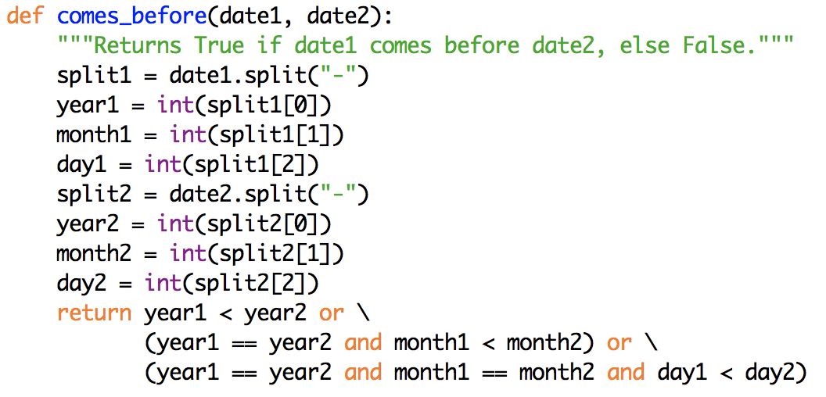
HW6
for the second question, you will write a function named year_splits that takes an additional date as input
displays the number of tweets in that year from before that date
displays the number of tweets in that year on or after that date
note: this task is very similar to am_pm_counts
consider a similar approach
in completing this task, you will need to be able to compare two dates
this brute-force function does that

Slide 30
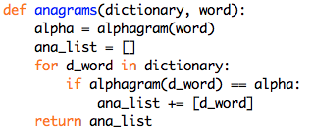
List building revisited
we have seen numerous examples of building lists

Slide 31
List comprehensions
Python has an alternative mechanism for building lists: comprehensions
inspired by math notation for defining sets
squares(N) = $\left\{\begin{matrix}i^{2} & \text{for} 1 ≤i ≤\text{N}\end{matrix}\right.$
in Python: [EXPR_ON_VAR for VAR in SEQUENCE]

Slide 32
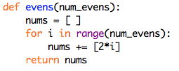
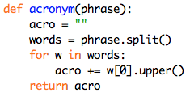
More comprehensions…

Slide 33
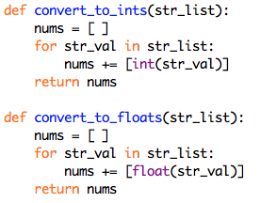
Even more…
as we saw in previous examples, it is useful to be able to convert a list of strings into a list of numbers
["12","3","60"] → [12,3,60]

Slide 34
Exercises:
use list comprehensions to build the following lists of numbers:
a list of the first 20 cubes
a list of the first 20 powers of 2
given a list of words, use list comprehensions to build:
a list containing all of the same words, but each word reversed
a list containing the lengths of all of the same words

Slide 35
Reimplementing dice_stats

Slide 36
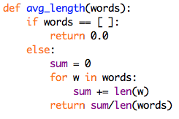
Throwaway comprehensions
comprehensions can be useful as part of bigger tasks

Slide 37
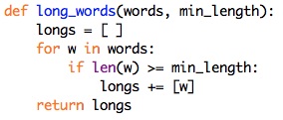
Conditional comprehensions
comprehensions can include conditions
each expression is included in the list only if the condition holds
in general: [EXPR_ON_VAR for VAR in SEQUENCE if CONDITION]

Slide 38
Reimplementing anagrams
list comprehensions are extremely handy
you should be comfortable reading/tracing comprehensions
it is fine to keep using loops to build lists
as you get more comfortable, consider writing comprehensions

