Slide 1
CSC 221: Introduction to Programming Fall 2018
Object-oriented programming
object-oriented approach
classes & objects
user-defined classes
examples: Die, Coin, Card, Deck_of_cards
useful methods: __str__, __eq__, __lt__, __le__
Card examples:
flush statistics, game of war
variables & scope
parameter passing

Slide 2
Object-oriented programming
the dominant approach to (large-scale) software development today is object-oriented programming (OOP)
in order to solve a problem, you identify the objects involved in the real-world solution and model them in software
e.g., if designing a banking system, model clients, accounts, deposits, …
a program is a collection of interacting objects
in software, objects are created from classes
the class describes the kind of object (its properties and behaviors)
the objects represent individual instantiations of the class
classes & objects in Scratch:
class: cat, baseball, die, … (collections of sprite templates)
object: sprite1, rollButton, … (can create or stamp out instances)
properties/fields: size, coords, costume, … (can view on stage and above scripts)
behaviors/methods: turn, move, think, … (can execute by clicking script or flag)

Slide 3
Class & object examples
REAL WORLD CLASS: automobiles
REAL WORLD OBJECTS: my 2011 Subaru Outback, the batmobile, …
the class encompasses all automobiles
they all have common properties: wheels, engine, brakes, …
they all have common behaviors: can sit in them, start them, accelerate, steer, …
each car object has its own specific characteristics and ways of producing behaviors
my car is white & seats 5; the batmobile is black & seats 2
accelerating with V-4 is different than accelerating with jet engine
class or object?
student
Creighton University
Morrison Stadium
shoe

Slide 4
OO in Python
Python fully supports the object-oriented approach
useful classes are built-in (e.g., string, list); new classes can be defined
str class:
properties/fields: the sequence of characters
behaviors/methods: upper, lower, toupper, tolower, capitalize, strip, split, …
>>> str1 = "foo" ➔ shorthand for str1 = str("foo")
>>> str1.upper()
'FOO'
list class:
properties/fields: the sequence of items
behaviors/methods: sort, reverse, index, count,…
>>> list1 = [2, 6, 4] ➔ shorthand for list1 = list([2, 6, 4])
>>> list1.sort()
>>> list1
[2, 4, 6]
Turtle class

Slide 5
Python class definition
each method has an implicit parameter self, which refers to the object that the method is being applied to
__init__ is a special method for initializing an object; it is automatically called when an object is created:
obj = CLASSNAME()
the fields (i.e., properties) of the object are variables with the prefix self., which implies that they belong to this object
fields can be accessed by all the methods; they exist as long as the object does
general form:
class CLASSNAME:
def __init__(self):
self.FIELD1 = INITIAL_VALUE
…
self.FIELDn = INITIAL_VALUE
def METHOD1(self):
STATEMENTS
…
def METHODn(self):
STATEMENTS

Slide 6
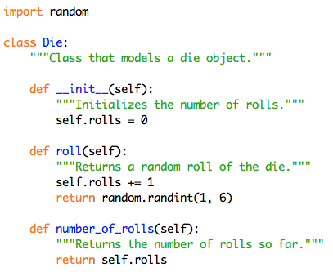
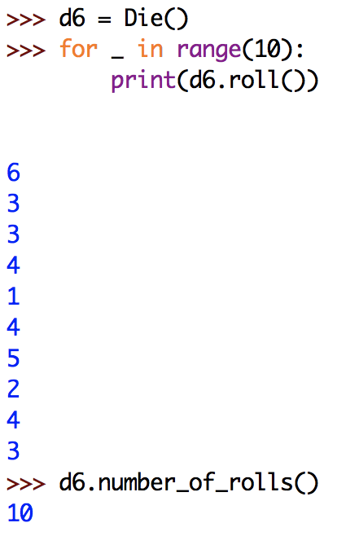
Example: modeling a 6-sided die
properties/fields: rolls
behaviors/methods: roll, number_of_rolls
by convention: class names are capitalized; field & method names are lowercase

Slide 7
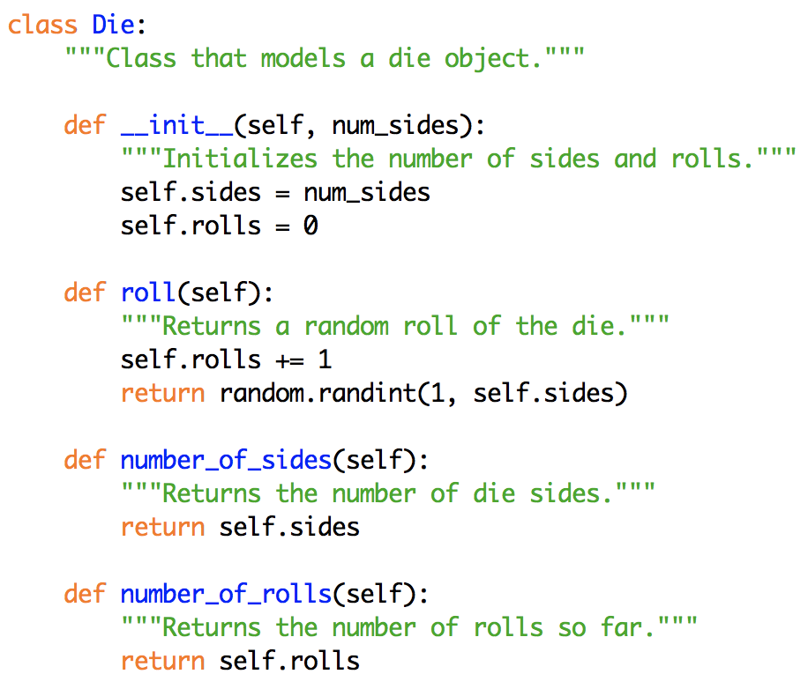
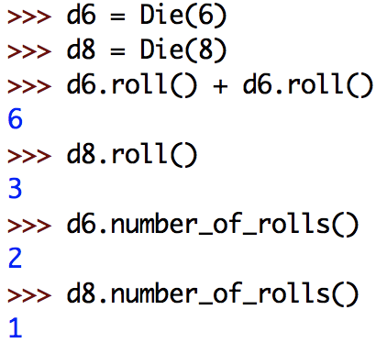
Example: N-sided die
can easily generalize the class to allow for different sided dice
properties/fields: number of sides, number of rolls
behaviors/methods: rolls, numberOfSides, numberOfRolls
if a method has explicit parameters, place after self
note: each Die object has its own copy of the fields

Slide 8
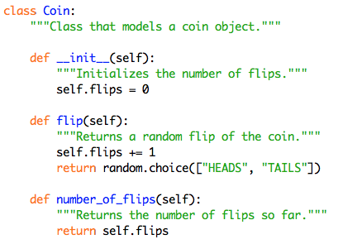
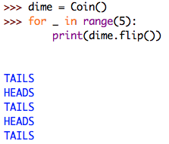
Exercise: Coin class
define a class named Coin
field: flips
methods: flip (returns "HEADS" or "TAILS"), number_of_flips

Slide 9
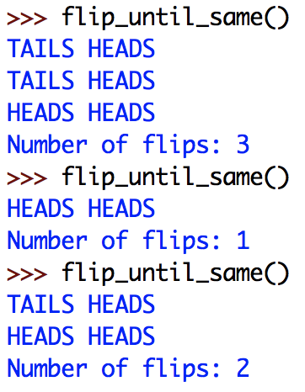
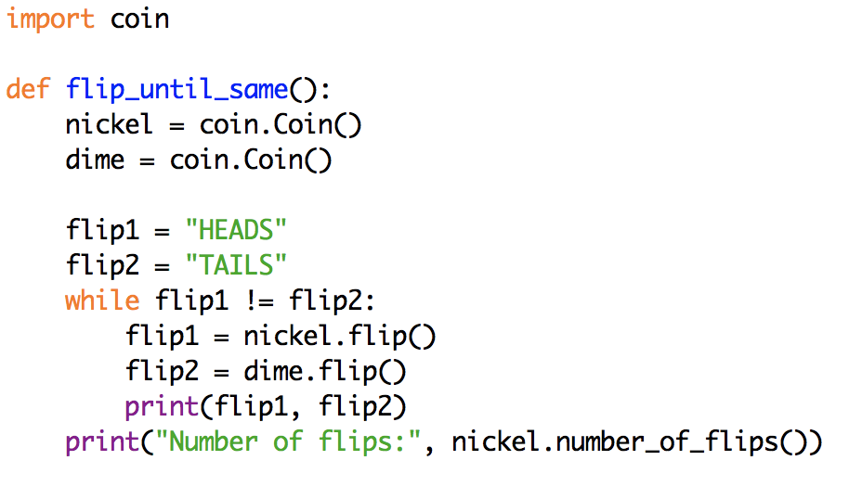
Exercise: Coin simulations
write a function that repeatedly flips two coins until identical flips are made
should print the flips, and return the number of flips

Slide 10
Card game simulations
suppose we wanted to simulate card games
e.g., Game of War, solitaire, poker, …
we need to model individual cards, decks of cards, …
we could do so with built-in structures
e.g., could represent a card as a string: "2C" "9H" "QS" "AD"
e.g., could represent a deck as a list of such strings: ["AS", "KS", "QS", …, "2C"]
would need to remember the details (rank before suit, top of deck is end, …)
common tasks would result in duplicated code (e.g., dealing from the deck)
better solution: define classes that capture their data + behaviors
Card class
fields: rank, suit
methods: get_rank, get_suit, …
Deck_of_cards class
fields: list of cards
methods: shuffle, deal_card, add_card, num_cards, …

Slide 11
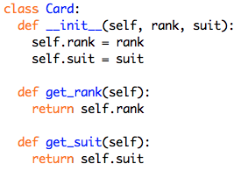
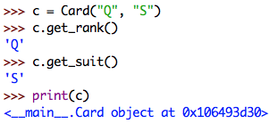
Card class
a Card object will have two fields: rank and suit
__init__ has two inputs (in addition to self)
when you create a Card object, must specify the rank and suit
note: by default, printing an object just prints info about that object
not very useful!

Slide 12
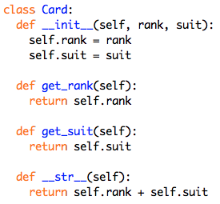
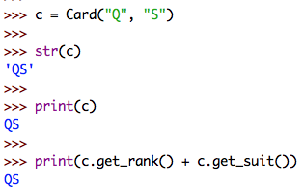
__str__ method
if you want to naturally print an object of a class,
define a __str__ method that returns the string representation of that object
this method is automatically called when printing an object

Slide 13
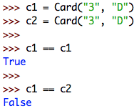
Object comparisons
by default, == and != are defined for objects
X == Y if and only if X and Y are the same object
not incredibly useful – we would like to define when two objects are equal

Slide 14
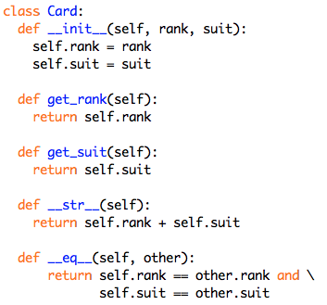
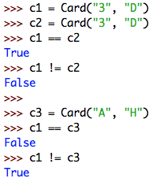
__eq__ method
can define the __eq__ method that has another object as input
returns True if this object and the other are equal, else False
this method is used when you use == to compare objects
note: X != Y is automatically inferred as not (X == Y)

Slide 15
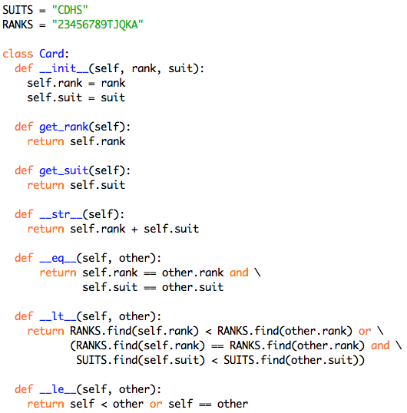
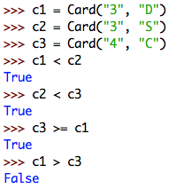
Other comparisons
can similarly define__lt__ and __le__ methods
used for < and <=; all other comparisons are inferred from these
constants specify the order of the ranks & suits

Slide 16
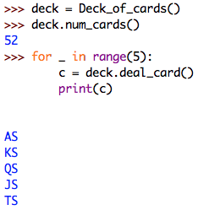
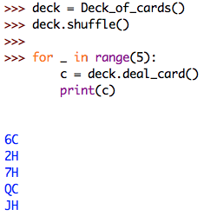
Deck of cards
for most games, we really want to model a deck of cards
by default, a deck of cards is initialized to represent a list of 52 cards (in order)
[2C, 3C, 4C, 5C, …, KS, AS]
want to be able to:
shuffle the deck (randomly rearrange the cards)
deal a card (remove it from the "top")
add a card (insert it on the "bottom")
determine the number of cards remaining in the deck

Slide 17
Deck_of_cards class
initializing the 52 card deck seems like a complex task
a list comprehension makes it EASY!
we want a list of Card objects,
so the expression in the comprehension is Card(r,s)
we want the values for s to range over the SUITS ("CHDS") and the values for r to range over the RANKS ("23456789TJQKA")
QUESTION: same as [Card(r,s) for r in RANKS for s in SUITS] ?

Slide 18
Comprehending the comprehension
cards = [Card(r,s) for s in SUITS for r in RANKS]
is equivalent to cards = []
for s in SUITS:
for r in RANKS:
cards += [Card(r, s)]
which builds [2C, 3C, 4C, 5C, …, TS, JS, QS, KS, AS]
cards = [Card(r,s) for r in RANKS for s in SUITS]
would reverse the order of the loops
and build [2C, 2D, 2H, 2S, 3C, 3D, …, AC, AD, AH, AS]

Slide 19
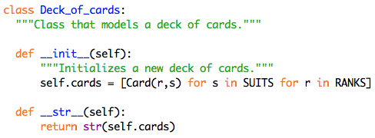
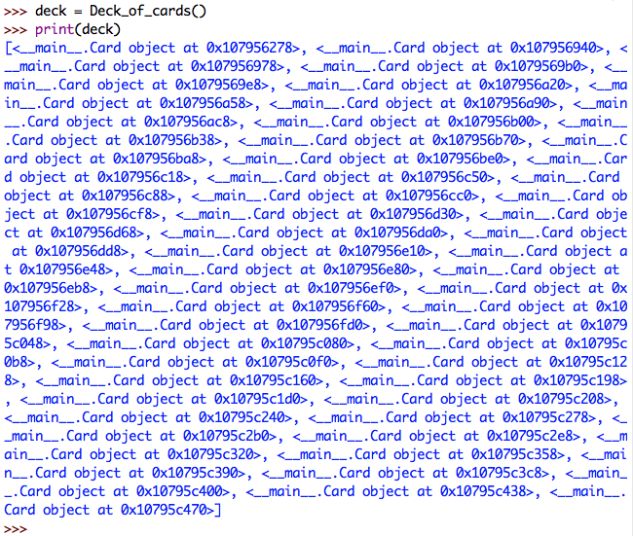
Printing a deck
to convert to a string (e.g., for printing), it is tempting to just convert the list of cards field to a string and return that
problem: when converting the list to a string, Python does not automatically convert the individual cards into strings
how can we fix this?

Slide 20
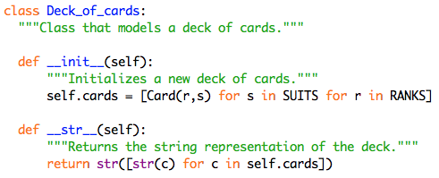
Printing a deck (cont.)
again, can use a list comprehension to make this EASY!
build a list that contains the string representation of each card in self.cards
then, convert that list to a string

Slide 21
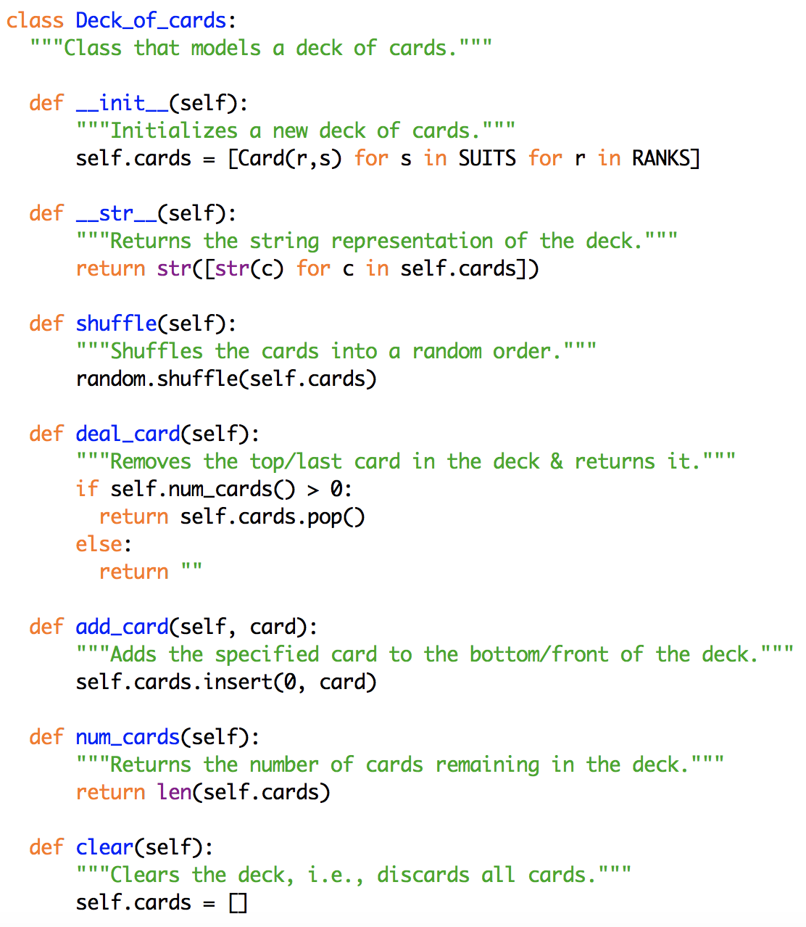
Deck_of_cards class
shuffle
the shuffle method from random does this
deal_card
assuming there are cards in the deck, want to remove from the "top" (end of the list)
the list pop method removes and returns the last item
add_card
want to add at the "bottom" (front of the list)
call insert with index 0
num_cards
simply returns the length of the card list
clear
discards all cards

Slide 22
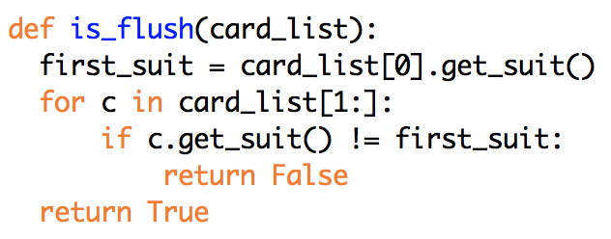
Example: is_flush
determine if a hand (list) of cards are all of the same suit
there are a number of way to approach this
assume the Card and Deck_of_cards classes are defined in cards.py
is_flush is in a different module
QUESTION: will this function work if the card list doesn't contain 5 cards?

Slide 23
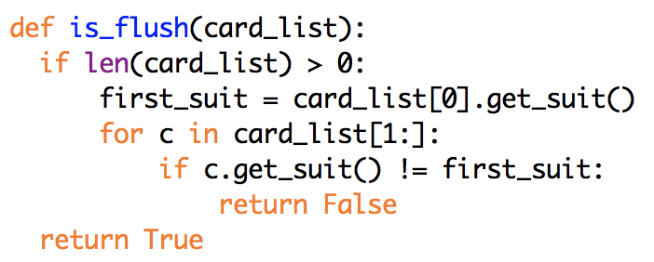
Example: is_flush (cont.)
to be safe, add a check for an empty list
QUESTION: what are your odds of being dealt a flush?
for a 5-card hand:
1 * (12/51) * (11/50) * (10/49) * (9/48) = 0.00198 = .198%
for a 3-card hand
1 * (12/51) * (11/50) = 0.05176 = 5.176%

Slide 24
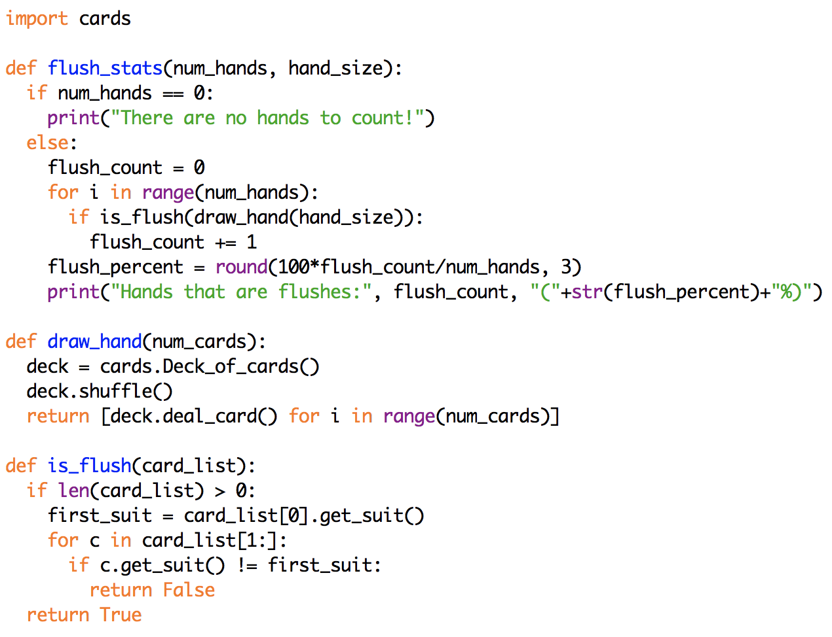
Experimental verification
note: it simplifies the main loop to have separate functions to generate the hand, check for flush

Slide 25
Game of War
suppose we wanted to model the "game of war" card game
shuffle and split a deck of cards among two players
repeatedly, each player deals a card
higher card (by rank only) wins, that player adds both cards to his/her deck
if there is a tie, a war ensues
each player deals three cards and the last cards are compared
winner adds all cards to his/her deck (repeat if another tie)
game ends when a player runs out of cards
how do we design, code & debug a solution?
first step: object-oriented design
identify the physical objects involved and build software models
we have already done this with Card and Deck_of_card classes
next step: divide-and-conquer?
identify the smaller tasks, implement & test code for each task
this has worked fine so far (when problems are modestly sized)

Slide 26
Agile development
going straight to coding subtasks does not work as well with large, real-world problems
can be too much complexity
waiting until you have a complete design before coding is not practical
in the real world, customers want to see working code, provide feedback
the predominant development process in commercial software engineering is agile development
agile development takes a high-level (usually OO) design and builds a series of incremental prototypes
simplify the problem, get a working prototype done quickly
then, can repeatedly augment/revise the prototypes to build toward the complete version

Slide 27
Agile approach to the game of war
high-level design
start with a shuffled deck of cards
deal an equal number to each player
while both players have cards
each deals a card
if different ranks, player with higher rank adds both cards (in random order) to the bottom of his/her deck
if same rank, a war ensues
repeatedly deal three cards and compare, until ranks are different (or a player runs out of cards)
player with higher ranked card wins all and adds (in random order) to the bottom of his/her deck
winner is declared when opponent runs out of cards
what are the most complicated parts of this solution?
what can be simplified, then incrementally added back in?

Slide 28
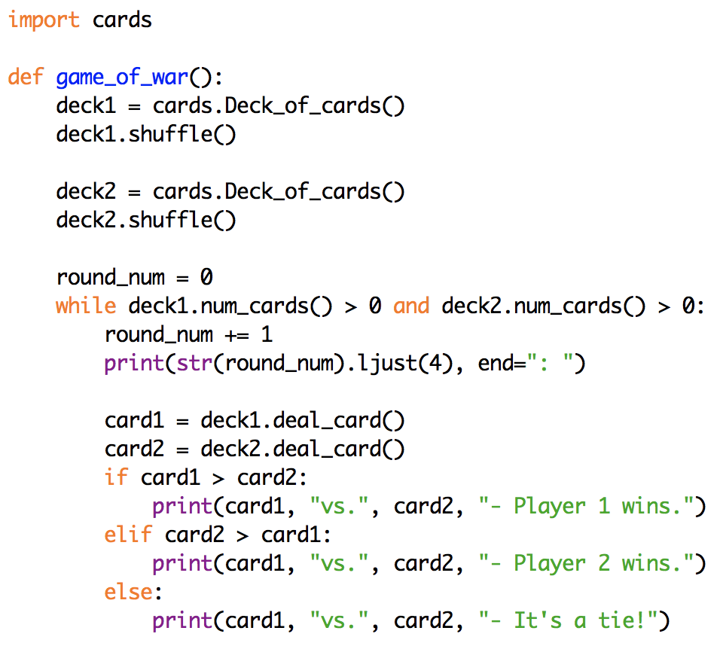
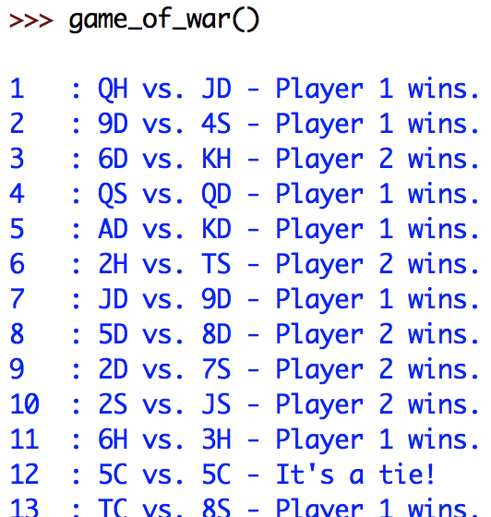
Game of war (prototype 1)
assume each player starts with a complete deck of cards
use card comparison (which uses rank & suit)
throw away cards after each comparison

Slide 29
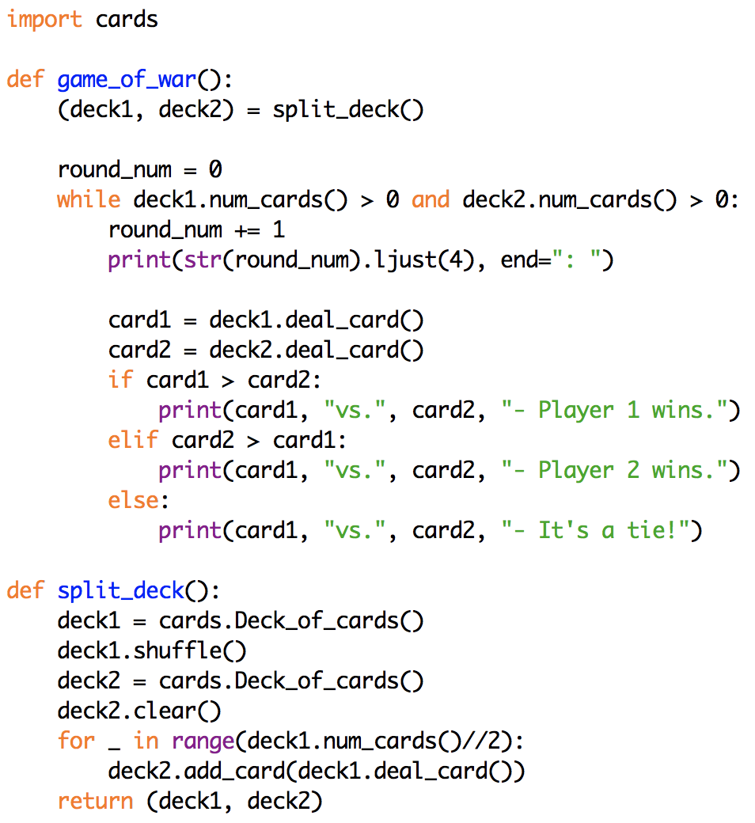
Game of war (prototype 2)
next, modify so that a single deck is split between the players
to keep the main loop simple, can define a separate function for splitting the decks
here, the function returns the pair of decks

Slide 30
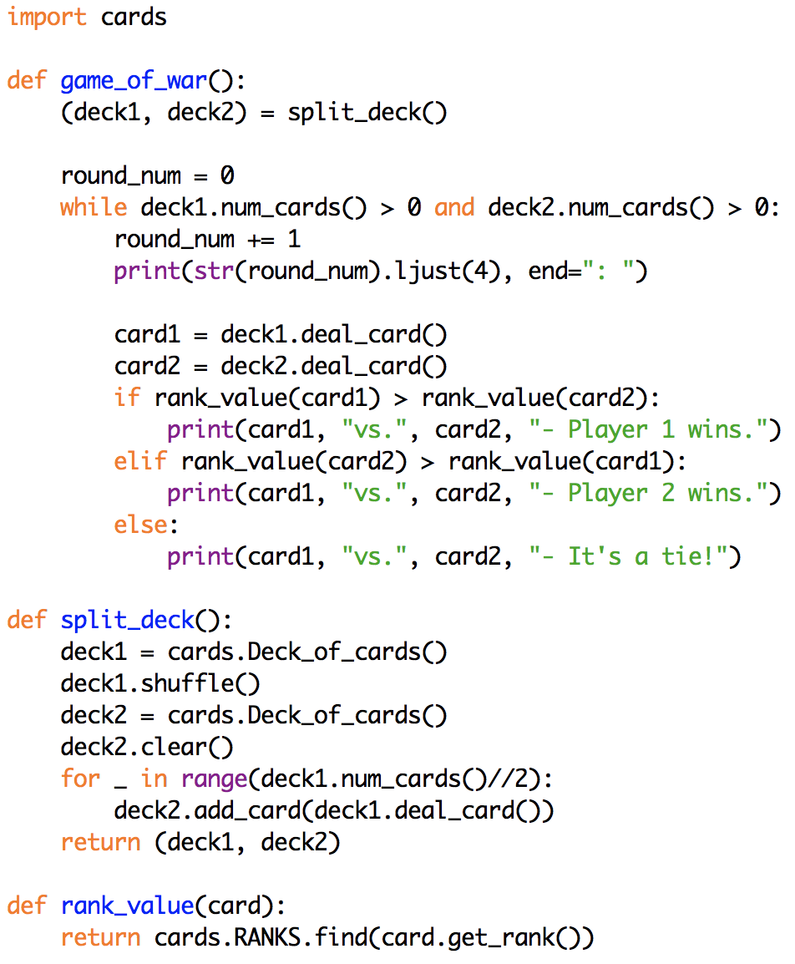
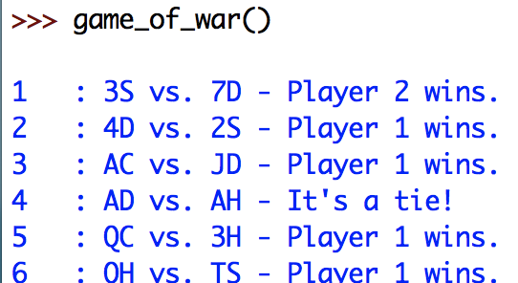
Game of war (prototype 3)
next, modify so that cards with the same rank are ties
again, can define a separate function to perform the comparison
uses the RANKS string from cards.py
if a rank appears later in the RANKS string, then it is higher

Slide 31
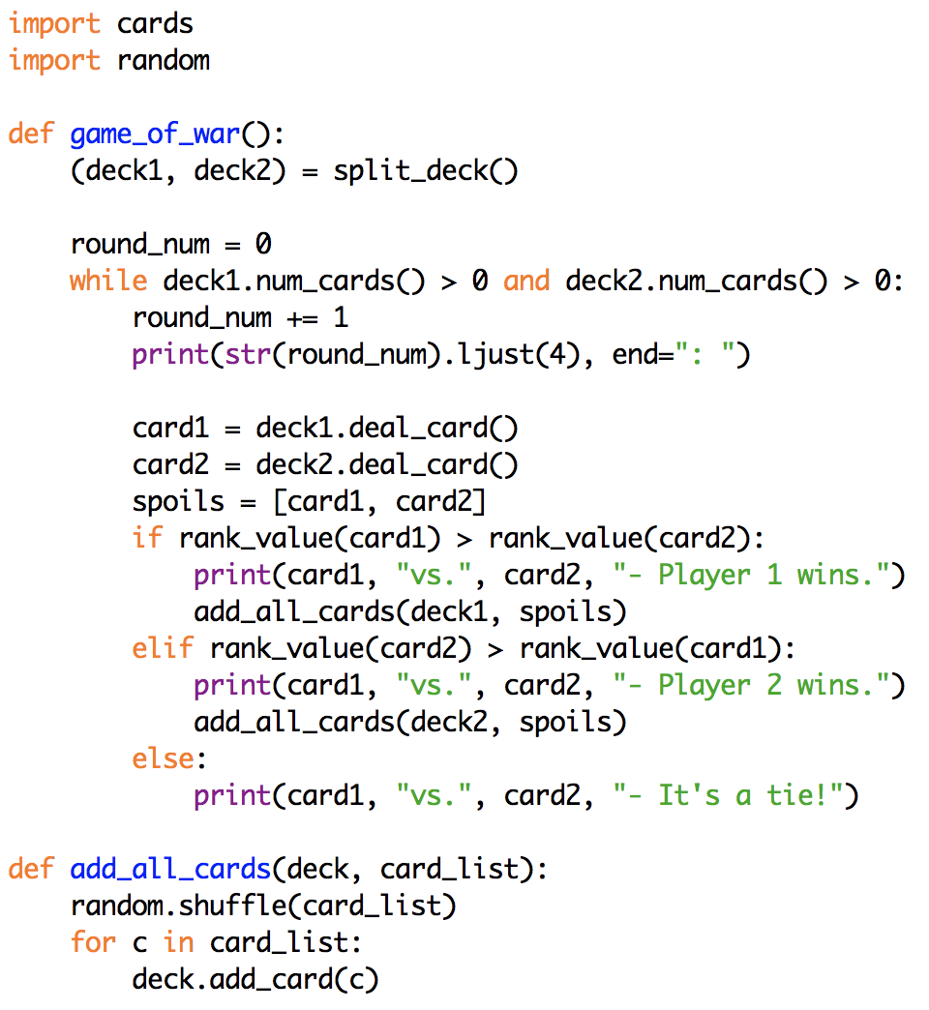
Game of war (prototype 4)
next, modify so that cards are awarded to the winner (still ignoring ties)
note: the card order should be random
again, can define a separate function to keep the main loop simple
note: for brevity, split_deck and rank_value functions are not shown

Slide 32
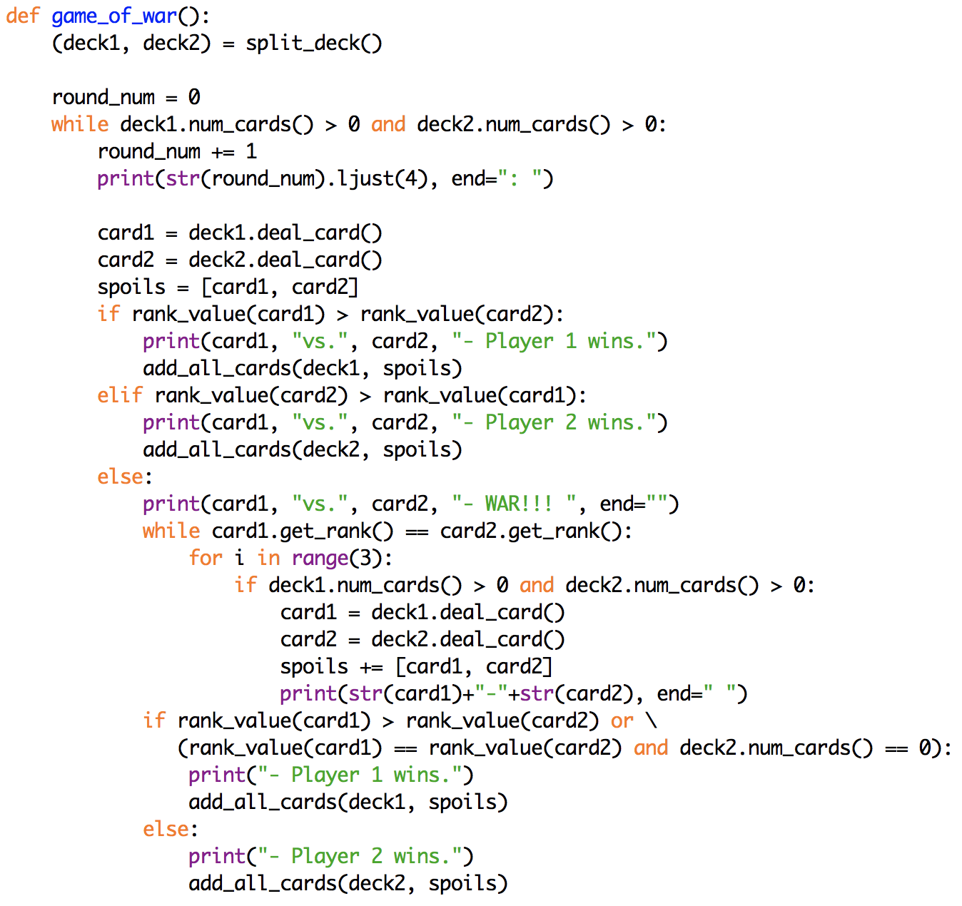
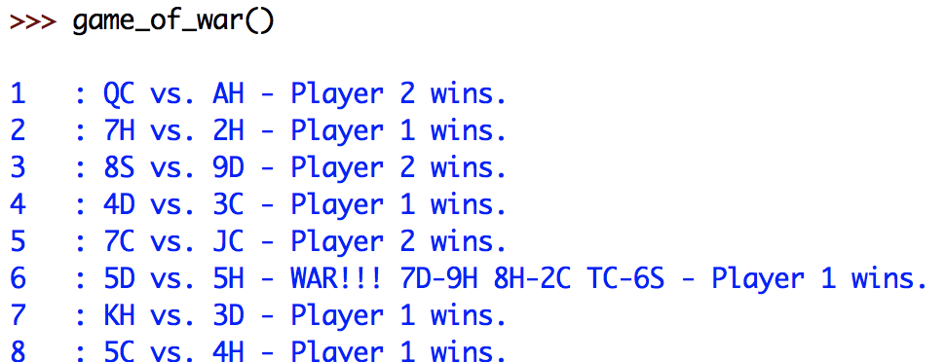
Game of war (final version)
the last step, handling ties, is by far the most complex
how do you display the war?
what if the war ends in a tie?
what if a player runs out of cards in a war?
again, for brevity, supporting functions are not shown

Slide 33
Variables & scope
throughout this course, we have used variables to
store the results of calculations
keep running counts or sums
store values read in from the user or from a file
store inputs to functions (known as parameters)
maintain the internal values of objects (known as fields)
in addition to its value and type, each variable has another attribute associated with it, known as its scope
the scope of a variable is that portion of the code in which that variable exists and can be accessed

Slide 34
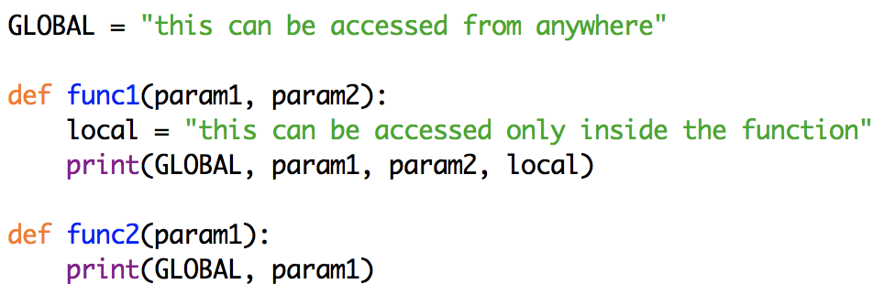
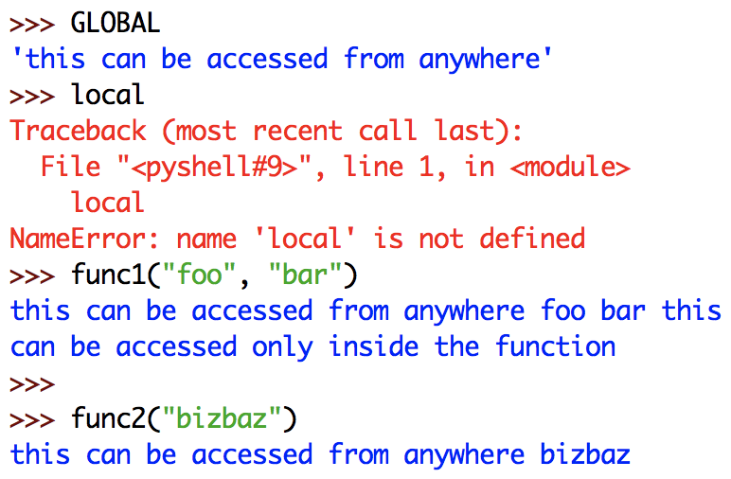
Global vs. local scope
variables that appear outside of any function are global
their scope is unlimited
variables that appear only in a function (which includes parameters) are local to that function
their scope is limited to the function
attempting to access them outside of their function produces an error

Slide 35
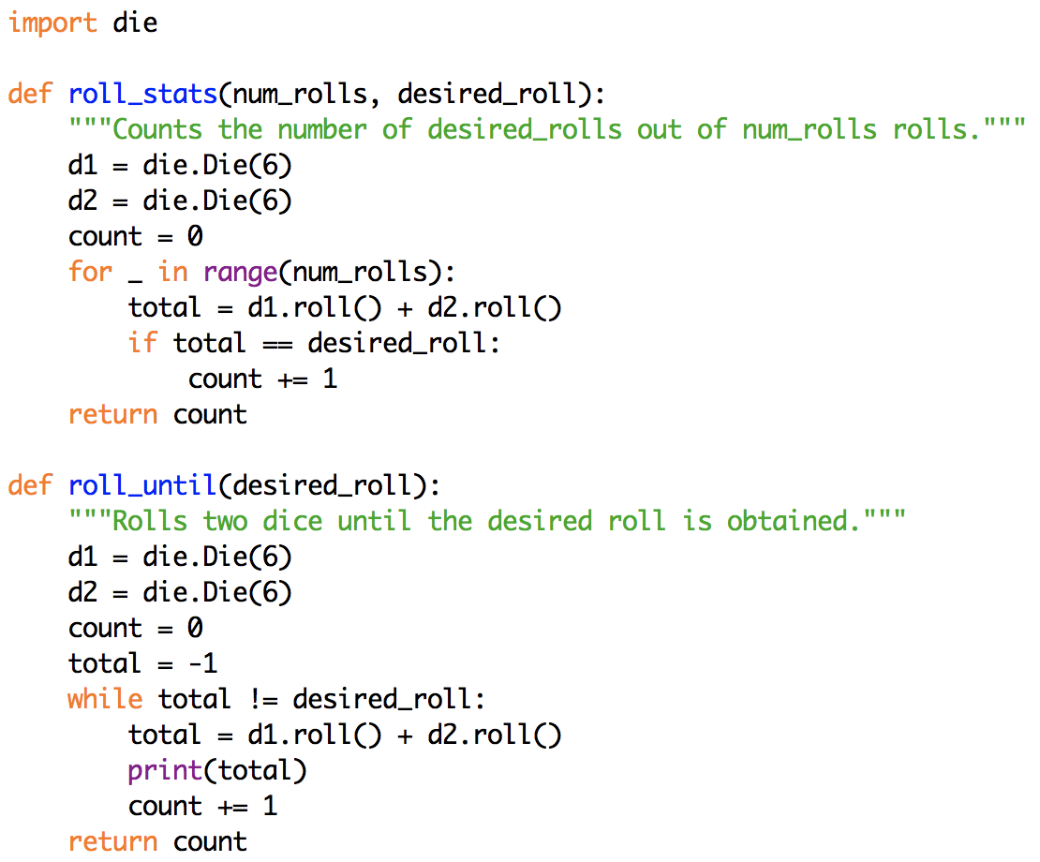
Locality
locality simplifies the development of functions
can have local variables with the same name in different functions
each function has its own, distinct variable

Slide 36
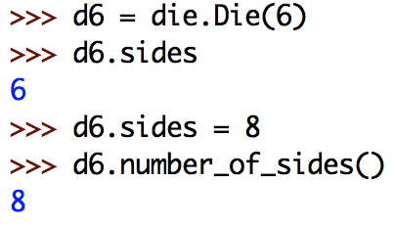
Fields & scope
in most languages, the scope of a field is limited to within the object
this protects the integrity of fields - can only access and change them through methods
Python is flawed in this respect
fields are global – can be accessed and even changed outside of the methods
DO NOT EXPLOIT THIS FLAW
don't' ever do this!
only access/change fields through methods

Slide 37
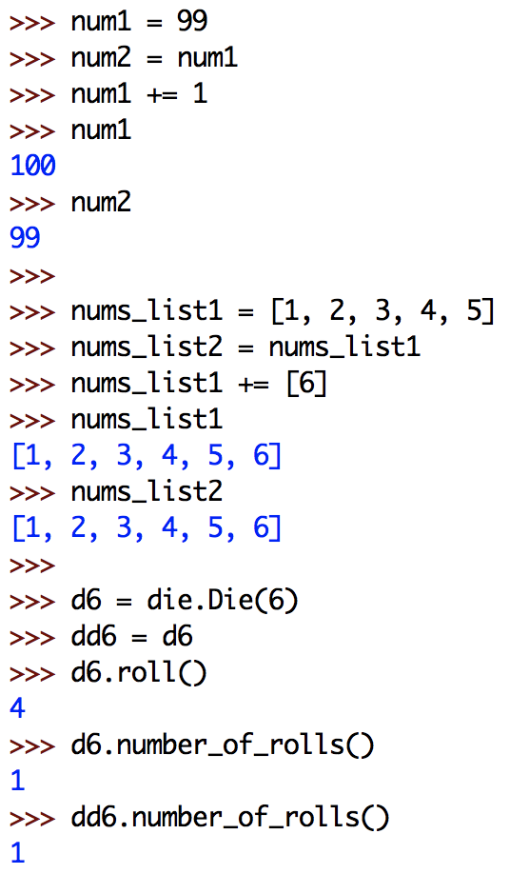
Immutable vs. mutable values
recall that some types in Python are immutable (int, float, bool, str), while others are mutable (list, objects)
you cannot change an immutable value, you can only reassign a variable to a different value
so, if more than one variable refers to the same immutable value, changing one does not affect the others
you can change a mutable value
so, if more than one variable refers to the same mutable value, changing one changes them all

Slide 38
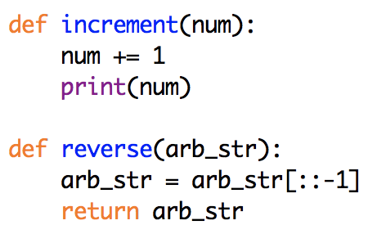
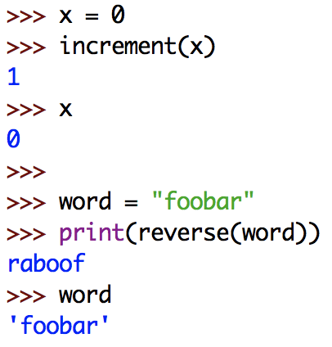
Passing immutable values
parameters are local variables
meaning their names exist and can only be accessed within the function
when you pass a value to a function, that value is automatically assigned to the parameter variable
for immutable types (int, float, bool, str)
any changes you make in the function will not affect the outside
e.g., for the call increment(x), x and num both refer to 0. Incrementing num does not change the value of 0, it reassigns num (and only num) to be 1

Slide 39
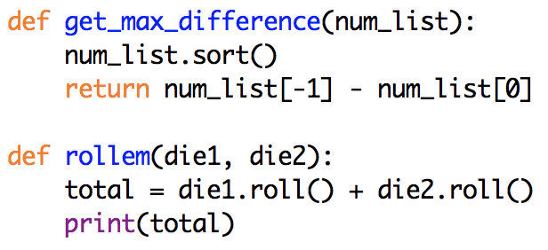
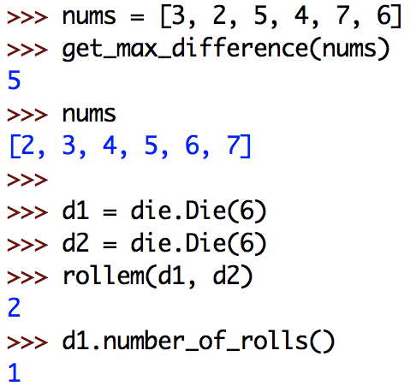
Passing mutable values
however, for mutable types (lists, objects), the behavior is quite different
as before, the parameter variable is assigned the passed value
any change you make to a mutable value affects all variable that refer to it
so, if you pass a list to a function and add to or rearrange its contents, those changes will persist
likewise, if you pass an object to a function and call methods that change its fields, those changes will persist

