Slide 1
Computer Science:
Concepts & Explorations
David Reed, Creighton University
Applications in Artificial Intelligence

Slide 2
Artificial Intelligence
Artificial Intelligence (AI) is a subfield of computer science closely tied with biology and cognitive science
  AI is concerned with computing techniques and models that simulate/investigate intelligent behavior
  AI research builds upon our understanding of the brain and evolutionary development
  in return, AI research provides insights into the way the brain works, as well as the larger process of biological evolution
three important research areas in AI are:
  expert systems: building rule-based systems that utilize expert knowledge in order to diagnose problems or identify solutions
  neural networks: building a model of the brain and "training" that model to recognize certain types of patterns
  genetic algorithms: "evolving" solutions to complex problems (especially problems that are intractable using other methods)

Slide 3
Expert Systems
expert systems encapsulate the knowledge and reasoning of experts in specific domains
  in 70s and 80s, rule-based expert systems replaced human expertise in many diagnosis situations
  expert systems are still popular & profitable today, but utilize many different techniques
EXAMPLE: tax-law is complex & experts are in demand
  much of human expertise can be encapsulated into rules
  IF single AND itemized_deductions < $12,550 THEN use_standard_deduction
  IF medical_expenses > 0.075*AGI THEN deduct_expenses
  tax software (e.g., H&R Block, TaxCut) includes an expert system that asks questions, applies rules, and fills out tax forms for you

Slide 4
Expert Systems & Uncertainty
in applications involving diagnosis or analysis, expert systems must handle uncertainty
  e.g., consider medical diagnosis – the same symptoms can suggests multiple diseases
    IF congestion AND cough THEN allergies
    IF cough AND fever THEN flu
  can add probabilities or certainty factors to rules
    IF congestion AND cough THEN allergies (40% of time)
    IF cough AND fever THEN flu (50% of time)
  can even deal with uncertain data
    patient has little congestion (0.2), persistent cough (0.6), high fever (0.95)
    Rule1: min(0.2, 0.6) = 0.2 * 0.40 = 0.08 very little evidence of allergies
    Rule 2: min(0.6, 0.95) = 0.6 * 0.5 = 0.30 suggestive of flu

Slide 5
Expert System Applications
expert systems have been highly effective in diagnosis/advising applications that utilize complex but extractable knowledge
  medical diagnosis
  customer support
  process control systems
  tax and finance management
the challenge is finding domains where expertise is straightforward to extract & experts are expensive
  once the expertise is extracted and the expert system is built, can be widely proliferated at little to no cost
the term "expert system" has somewhat fallen out of favor
  modern expert systems utilize big data and machine learning algorithms
  usually now just referred to as AI systems

Slide 6
Machine Learning
Machine Learning (ML) is driving many powerful applications
  ML utilizes algorithms to process (potentially large) data sets to improve problem solving
  historically, has been seen as a subdiscipline of Artificial Intelligence
  the new discipline Data Science utilizes ML to process (potentially large) data sets to discover patterns
  this process is known as Data Mining
Machine Learning relies heavily on supervised learning
  algorithms are trained by providing sample inputs and classifications
  the algorithms learn to recognize patterns and classify new inputs

Slide 7
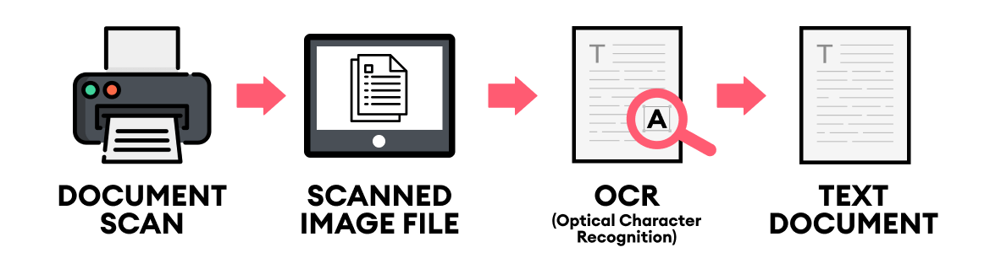
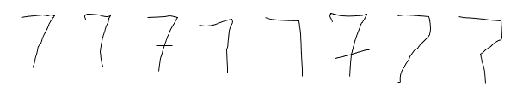
Example: OCR
Optical Character Recognition is used by devices (e.g., phones, tablets, scanners) to extract text from images
  when scanning printed text, each font has slight variations
  handwriting can have extreme variations
  programming every variation would be impossible
  instead, provide numerous examples and have the program learn to identify
    essentially, the program deduces which features are essential to each character
    uses those features to classify new examples

Slide 8
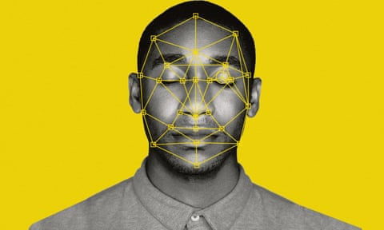
Example: facial recognition
similarly, facial recognition software identifies facial features (e.g., distance between eyes, ear size)
  can then match those features against new images to identify people
  since many features persist regardless of lighting or perspective, can be effective under varying conditions
  many smartphones utilize facial recognition for security
  has been used by law enforcement, but false matches and biases have caused many to rethink

Slide 9
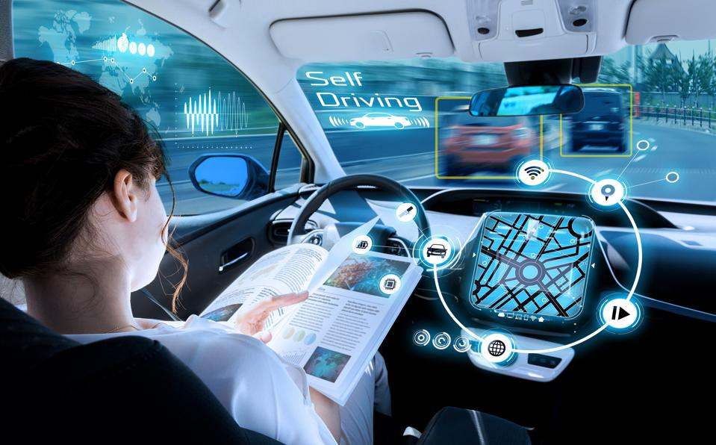
Example: self-driving cars
autonomous vehicles utilize cameras, radar, lidar (light detection) and even GPS sense their surroundings
  they are programmed to react under specific circumstance, but learn to apply rules to new situations
  they can improve over time as new circumstances are experienced
  In 2022, 1,450 reported crashes by advanced driver assistance vehicles
    9.1 accidents per million miles driven vs. 4.1 accidents in traditional cars

Slide 10
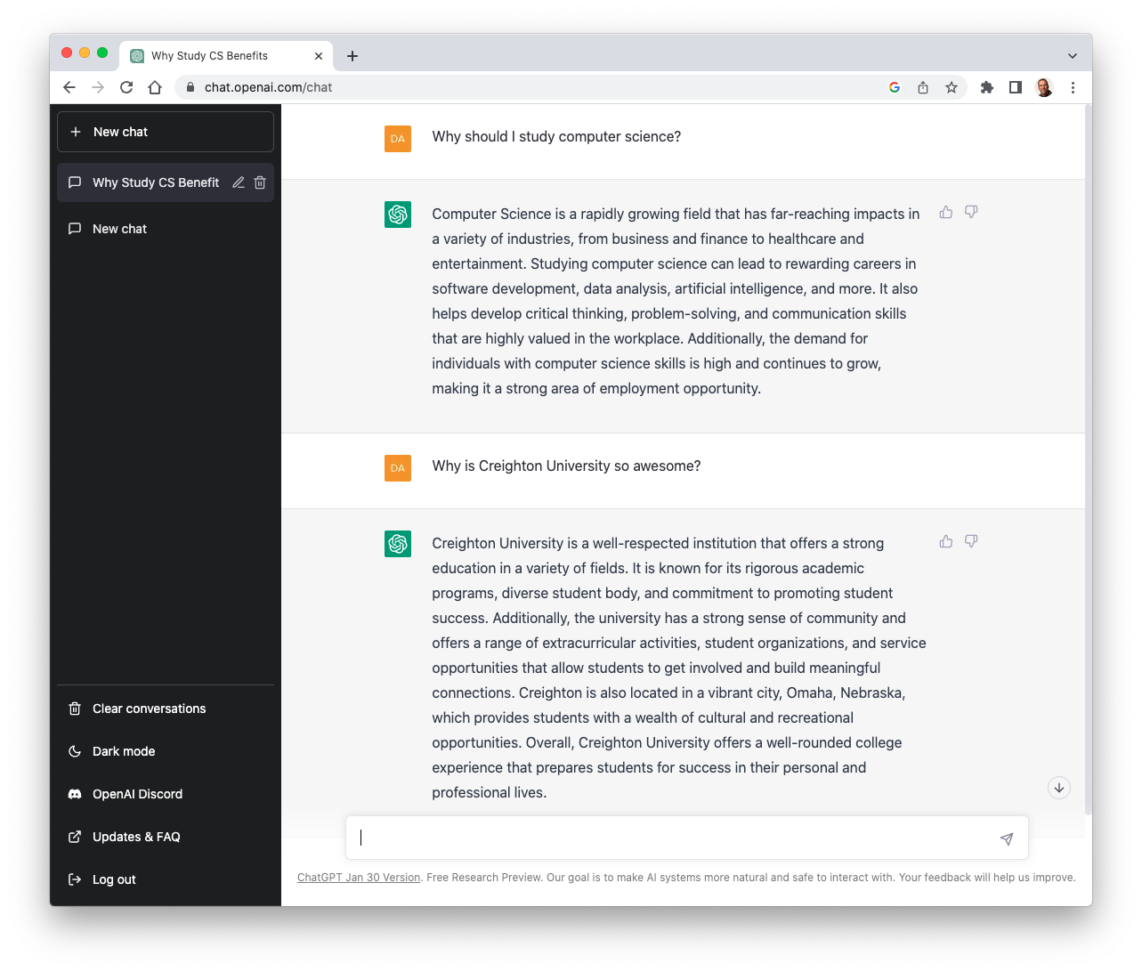
Example: chatbots
ChatGPT (Chat Generative Pre-trained Transformer) was released in Nov 2022 by OpenAI
  was trained by providing recorded conversations and Web content, also utilized human trainers to provide feedback
  in addition to carry on on a conversation, can write code, music, poems, …
  ChatGPT and similar tools are known as LLMs (Large Language Models) since they are trained on massive text
  how will tools like this change
    education
    writing
    software development
    tech support
    therapy

Slide 11
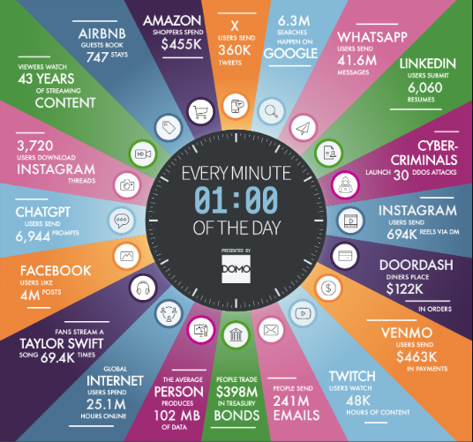
Example: data mining
it was estimated that 120 ZB of data was generated every day in 2023
  kilobyte 2¹⁰ ~thousand
  megabyte 2²⁰ ~million
  gigabyte 2³⁰ ~billion
  terabyte 2⁴⁰ ~trillion
  petabyte 2⁵⁰ ~quadrillion
  exabyte 2⁶⁰ ~quintillion
  zettabyte 2⁷⁰ ~sextillion
Data Science is a discipline that focuses on extracting patterns and trends from data
  relies on Machine Learning to process the massive amounts of data and learn what features are significant

Slide 12
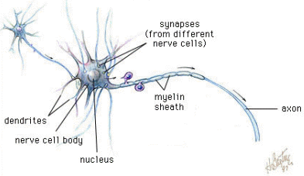
Neural Networks
at the core of most Machine Learning algorithms are neural networks
  a neural network mimics the structure of the human brain
  utilizes supervised learning to develop proficiency in recognizing patterns
neural nets predate modern computers
  first invented by McCulloch and Pitts in 1943
general brain architecture:
  many (relatively) slow neurons, interconnected
  dendrites serve as input devices (receive electrical impulses from other neurons)
  cell body "sums" inputs from the dendrites (possibly inhibiting or exciting)
  if sum exceeds some threshold, the neuron fires an output impulse along axon

Slide 13
Artificial Neurons
neural networks are based on the brain metaphor
  large number of simple, neuron-like processing elements
  large number of weighted connections between neurons
    note: the weights encode information, not symbols!
  parallel, distributed control
  emphasis on learning
McCulloch & Pitts (1943) described an artificial neuron
  inputs are binary: 0 (no input signal) or 1 (input signal)
  each input has a weight associated with it
  the activation function multiplies each input value by its weight
  if the sum of the weighted inputs >= θ,
    then the neuron fires (outputs 1), else doesn't fire (outputs 0)
if Σw_{i}x_{i} >= θ, output = 1
if Σw_{i}x_{i} < θ, output = 0

Slide 14
Computation via Neurons
can view an (artificial or not) neuron as a computational element
  accepts or classifies an input if the output fires
INPUT: x₁ = 1, x₂ = 1
  .75*1 + .75*1 = 1.5 >= 1 ➔ OUTPUT: 1
INPUT: x₁ = 1, x₂ = 0
  .75*1 + .75*0 = .75 < 1 ➔ OUTPUT: 0
INPUT: x₁ = 0, x₂ = 1
  .75*0 + .75*1 = .75 < 1 ➔ OUTPUT: 0
INPUT: x₁ = 0, x₂ = 0
  .75*0 + .75*0 = 0 < 1 ➔ OUTPUT: 0
this neuron computes the AND function

Slide 15
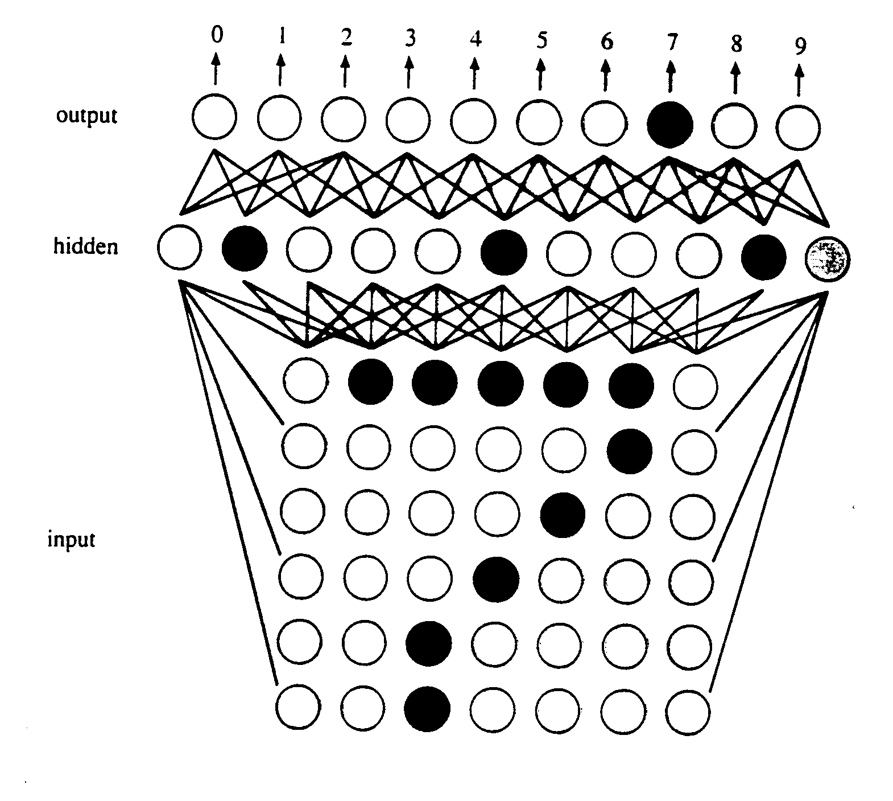
Learning Algorithm
Rosenblatt (1958) devised a learning algorithm for artificial neurons
  start with a training set (example inputs & corresponding desired outputs)
  train the network to recognize the examples in the training set (by adjusting the weights on the connections)
  once trained, the network can be applied to new examples
this basic algorithm has been expanded to handle complex applications
e.g., OCR
  inputs are pixels in a scanned image
  a "hidden" layer identifies relevant features (e.g., horizontal line near top, diagonal in middle)
  the combination of features discovered by the hidden layer identifies the character

Slide 16
Generalization problem
suppose a network is trained to recognize digits:
  training set for 1:
  training set for 2:
1
1
1
1
2
2
2
2
2
  when the network is asked to identify it comes back with 1. WHY?
there is always a danger that the network will focus on specific (maybe unintentional) features as opposed to general patterns
to avoid networks that are too specific, cross-validation can be used
  split training set into training & validation data
  after each generation, test the net on the validation data
  continue until performance on the validation data diminishes

Slide 17
Neural Net Applications
Aerospace: Aircraft component fault detectors and simulations, aircraft control systems
Automotive: Improved guidance systems, virtual sensors, warranty activity analyzers
Electronics: Chip failure analysis, circuit chip layouts, machine vision, non-linear modeling, process control
Manufacturing: Machine diagnosis, product design and analysis, visual quality inspection systems
Robotics: Forklift robots, manipulator controllers, trajectory control, and vision systems
Telecommunications: Network monitoring, speech recognition, customer payment processing systems
Banking: Credit card attrition, credit and loan application evaluation, fraud and risk evaluation
Business Analytics: Customer behavior modeling, fraud propensity, market research
Financial: Corporate financial analysis, currency price prediction, loan advising, portfolio trading
Securities: Automatic bond rating, market analysis, and stock trading advisory systems
source: https://www.smartsheet.com/neural-network-applications
more than 9,000 companies (including credit cards) use FICO Falcon
  uses neural nets to model customer behavior, identify fraud
  claims improvement in credit card fraud detection of 30-70%

Slide 18
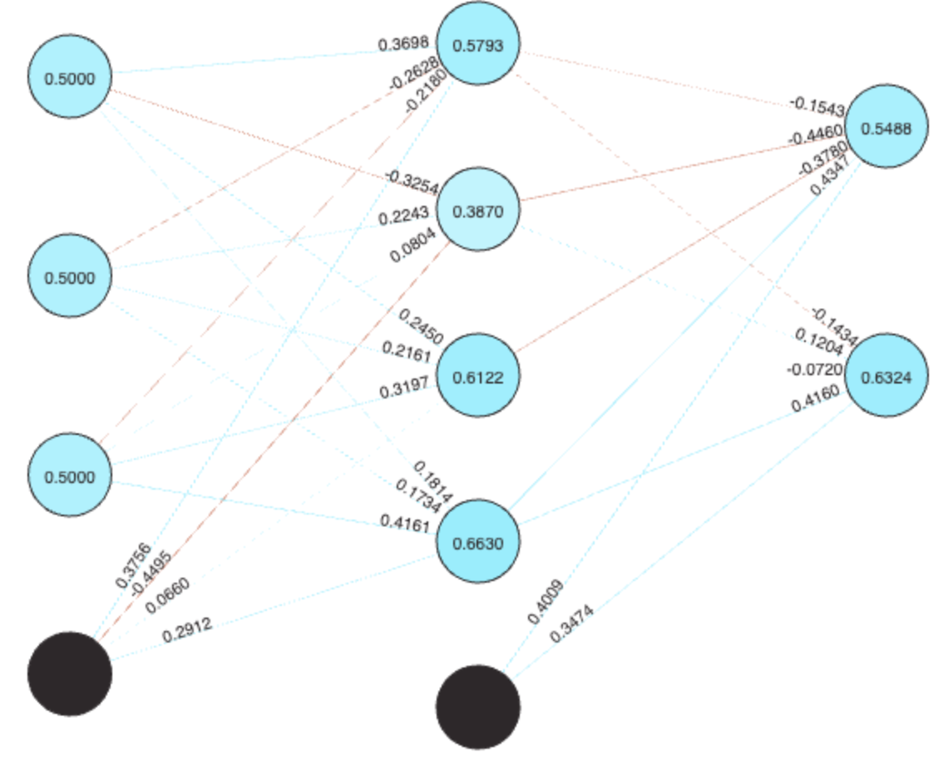
NN example
suppose we wanted to provide guidance on major selection
  hypothesis: certain personality traits or life skills suggest certain majors
  conduct a survey of students, asking them to self-assess their traits/skills on a scale of 0 to 1.0, along with their major
  build a network of artificial neurons, with three inputs (corresponding to survey skills), 4 hidden neurons (for feature extraction) and two outputs (corresponding to the majors)
 | How creative are you? | Good at problem solving? | How extraverted are you? | Major
stu1 | 0.8 | 0.6 | 0.9 | GDE
stu2 | 0.9 | 0.7 | 1.0 | GDE
stu3 | 0.8 | 0.9 | 0.6 | GDE
stu4 | 0.2 | 0.9 | 0.2 | CSC
stu5 | 0.6 | 0.8 | 0.4 | CSC
stu6 | 0.8 | 0.8 | 0.8 | CSC
https://nnplayground.com/

Slide 19
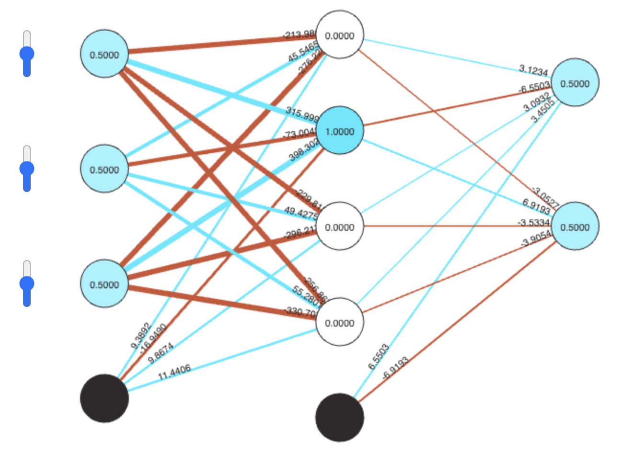
NN example
  feed those inputs and outputs to the network and train it to recognize
  once trained, it can be applied to new patterns to classify them (based on best fit)
 | How creative are you? | Good at problem solving? | How extraverted are you? | CSC | GDE
stu1 | 0.8 | 0.6 | 0.9 | 0 | 1
stu2 | 0.9 | 0.7 | 1.0 | 0 | 1
stu3 | 0.8 | 0.9 | 0.6 | 0 | 1
stu4 | 0.2 | 0.9 | 0.2 | 1 | 0
stu5 | 0.6 | 0.8 | 0.4 | 1 | 0
stu6 | 0.8 | 0.8 | 0.8 | 1 | 0
[
[[0.8, 0.6, 0.9],[0, 1]],
[[0.9, 0.7, 1.0],[0, 1]],
[[0.8, 0.9, 0.6],[0, 1]],
[[0.2, 0.9, 0.2],[1, 0]],
[[0.6, 0.8, 0.4],[1, 0]],
[[0.7, 0.7, 0.7],[1, 0]]
]
this is a very small, non-scientific example
  data scientists typically deal with massive amounts of data
  utilize analytical methods to ensure statistical significance

Slide 20
Evolutionary Models
neural networks are patterned after the processes underlying brain activity
  artificial neurons are interconnected into networks
  information is sub-symbolic, stored in the strengths of the connections
genetic algorithms represent an approach to problem-solving that is patterned after the processes underlying evolution
  potential solutions to problems form a population
  better (more fit) solutions evolve through natural selection
Darwin saw "… no limit to the power of slowly and beautifully adapting each form to the most complex relations of life …"
  through the process of introducing variations into successive generations and selectively eliminating less fit individuals, adaptations of increasing capability and diversity emerge in a population
  evolution and emergence occur in populations of embodied individuals, whose actions affect others and that, in turn, are affected by others
  selective pressures come not only from the outside, but also from the interactions between members of the population

Slide 21
Evolution & Problem-Solving
evolution slowly but surely produces populations in which individuals are suited to their environment
  the characteristics/capabilities of individuals are defined by their chromosomes
  those individuals that are most fit (have the best characteristics/capabilities for their environment) are more likely to survive and reproduce
  since the chromosomes of the parents are combined in the offspring, combinations of fit characteristics/capabilities are passed on
  with a small probability, mutations can also occur resulting in offspring with new characteristics/capabilities
in 1975, psychologist/computer scientist John Holland applied these principles to problem-solving → genetic algorithms
  solve a problem by starting with a population of candidate solutions
  using reproduction, mutation, and survival-of-the-fittest, evolve even better solutions

Slide 22
Genetic Algorithm (GA)
for a given problem, must define:
  chromosome: bit string that represents a potential solution
  fitness function: a measure of how good/fit a particular chromosome is
  reproduction scheme: combining two parent chromosomes to yield offspring
  mutation rate: likelihood of a random mutation in the chromosome
  replacement scheme: replacing old (unfit) members with new offspring
  termination condition: when is a solution good enough?
in general, the genetic algorithm:
  start with an initial (usually random) population of chromosomes
  while the termination condition is not met
  evaluate the fitness of each member of the population
  select members of the population that are most fit
  produce the offspring of these members via reproduction & mutation
  replace the least fit member of the population with these offspring
  essentially, attempt to evolve better and better solutions

Slide 23
GA example
Suppose you are the logistics manager for a trucking company. You have items to ship, and a truck that can only hold 500 pounds or cargo. How do you select the items to put in the truck with the maximum dollar value?
      cabinet $5000 30 lbs
      shelves $2200 50 lbs
      statue $2100 400 lbs
      desk $2000 80 lbs
      stereo $1200 100 lbs
      chair $800 250 lbs
      console $600 10 lb
      clock $300 40 lbs
could try a greedy approach (take next highest value item that fits)
  based on value: cabinet+shelves+statue+console = 490 lbs, $9,900
note that this collection is not optimal
  cabinet+shelves+desk+stereo+console+clock = 310 lbs, $11,300

Slide 24
GA example (cont.)
      cabinet $5000 30 lbs
      shelves $2200 50 lbs
      statue $2100 400 lbs
      desk $2000 80 lbs
      stereo $1200 100 lbs
      chair $800 250 lbs
      console $600 10 lb
      clock $300 40 lbs
chromosome: a string of 8 bits with each bit corresponding to an item
  1 implies that the corresponding item is included; 0 implies not included
    e.g., 11100000 represents (cabinet+shelves+statue)
    01101001 represents (shelves+statue+stereo+clock)
fitness function: favor collections with higher values
  fit(chromosome) = sum of dollar amounts of items, or 0 if weight > 500
    e.g., fit(11100000) = 9300
    fit(01101001) = 0
reproduction scheme: utilize crossover (a common technique in GA's)
  pick a random index, and swap left & right sides from parents
    e.g., parents 11100000 and 01101000, pick index 4
    1110|0000 and 0110|1000 yield offspring 11101000 and 01100000

Slide 25
GA example (cont.)
      cabinet $5000 30 lbs
      shelves $2200 50 lbs
      statue $2100 400 lbs
      desk $2000 80 lbs
      stereo $1200 100 lbs
      chair $800 250 lbs
      console $600 10 lb
      clock $300 40 lbs
Generation 0 (randomly selected):
  11100000 (fit = 9300) 01101000 (fit = 0) 11001011 (fit = 9300)
  11010000 (fit = 9200) 00010100 (fit = 2800) 01001011 (fit = 4300)
  11110111 (fit = 0) 10011000 (fit = 8200)
  choose fittest 4, perform crossover with possibility of mutation
  111000|00 + 110010|11 → 11100011 11001001
  110|10000 + 100|11000 → 11011000 10010000
Generation 1 (replacing least fit from Generation 0):
  11100000 (fit = 9300) 11100011 (fit = 0) 11001011 (fit = 9300)
  11010000 (fit = 9200) 11001001 (fit = 8700) 11011000 (fit = 10400)
  10010000 (fit = 7000) 10011000 (fit = 8200)
  choose fittest 4, perform crossover with possibility of mutation
  1101|1000 + 1100|1011 → 11011011 11001000
  1110000|0 + 1101000|0 → 11100000 11010000
Generation 2 (replacing least fit from Generation 1):
  11100000 (fit = 9300) 11001000 (fit = 8400) 11001011 (fit = 9300)
  11010000 (fit = 9200) 11100000 (fit = 9300) 11011000 (fit = 10400)
  11011011 (fit = 11300) 11010000 (fit = 9200)

Slide 26
GA Applications
genetic algorithms for scheduling complex resources
  e.g., Smart Airport Operations Center by Ascent Technology
    uses GA for logistics: assign gates, direct baggage, direct service crews, …
    considers diverse factors such as plane maintenance schedules, crew qualifications, shift changes, locality, security sweeps, …
    too many variables to juggle using a traditional algorithm (NP-hard)
    GA is able to evolve sub-optimal schedules, improve performance
    Ascent claims 30% increase in productivity (including SFO, Logan, Heathrow, …)
genetic algorithms for data mining
  using GA's, it is possible to build statistical predictors over large, complex sets of data
    e.g., stock market predictions, consumer trends, …
  GA's do not require a deep understanding of correlations, causality, …
    start with a random population of predictors
    fitness is defined as the rate of correct predictions on validation data
    "evolution" favors those predictors that correctly predict the most examples
  e.g., Prediction Company was founded in 1991 by astrophysicists (Farmer & Packard)
    developed software using GA's to predict the stock market – very successful

