Slide 1
Computer Science:
Concepts & Explorations
David Reed, Creighton University
Uploading a Web Page to Infinityfree

Slide 2
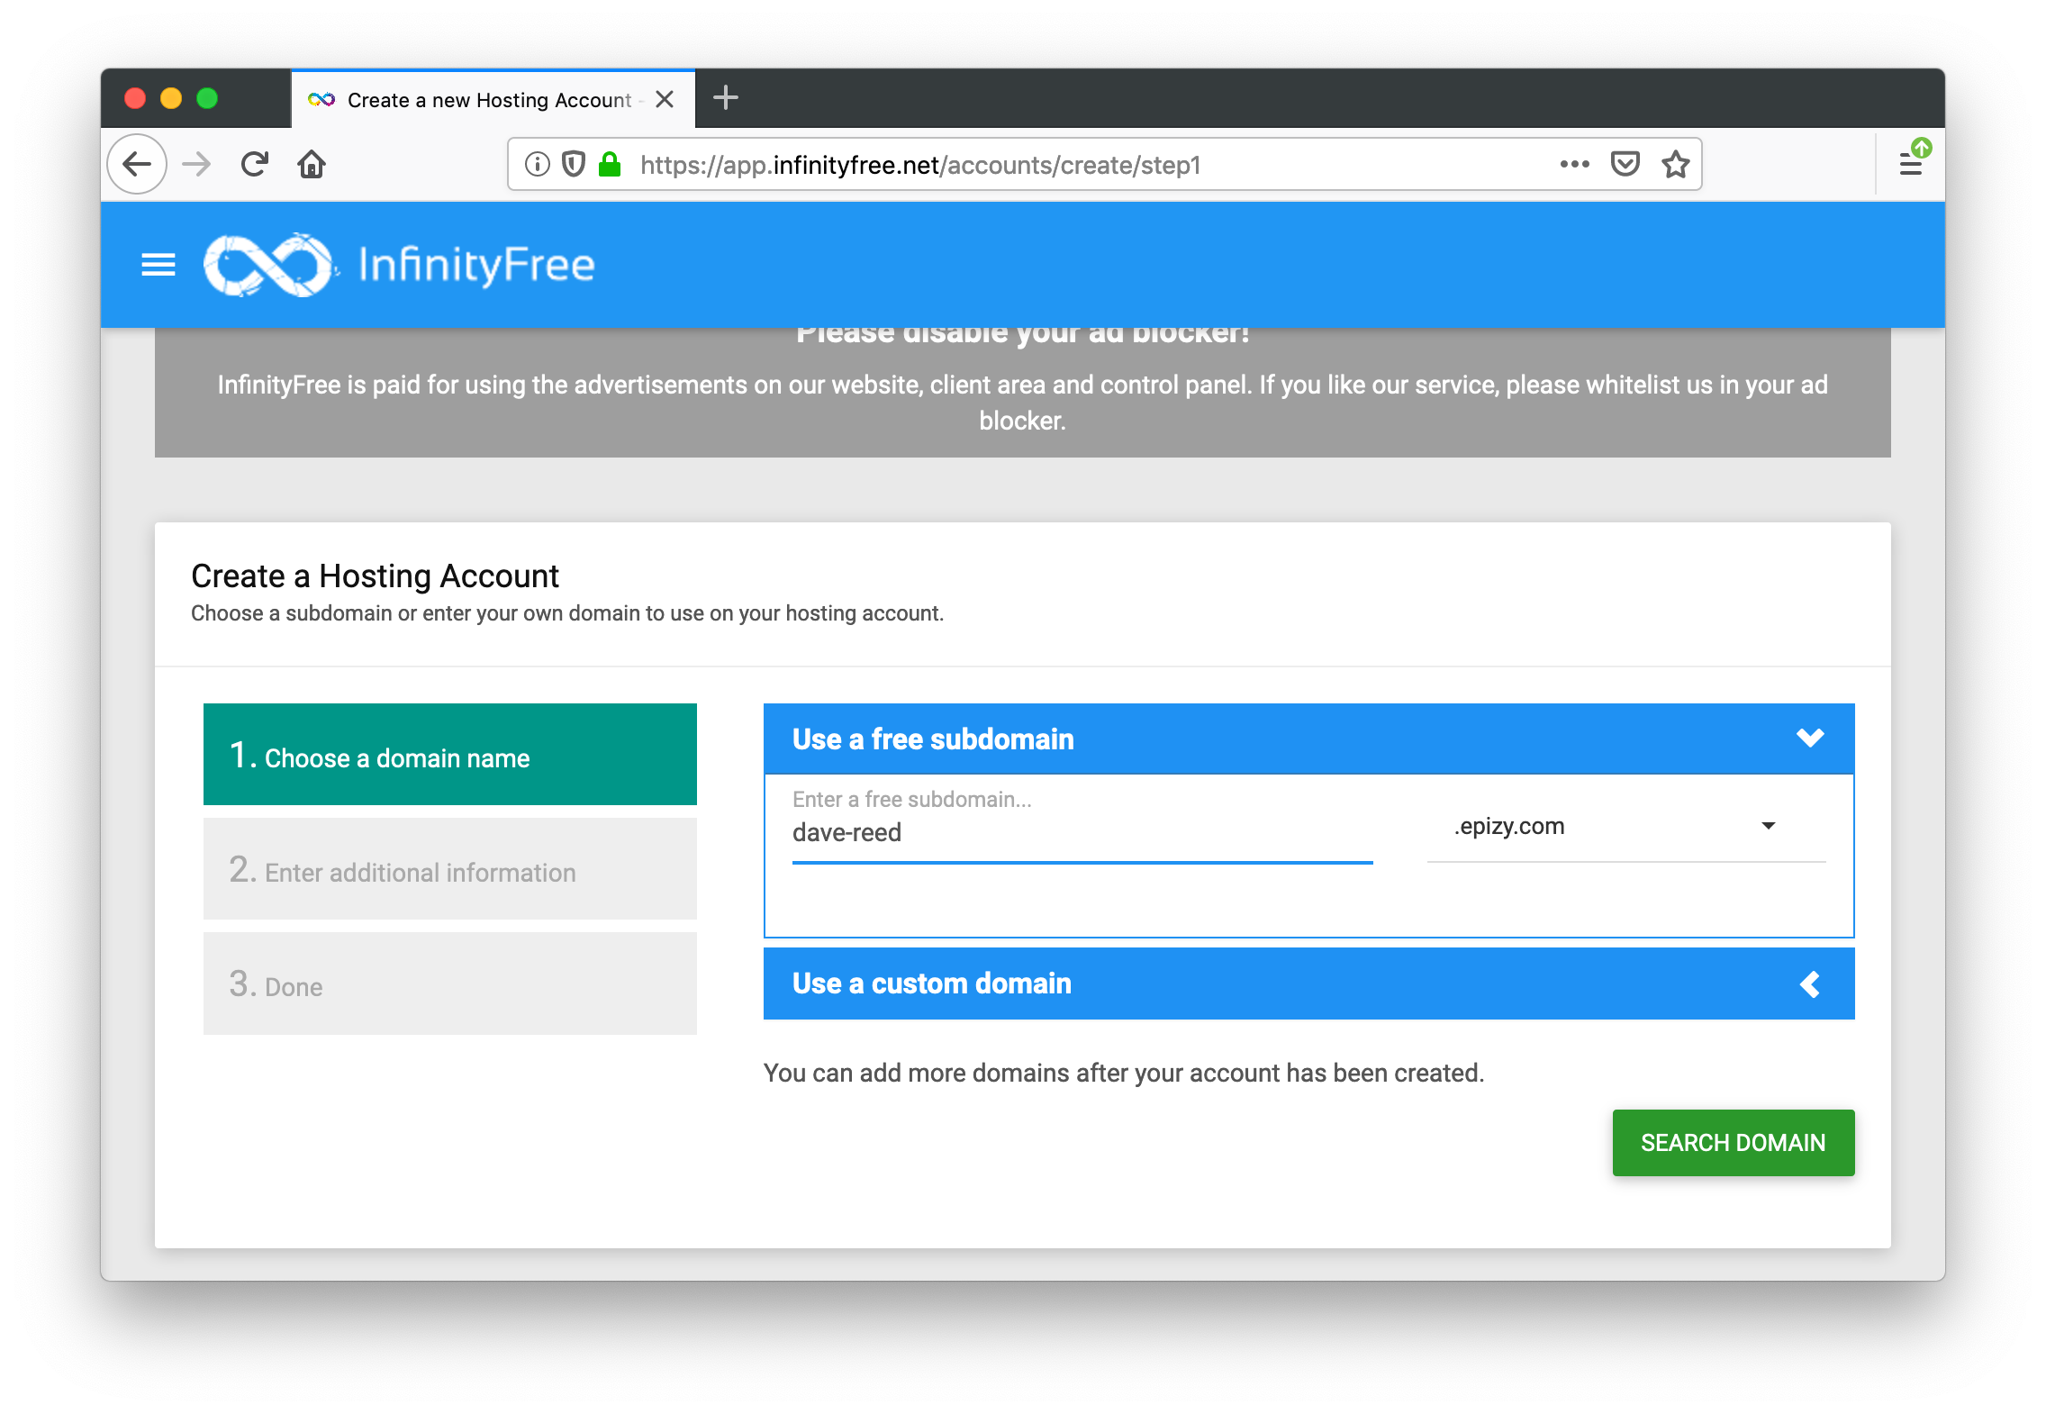
Infinityfree Web hosting
in order to make your Web pages accessible, you need a Web host
  there are many free or inexpensive Web hosting services available
infinityfree.net provides free Web space where you can post your pages
  register for a free account
    you will be prompted for a subdomain name and a password

Slide 3
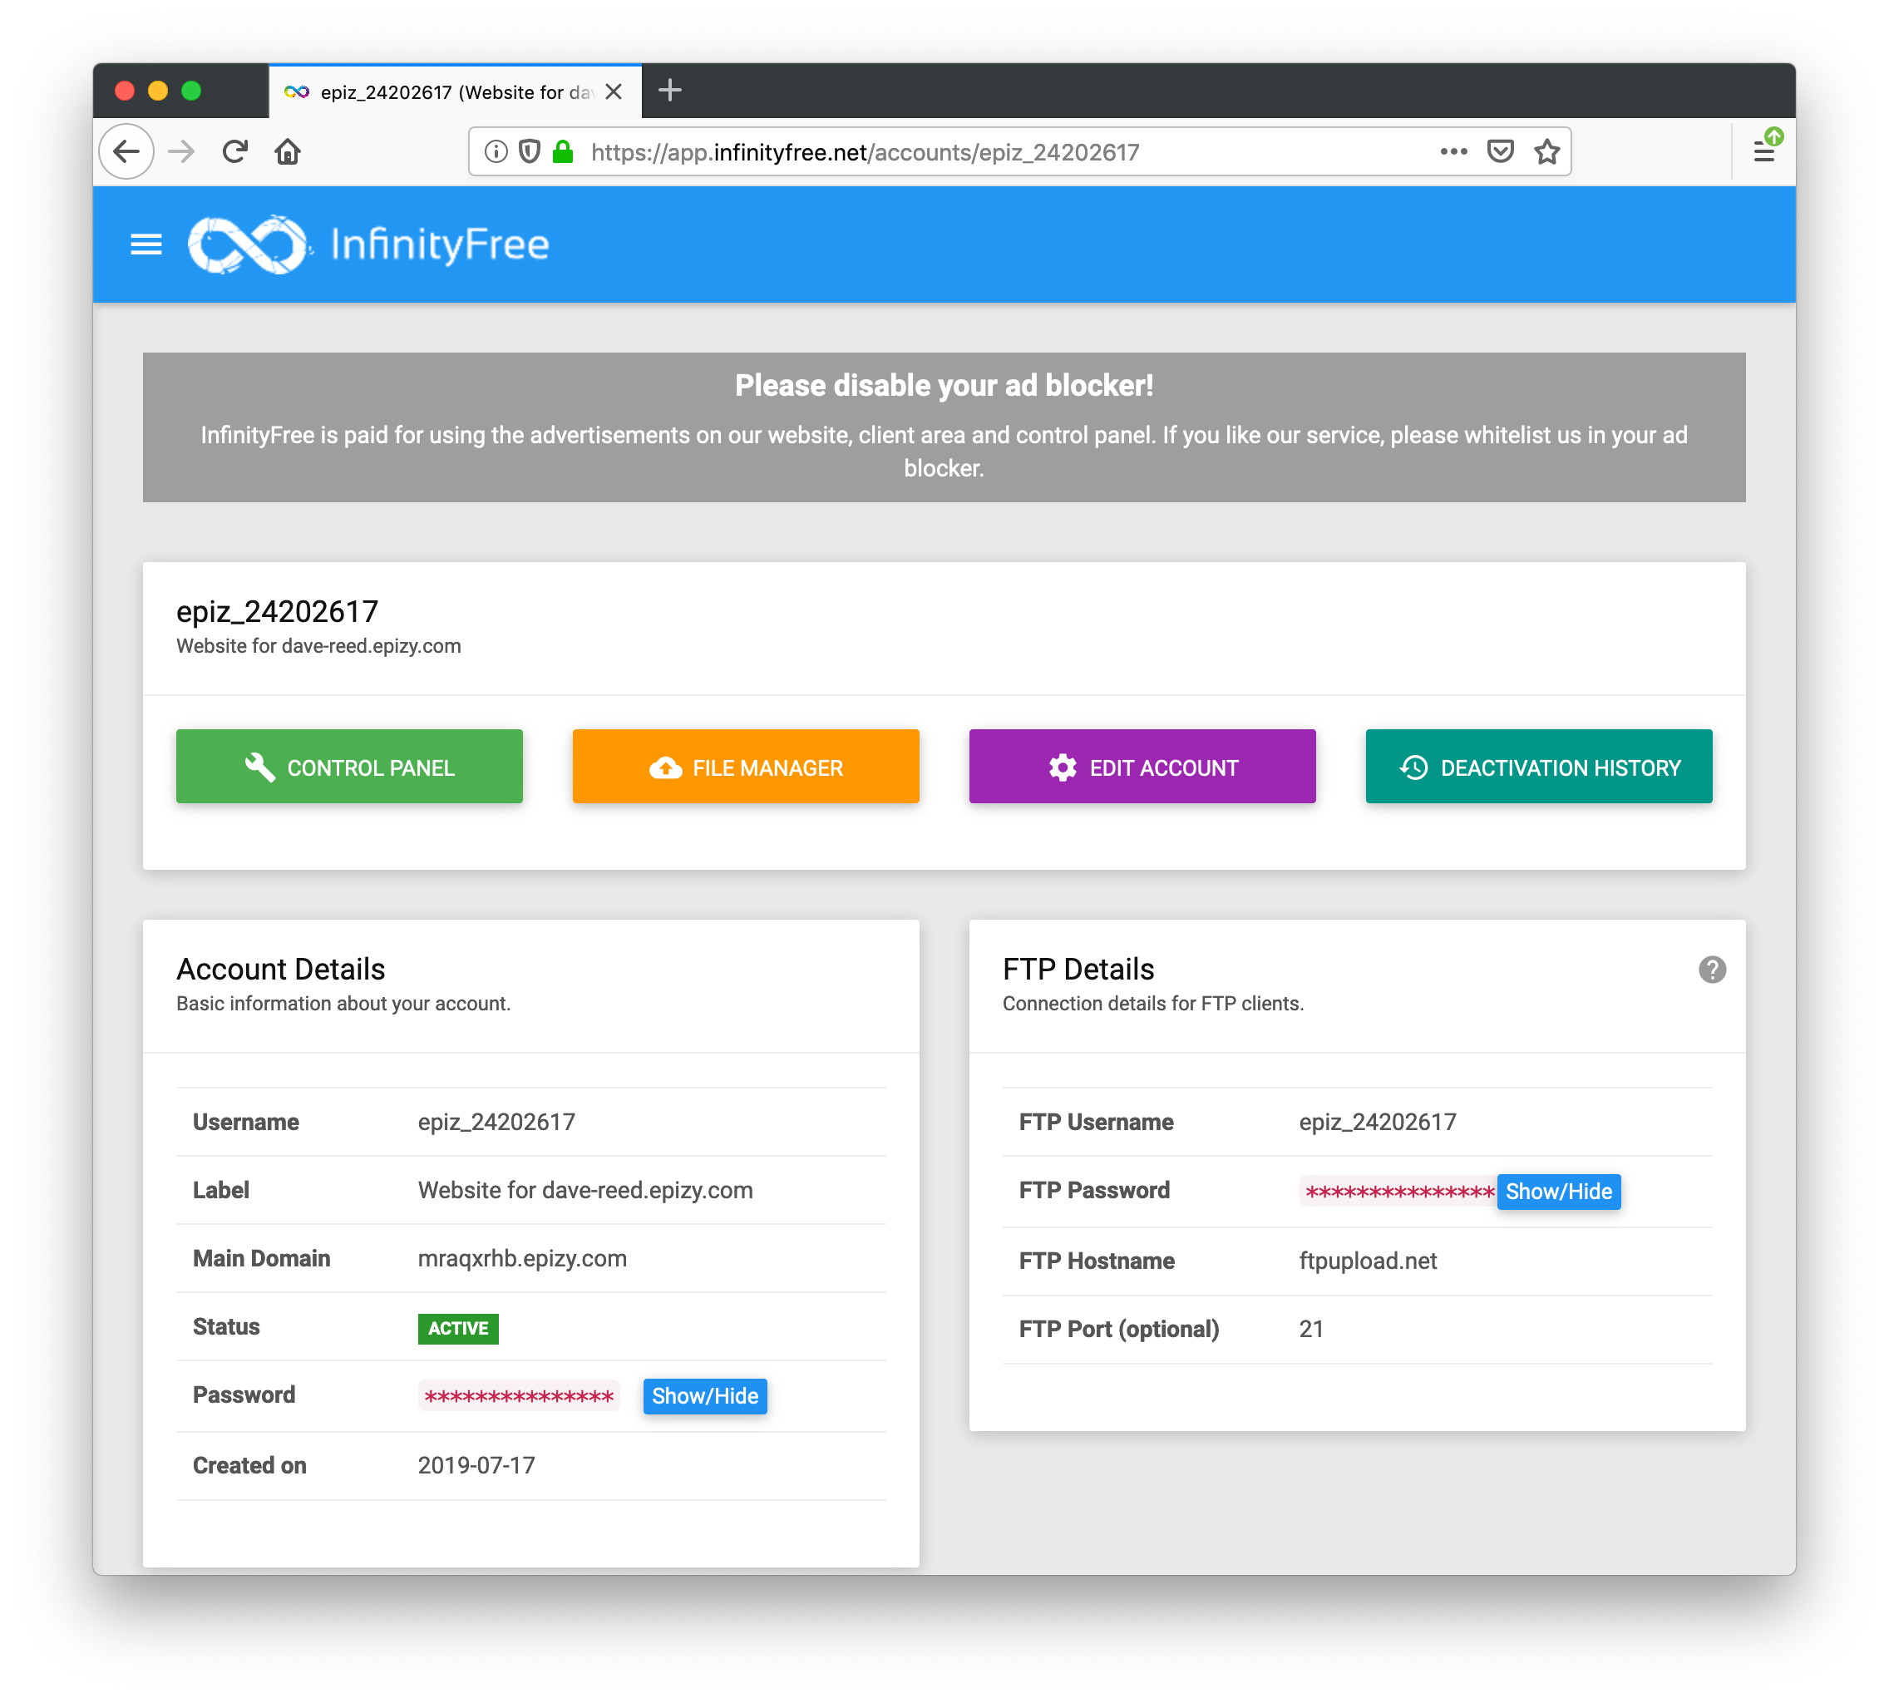
Infinityfree dashboard
once your account is created, the main dashboard shows your options
  note that your Web site URL is subdomain.epizy.com

Slide 4
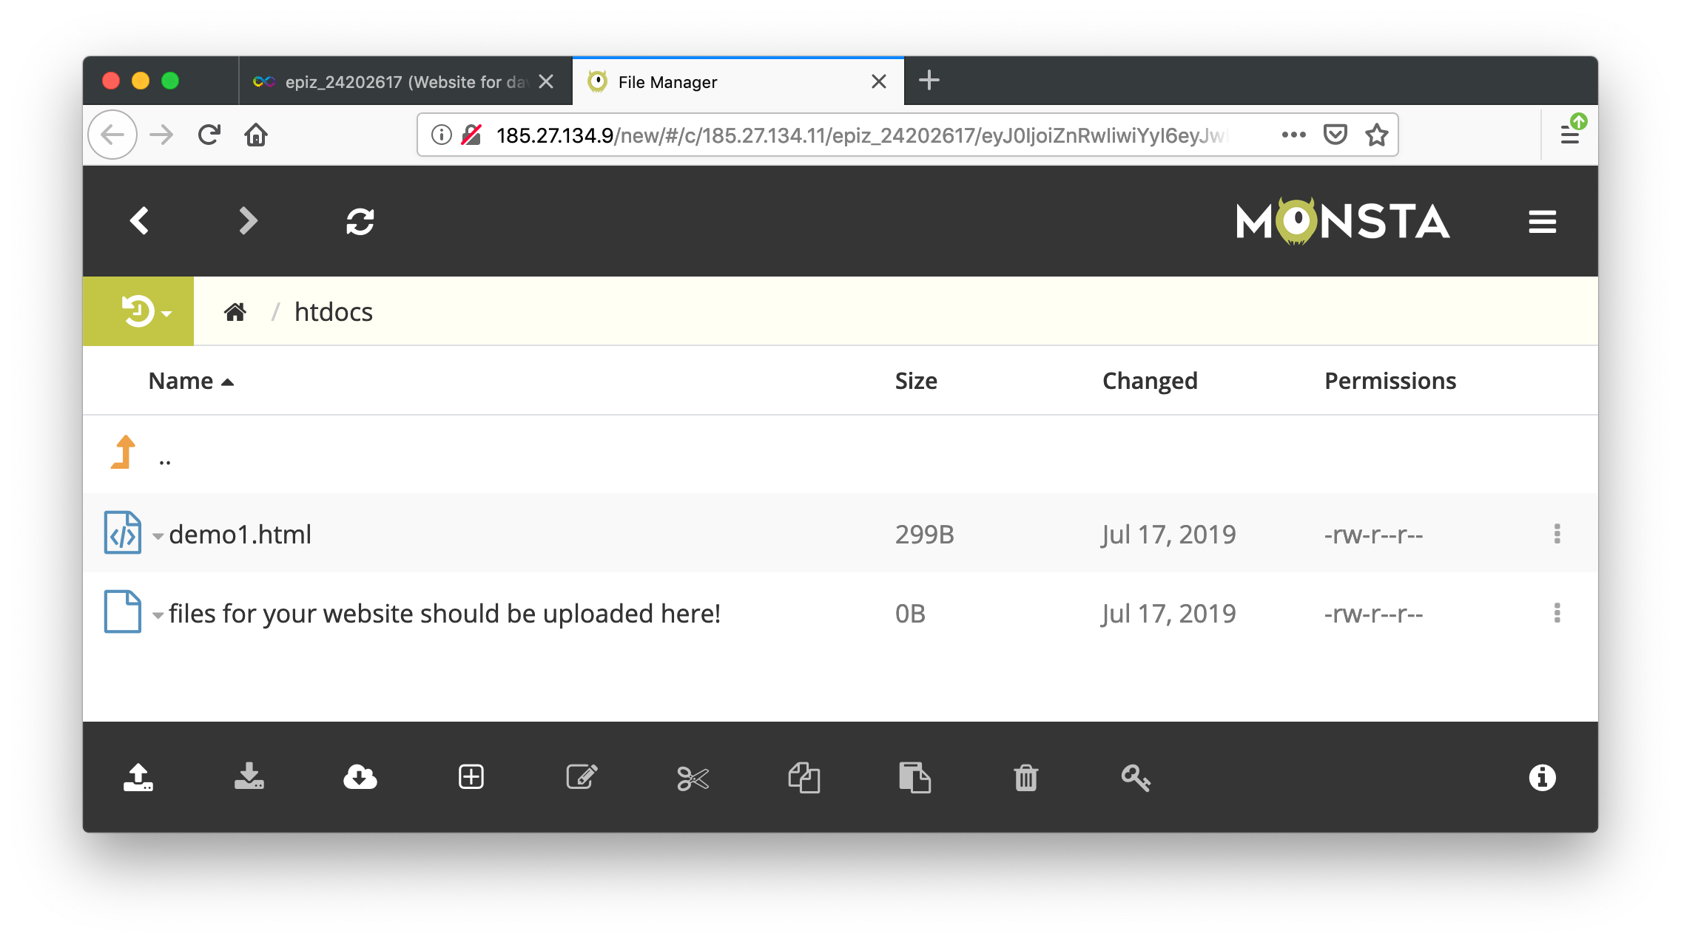
Uploading pages
to upload a page,
  select File Manager
  click on the htdocs folder
  click on the uparrow icon at the bottom left and select Upload File
    you can then browse to select the file to upload

Slide 5
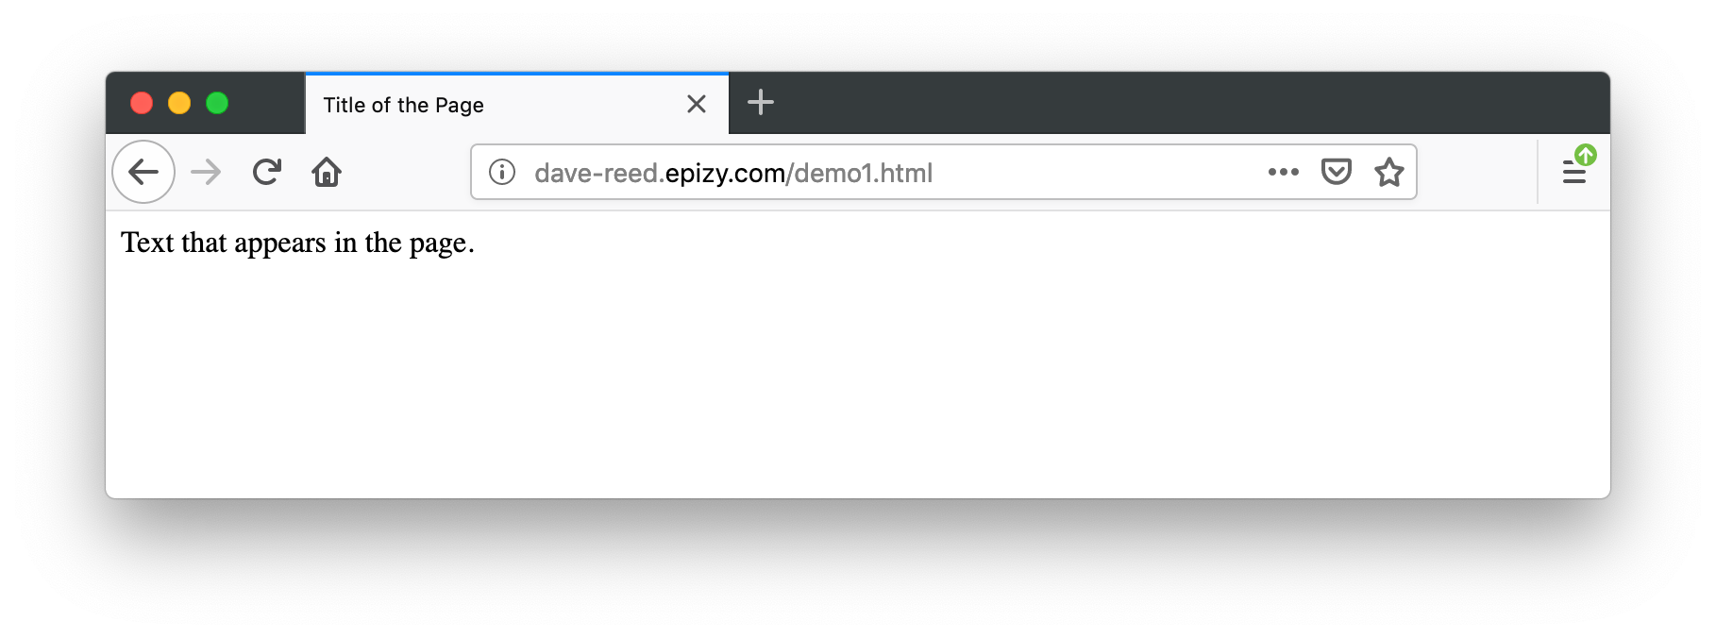
Accessing pages
once the page is uploaded, you can view it as
  subdomain.epizy.com/filename
when uploading pages, be sure to also upload any supporting files (e.g., images, style sheets, related Web pages)

