Slide 1
Computer Science: Concepts & Explorations David Reed, Creighton University
Computational Thinking & Coding

Slide 2
Computational Thinking
recall the high-level characteristics of computational thinking
DECOMPOSITION – breaking a large, complex problem into smaller, more manageable problems
PATTERN MATCHING – recognizing how solutions to similar problems can be applied to new problems
ABSTRACTION – focusing on important details while ignoring irrelevant information
ALGORITHMS – designing and implementing the solution in the form of an algorithm
when designing & developing code (e.g., interactive Web pages), need to keep these characteristics in mind
as we have discussed, code is just an algorithm written for the computer to execute

Slide 3
Decomposition
when you tackle a complex problem, break it into smaller, more manageable pieces
general rule for Web pages:
do the BODY/HTML first, since it must be in place to control the behavior and display the results
then add the HEAD/JavaScript to implement the desired behavior
EXAMPLE: design & implement a slots page
design the look of the page (3 slot images, button, credit counter)
implement the look (HTML elements & formatting)
design the behavior of the page (click to change images, check for winner, update credits)
implement the behavior (JavaScript function & game logic)

Slide 4
Decomposition
similarly, when designing complex behavior within a page, break it into pieces
EXAMPLE: design & implement the slot machine behavior
get slots images to change randomly
add code to check for a winner, pop up alert
add code to update the credit count based on win/loss (since this involves a choice, will need an if statement)
add code to ensure that the game is played only if player has credits
decomposition makes development & testing easier

Slide 5
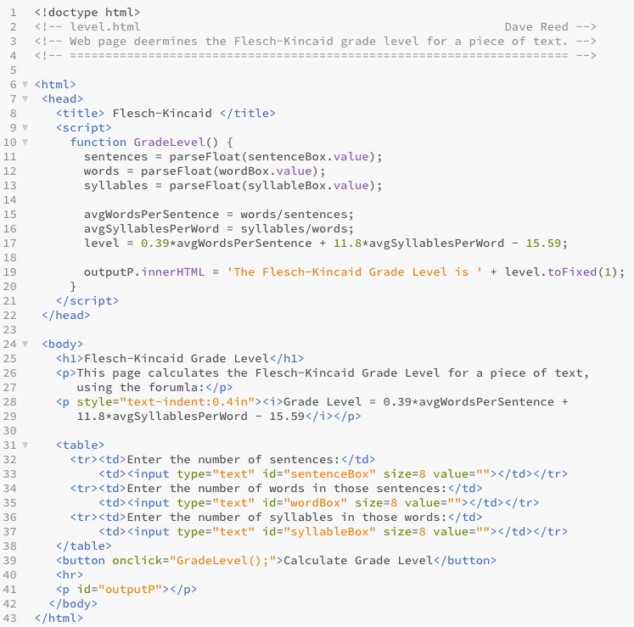
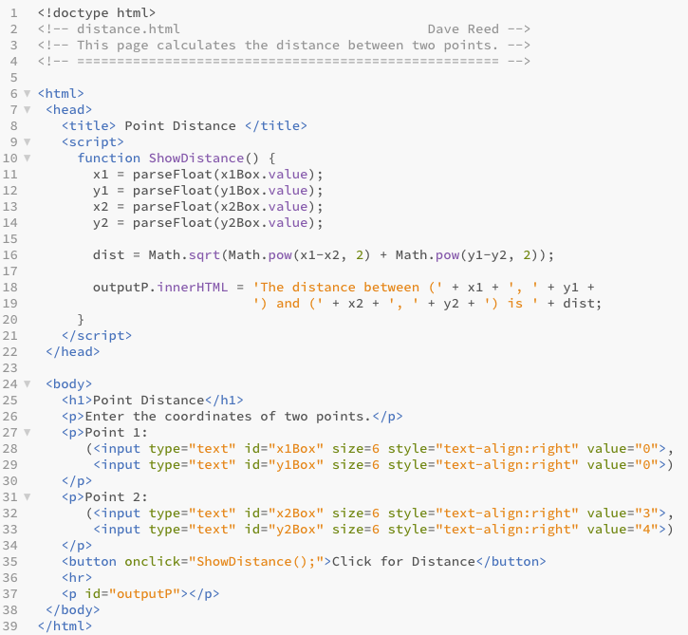
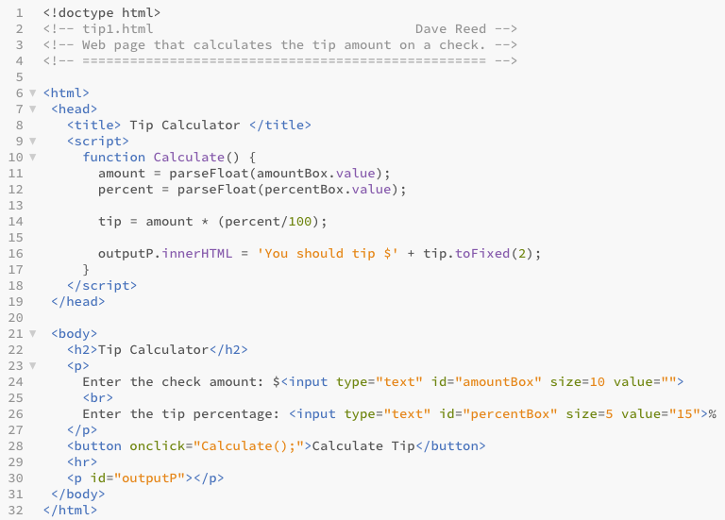
Pattern Matching
it's very rare that you develop a page that is entirely unique
you want to be able to recognize when you have solved a similar problem, and leverage past solutions

Slide 6



Pattern Matching
all three pages follow the same pattern
access numbers from text boxes
perform some calculation(s) using those numbers
display the results of the calculation(s)
accessing the number in a box is the same each time
something = parseFloat(somethingBox.value);
on a test, just showing that you can access the box values can earn you points

Slide 7


Pattern Matching
the calculation(s) vary by the page
since we called parseFloat before storing the values in variables, we know they are already numbers
can just apply math operations (+, -, *, /) and/or built-in functions
on a test, you may not get all the calculation details correct, but you can still earn partial credit

Slide 8
Pattern Matching
displaying the results is similar in each page
outputP.innerHTML =
'The first answer is ' + answer1 +
' and the second is ' + answer2 = '.';
on a test, showing the intent to display a message involving the answer will earn partial credit
note: toFixed is used repeatedly to round results

Slide 9
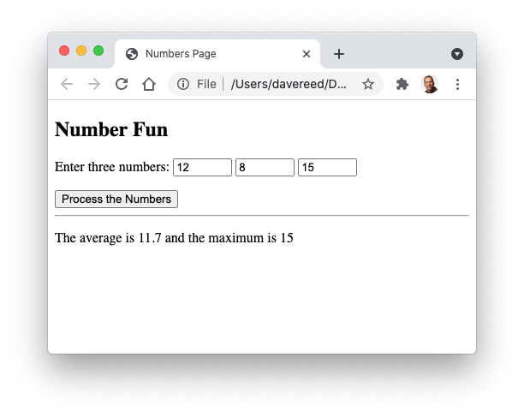
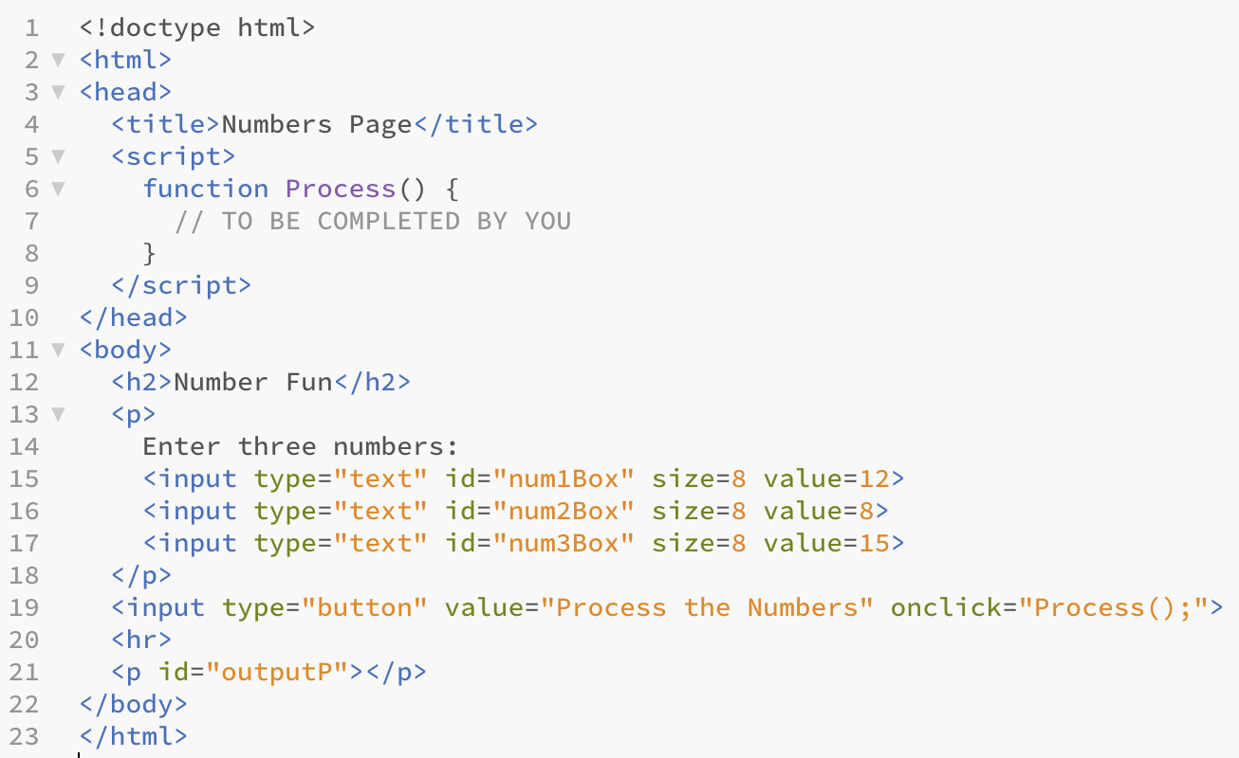
Test 2 Question
how do you tackle a new problem?
decompose into parts
recognize patterns & leverage past solutions
function Process() {
}
code for accessing the box contents (here, three numbers)
code for calculating the needed values (here, avg & max)
code for displaying the results (here, with rounding)

Slide 10
Test 2 Question
on a test, you can get credit for the parts you know even if it doesn't work overall
function Process() {
}
num1 = parseFloat(num1Box.value);
num2 = parseFloat(num2Box.value);
num3 = parseFloat(num3Box.value);
avg = (num1+num2+num3)/3;
max1 = Math.max(num1, num2);
max2 = Math.max(max1, num3);
outputP.innerHTML =
'The average is ' +
avg.toFixed(1) +
' and the maximum is ' +
max2;

Slide 11
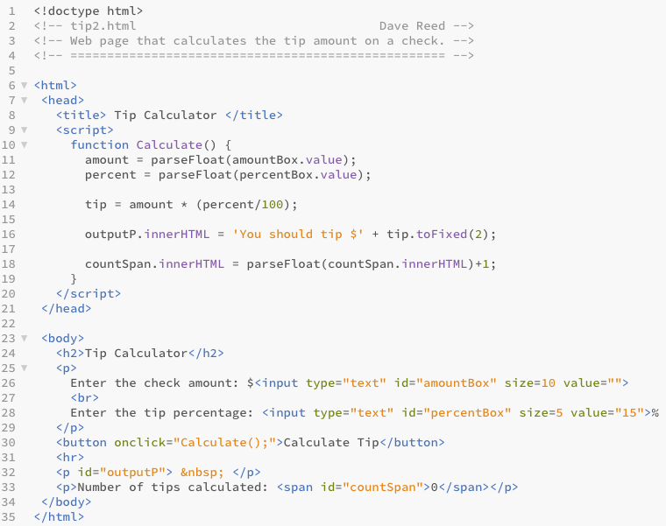
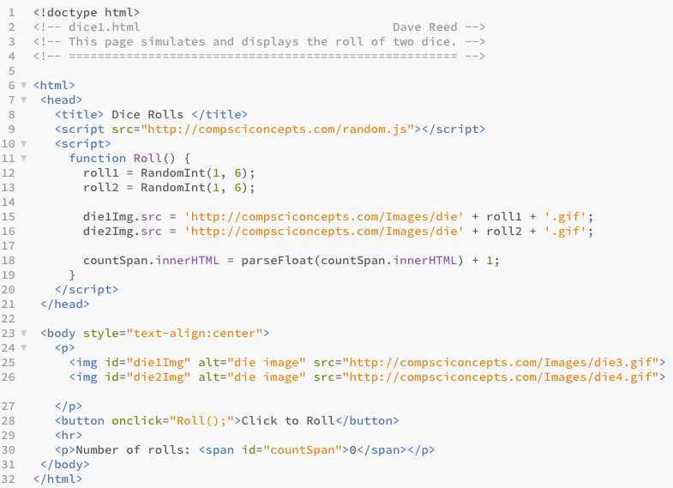
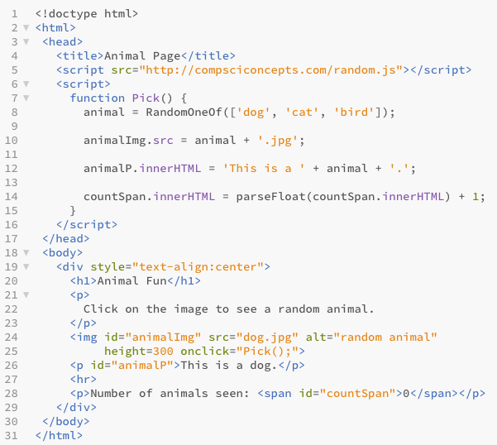
Another Pattern
we have seen a number of pages with embedded counters
need to have a span in the page:
<span id="countSpan">0</span>
update the span in function:
countSpan.innerHTML = parseFloat(countSpan.innerHTML) + 1;

Slide 12
Pattern Revision
note: pattern matching doesn't mean you will always find the exact solution you need
recognize the similarities with a past situation
also recognize the differences, and revise the past solution to fit the new situation
EXAMPLE: for the slots page, you need to keep track of credits
similar to but not quite the same as an embedded counter
counter starts at 0, goes up by 1 each time
credits start at 20, goes down 1 with loss and up 12 with win

Slide 13
Abstraction
built-in JavaScript functions make coding easier
you don't have to know how to find the max of two numbers, just call Math.max(num1, num2)
you don't have to know how to calculate the square root, just call Math.sqrt(num)
the library file random.js contains useful functions involving randomness
can load this library file using <script src=". . ."></script>
can then call those functions (e.g., RandomInt, RandomOneOf) within the page
starting in chapter X4, we introduced user-defined functions
associate a function with each event-handler
simplifies HTML elements, abstracts away behavioral details

Slide 14
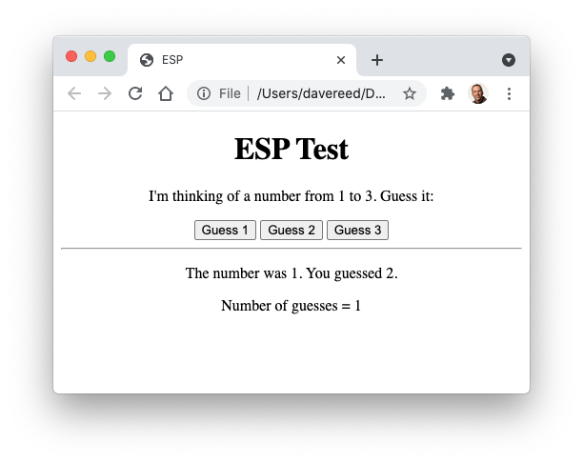
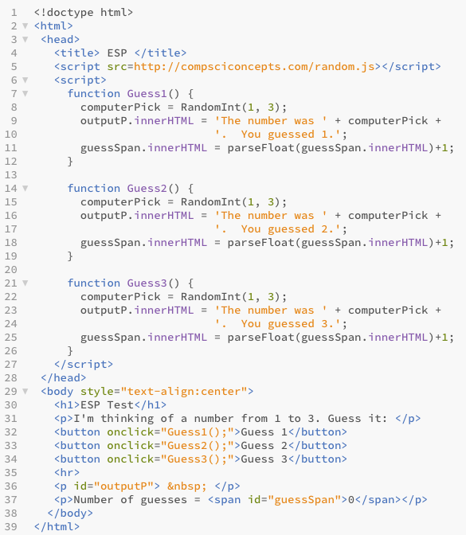
ESP page
up to this point, each event-handler required its own function
EXAMPLE: ESP page
3 buttons → 3 functions
in this case, there is a lot of redundancy
the only difference between the 3 functions is a different user guess displayed
we could simplify this by having one function with an input

Slide 15
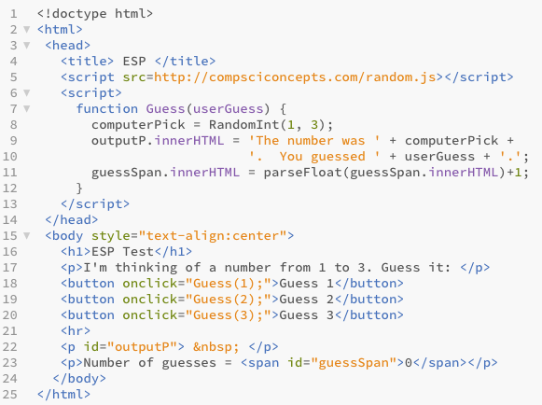
ESP page
in general, each action/event is associated with a function
to change a page's behavior, you change one or more functions

