Slide 1
Computer Science:
Concepts & Explorations
David Reed, Creighton University
Applications in Data Science

Slide 2
Data Science
data science is a relatively new discipline
  uses computer science algorithms, machine learning, and statistical modeling to extract knowledge and insights from (potentially massive) data sets
  it combines elements of computer science, mathematics & statistics
  the term "data science" started being used in the 1990's
  William Cleveland (Bell Labs) wrote an article in 2001 that introduced data science as an independent discipline
  in 2012, data science was tabbed "the sexiest job of the 21st century"
related terms
  data mining
  big data
  business analytics

Slide 3
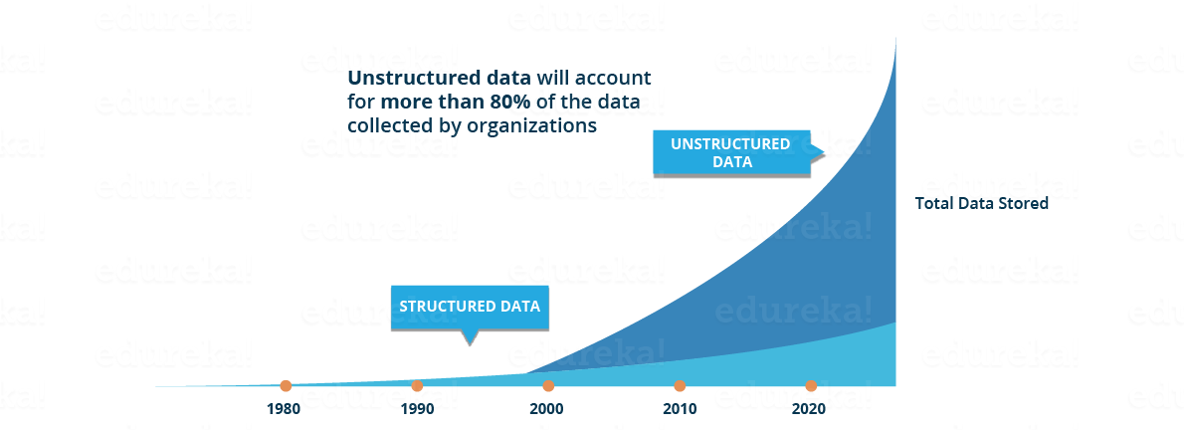
Unstructured data
computer science and statistics have both been effective working with structured data
  when data is organized and neatly classified, can use algorithms or statistical reasoning to draw conclusions or identify patterns
  however, the modern world is producing more data than we can process, let alone organize
  it is estimated that 2.5 billion GB of data are generated each day
    a vast majority is unstructured data
from: edureka!

Slide 4
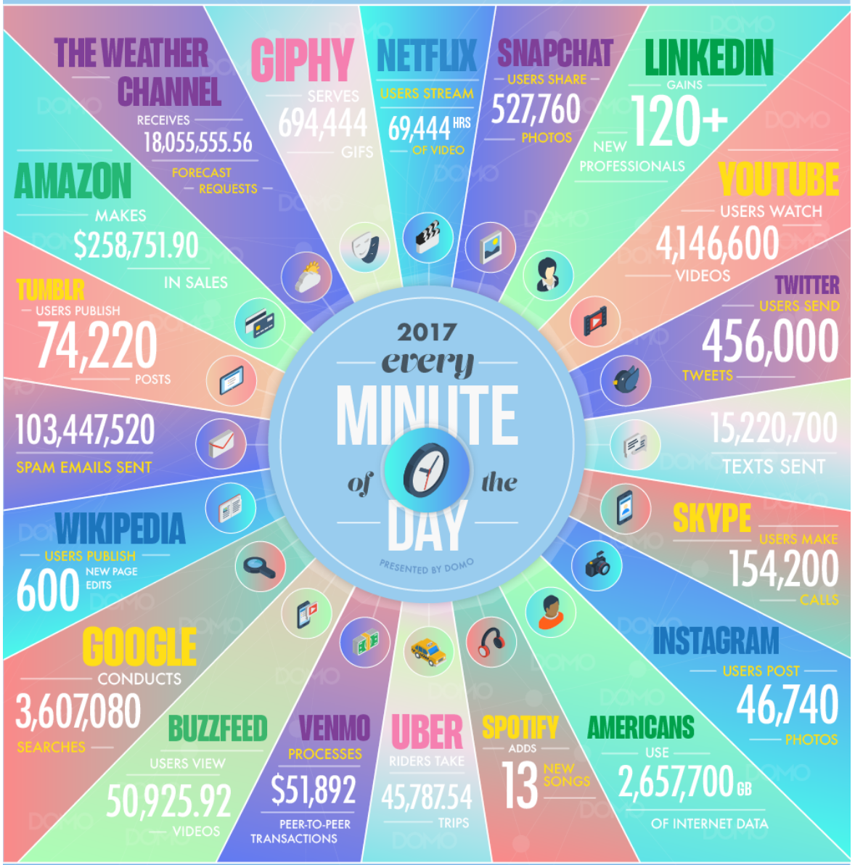
Data overload
in addition,
  Amazon processes tens of millions of transactions a day
  Netflix streams 140 million hours of content a day
  London has more than 627,000 video surveillance cameras

Slide 5
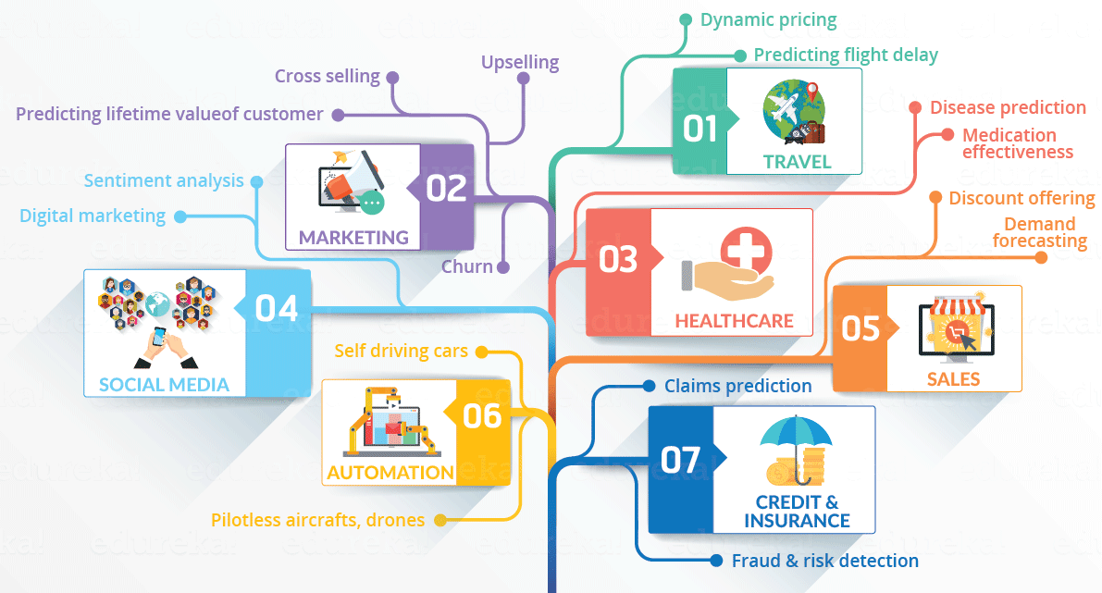
Data science applications
data science is used in a variety of data-driven applications
  often focused on either prediction or pattern discovery
from: edureka!

Slide 6
Supervised vs. unsupervised
DS methods can involve supervised or unsupervised learning
  supervised learning is used when you want to be able to predict future outcomes based on past history
    e.g., stock market forecasting, credit card fraud detection, Amazon recommendations
    also used to train self-driving cars
  unsupervised learning is used when you want to identify useful patterns or gain insights from data
    e.g., sports analytics, consumer marketing trends, public policy making
the most common supervised learning approaches use neural networks
start with a random neural network
train that network by giving it sample input for which the desired output is known – it "learns" what patterns in the inputs yield the different outputs
then, can generalize to new, unknown patterns

Slide 7
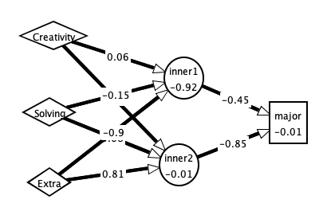
NN example
suppose we wanted to provide guidance on major selection
  hypothesis: certain personality traits or life skills suggest certain majors
  conduct a survey of students, asking them to self-assess their traits/skills on a scale of 0 to 1.0, along with their major
  build a network of artificial neurons, with three inputs (corresponding to survey skills) and a single output (corresponding to major)
 | How creative are you? | Good at problem solving? | How extraverted are you? | Major
stu1 | 0.85 | 0.75 | 0.9 | GDE (0)
stu2 | 0.9 | 0.7 | 1.0 | GDE (0)
stu3 | 0.8 | 0.9 | 0.6 | GDE (0)
stu4 | 0.2 | 0.9 | 0.2 | CSC (1)
stu5 | 0.6 | 0.8 | 0.4 | CSC (1)
stu6 | 0.7 | 0.7 | 0.7 | CSC (1)

Slide 8
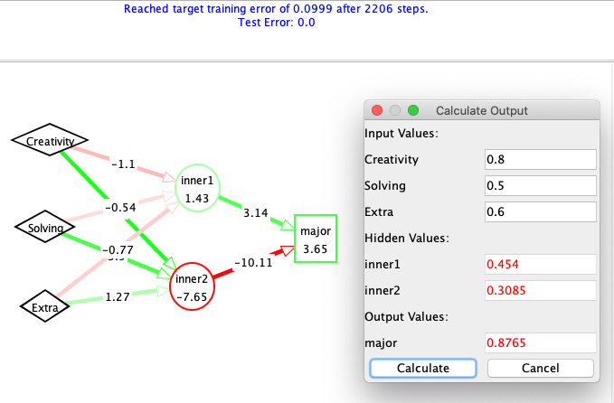
Neural networks
  feed those inputs and outputs to the network and train it to recognize
  once trained, it can be applied to new patterns to classify them (based on best fit)
 | How creative are you? | Good at problem solving? | How extraverted are you? | Major
stu1 | 0.85 | 0.75 | 0.9 | GDE (0)
stu2 | 0.9 | 0.7 | 1.0 | GDE (0)
stu3 | 0.8 | 0.9 | 0.6 | GDE (0)
stu4 | 0.2 | 0.9 | 0.2 | CSC (1)
stu5 | 0.6 | 0.8 | 0.4 | CSC (1)
stu6 | 0.7 | 0.7 | 0.7 | CSC (1)
note: this is a very small, non-scientific example
  data scientists typically deal with massive amounts of data (e.g., hundreds or thousands of survey responses)
  utilize analytical methods to ensure statistical significance

Slide 9
Generalization problem
suppose a network is trained to recognize digits:
  training set for 1:
  training set for 2:
1
1
1
1
2
2
2
2
2
  when the network is asked to identify it comes back with 1. WHY?
there is always a danger that the network will focus on specific (maybe unintentional) features as opposed to general patterns
to avoid networks that are too specific, cross-validation can be used
  split training set into training & validation data
  after each generation, test the net on the validation data
  continue until performance on the validation data diminishes

Slide 10
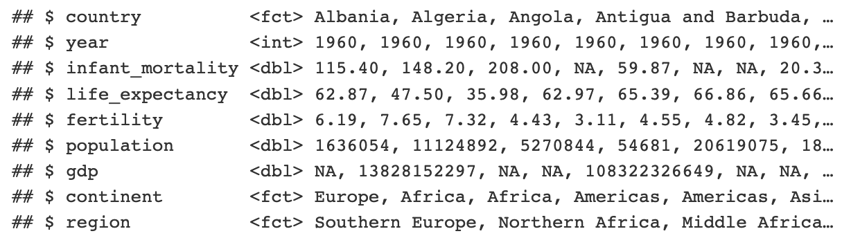
Clustering
with unsupervised learning, you may not know what features are important or relevant
  you are hoping to identify patterns in the data & gain insights
clustering is a common unsupervised learning technique
consider health policy-making,
  given stats on life expectancy, infant mortality, fertility, gdp, …
  would like to identify countries that are "similar"
  could then consider programs tried in similar countries, compare effectiveness

Slide 11
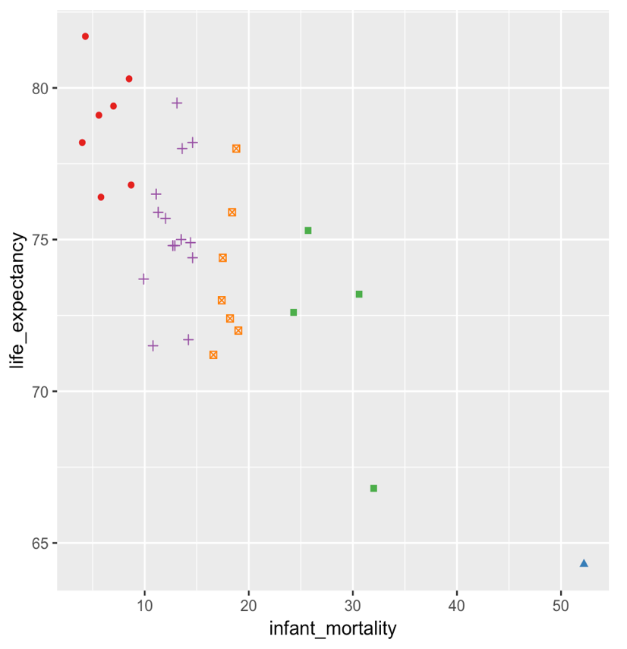
Clustering
here, western hemisphere countries are graphed based on two stats (we could generalize to more dimensions)
similar countries are grouped into clusters (using different colors)
clustering has been used by law enforcement to identify trouble spots, insurance companies to identify earthquake risk, media companies to identify viewer segments, …
  would like to identify countries that are "similar"
  could then consider programs tried in similar countries, compare effectiveness

