Slide 1
Computer Science:
Concepts & Explorations
David Reed, Creighton University
Applications in Cryptography

Slide 2
Cryptography
  encryption is the process of encoding a message so that it is decipherable only by its intended recipient
  cryptography is the study of methods for encrypting and decrypting messages
  the earliest known encryption algorithms are
  Atbash cipher (500 B.C.), used by Hebrew scribes
  Caesar cipher (50-60 B.C.), used by Julius Caesar
  both are known as substitution ciphers, since they substitute one letter for another in the message

Slide 3
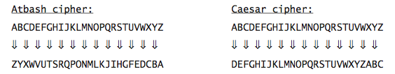
Substitution Ciphers
Atbash cipher substitutes the corresponding letter from the reverse alphabet
Caesar cipher substitutes the letter three later in the alphabet (wrapping back around to the beginning)
  ABC → ZYX ABC → DEF
  HELLO → SVOOL HELLO → KHOOR
substitution ciphers are easy to understand and use

Slide 4
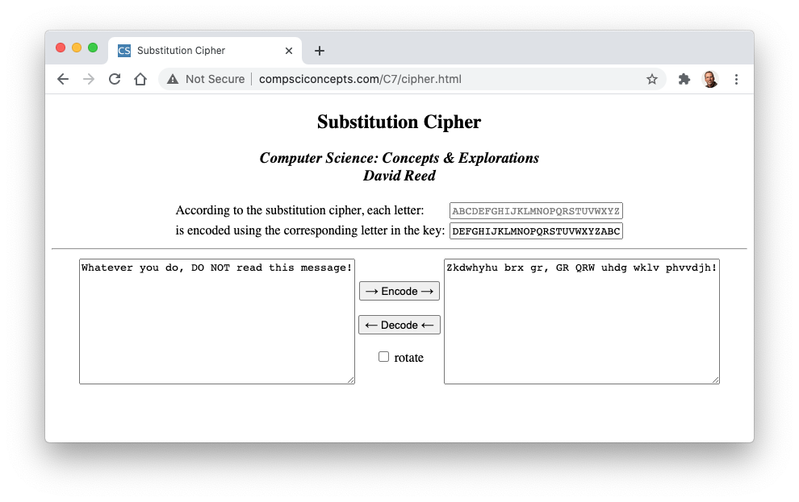
Web page
note: when decoding, the roles of the alphabet & key are reversed

Slide 5
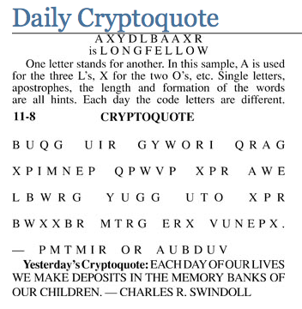
Breaking codes
in theory, substitution ciphers are reasonably secure
  26! ≈ 4 x 10²⁶ possible substitution keys
  however, patterns in letters provide clues for deducing the key (e.g., letter frequency analysis)
  Cryptoquotes are common newspaper puzzles that require breaking a substitution cipher to decode a quotation

Slide 6
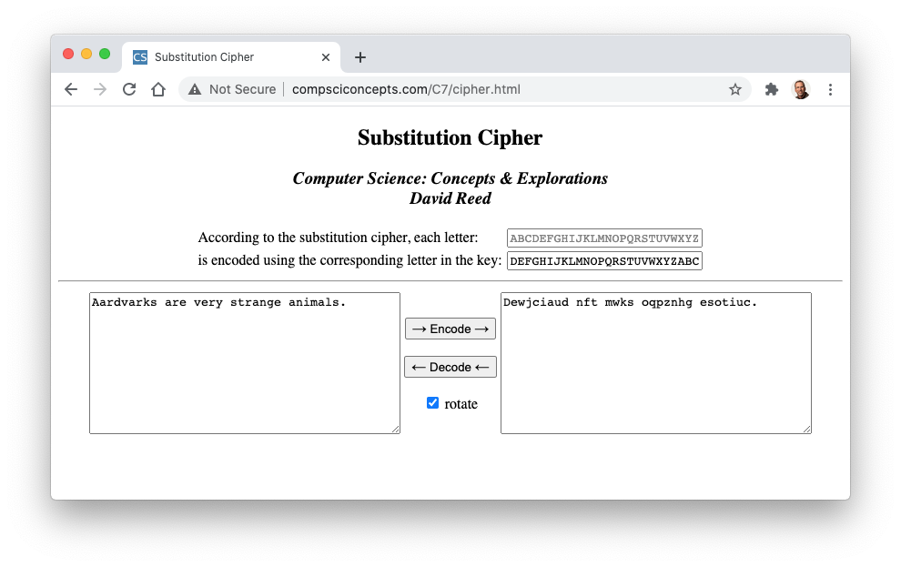
Rotating ciphers
one technique for making substitution ciphers harder to break is rotating the key (i.e., shifting left) after each letter is encoded

Slide 7
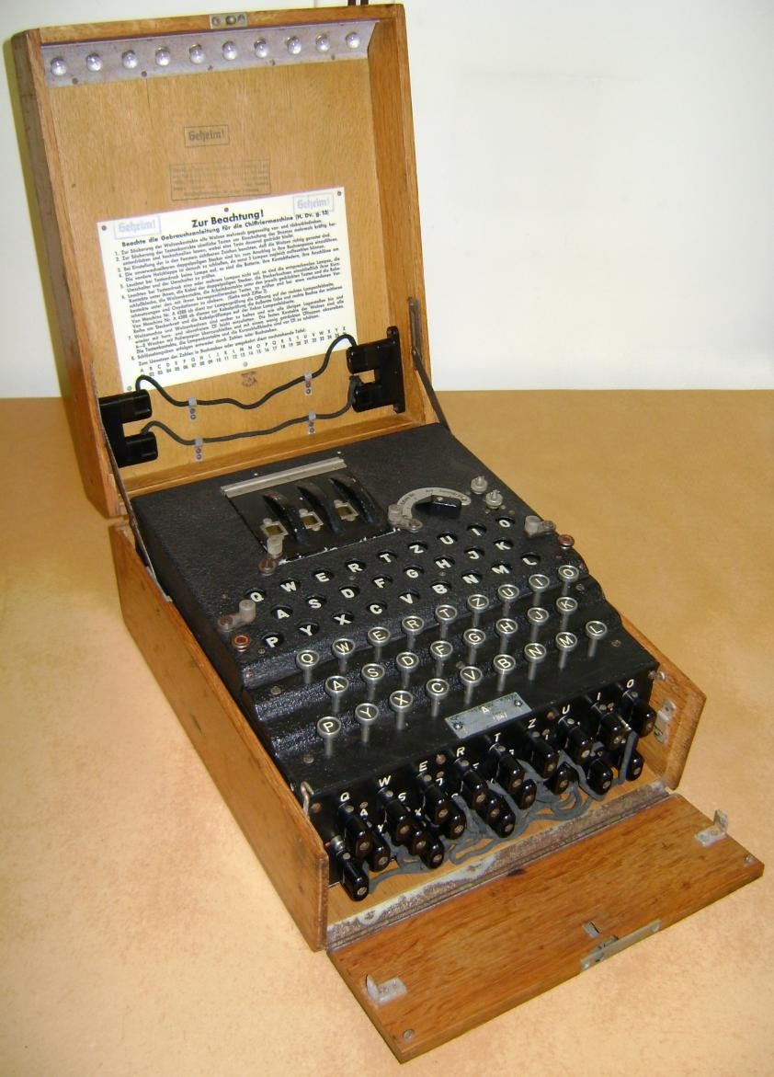
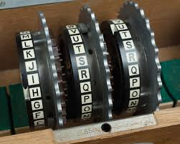
Historical excursion
during WWII, the German military used a typewriter-like device called an Enigma machine to encode/decode communications
  the machine utilized interchangeable rotors with internal circuitry that mapped each letter to another letter (i.e., a substitution cipher)
  however, the rotors rotated in a complex pattern between letters, yielding a complex, dynamic substitution pattern – thought to be unbreakable

Slide 8
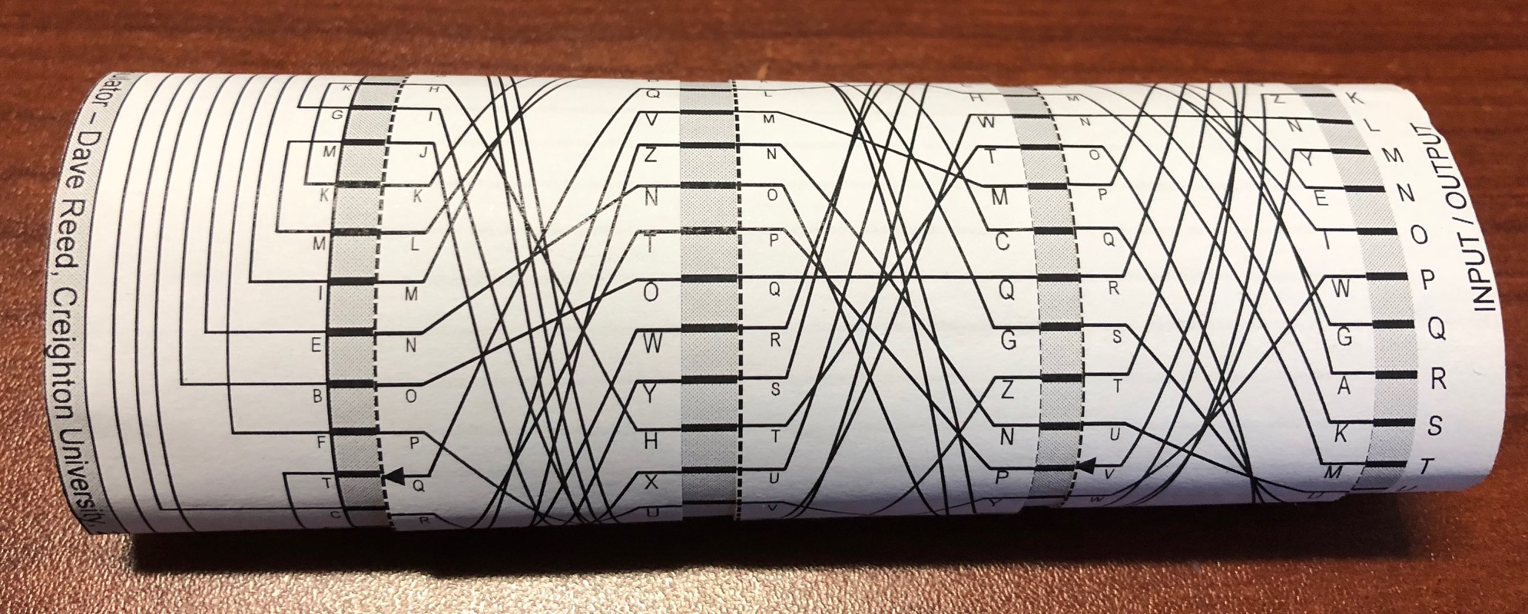
Historical excursion
efforts to break the Enigma code led to the first electronic computers
  the Bombe (designed by Alan Turing), and its successor Colossus, were used to generate and test Enigma keys
  they enabled the Allies to break the Enigma code for extended periods during the war, achieving immense tactical advantage
  historians estimate that breaking Enigma shortened the war by 2 years, saving more than 14 million lives
it is possible to simulate the behavior of a basic Enigma machine using a simple paper model

Slide 9
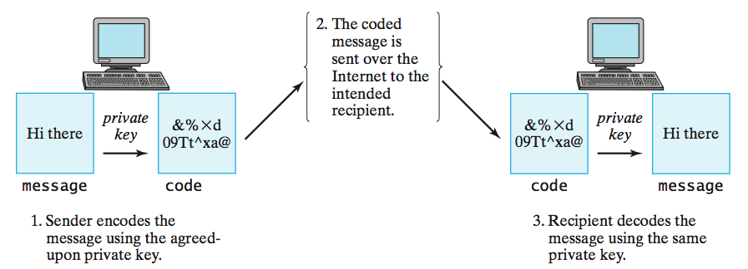
Private-key encryption
substitution ciphers are examples of private-key encryption
  rely on the sender and the recipient sharing a secret key/password
  must keep that key/password secret, or intercepted messages could be decoded
some modern encryption algorithms rely on private keys
  e.g., Advanced Encryption Standard (AES) was adopted by the U.S. govt in 2001
  utilizes 256-bit keys (2²⁵⁶ ≈ 10⁷⁷ possibilities)
private-key encryption assumes that the sender and recipient have agreed upon some key ahead of time (which introduces other security risks)

Slide 10
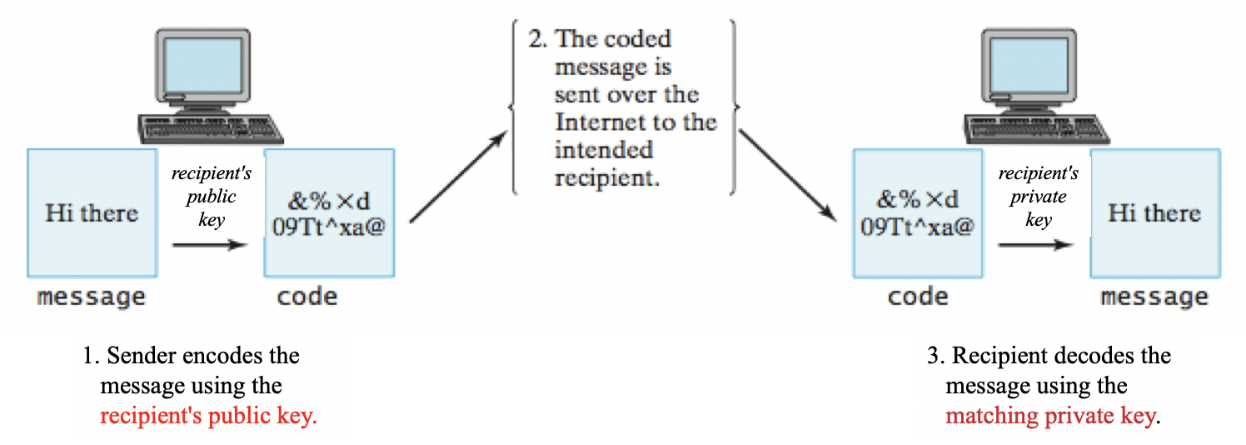
Public-Key Encryption
in mid 1970s, Diffie and Hellman introduced public-key encryption
  the recipient generates a pair keys
  the public key can be freely shared with anyone
  the private key must be kept secure
  a message encoded with a public key can only be decoded by the corresponding private key, so broadcasting an encrypted message is safe
  note: the math behind key generation and encoding/decoding is INTENSE!
virtually all secure communication on the Internet uses public-key encryption

Slide 11
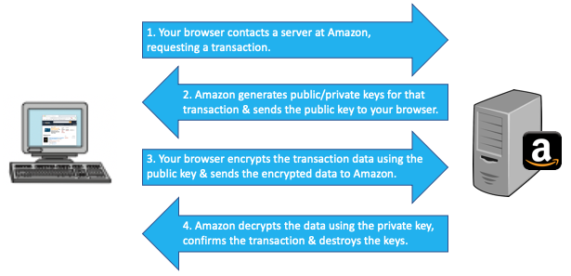
Public-Key Encryption
e.g., when you purchase something on Amazon
  a similar exchange occurs between a laptop and wifi router when using a secure wireless network
  likewise, for accessing any Web page that starts with https://

Slide 12
Encryption in the news
the 5th amendment protects a suspect from self-incrimination
  historically, this has meant that a suspect need not answer questions in an investigation or trial
  recent cases have brought into question the role of encryption
can/should a suspect be forced to provide his/her private key in order to decrypt incriminating data?
PROS?
CONS?

