Slide 1
Computer Science: Concepts & Explorations David Reed, Creighton University
Applications in Artificial Intelligence

Slide 2
Artificial Intelligence
Artificial Intelligence (AI) is a subfield of computer science closely tied with biology and cognitive science
AI is concerned with computing techniques and models that simulate/investigate intelligent behavior
AI research builds upon our understanding of the brain and evolutionary development
in return, AI research provides insights into the way the brain works, as well as the larger process of biological evolution
three important research areas in AI are:
expert systems: building rule-based systems that utilize expert knowledge in order to diagnose problems or identify solutions
neural networks: building a model of the brain and "training" that model to recognize certain types of patterns
genetic algorithms: "evolving" solutions to complex problems (especially problems that are intractable using other methods)

Slide 3
Expert Systems
expert systems encapsulate the knowledge and reasoning of experts in specific domains
in 70s and 80s, rule-based expert systems replaced human expertise in many diagnosis situations
expert systems are still popular & profitable today, but utilize many different techniques
EXAMPLE: tax-law is complex & experts are in demand
much of human expertise can be encapsulated into rules
IF single AND itemized_deductions < $12,550 THEN use_standard_deduction
IF medical_expenses > 0.075*AGI THEN deduct_expenses
tax software (e.g., H&R Block, TaxCut) includes an expert system that asks questions, applies rules, and fills out tax forms for you

Slide 4
Expert Systems & Uncertainty
in applications involving diagnosis or analysis, expert systems must handle uncertainty
e.g., consider medical diagnosis – the same symptoms can suggests multiple diseases
IF congestion AND cough THEN allergies
IF cough AND fever THEN flu
can add probabilities or certainty factors to rules
IF congestion AND cough THEN allergies (40% of time)
IF cough AND fever THEN flu (50% of time)
can even deal with uncertain data
patient has little congestion (0.2), persistent cough (0.6), high fever (0.95)
Rule1: min(0.2, 0.6) = 0.2 * 0.40 = 0.08 very little evidence of allergies
Rule 2: min(0.6, 0.95) = 0.6 * 0.5 = 0.30 suggestive of flue

Slide 5
Expert System Applications
expert systems have been highly effective in diagnosis/advising applications that utilize complex but extractable knowledge
medical diagnosis
customer support
process control systems
tax and finance management
the challenge is finding domains where expertise is straightforward to extract & experts are expensive
once the expertise is extracted and the expert system is built, can be widely proliferated at little to no cost
the term "expert system" has somewhat fallen out of favor
modern expert systems utilize big data and machine learning algorithms
usually now just referred to as AI systems

Slide 6
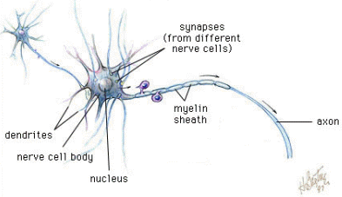
Neural Networks
the idea of neural networks predates modern computers
in 1943, McCulloch and Pitts described a simple computational model of a neuron
neural networks were a focus of CS research in the 1950's
humans lack the speed & memory of computers, yet are capable of complex reasoning/action → maybe our brain architecture is well-suited for certain tasks
general brain architecture:
many (relatively) slow neurons, interconnected
dendrites serve as input devices (receive electrical impulses from other neurons)
cell body "sums" inputs from the dendrites (possibly inhibiting or exciting)
if sum exceeds some threshold, the neuron fires an output impulse along axon

Slide 7
Artificial Neurons
neural networks are based on the brain metaphor
large number of simple, neuron-like processing elements
large number of weighted connections between neurons
note: the weights encode information, not symbols!
parallel, distributed control
emphasis on learning
McCulloch & Pitts (1943) described an artificial neuron
inputs are either electrical impulse (1) or not (0)
each input has a weight associated with it
the activation function multiplies each input value by its weight
if the sum of the weighted inputs >= θ,
then the neuron fires (returns 1), else doesn't fire (returns 0)
if Σw_{i}x_{i} >= θ, output = 1
if Σw_{i}x_{i} < θ, output = 0

Slide 8
Computation via Neurons
can view an (artificial or not) neuron as a computational element
accepts or classifies an input if the output fires
INPUT: x₁ = 1, x₂ = 1
.75*1 + .75*1 = 1.5 >= 1 ➔ OUTPUT: 1
INPUT: x₁ = 1, x₂ = 0
.75*1 + .75*0 = .75 < 1 ➔ OUTPUT: 0
INPUT: x₁ = 0, x₂ = 1
.75*0 + .75*1 = .75 < 1 ➔ OUTPUT: 0
INPUT: x₁ = 0, x₂ = 0
.75*0 + .75*0 = 0 < 1 ➔ OUTPUT: 0
this neuron computes the AND function

Slide 9
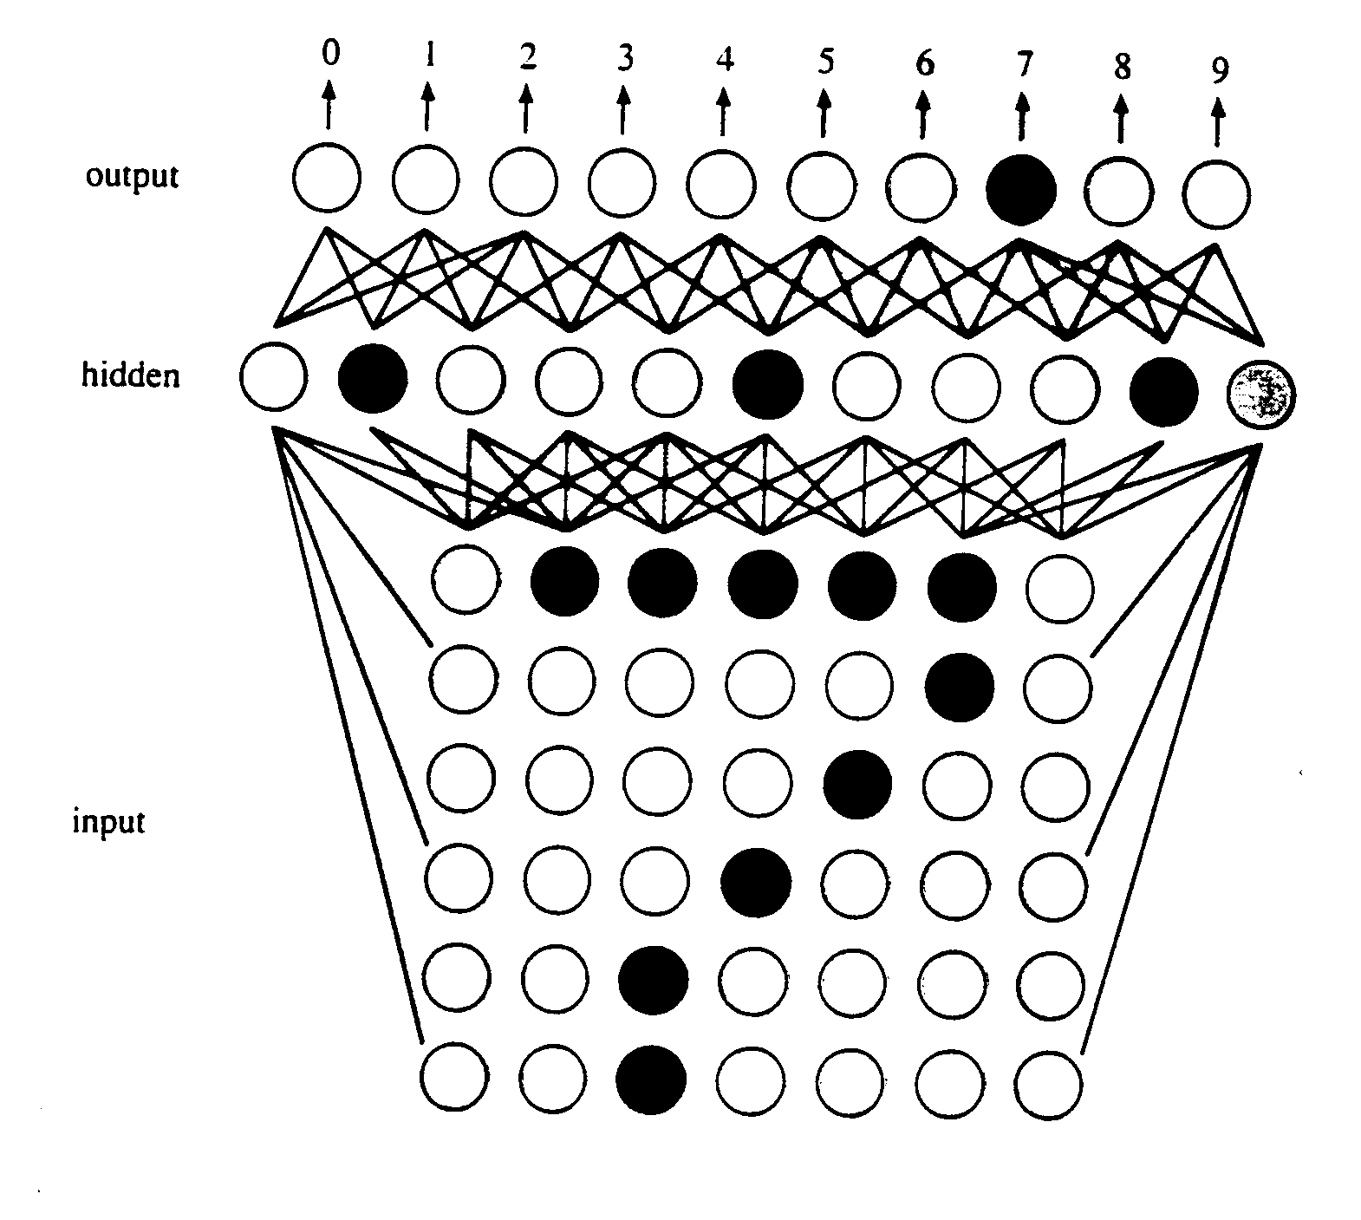
Learning Algorithm
Rosenblatt (1958) devised a learning algorithm for artificial neurons
start with a training set (example inputs & corresponding desired outputs)
train the network to recognize the examples in the training set (by adjusting the weights on the connections)
once trained, the network can be applied to new examples
while this algorithm is simple and easy to execute, it doesn't always work
there are some patterns that cannot be recognized by a single neuron
however, by adding additional layers of neurons, the network can develop complex feature detectors (i.e., internal representations)
e.g., Optical Character Recognition (OCR)
perhaps one hidden unit "looks for" a horizontal bar
another hidden unit "looks for" a diagonal
another looks for the vertical base
the combination of specific hidden units indicates a 7

Slide 10
Neural Net Applications
pattern classification
9 of top 10 US credit card companies use Falcon
uses neural nets to model customer behavior, identify fraud
claims improvement in fraud detection of 30-70%
scanners, tablet PCs, PDAs -- Optical Character Recognition (OCR)
prediction & financial analysis
Merrill Lynch, Citibank, … -- financial forecasting, investing
Spiegel – marketing analysis, targeted catalog sales
control & optimization
Texaco – process control of an oil refinery
Intel – computer chip manufacturing quality control
AT&T – echo & noise control in phone lines (filters and compensates)
Ford engines utilize neural net chip to diagnose misfirings, reduce emissions
self-driving vehicles
video pixels and GPS data act as inputs to neural network
the network learns to interpret the video, control the vehicle

Slide 11
Evolutionary Models
neural networks are patterned after the processes underlying brain activity
artificial neurons are interconnected into networks
information is sub-symbolic, stored in the strengths of the connections
genetic algorithms represent an approach to problem-solving that is patterned after the processes underlying evolution
potential solutions to problems form a population
better (more fit) solutions evolve through natural selection
Darwin saw "… no limit to the power of slowly and beautifully adapting each form to the most complex relations of life …"
through the process of introducing variations into successive generations and selectively eliminating less fit individuals, adaptations of increasing capability and diversity emerge in a population
evolution and emergence occur in populations of embodied individuals, whose actions affect others and that, in turn, are affected by others
selective pressures come not only from the outside, but also from the interactions between members of the population

Slide 12
Evolution & Problem-Solving
evolution slowly but surely produces populations in which individuals are suited to their environment
the characteristics/capabilities of individuals are defined by their chromosomes
those individuals that are most fit (have the best characteristics/capabilities for their environment) are more likely to survive and reproduce
since the chromosomes of the parents are combined in the offspring, combinations of fit characteristics/capabilities are passed on
with a small probability, mutations can also occur resulting in offspring with new characteristics/capabilities
in 1975, psychologist/computer scientist John Holland applied these principles to problem-solving → genetic algorithms
solve a problem by starting with a population of candidate solutions
using reproduction, mutation, and survival-of-the-fittest, evolve even better solutions

Slide 13
Genetic Algorithm (GA)
for a given problem, must define:
chromosome: bit string that represents a potential solution
fitness function: a measure of how good/fit a particular chromosome is
reproduction scheme: combining two parent chromosomes to yield offspring
mutation rate: likelihood of a random mutation in the chromosome
replacement scheme: replacing old (unfit) members with new offspring
termination condition: when is a solution good enough?
in general, the genetic algorithm:
start with an initial (usually random) population of chromosomes
while the termination condition is not met
evaluate the fitness of each member of the population
select members of the population that are most fit
produce the offspring of these members via reproduction & mutation
replace the least fit member of the population with these offspring
essentially, attempt to evolve better and better solutions

Slide 14
GA example
Suppose you are the logistics manager for a trucking company. You have items to ship, and a truck that can only hold 500 pounds or cargo. How do you select the items to put in the truck with the maximum dollar value?
cabinet $5000 30 lbs
shelves $2200 50 lbs
statue $2100 400 lbs
desk $2000 80 lbs
stereo $1200 100 lbs
chair $800 250 lbs
console $600 10 lb
clock $300 40 lbs
could try a greedy approach (take next highest value item that fits)
based on value: cabinet+shelves+statue+console = 490 lbs, $9,900
note that this collection is not optimal
cabinet+shelves+desk+stereo+console+clock = 310 lbs, $11,300

Slide 15
GA example (cont.)
cabinet $5000 30 lbs
shelves $2200 50 lbs
statue $2100 400 lbs
desk $2000 80 lbs
stereo $1200 100 lbs
chair $800 250 lbs
console $600 10 lb
clock $300 40 lbs
chromosome: a string of 8 bits with each bit corresponding to an item
1 implies that the corresponding item is included; 0 implies not included
e.g., 11100000 represents (cabinet+shelves+statue)
01101001 represents (shelves+statue+stereo+clock)
fitness function: favor collections with higher values
fit(chromosome) = sum of dollar amounts of items, or 0 if weight > 500
e.g., fit(11100000) = 9300
fit(01101001) = 0
reproduction scheme: utilize crossover (a common technique in GA's)
pick a random index, and swap left & right sides from parents
e.g., parents 11100000 and 01101000, pick index 4
1110|0000 and 0110|1000 yield offspring 11101000 and 01100000

Slide 16
GA example (cont.)
cabinet $5000 30 lbs
shelves $2200 50 lbs
statue $2100 400 lbs
desk $2000 80 lbs
stereo $1200 100 lbs
chair $800 250 lbs
console $600 10 lb
clock $300 40 lbs
visual example: www.rennard.org/alife/english/gavgb.html
Generation 0 (randomly selected):
11100000 (fit = 9300) 01101000 (fit = 0) 11001011 (fit = 9300)
11010000 (fit = 9200) 00010100 (fit = 2800) 01001011 (fit = 4300)
11110111 (fit = 0) 10011000 (fit = 8200)
choose fittest 4, perform crossover with possibility of mutation
111000|00 + 110010|11 → 11100011 11001001
110|10000 + 100|11000 → 11011000 10010000
Generation 1 (replacing least fit from Generation 0):
11100000 (fit = 9300) 11100011 (fit = 0) 11001011 (fit = 9300)
11010000 (fit = 9200) 11001001 (fit = 8700) 11011000 (fit = 10400)
10010000 (fit = 7000) 10011000 (fit = 8200)
choose fittest 4, perform crossover with possibility of mutation
1101|1000 + 1100|1011 → 11011011 11001000
1110000|0 + 1101000|0 → 11100000 11010000
Generation 2 (replacing least fit from Generation 1):
11100000 (fit = 9300) 11001000 (fit = 8400) 11001011 (fit = 9300)
11010000 (fit = 9200) 11100000 (fit = 9300) 11011000 (fit = 10400)
11011011 (fit = 11300) 11010000 (fit = 9200)

Slide 17
GA Applications
genetic algorithms for scheduling complex resources
e.g., Smart Airport Operations Center by Ascent Technology
uses GA for logistics: assign gates, direct baggage, direct service crews, …
considers diverse factors such as plane maintenance schedules, crew qualifications, shift changes, locality, security sweeps, …
too many variables to juggle using a traditional algorithm (NP-hard)
GA is able to evolve sub-optimal schedules, improve performance
Ascent claims 30% increase in productivity (including SFO, Logan, Heathrow, …)
genetic algorithms for data mining
using GA's, it is possible to build statistical predictors over large, complex sets of data
e.g., stock market predictions, consumer trends, …
GA's do not require a deep understanding of correlations, causality, …
start with a random population of predictors
fitness is defined as the rate of correct predictions on validation data
"evolution" favors those predictors that correctly predict the most examples
e.g., Prediction Company was founded in 1991 by astrophysicists (Farmer & Packard)
developed software using GA's to predict the stock market – very successful

