Slide 1

Python Anywhere
Web Hosting
How to set up a website for CSC 121

Slide 2
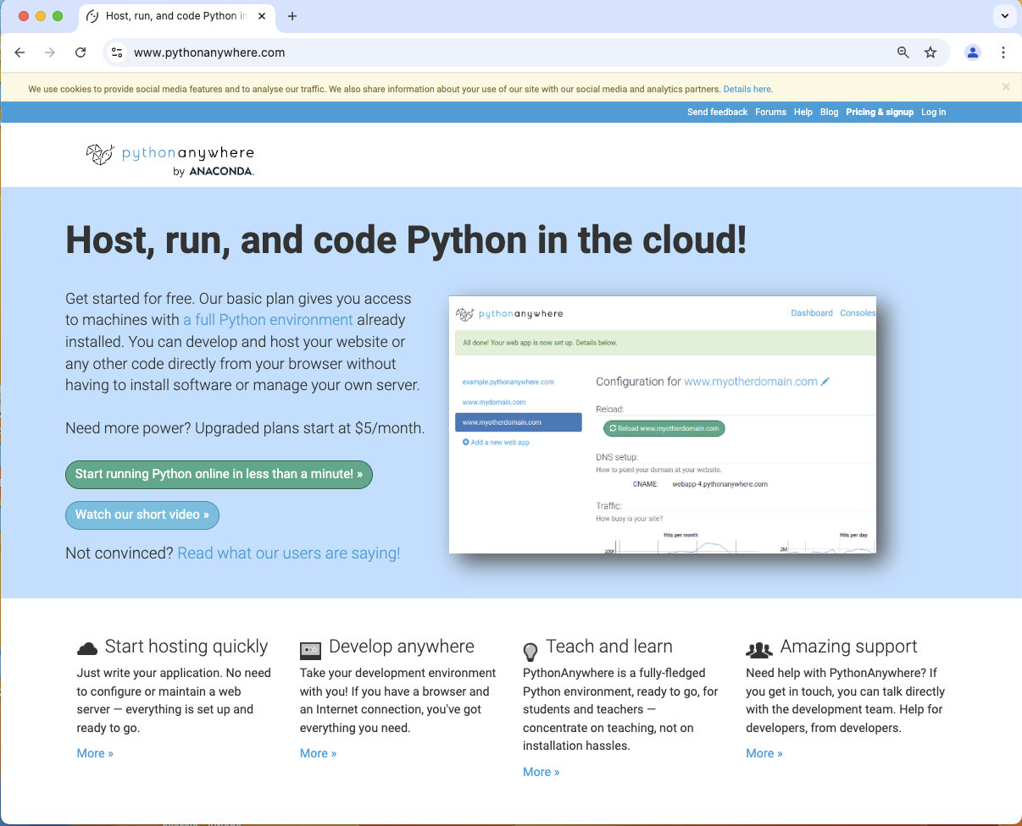
www.pythonanywhere.com
Go the pythonanywhere.com site and select Pricing & Signup.

Slide 3
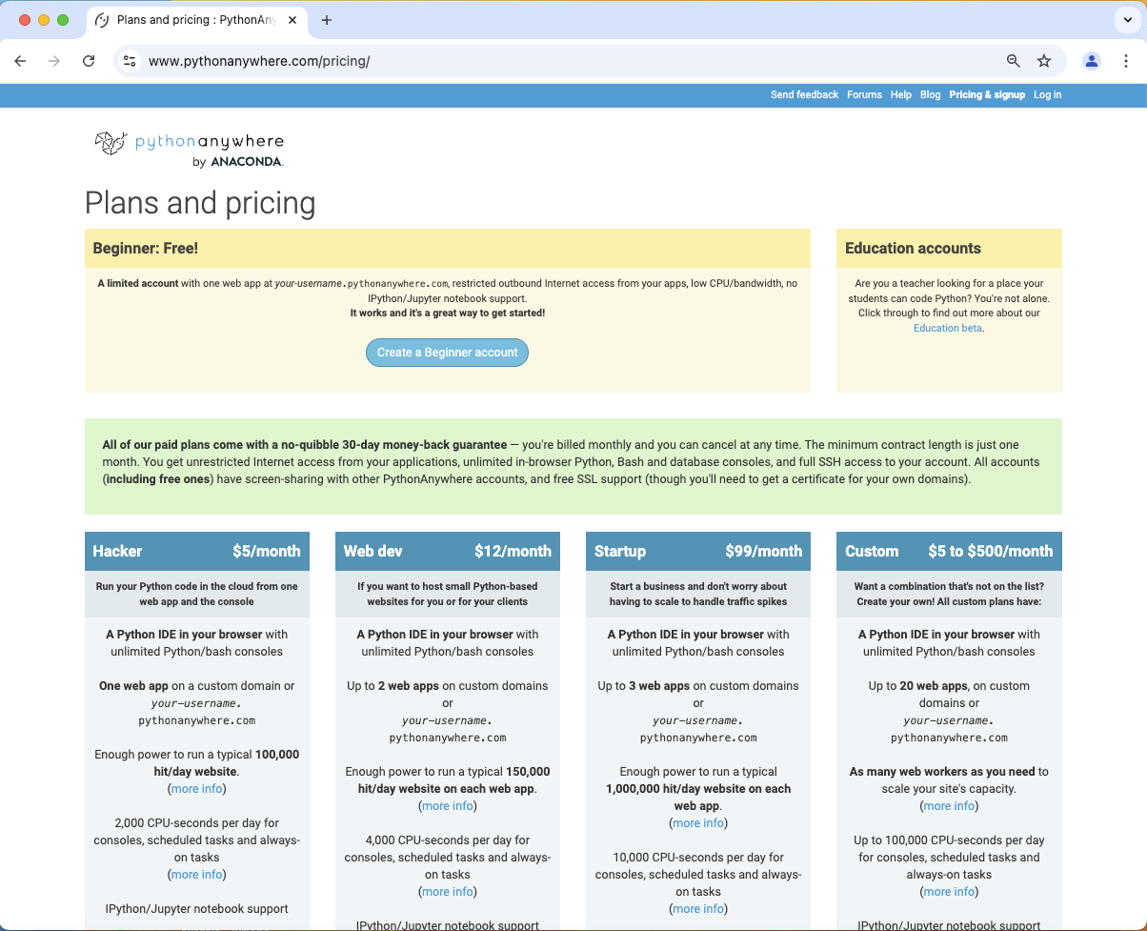
Create an account
Click on Create a Beginner Account.

Slide 4
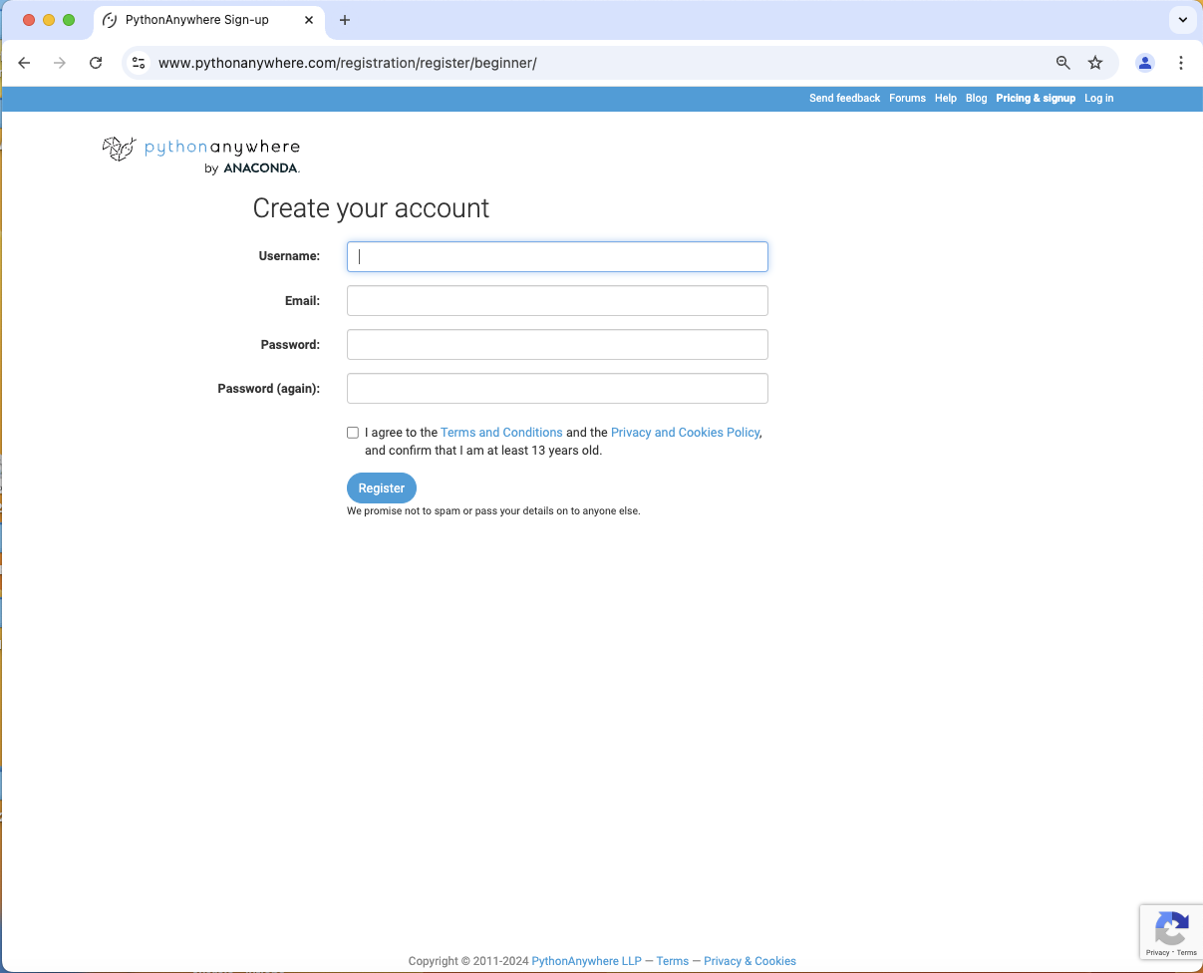
Enter account info
Enter your username (should be your name with no spaces, e.g., DaveReed), email and password, agree to terms, and click Register.

Slide 5
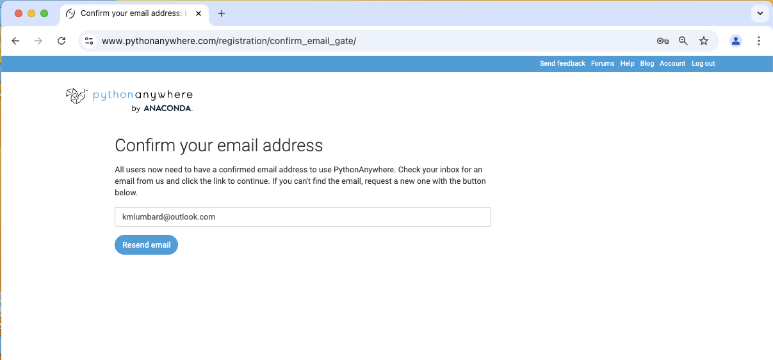
Confirm via email
You will receive an email confirmation, click on the email link to log in.

Slide 6
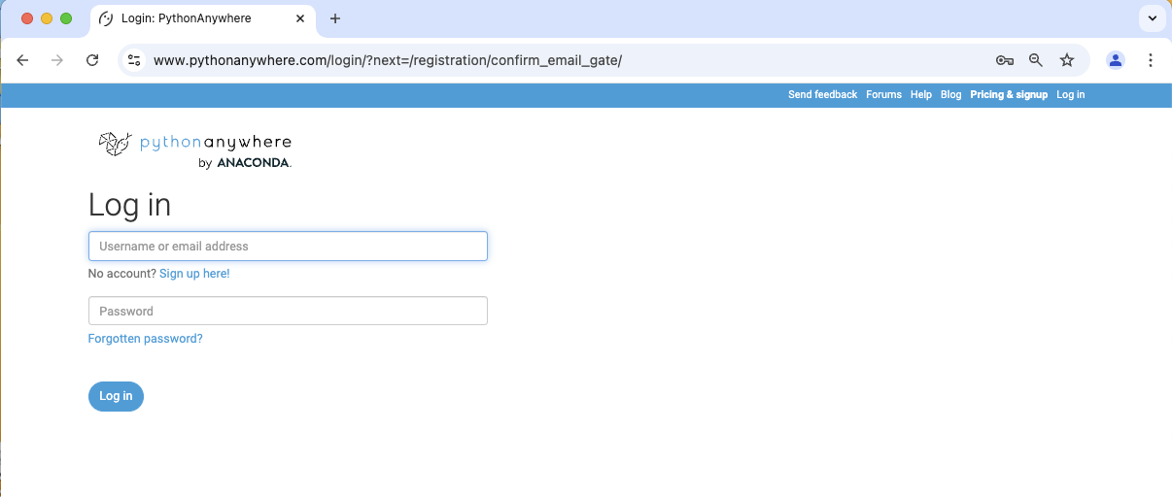
Log in
Clicking the link in your email should take you to the log in page. If not, select Log in from the navigation menu.
Enter your username and password, then click Log in.

Slide 7
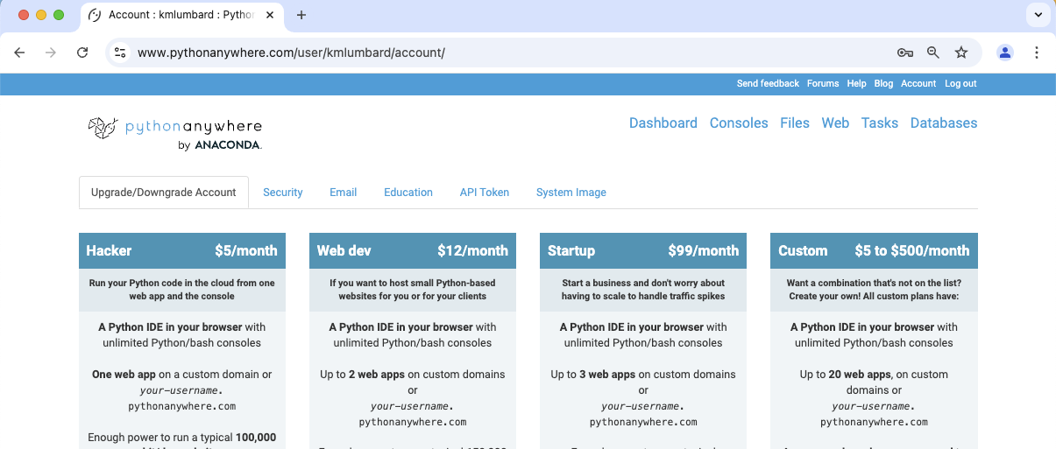
Web settings
Select Web from the navigation menu.

Slide 8
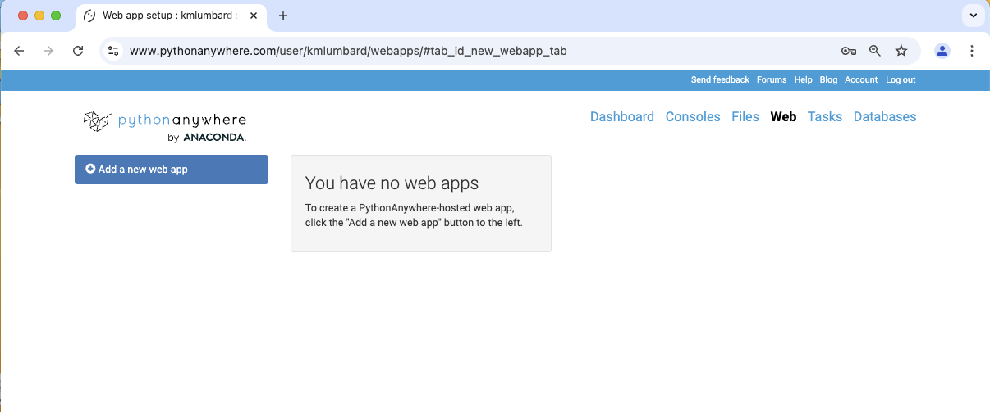
Add Web app
Click Add a new Web app.

Slide 9
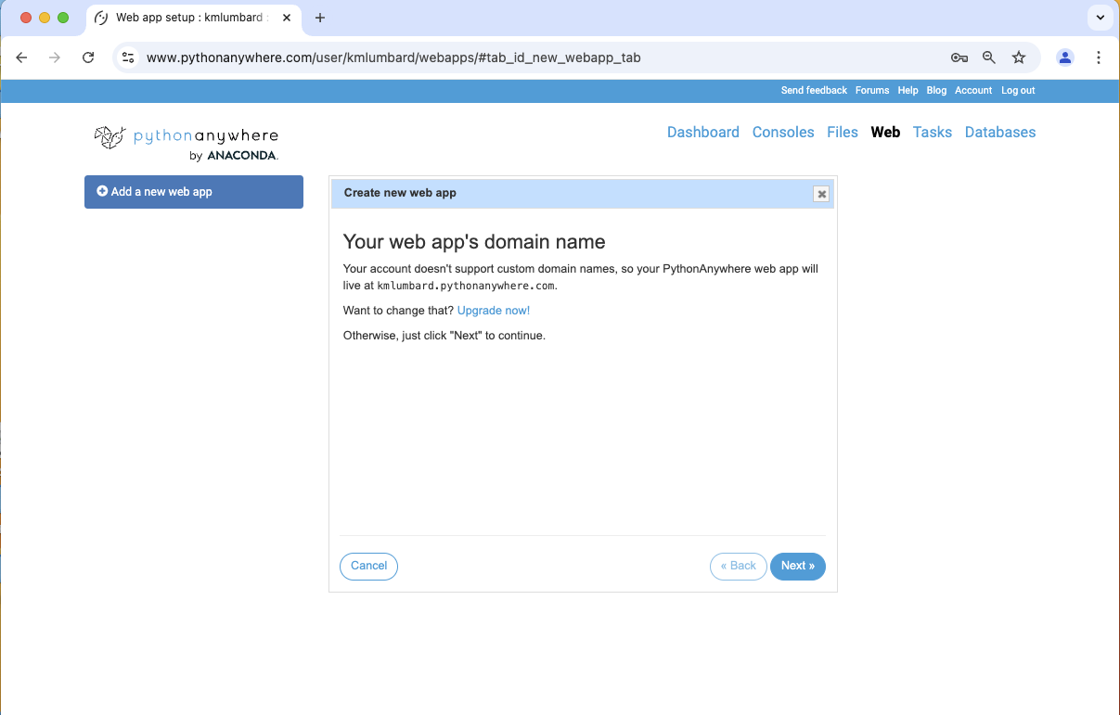
Select domain name
By default, your domain will be userName.pythonanywhere.com.
Click Next.

Slide 10
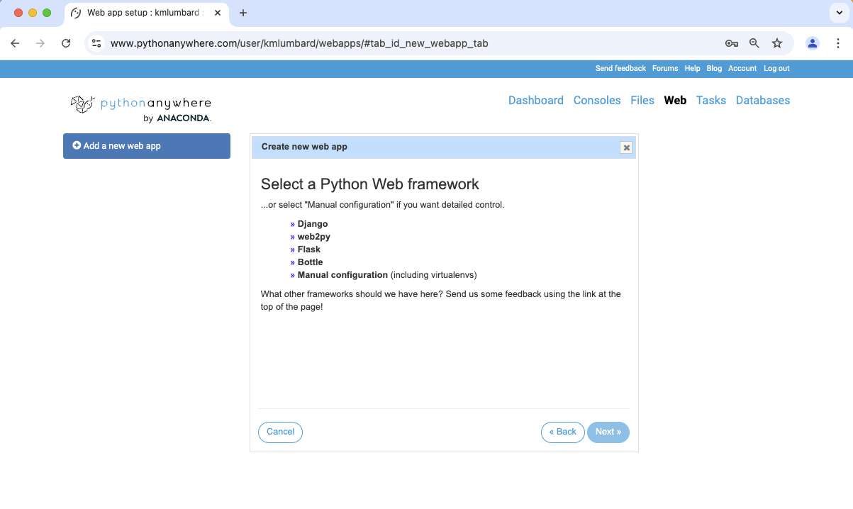
Select framework
Select Manual configuration and then click Next.

Slide 11
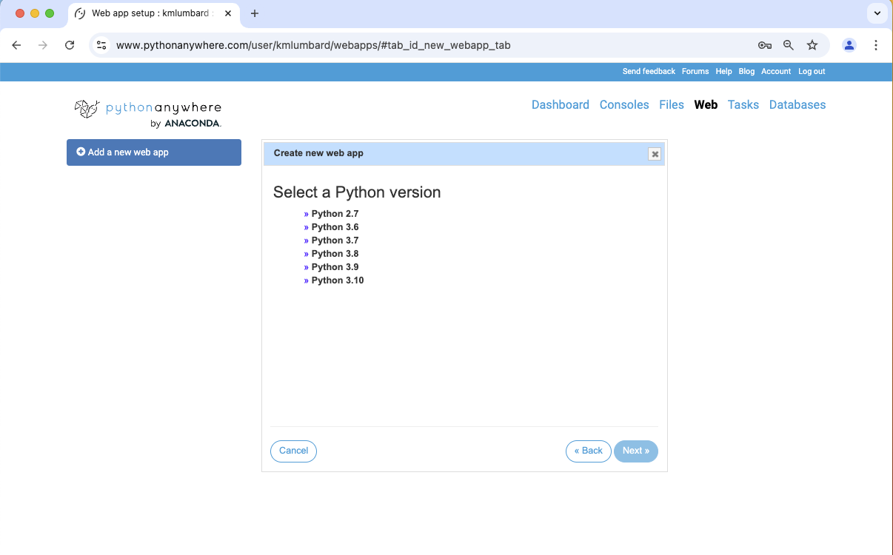
Install Python ???
Select the newest version of Python and click Next.
Note: you will not be using Python in this class but this is required by the host.

Slide 12
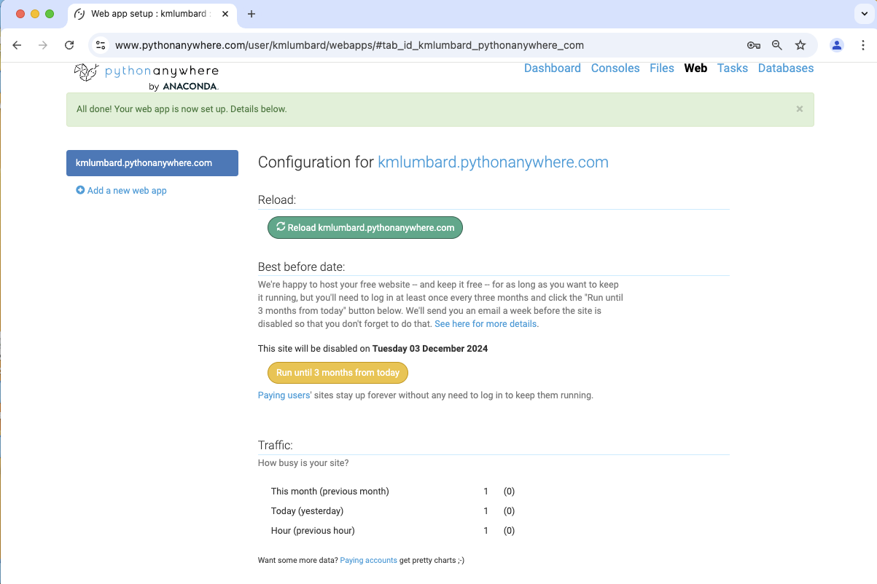
Configure Web site
The configuration page is long. Scroll Down.

Slide 13
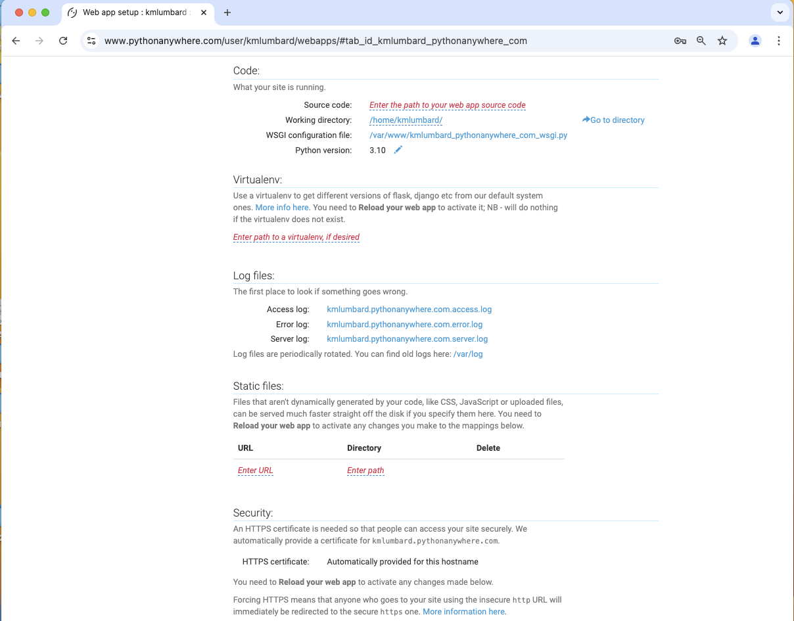
Configure Web site (cont.)
Scroll down to the Static files section.

Slide 14
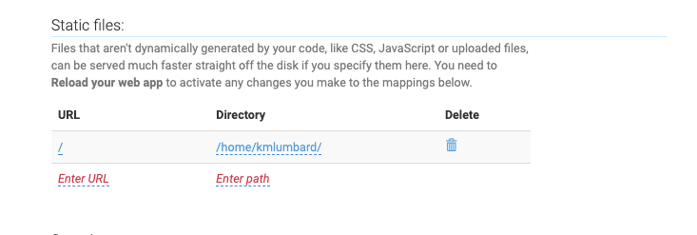
Configure Web site (cont.)
Click on Enter URL and type /
Click on Enter path and type /home/userName/

Slide 15
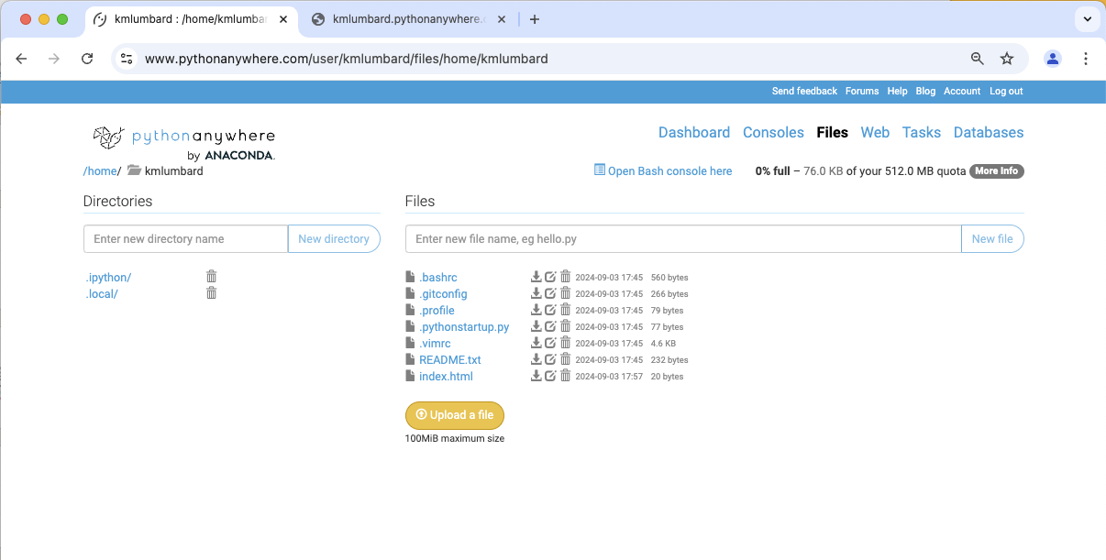
Upload your page
Select Files from the navigation menu.
Click on Upload a File and select the Web page (e.g., index.html) from your computer.
If the page includes local images, you must upload them as well.

Slide 16
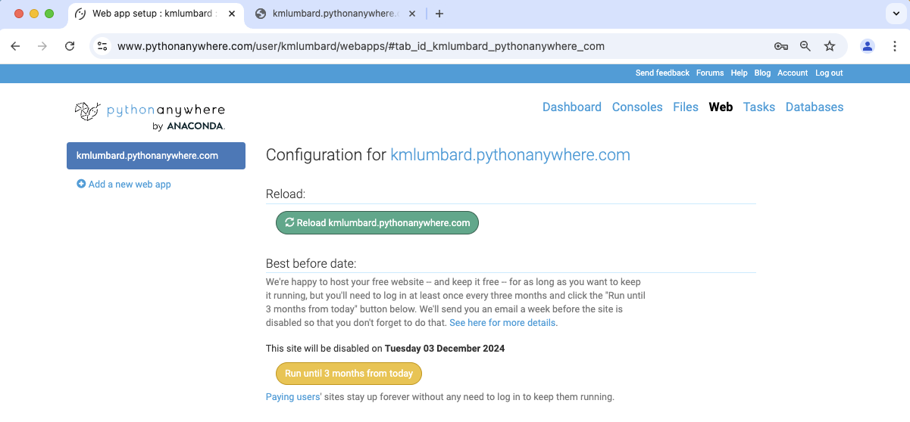
Reload
Select Web from the navigation menu then click Reload.

Slide 17
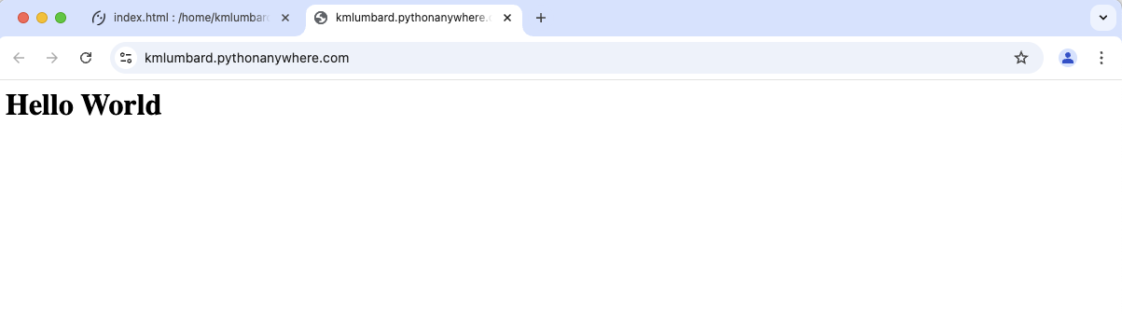
Congrats - you are a Web author
Open a browser windww and type userName.pythonanywhere.com as the address.
You should see your page!

