Slide 1
Computer Science:
Concepts & Explorations
David Reed, Creighton University
Test2 Prep

Slide 2
Test2
the test is Tuesday, Nov 5
  same format as Test1
    60 minutes (2:00-3:00)
    will be administered via Blueline, requires Lockdown browser
      bring a laptop, make sure Lockdown is installed and working
    closed notes, closed book, closed neighbor, …
    you MUST take it in-person in your assigned seat (Hixson-Lied 244)
      unless you have arranged special accommodations ahead of time
  a practice test is available in Blueline
similar types of questions as Test1
  factual knowledge: true/false or multiple choice
  conceptual understanding: short answer
  synthesis & application: describe/modify HTML and/or JavaScript
as before, there will be 2 extra points on the test

Slide 3
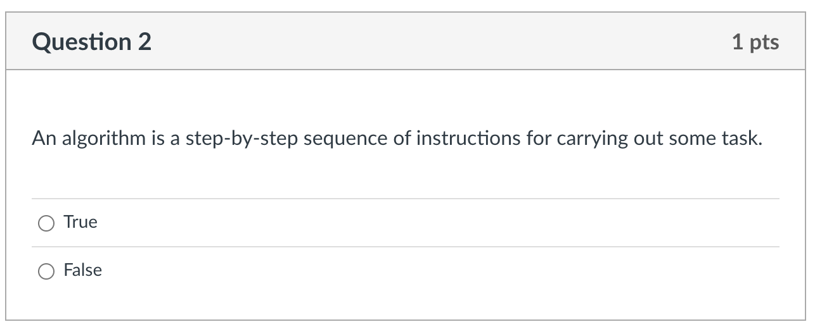
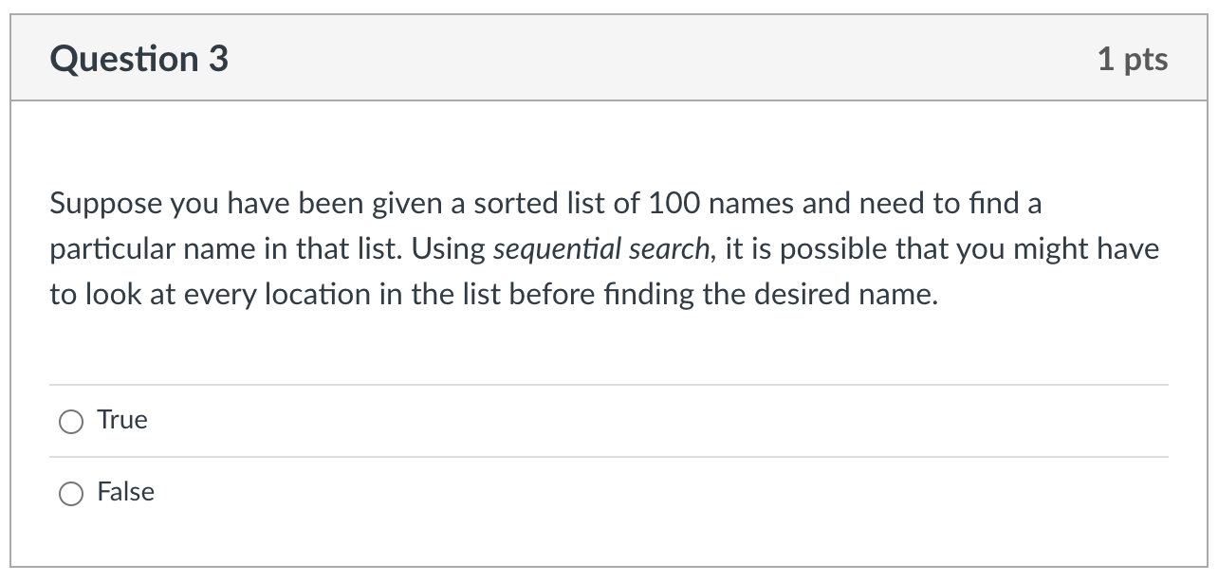
Factual knowledge: T/F

Slide 4
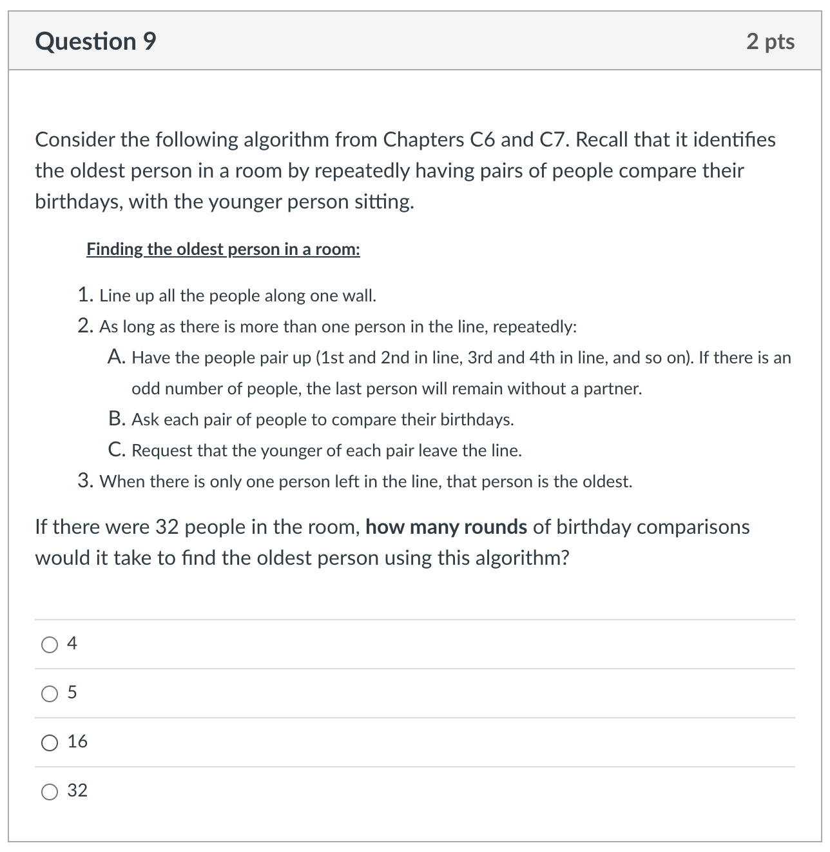
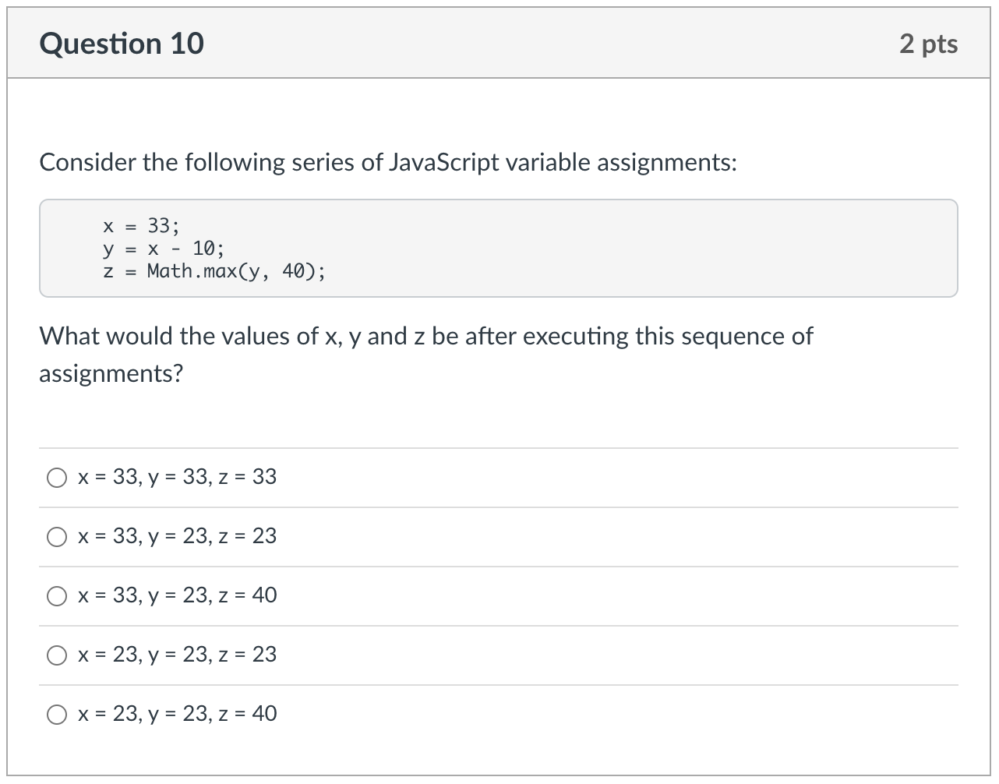
Factual knowledge: MC

Slide 5
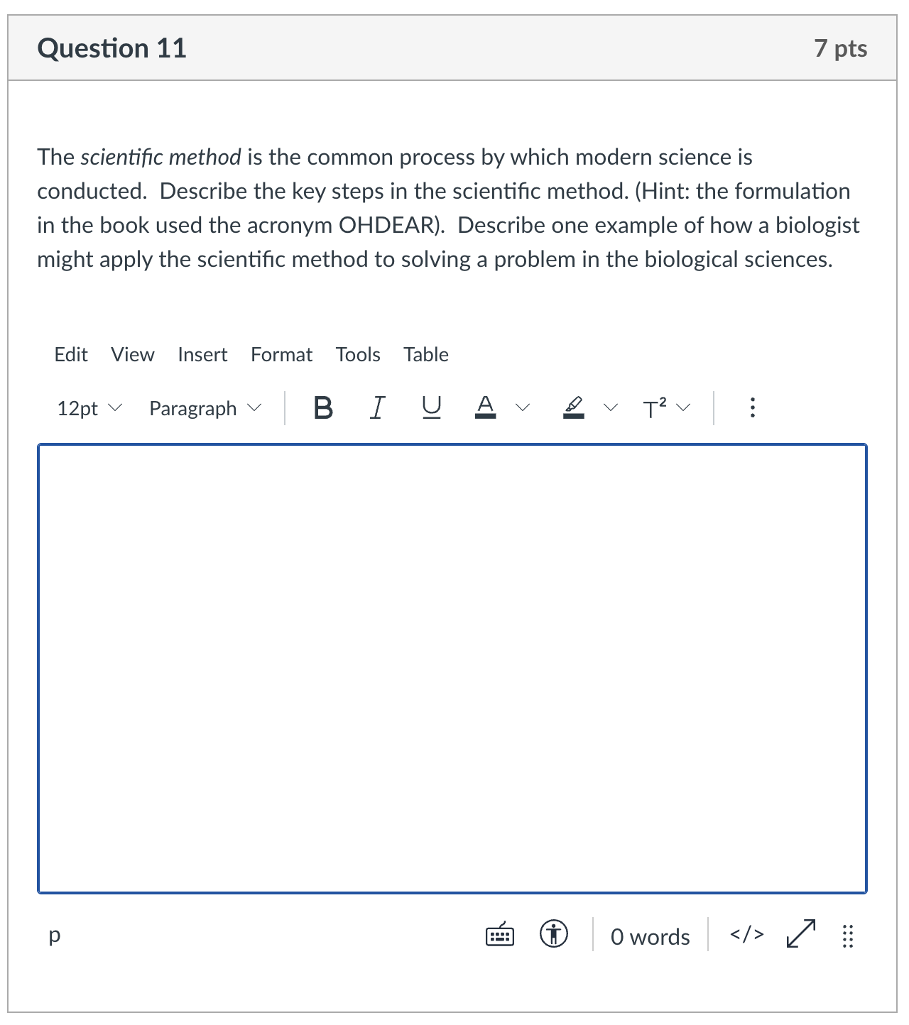
Conceptual Understanding: SA
remember: there is lots of partial credit available
  describe each step
  describe example
give complete answers, but don't brain dump!

Slide 6
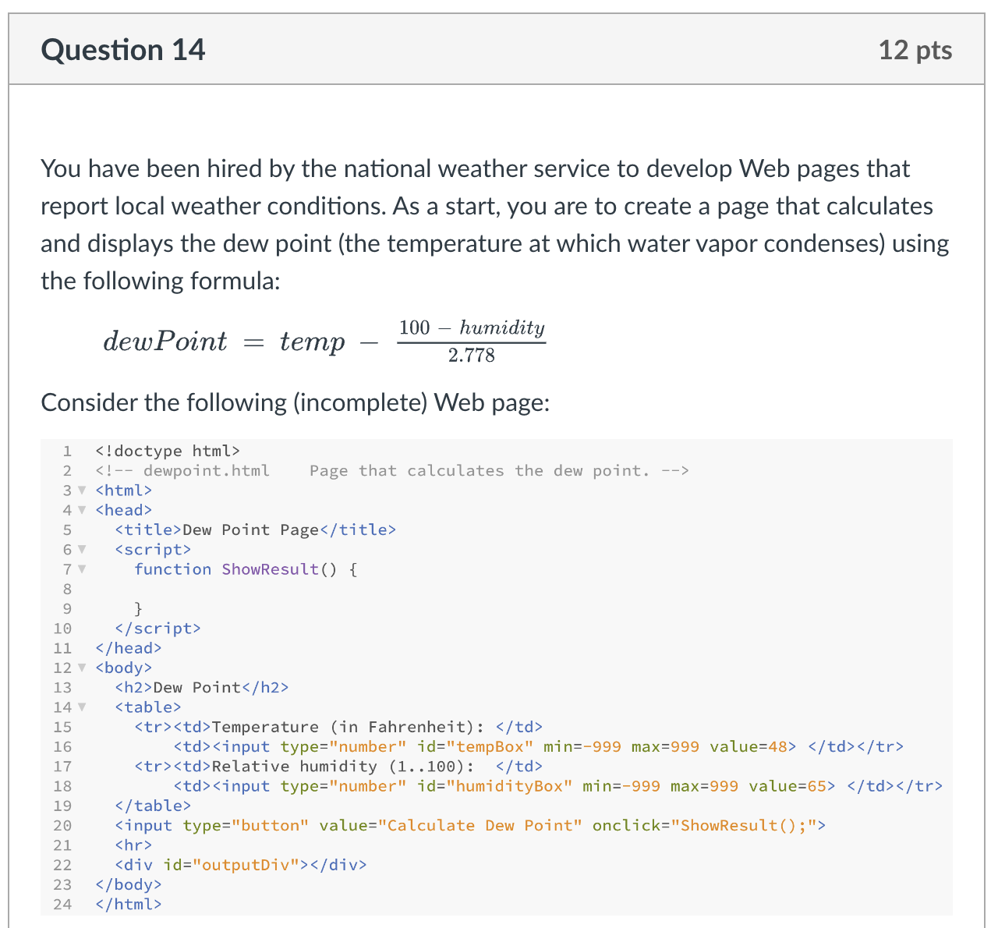
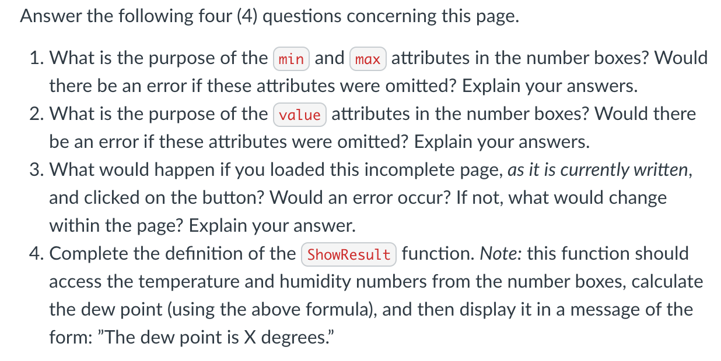
Synthesis/Application:

Slide 7
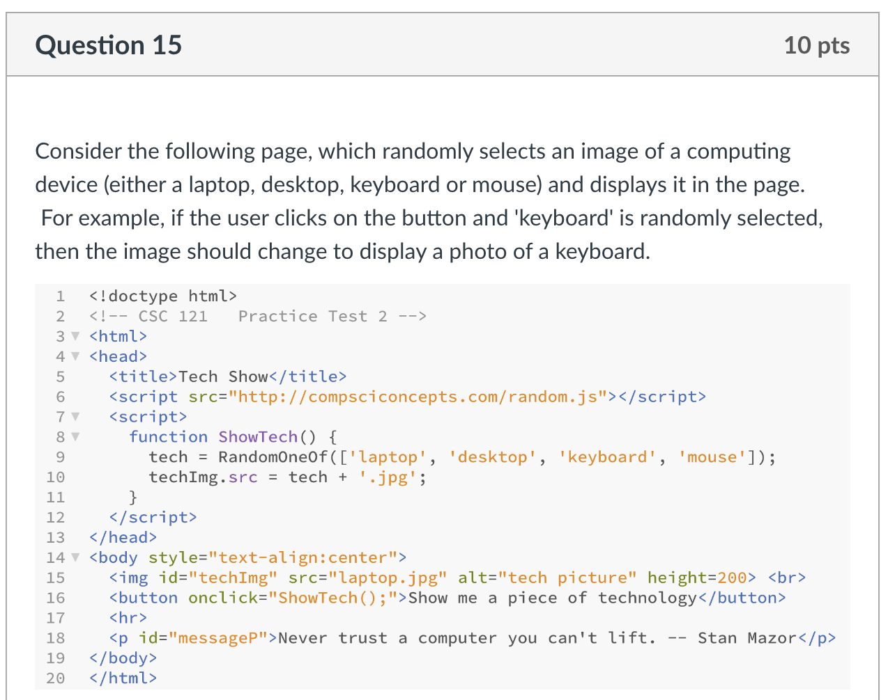
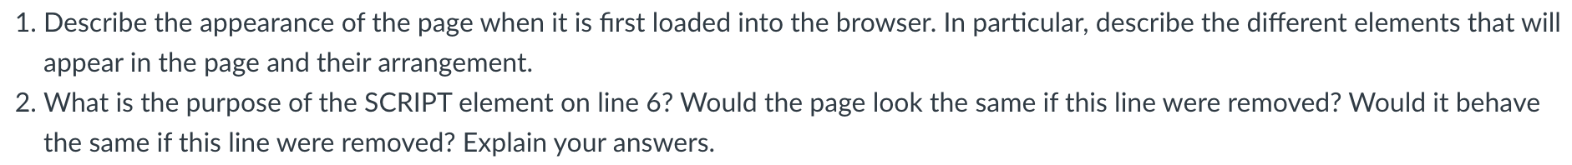
Synthesis/Application:

Slide 8
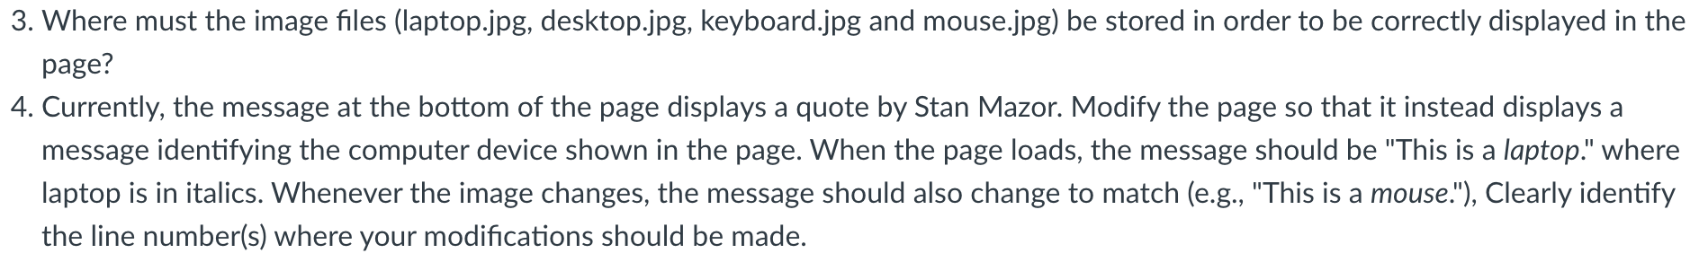
Synthesis/Application:

Slide 9
Advice
Review Sheet (linked from online syllabus)
  provides outline of course by topics
  serves as a good study guide
preparation priorities
  reflect on your Test1 performance
  review C5-7, X4-6 material
    PowerPoints highlight main ideas & examples
    reread chapters as needed for details
    summaries at end of chapters are also useful for review
    questions from end of chapters are fair game
  review projects & labs
    Project 4.A (story): text boxes, button, dynamic text
    Project 5.B (grades): number boxes, simple function, 3-step pattern
    Project 6.B (coin) & 6.C (oracle): functions, random.js library
    Lab 2 (Monte Carlo): experimentation, consistency vs. accuracy
    Lab 3 (Dino DNA): applications in biology

