Slide 1
Computer Science:
Concepts & Explorations
David Reed, Creighton University
Course Overview
and
Final Exam Prep

Slide 2
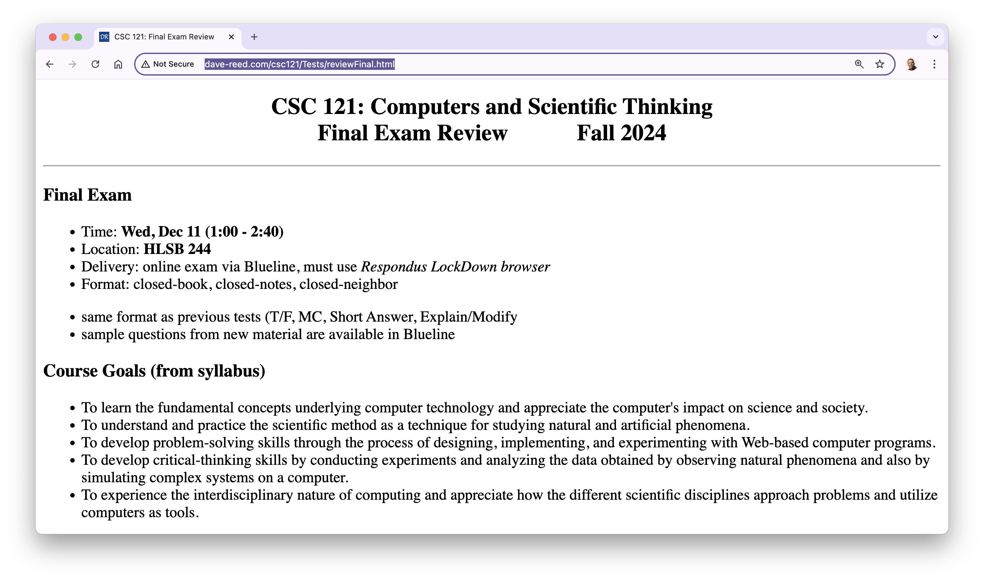
Course overview

Slide 3
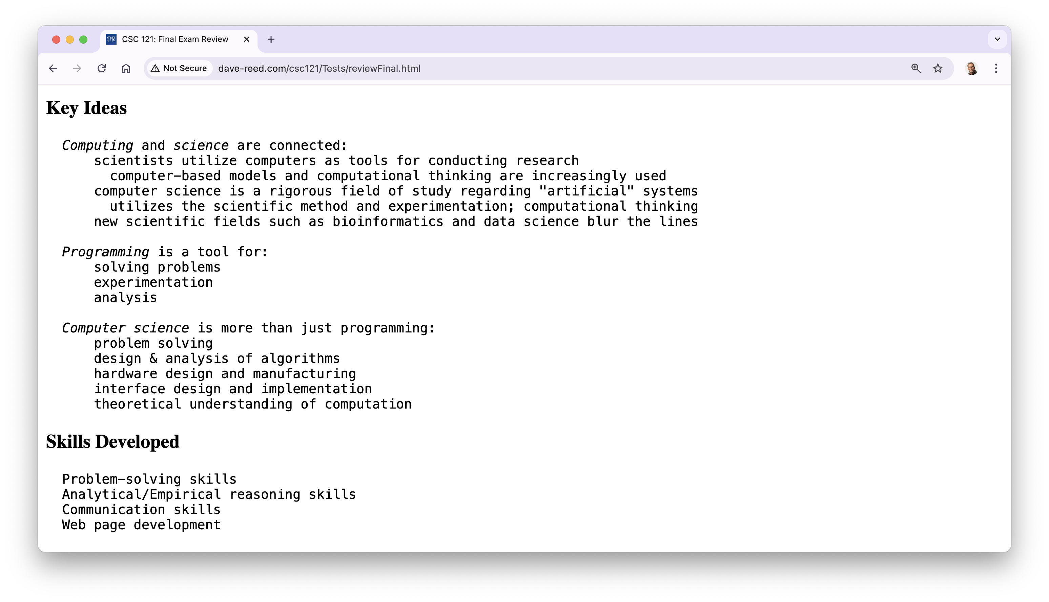
Course overview (cont.)

Slide 4
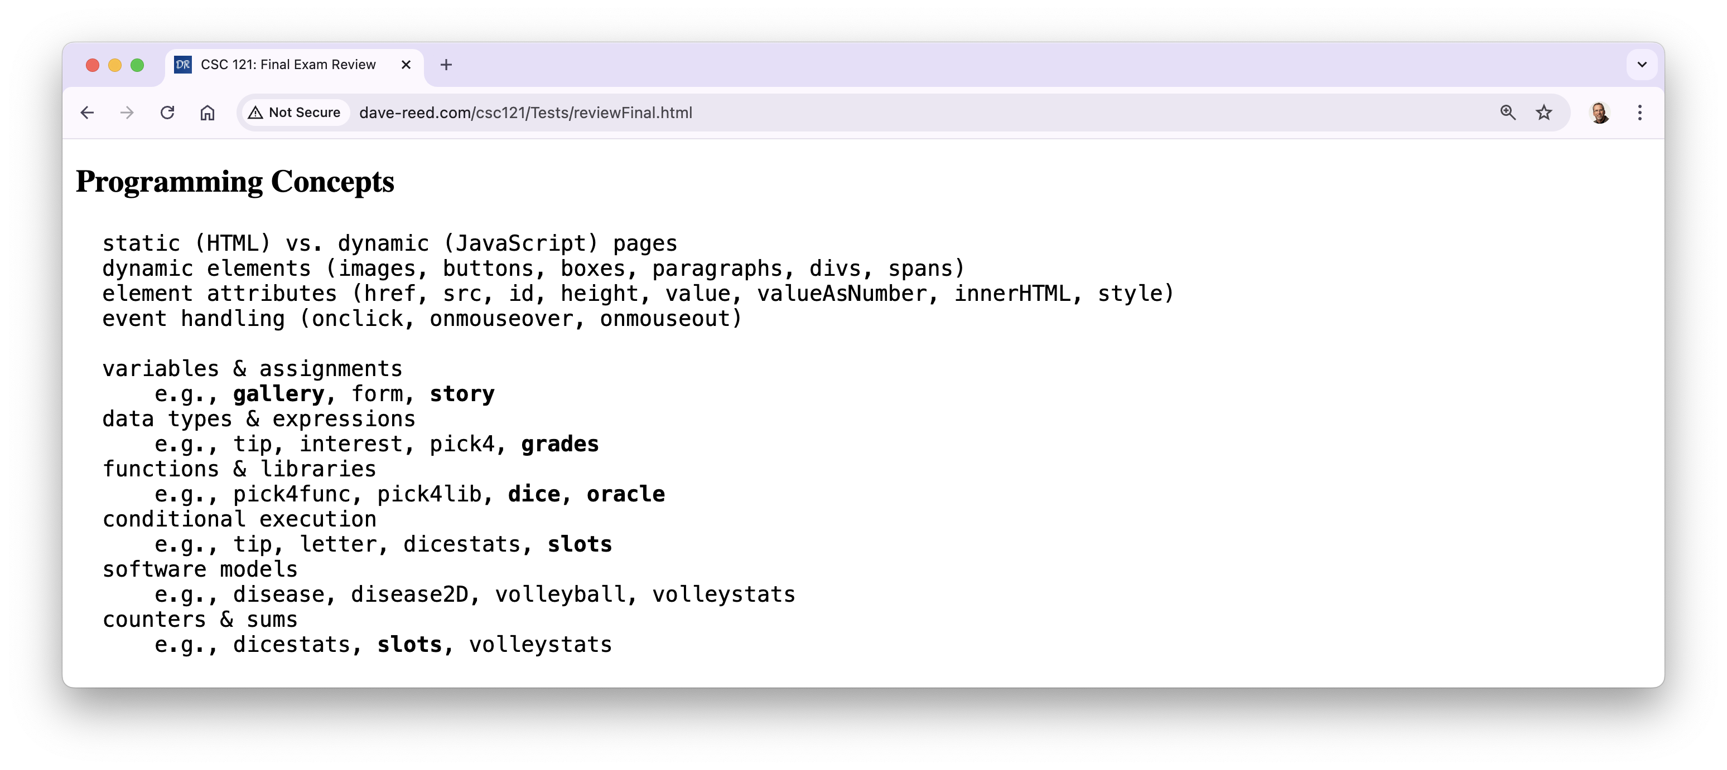
Course overview (cont.)

Slide 5
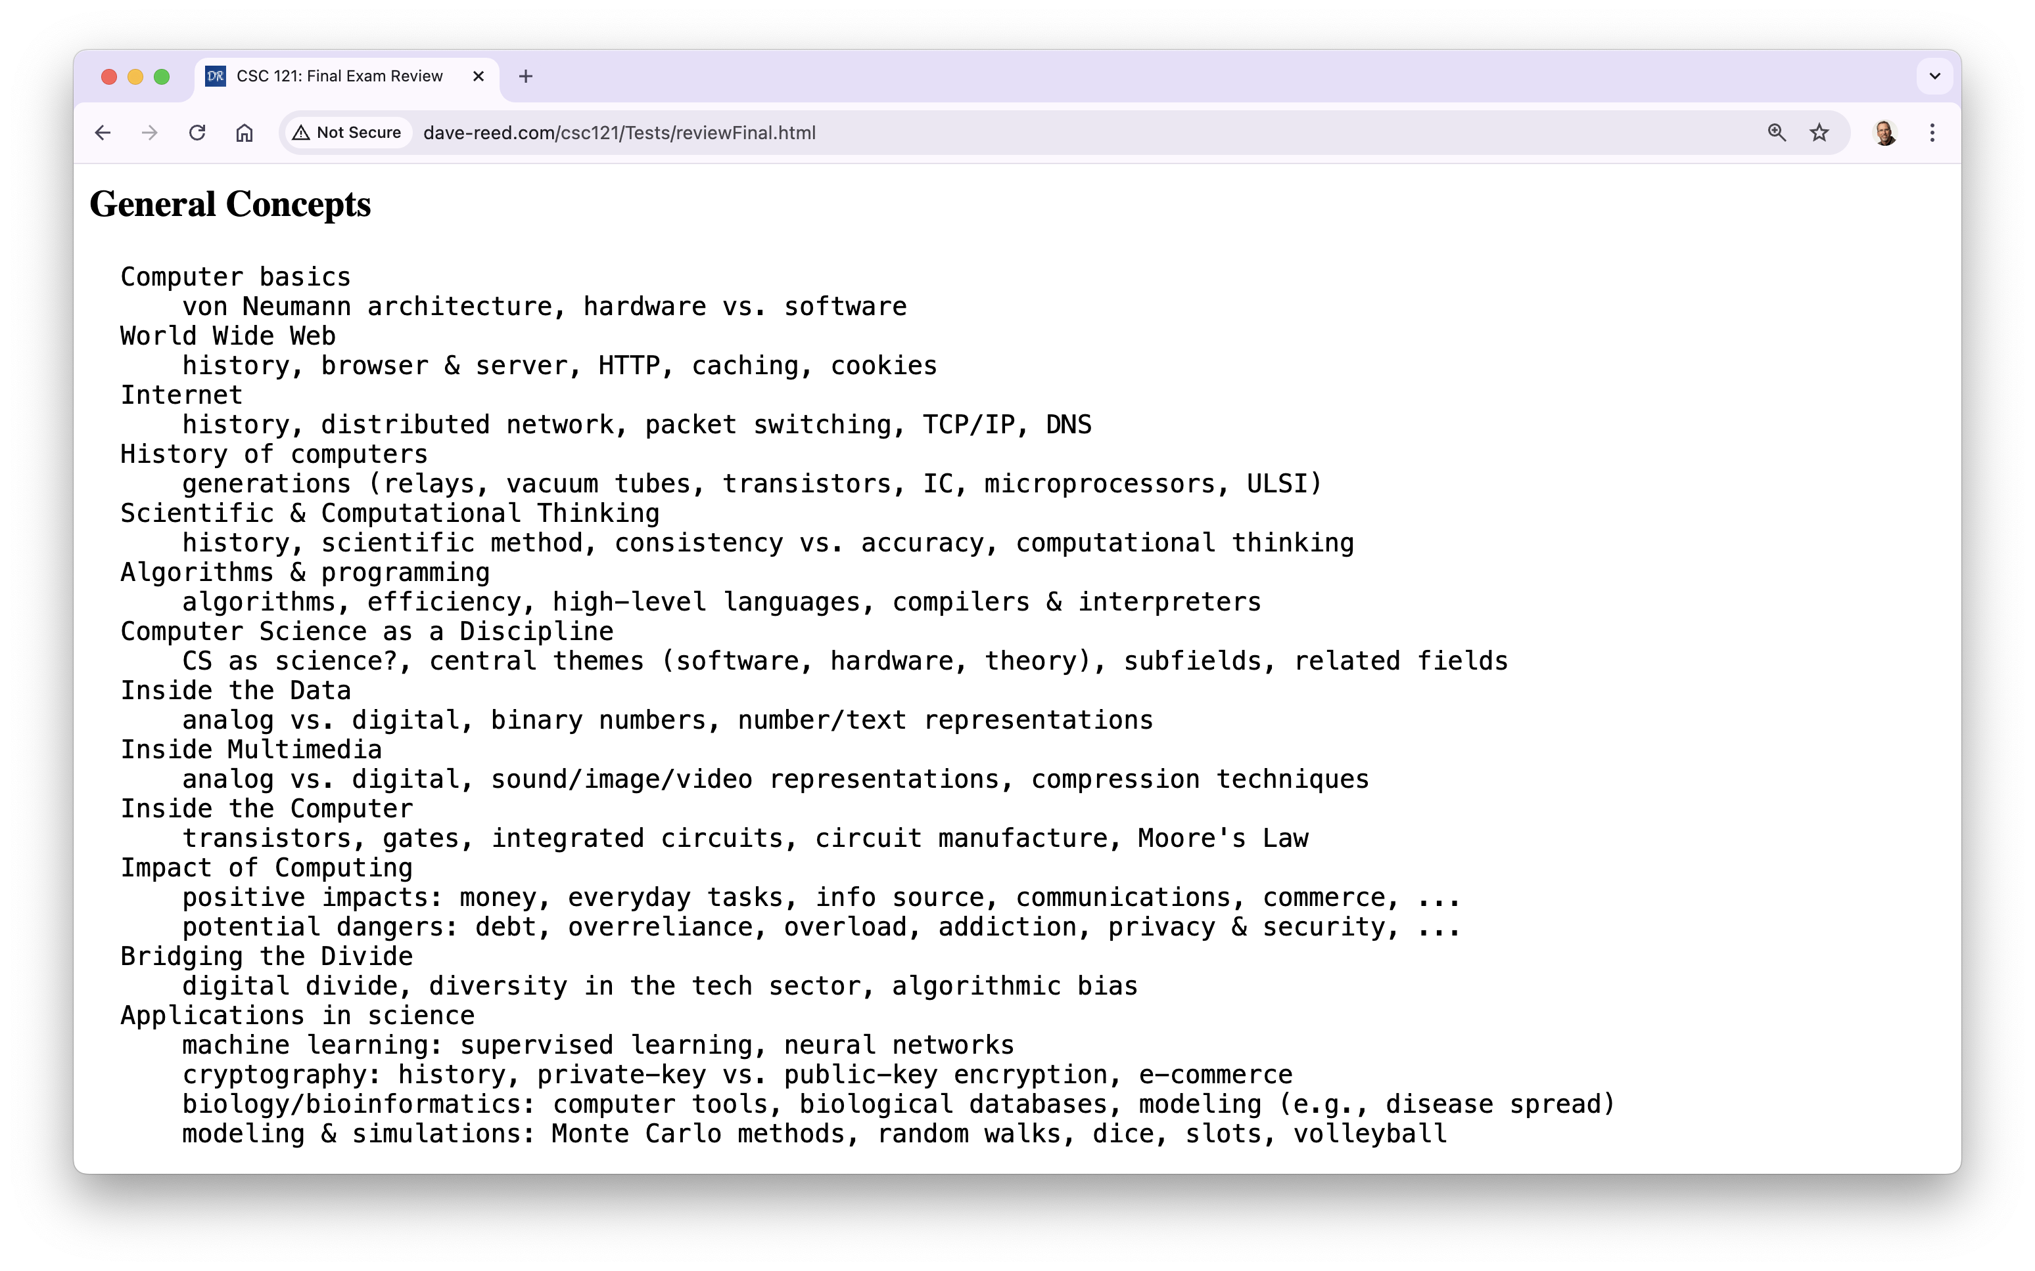
Course overview (cont.)

Slide 6
Final exam
the exam is Wednesday, Dec 11 (1:00-2:40)
  similar format as Test1 & Test2, but longer
    100 minutes
    will be administered via Blueline, requires Lockdown browser
      bring a laptop, make sure Lockdown is installed and working
    closed notes, closed book, closed neighbor, …
    you MUST take it in-person in your assigned seat (Hixson-Lied 244)
      unless you have arranged special accommodations ahead of time
  practice questions available in Blueline
similar types of questions as Test1 & Test2
  factual knowledge: true/false or multiple choice
  conceptual understanding: short answer
  synthesis & application: describe/modify HTML and/or JavaScript
there will be 5 extra points (out of 100) on the test

Slide 7
Final exam
the exam is cumulative, but will emphasize material since Test2
  C8 (Inside the Data): analog vs. digital, binary numbers, number/text repr.
  C9 (Inside Multimedia): sound/image/video repr., lossy vs. lossless compression
  C10 (Inside the Computer): transistors, gates, circuits, Moore's Law
  C11 (Impact on Society): positives & negatives (e.g. digital cash/identity theft)
  C12 (Bridging the Divide): Digital Divide, tech inequities, algorithmic bias
  X7 (Conditional Execution): if-else statement, counters/sums
  X9 (Software Models): advantages & disadvantages of modeling
  Lab 3 (Dino DNA): computers in biology, online databases
  Lab 4 (Random Walks): turtle graphics, simulations, scientific method
  Lab 5 (Volleyball Simulations): modeling systems, scientific method

Slide 8
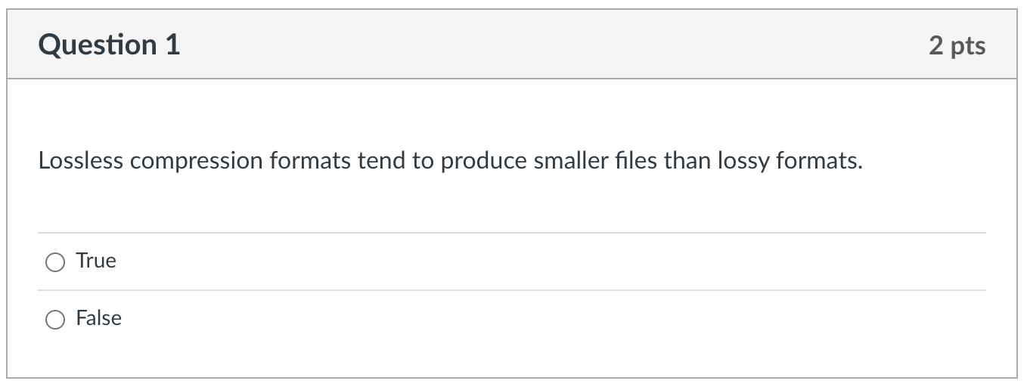
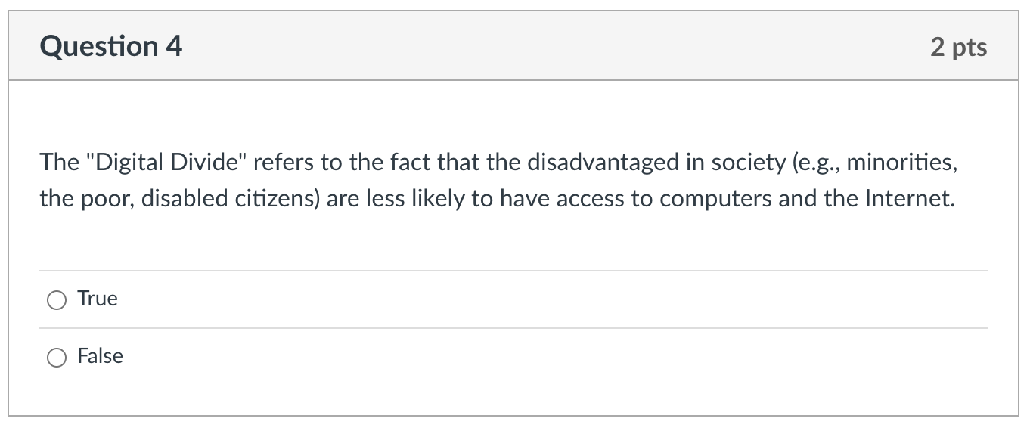
Factual knowledge: T/F

Slide 9
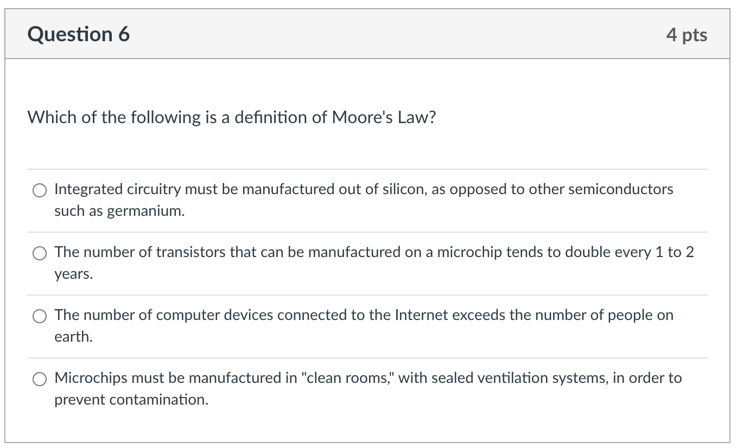
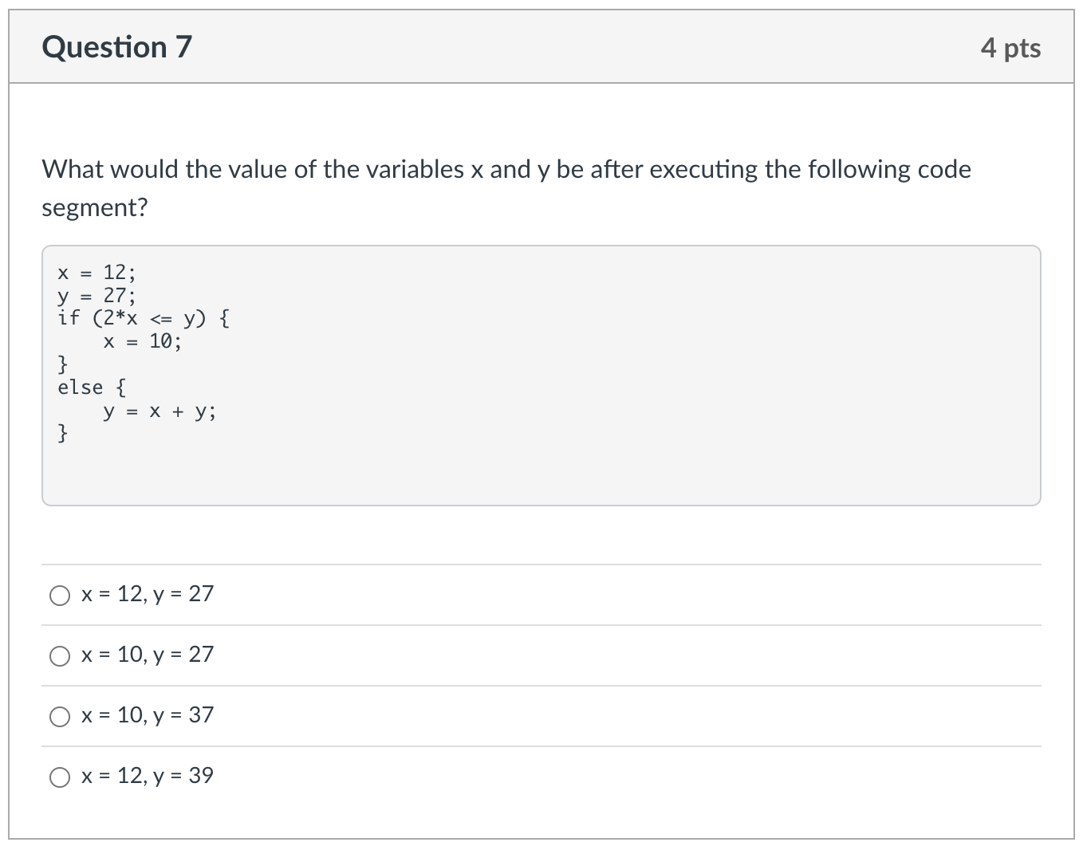
Factual knowledge: MC

Slide 10
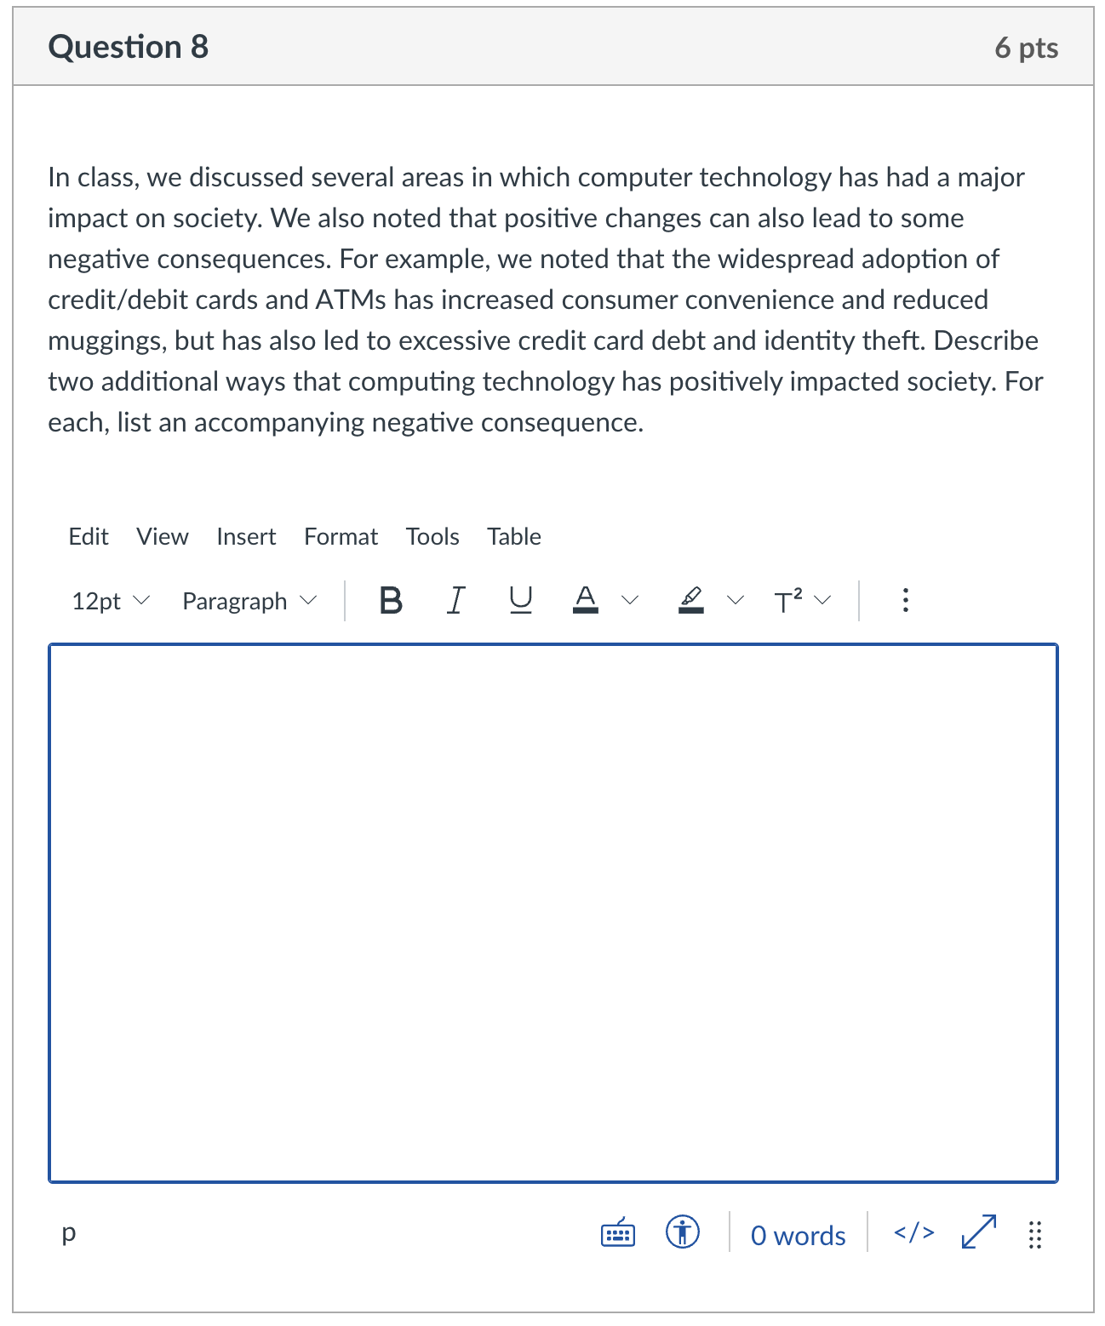
Conceptual Understanding: SA
remember: there is lots of partial credit available
  describe 1st positive impact
  describe accompanying neg.
  describe 2nd positive impact
  describe accompanying neg.
give complete answers, but don't brain dump!

Slide 11
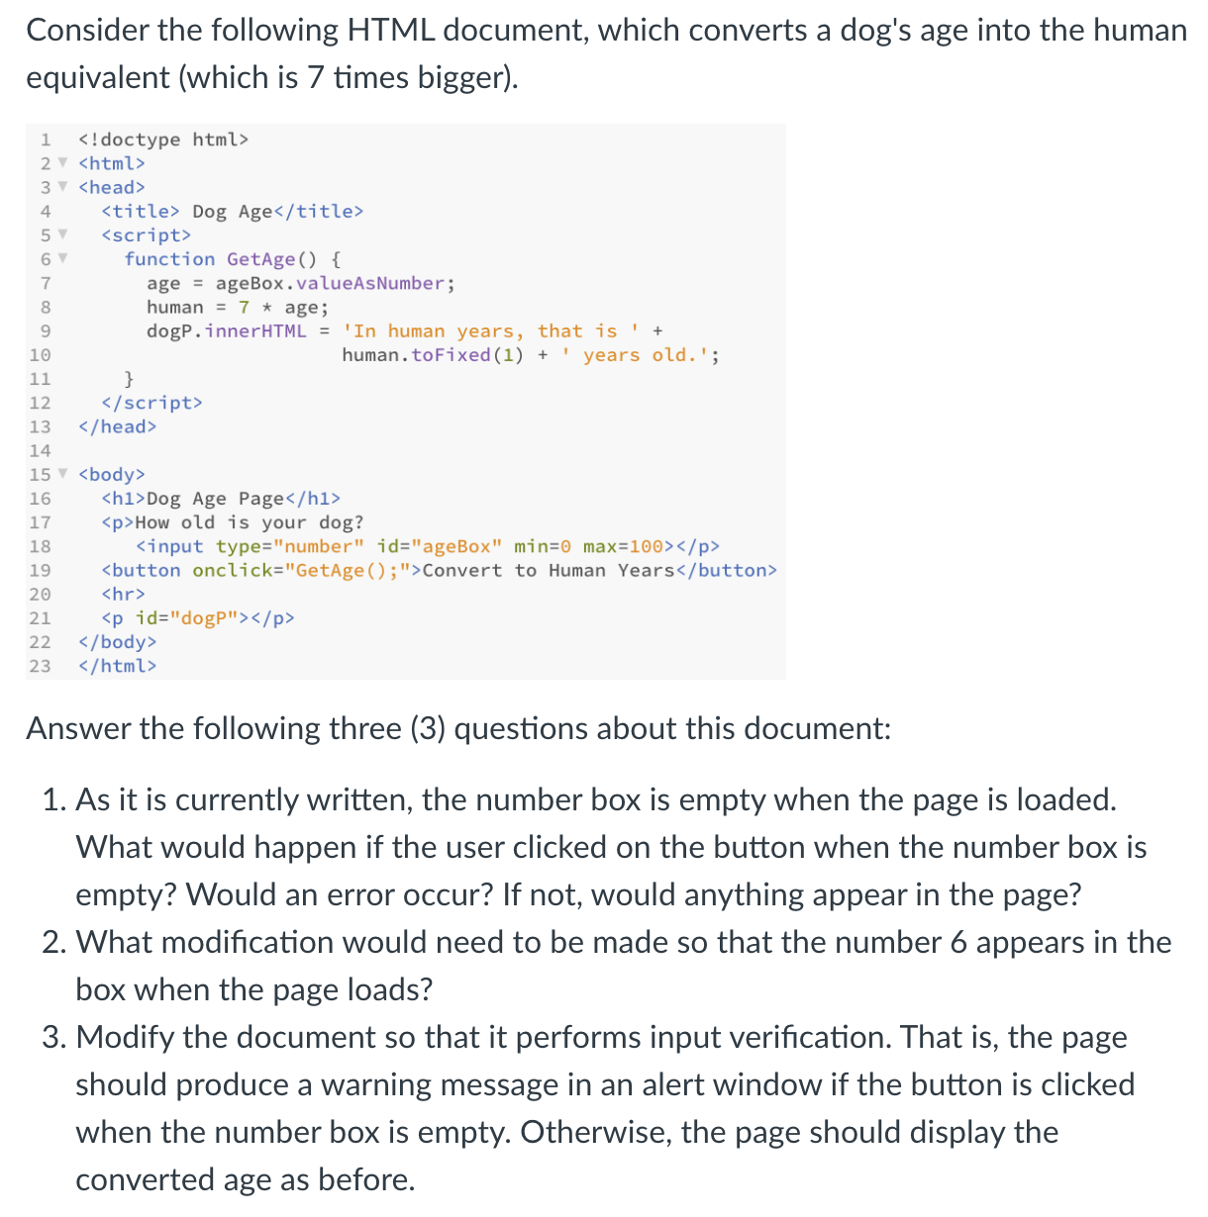
Synthesis/Application:
will emphasize new material/skills
  but build on earlier materials/skills
multi-part questions:
  describe page
  explain behavior
  add features
  MAXIMIZE PARTIAL CREDIT!

Slide 12
Advice
Review Sheets (linked from online syllabus)
  final exam review gives more conceptual overview of the class
preparation priorities
  reflect on earlier test performances
    did your previous study strategy work well?
    did you do better/worse on one type of question?
  review both Concepts & Explorations chapters
    PowerPoints highlight main ideas & examples
    reread chapters as needed for details
    summaries at end of chapters are also useful for review
    questions from end of chapters are fair game
  know difference between HTML and JavaScript
    if controlling the look of the page, then HTML
    if controlling the behavior of the page, then JavaScript

Slide 13
Advice
  review projects & labs - familiarize with recurring patterns
    e.g., page that computes
      number boxes for input, button, p/div for output
      function called to access boxes, do calculation, display result
    e.g., page with random image
      image, button, p/div for caption
      load random.js library using script element w/ src attribute
      function called to select random value (using RandomInt or RandomOneOf), change image by assigning src attribute, change caption by assigning innerHTML attribute
    e.g., input verification
      text or number boxes, button
      if statements checks box contents: if empty, alert warning; else, proceed
    e.g., counter in page
      span that initially contains 0
      access span, convert to Number, add 1, reassign to span

