Slide 1
Computer Science:
Concepts & Explorations
David Reed, Creighton University
Computers in
Biology and Bioinformatics

Slide 2
Biology
biology is roughly defined as "the study of life"
  it is concerned with the characteristics and behaviors of organisms, how species and individuals come into existence, and the interactions they have with each other and with the environment
  (en.wikipedia.org/wiki/Biology)
biology encompasses a broad spectrum of academic fields that are often viewed as independent disciplines
  ecology and evolutionary biology study life at the habitat or population level
  developmental biology and genetics study life at organism level
  physiology, anatomy, and histology study life at the multicellular level
  cell biology studies life at the cellular level
  molecular biology, biochemistry, and molecular genetics study life at the atomic and molecular level

Slide 3
Impact of Computers
the history of biology dates as far back as the rise of various civilization
  while computers are relatively new, they have had a monumental impact on biological research
3 examples of impact:
  computer technology is rapidly advancing the tools of scientific research
  computer models are being used to study complex systems
  computers are being used to store, process, and analyze large collections of biological data
note: this list is in no way exhaustive
  many aspects of biology and computer science are converging
  biology researchers must be savvy computer users and even programmers
  computer scientists must be able to solve interdisciplinary problems

Slide 4
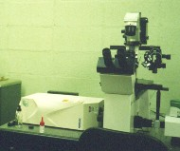
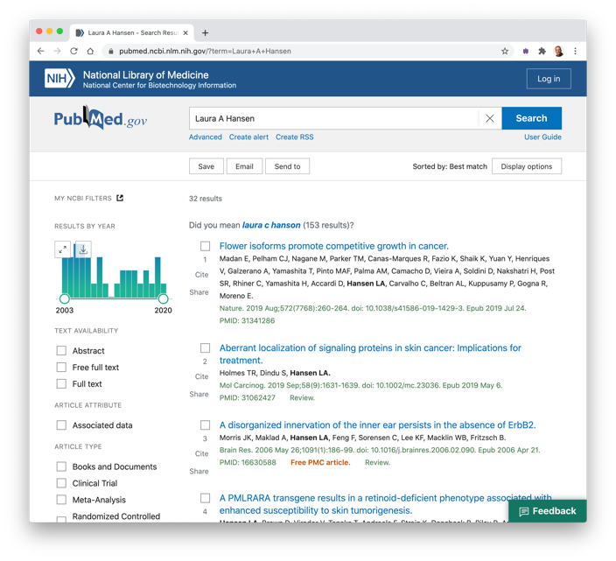
Technology Tools/Resources
many of the traditional tools of biological research are integrating computer technology
  e.g., the confocal microscope
    invented by Marvin Minsky (computer science pioneer)
    works by focusing a laser on a dyed sample and
    measuring the fluorescent light emitted
    can be used to build up a 3-D model of a sample, stored on
    a computer
  e.g., DNA Microarrays to measure the expression levels of genes
the Internet and the Web allow researchers to share data and publications
  speeds the dissemination of information and the advancement of science
  e.g., PubMed, from the National Library of Medicine

Slide 5
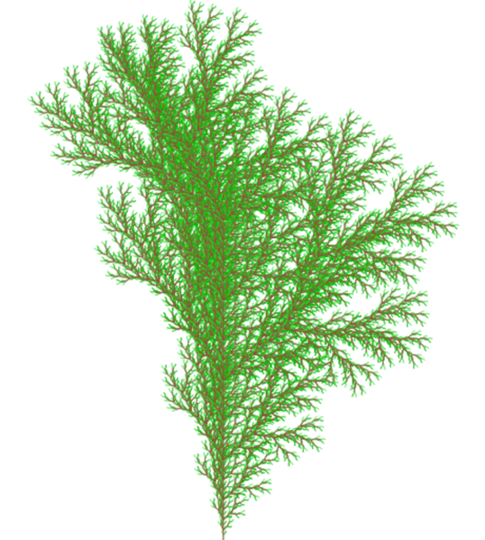
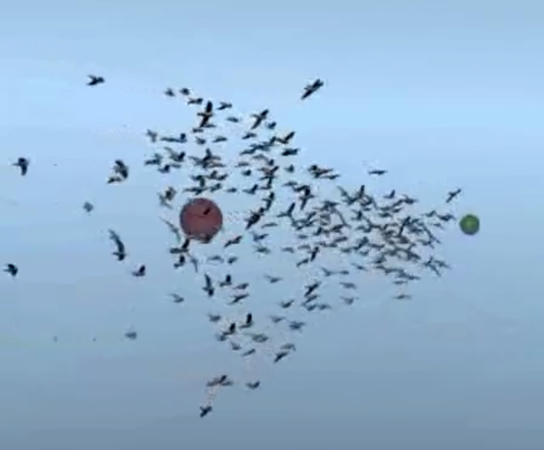
System Modeling
as computer memory and processing power has increased, it has become possible to model complex biological systems in software
  can attempt to discern natural laws or behaviors by observing the model under varying conditions
    e.g., models of plant or seashell growth
    e.g., the evolution of cooperative behavior in species, such as bird flocking
  can predict the effects of actions over long periods
    e.g., the effects of automobile emissions on global warming
    e.g., the effects of increased fishing on worldwide fishery stocks
  can avoid infeasible, unethical, or costly experimentation
    e.g., predict the toxicity of a new drug based on a chemical/biological model as opposed to animal testing
    e.g., study brain trauma using a neural network model

Slide 6
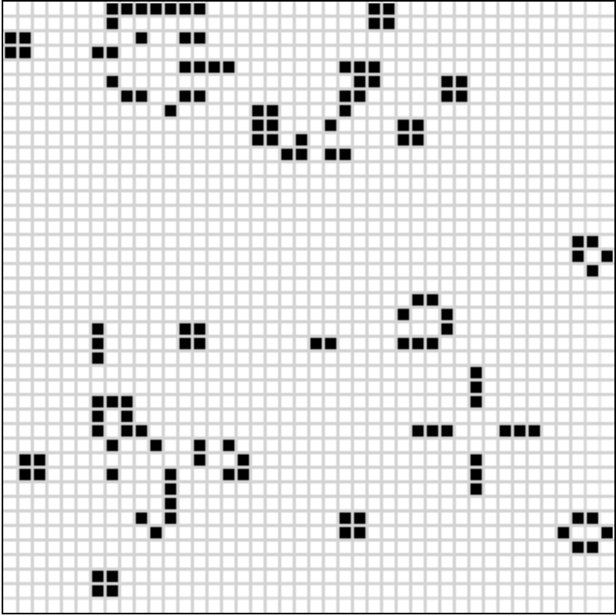
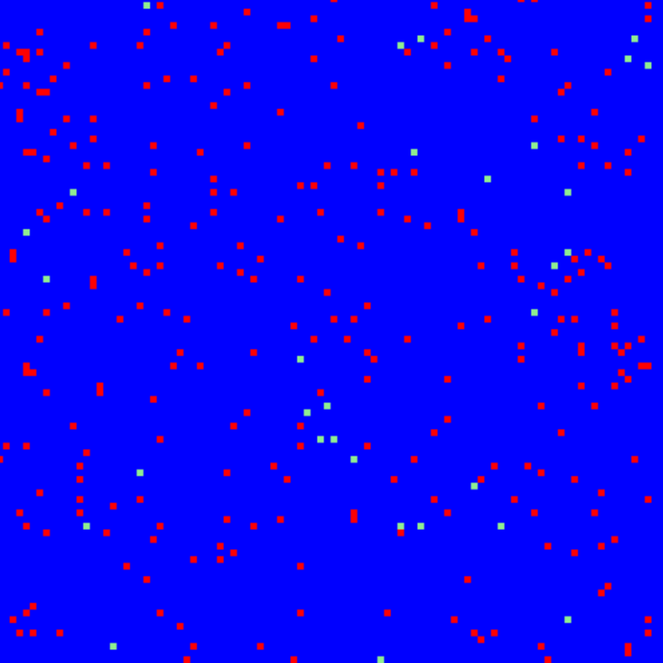
Ecosystem Modeling
in the late 1960s, John Conway showed that a simple model of an environment could produce complex and interesting behavior
  the environment is modeled as a 2-D grid of cells
  a cell can be alive (contain an organism) or dead
  simple rules model evolution
    a dead cell becomes alive in the next generation if it has exactly 3 neighbors
    a living cell survives in the next generation if it has 2 or 3 neighbors
Conway's ideas have been extended to a variety of ecosystems
  here, different colored cells denote different organisms (sharks & fish)
  other systems have modeled:
    the growth of viruses
    the spread of infectious diseases in a population
    the behavior of an ant colony

Slide 7
Bioinformatics
perhaps the biggest impact of computers in biology is in storing, accessing, and processing large amounts of biological data
the new field of bioinformatics bridges biology and computer science (or informatics, as it is known in Europe)
  broad definition of bioinformatics: the use of computer science techniques to solve biological problems
  narrower but common definition: the application of computer science techniques to the representation and processing of biological data
as research tools advance, biologists are generating enormous amount of data
  a single experiment with genetic material can produce thousands or millions of data points
  computational and statistical tools are needed to analyze and understand such volumes of data

Slide 8
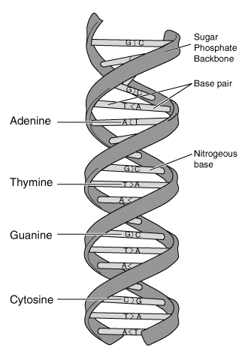
DNA Overview
DNA is the genetic blue-print of life
  made of nucleotides with four bases (A, T, G, C), organized in a double-helix
  the two strands match A+T and C+G base pairs
  can think of DNA as encoding information in base 4
a gene is a region of DNA that encodes the chemical structure of a protein
  proteins (e.g., enzymes, hormones, antibodies) control cellular and organ functions
it is currently believed that there are 20,000-30,000 different genes in human DNA
  roughly 3 billion base pairs
"If our strands of DNA were stretched out in a line, the 46 chromosomes making up the human genome would extend more than six feet. If the ... length of the 100 trillion cells could be stretched out, it would be ... over 113 billion miles. That is enough material to reach to the sun and back 610 times." [Source: Centre for Integrated Genomics]

Slide 9
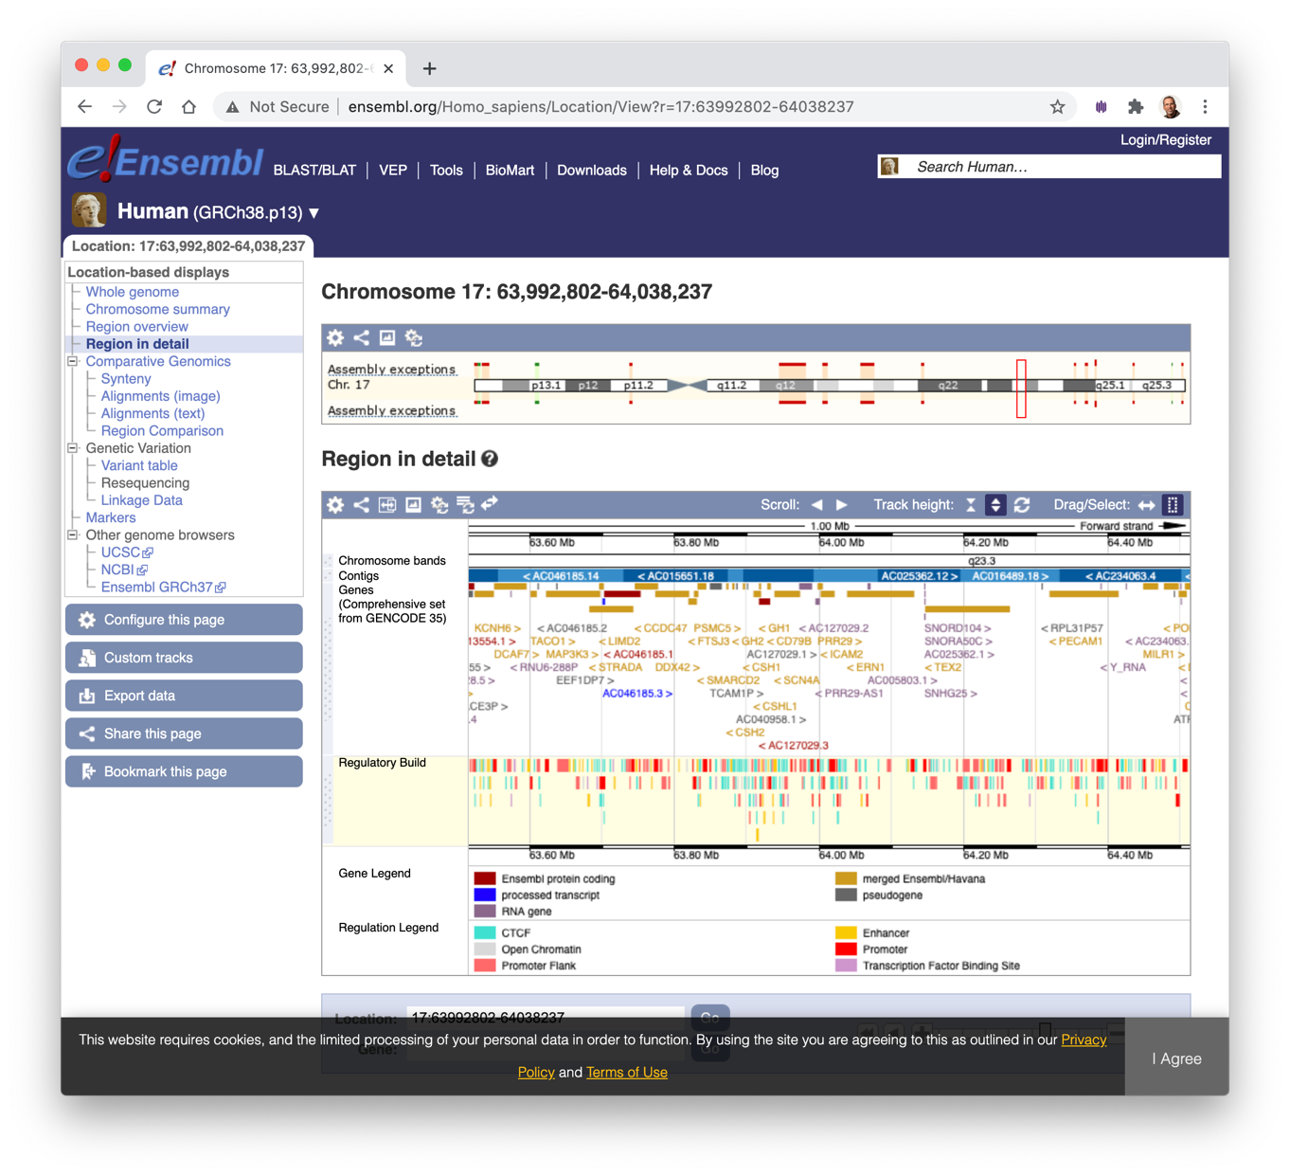
DNA Databases and Tools
often, the source or purpose of a DNA sequence can be determined by comparing it with documented genetic material
  several large databases are available online
  tools for visualizing and/or searching the databases are also available
e.g., the Ensemble site (www.ensembl.org) contains visualizations of the human genome and other DNA sequences

Slide 10
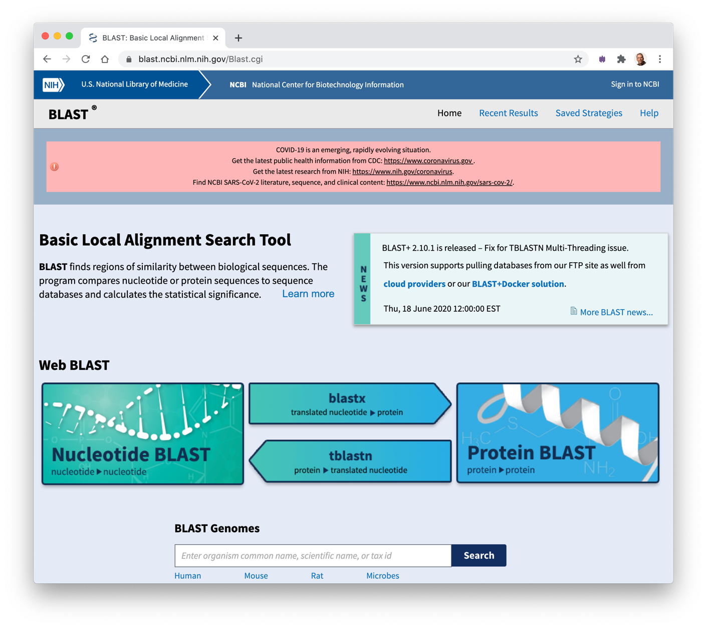
GenBank
the GenBank public repository of DNA and RNA sequence data contains
  partial or complete genomes for more than 300,000 organisms
  more than 1 trillion bases of sequence data
  roughly 250 million new DNA sequences are added per month
the database can be accessed and searched using various tools at www.ncbi.nlm.nih.gov

